Slide 1

How can a wellness technology company play it smart?
Bellabeat
December 2021
Beatrice Mensah

Slide 2
Table of Contents
Overview
Introduction to Bellabeat
Preparation & Processing
Analysis
Visualisations
Recommendations

Slide 3
Overview
A market analysis of current trends in wearable devices and suggestions for Bellabeat product positioning.
By observing consumer data from non-Bellabeat products, we can reveal opportunities for growth in the market.
Smart device usage indicates that understanding current habits leads to making healthy decisions.
Analysis of Fitbit data. Data collected includes physical activity, heart rate, and sleep monitoring.

Slide 4
Bellabeat
Bellabeat is a high-tech manufacturer of health-focused smart products for women. Bellabeat's app and multiple smart devices collect data on activity, sleep, stress, hydration levels, and reproductive health to empower women with an understanding of their own health and habits. The company was founded in 2013 and has expanded quickly since, now with the possibility to become a great player in the global smart device market.

Slide 5
Preparation & Processing
Fitbit Fitness Tracker Data (CC0: Public Domain, dataset made available through Mobius): This Kaggle data set contains personal fitness tracker from thirty Fitbit users. They consented to the submission of personal tracker data, including minute-level output for physical activity, heart rate, and sleep monitoring. It includes information about daily activity, steps, and weight fluctuations that can be used to explore users’ habits. These datasets were generated by respondents to a distributed survey via Amazon Mechanical Turk between 03.12.2016-05.12.2016.
Limitations:
Third Party data - Incomplete records - Old data - Small collection period - Small sample size
The sex and age for these users have not been recorded. Bellabeat creates products exclusively designed for women.
Data processing, analysing and visualisation was done using R Programming in RStudio. For further details refer to github.

Slide 6
Analysis
Key Observations:
The average user is taking 8506 steps a day.
On average, users are getting 175 minutes of intense activity a week and 126 minutes of moderate activity a week.
Participants are averaging 12 hours off sedentary time a day!
The average user is burning 2387 calories a day.
The average time to fall asleep is 39.3 minutes.
Only 72% of users tracked their sleep patterns.
Only 24% of users recorded their weight.

Slide 7
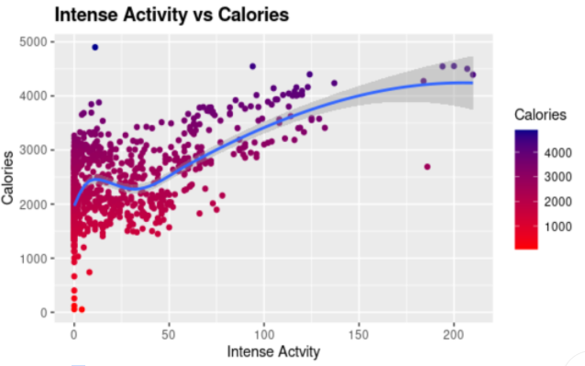
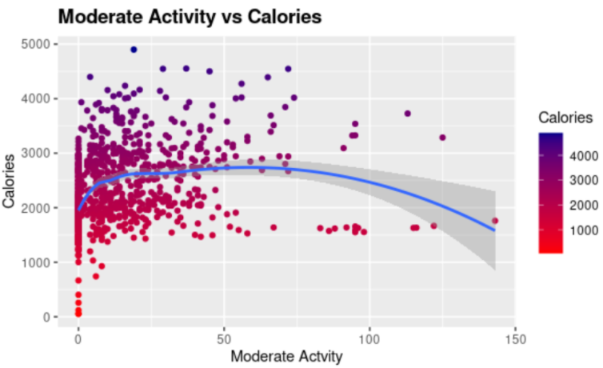
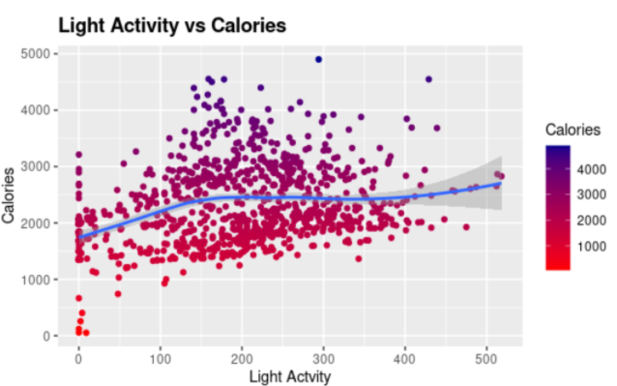
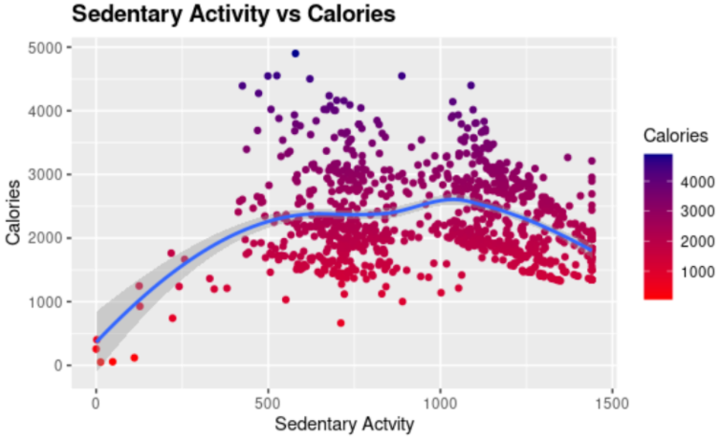
Visualisations
Intense activity has a positive relationship with calories.
The positive relationship between these two variables is quite low.
The correlation coefficient between these two variables is too low to say that there is a direct correlation between them.
Sedentary activity has no impact on the number of calories burned.

Slide 8
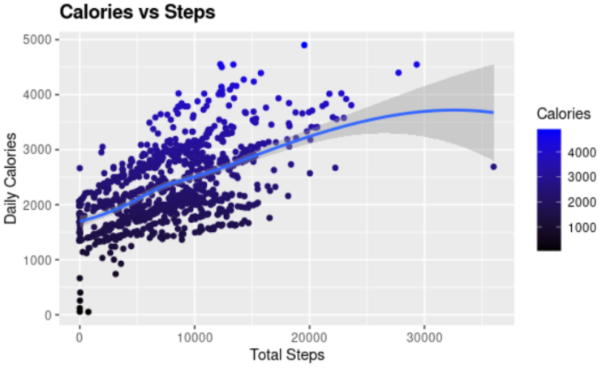
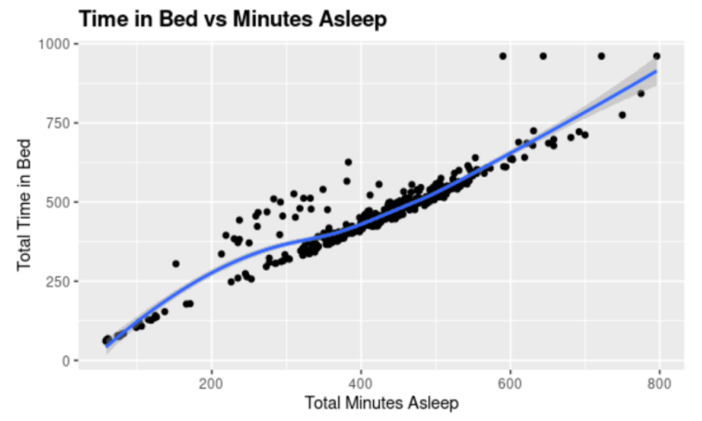
V2
Unsurprisingly, as the amount of steps increases, so does the amount of calories burned.
There is a positive relationship between the amount of time spent in bed and the number of minutes asleep.

Slide 9
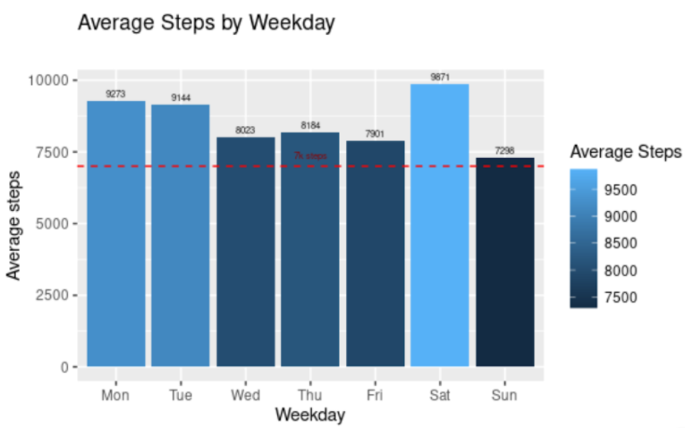
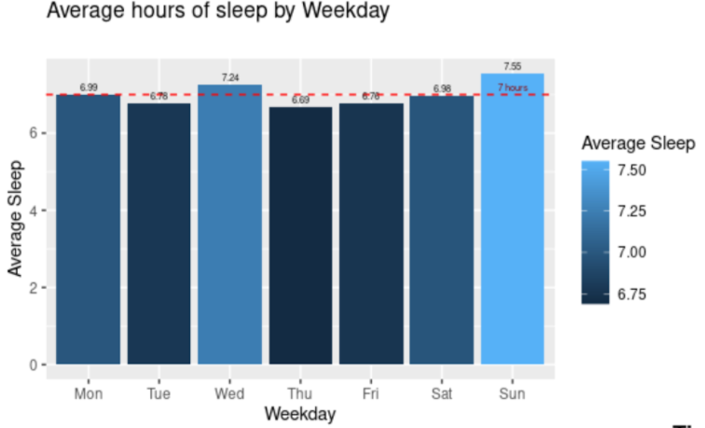
V3
The highest number of steps achieved are on Monday and Saturday and the least being on Sunday this is because people tend to have a lie in on that day.
Users are achieving the seven hour baseline on Wednesday and Sunday, with all the other days being slightly below average.

Slide 10
Recommendations
Bellabeat App:
Widget for Android/iPhone
Creation of badges
Features for sleep
Educate
Bellabeat Membership program:
30-day free trial for new members.
discounts offered for Bellabeat smart device products.
Receive discounted membership when you refer a friend.

Slide 11
Thank You

