Slide 1
Identify tumor types with gene expression data
JHU DaSH Hackathon

Slide 2
Overview
Question: Can we predict cancer status from single cell data based on gene expression?
Training Data: NCI 60 gene expression data
Testing Data: Single cells gene expression data
Goal: build a classifier based on gene expression and make predictions on single cell data
Methods:
Unsupervised learning to explore the data
Supervised learning to make predictions

Slide 3
Training Data
P=20,000
N=200

Slide 4
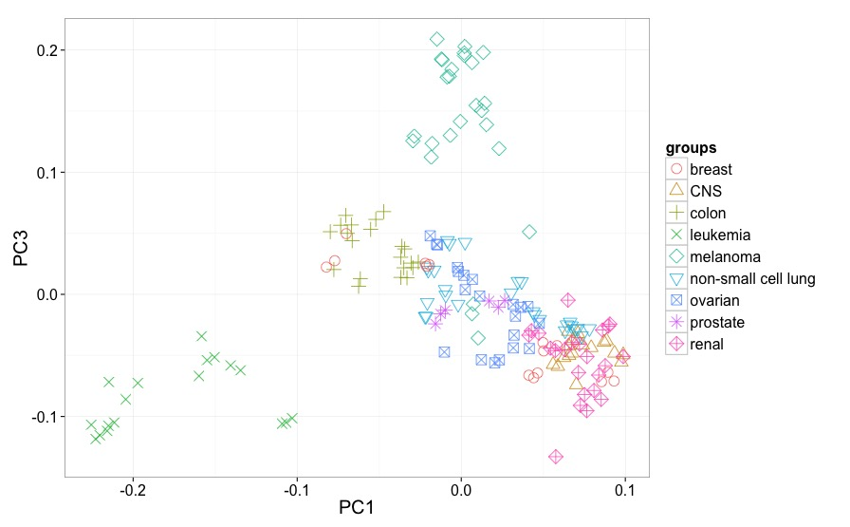
PCA - gene expression by tissue types

Slide 5
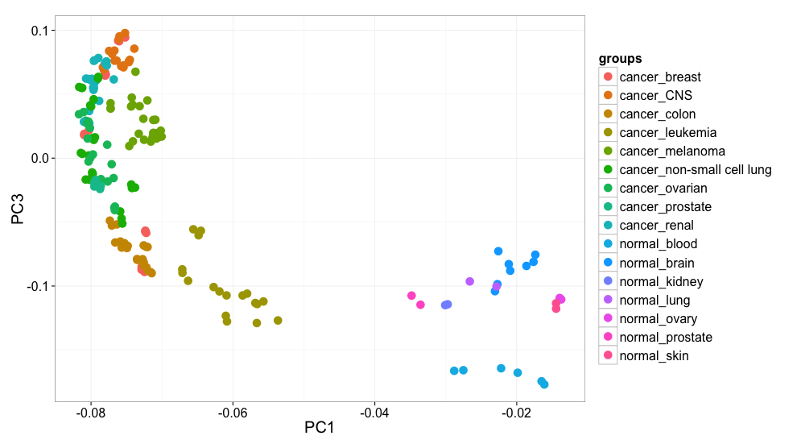
PCA – combining normal tissues
Melanoma
Leukemia
Normal

Slide 6
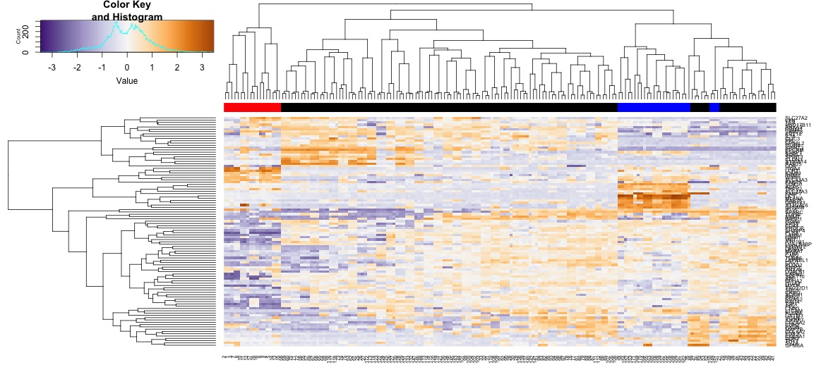
Hierarchical clustering of gene expression
Leukemia
Other type of cancer tissues
Melanoma

Slide 7
Improving Melanoma Resolution
8 Separate melanoma cell lines in NCI-60
Drill down into each cell line for genes distinctly expressed relative to other melanomas
Cluster with GO and/or response to chemotherapy agents
Can we harvest these genes to be descriptors for an improved melanoma classifier?

Slide 8
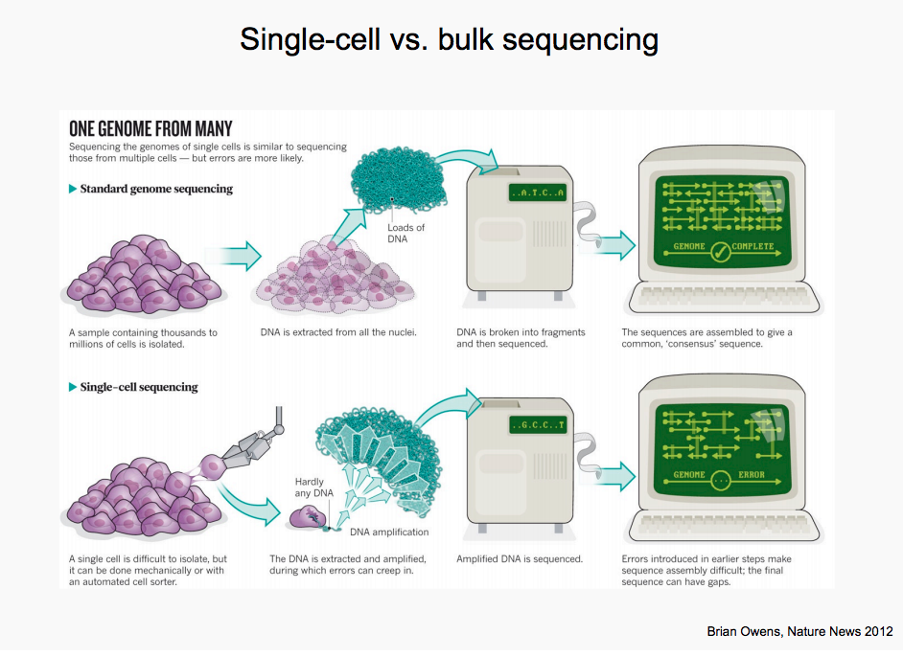

Slide 9
Classification
Input: gene expression levels for 400 differential expressed genes
-> top 40 PCs as input features
Output: tissue + cancer status
Tried SVM (Linear/RBF kernel), Logistic regression, Random forest, Naïve Bayes (scikit-learn)
Model: Logistic regression, elasticnet penalty
On training data cross validation 4-fold: accuracy 84.8%
Test data | Accuracy | # TP/ # Cancer | # TP/ # Normal
Leukemia single cells | 88.5% | 45 / 48 | 1/4
Melanoma single cells | 44.4% | 12 / 27

Slide 10
Summary
Achieved:
Developed a tumor classification workflow
Challenges:
Identify the right/useful data
Batch effects when integrating multiple data
Over-fitting issues with high dimensional data
Repo:
https://github.com/NCBI-Hackathons/DASH_cell_type
Slack:
https://dashcelltype.slack.com/

Slide 11
Acknowledgement
JHU Data Science Lab
JHU Biostatistics
NIH BD2K
JHU DaSH Hackathon-ers
Team:
Victoria Arthur: https://github.com/Ick22210
Han Fang: hanfang.github.io
Andrew Fant: https://github.com/molecuargeek
Nick Giangreco: https://github.com/ngiangre
Yuxing Liao: https://github.com/tryptochan

Slide 12
Supplemental

Slide 13
PCA - gene expression by tissue types

Slide 14
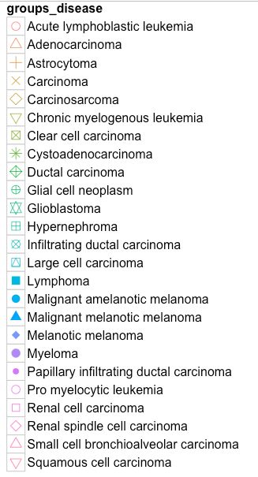
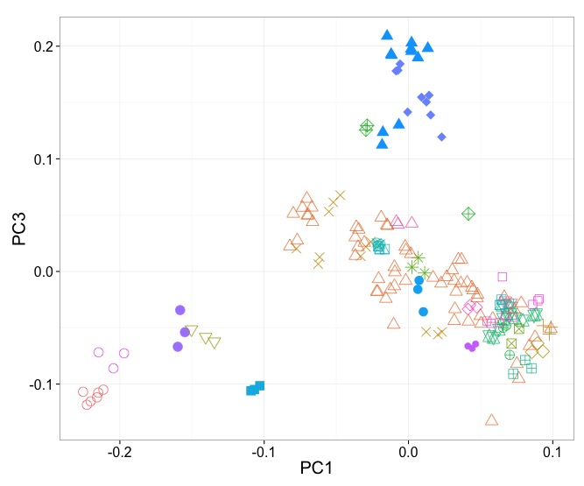
PCA - gene expression by disease types

