Slide 1
Machine Learning Immunogenicity from Peptides and Amino Acid Properties using IEDB data
Team Members
John Didion, john.didion@nih.gov National Institute of Health
Florian P Breitwieser, fbreitw1@jhu.edu Johns Hopkins School of Medicine
Xu Jiang, roger.jiang@nih.gov National Institute of Health
Tony Link, tlink@janushost.com
Pragyansmita Nayak, pragyansmita@gmail.com CGI Federal Inc.
Yuchen Yue, yuchen.yue@nist.gov National Institute of Standards and Technology
Github: https://github.com/NCBI-Hackathons/Machine_Learning_Immunogenicity
NCBI Hackathon, 8/15 - 8/17/2016

Slide 2
Scope
Predict Immunogenicity (Categorical; Positive/Negative) from Peptides using Machine Learning techniques using Logistic Regressions and Neural Networks
Data Source: IEDB (The Immune Epitope DataBase is a free resource, funded by a contract from the National Institute of Allergy and Infectious Diseases.)
Use Open source Machine Learning software “Tensorflow”
Data wrangling stage
Identifying attributes of interest including addition of data from other sources
De-duplication of data for effective training and removal of ambiguous training data
Remove records with Peptide sequence length greater than 20
Category | Record Count
T Cell Assays | 285,725
B Cell Assays | 385,639
MHC Ligand Assays | 510,786

Slide 3
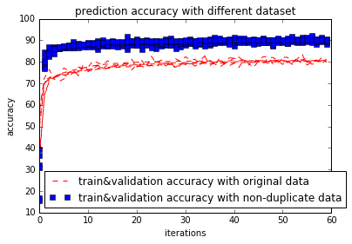
Results
Application of Machine Learning algorithms to t-cell and b-cell datasets:
Logistic Regression ~ 85%, accuracy
Neural Networks ~
F1 Score = 59.6 (b-cell)
F1 Score = 52.8 (t-cell)
Performed cross validation w/ multiple K values w/ holdout ~ 25%
Amino Acid properties inclusion into the dataset
Study usage to compare findings against other published methods (FRED2 package)

Slide 4
Future Work
Other ML algorithms to be evaluated:
DNN
CNN
MUST-CNN
RESNET
Bayesian Network
Regression
Compare and contrast cancer data with bacteria\virus data – cluster and study the similarities\dissimilarities

Slide 5
References
“MUST-CNN: A Multilayer Shift-and-Stitch Deep Convolutional Architecture for Sequence-Based Protein Structure Prediction”, Proceedings of the Thirtieth AAAI Conference on Artificial Intelligence (AAAI-16) URL: http://www.aaai.org/ocs/index.php/AAAI/AAAI16/paper/view/12440/11559
pepdata provides simple Python/NumPy/Pandas interfaces to commonly used immunology and bioinformatics datasets. URL: https://github.com/hammerlab/pepdata
R package Peptides: Calculate Indices and Theoretical Properties of Protein Sequences URL: https://cran.r-project.org/web/packages/Peptides/index.html
Dana-Farber Repository for Machine Learning in Immunology URL: http://projects.met-hilab.org/DFRMLI/index.php
IEDB “A free resource, funded by a contract from the National Institute of Allergy and Infectious Diseases. It offers easy searching of experimental data characterizing antibody and T cell epitopes studied in humans, non-human primates, and other animal species.” URL: http://www.iedb.org/home_v3.php
FRED 2 is a framework for T-cell epitope detection, and vaccine design. URL: http://fred-2.github.io/

