Slide 1
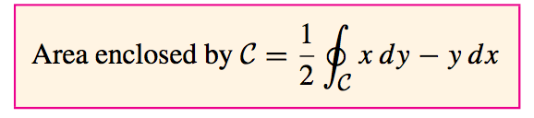
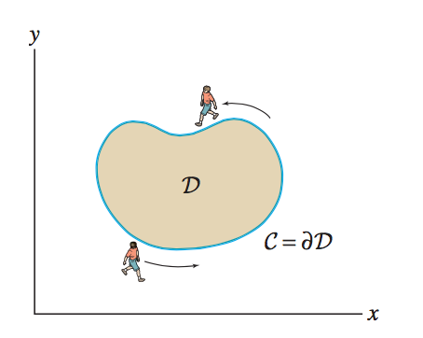
Project Los Gatos: An Algorithm to Numerically Compute Green’s Theorem for Physics/Engineering Applications
Eric Gelphman
University of California, San Diego Department of Physics
Matt Uffenheimer
University of California, Santa Barbara College of Creative Studies(CCS)
November 2016

Slide 2
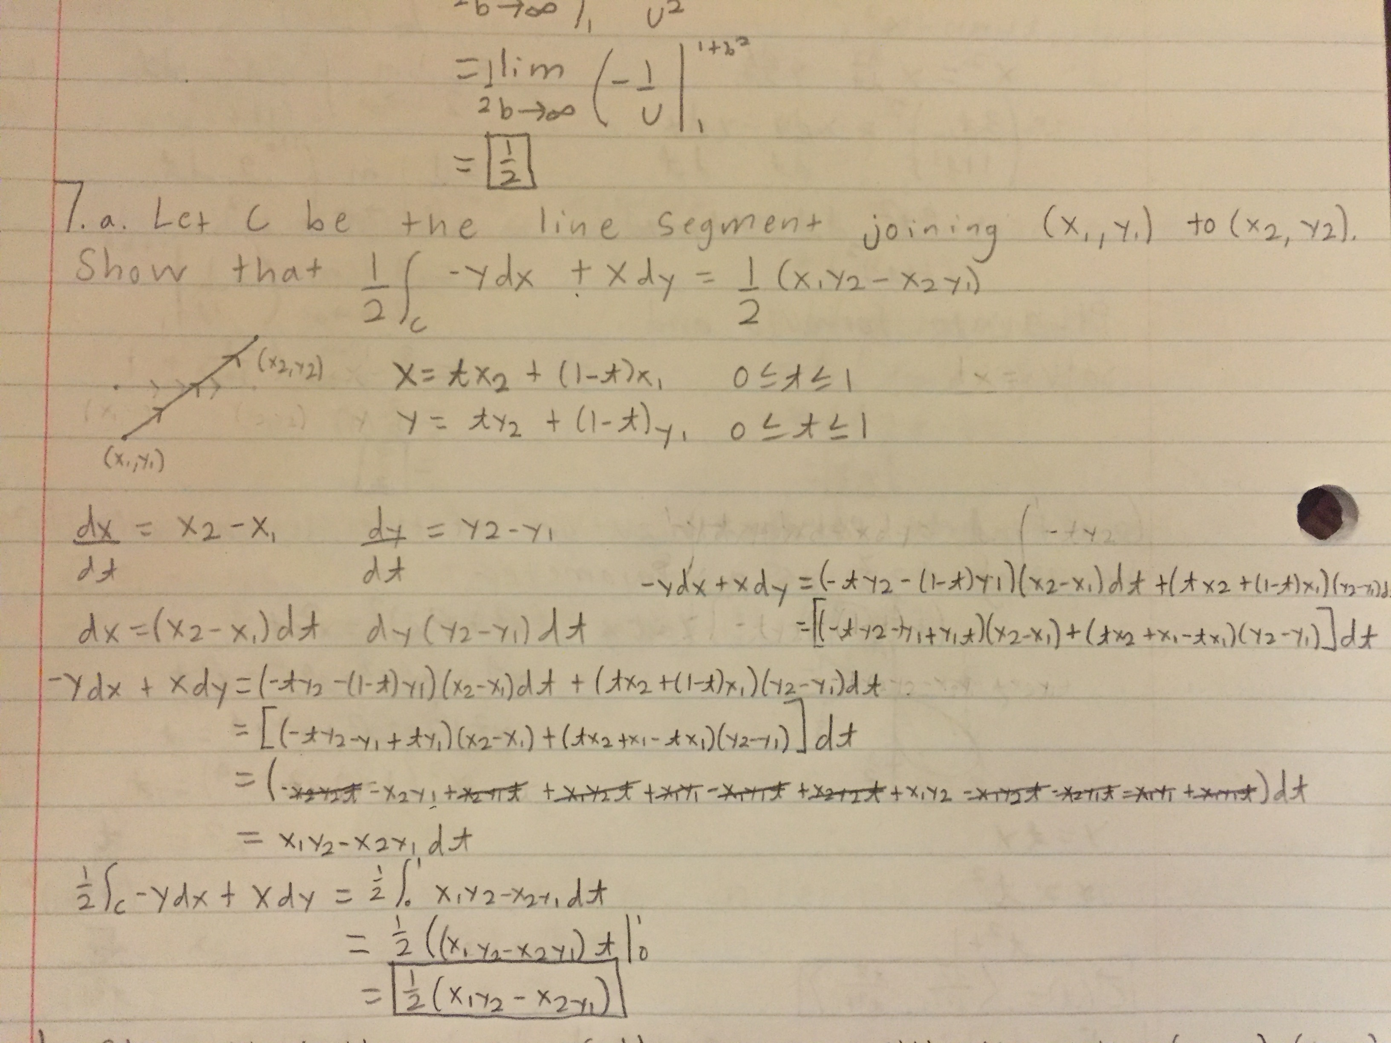
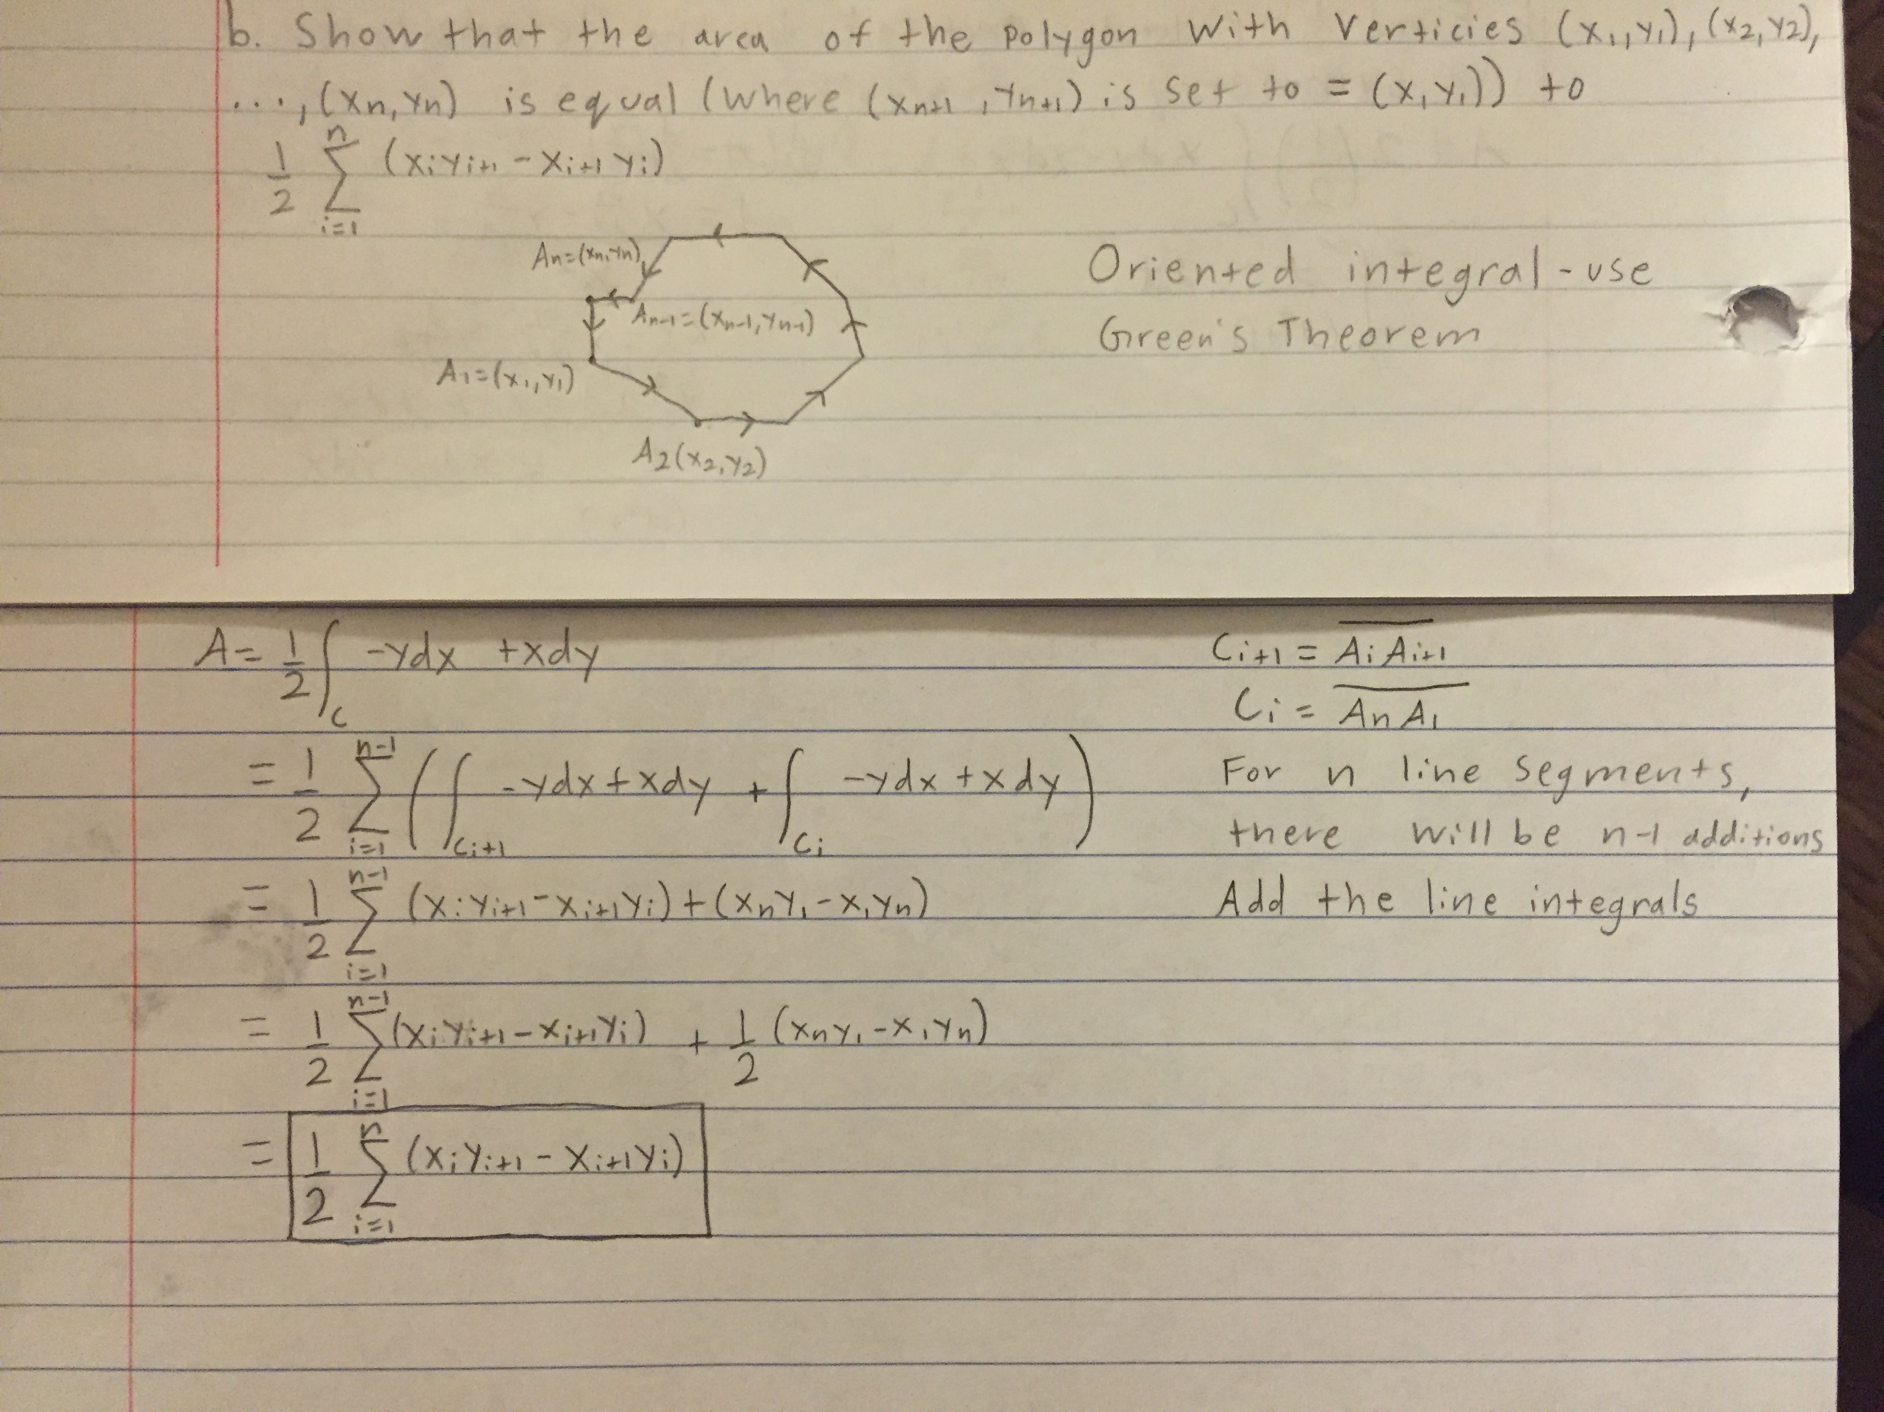
Intro to Project
Idea for numerical area calculation program in C
Derivation of “Slicker” Formula for area of irregular polygon
Prototype-PA3
Program could become more powerful/useful-creation of Hyades
Good way to apply math/physics/CS knowledge

Slide 3
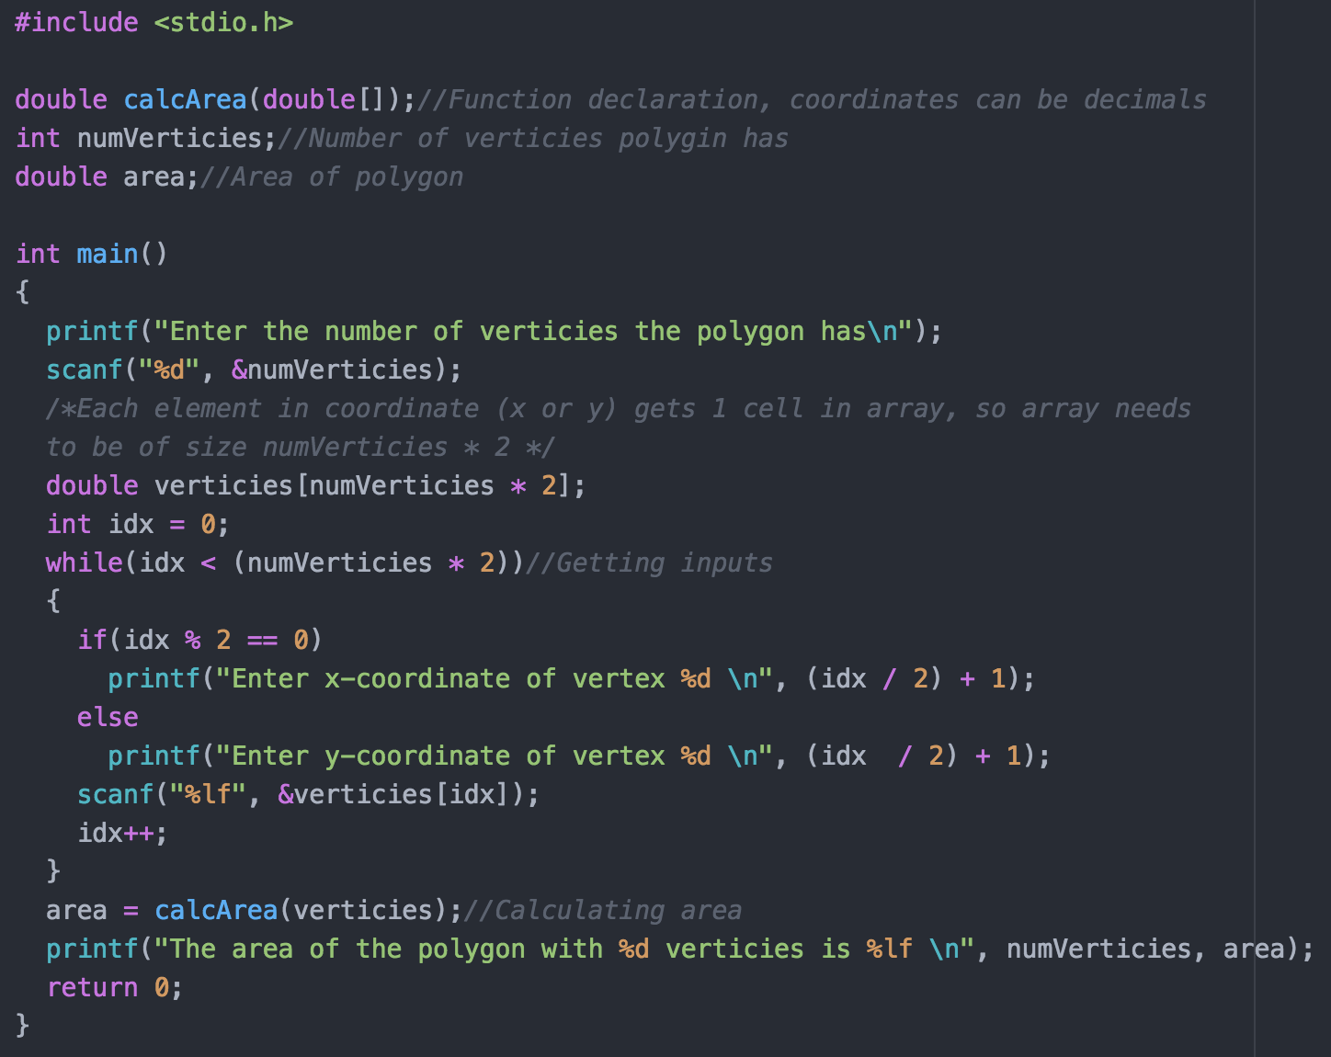
Prototype: Polygonal Area Approximation Algorithm(PA3)

Slide 4
Solution to Problem
Obtain points by traversing boundary of shape, starting from any arbitrary point
Traversal is a depth-first search(DFS) that executes in linear time O(n)
Add points to list(vector) during traversal in correct order to then pass to area formula
Also add visited points to a hash table to check if algorithm has been to that point before to prevent backtracking/oscillations

Slide 5
Why C/C++?
Probably the best optimized general-purpose language for mathematical operations, especially for fast numerical computations(sorry, Python)
Can do both numerical and symbolic calculations in C++ by making use of operator overloading
C++ well optimized for data structures, also has STL
Well-supported with many math libraries
Possibility of publishing as open-source library
Mathematica and MATLAB, while easier to use, are limited in their functionality, and I am not as familiar with them

Slide 6
Key Structures
C++ gives programmers the option of organizing data by using structures instead of objects
Hyades contains two structure definitions: point and functionStruct
Point struct: double coordinates for x and y
functionStruct: Has function f(x,y) = 0 for the boundary of the shape as well as the maximum and minimum x- and y-coordinates for which the function is defined on the boundary

Slide 7
Two Key Sub-Algorithms
Hash Function: R17L23XOR Hash Algorithm
Basic(but surprisingly effective) hash function to hash the double coordinates of the points
Called so because it right-shifts the x and y coordinates by 17 bits, then left shifts them by 23 bits, then bitwise XORs them together
A few arithmetic operations are needed before the bitwise operations to account for negative coordinates
Algorithm’s performance still suffers for small step sizes

Slide 8
Two Key Sub-Algorithms
Traversal: BlackBirdN
The traversal algorithm was by far the most difficult part of the project
Solution: Take partial derivatives of boundary function f(x,y) = 0 at search point (x0, y0) to form a tangent line approximation. Then, for a search grid of 8 points a fixed step distance around the search point, find the point that is closest to the line
That point becomes the next search point in the traversal
Search then keeps going until it reaches the end

Slide 9
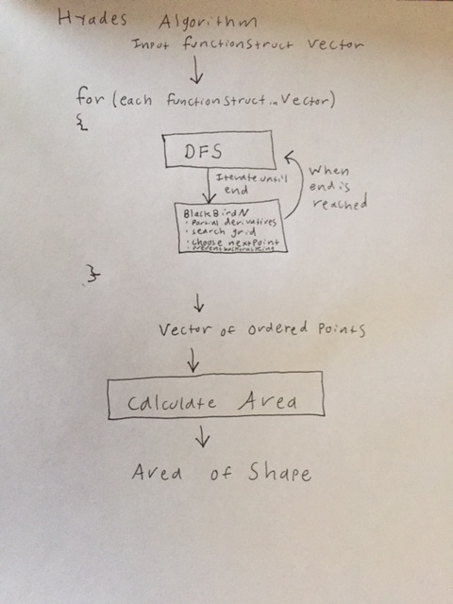
Flow Chart of Algorithm

Slide 10
Test Data
For ellipse f(x,y) = x^2 + xy + y^2 - 4 = 0
True Area:14.510
h | n | t(s) | A | % Error
0.1 | 127 | 0.518 | 14.520 | 0.066
0.05 | 253 | 1.877 | 14.505 | 0.037
0.01 | 1269 | 53.006 | 14.513 | 0.019

Slide 11
Application to Thermodynamics
For any internal combustion engine, the efficiency of the engine is calculated by dividing the work done by the engine by the heat required to run the engine(by burning fuel such as gasoline)
The work done by the engine is calculated by integrating along the path of the engine’s cycle on a pressure vs. volume graph(p-V diagram)
The heat required to run the engine is calculated by integrating along the path of the engine’s cycle on a temperature vs. entropy graph(T-S diagram)

Slide 12
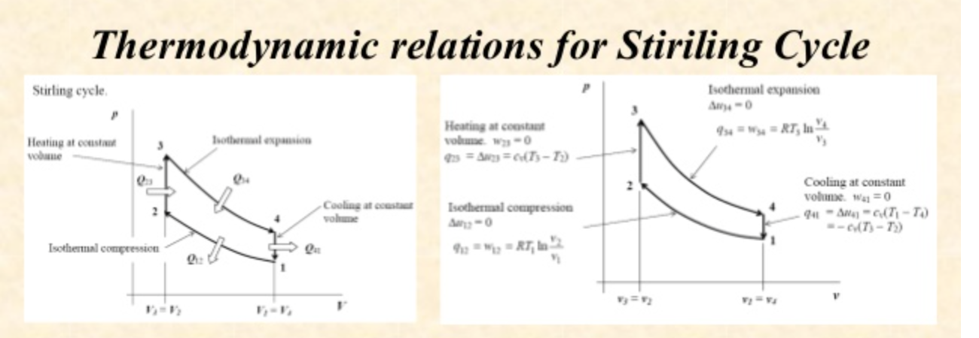
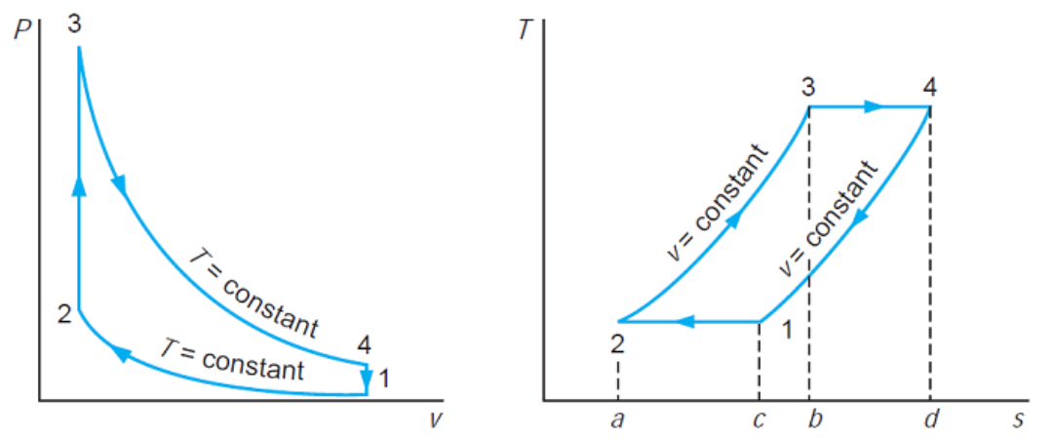
P-V and T-S Diagrams for Stirling Cycle

Slide 13
How Hyades Calculates Efficiency and Power
First, given the pressure vs. volume equations for the cycle, Hyades calculates work
Second, given the temperature vs. entropy equations for the cycle, Hyades calculates heat
Efficiency = Work Output / Heat Input
Power = dw/dt
Thus, by knowing how much time it takes to complete one cycle, Hyades can also calculate power

Slide 14
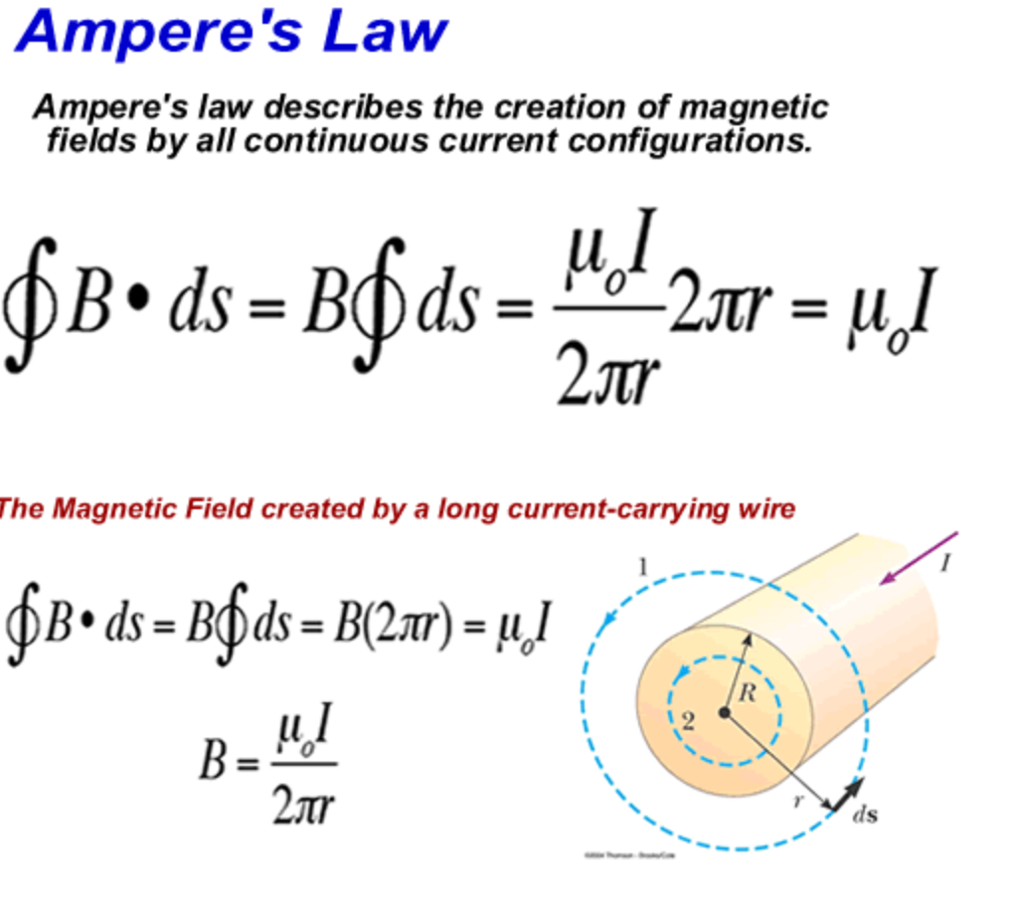
Another Application: Ampere’s Law

Slide 15
Ampere’s Law
By integrating the component of the magnetic field along a closed path, we can then calculate the current enclosed by the closed loop using Hyades
However, Hyades alone cannot calculate the component of the field along the path

Slide 16
Multithreading
Hyades can be made into a parallel algorithm for faster computation of the the parametrization via the traversal
Each functionStruct that makes up the boundary of the shape will be passed for a thread to executes the DFS
The vectors returned by the DFS will then be combined to compute the area

Slide 17
Interpolation/Integration Via Differential Forms
Since the traversal algorithm generates an ordered list of points, it is then possible to generate a parametrized function c(t) = <x(t), y(t)> for the boundary of the shape
c(t) can then be used to compute the line integral via differential forms
This makes the algorithm extendable to any number of dimensions

Slide 18
Thank You For Attending This Presentation!

