Slide 1
AWS Elastic Load Balancing
Created By Colin Johnson

Slide 2
ELB: Introduction
An ELB is Amazon’s Load Balancing offering.
Distribute Requests amongst a fleet of instances
Supports Health Checks to Add/Remove instances from service
Runs in multiple Availability Zones
Either “Internal” or “Internet Facing”
Can perform SSL Decryption*
SSL Decryption may violate compliance requirements
Paired easily with Amazon’s Auto Scaling
Notes:
Health Checks:
come in either HTTP or TCP variety
support only a single port
Do not support check based on page content
Reference:
http://aws.amazon.com/elasticloadbalancing/

Slide 3
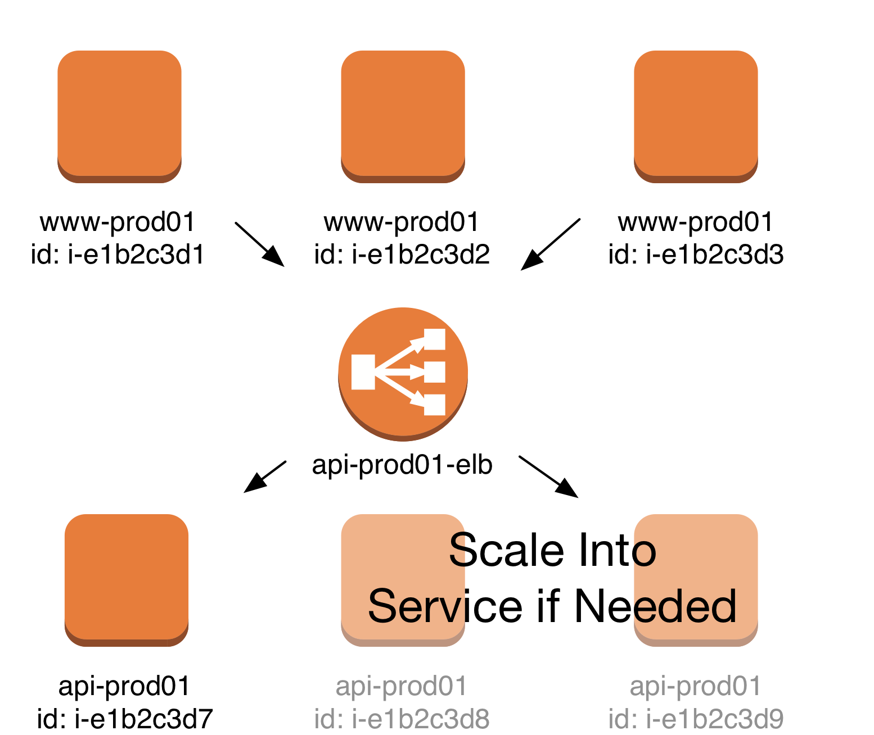
ELB: Scalability

Slide 4
ELB: Introduction
An ELB is Amazon’s Load Balancing offering.
Supports Health Checks to Add/Remove instances from service
Runs in multiple Availability Zones
Either “Internal” or “Internet Facing”
Can perform SSL Decryption*
SSL Decryption may violate compliance requirements
Paired easily with Amazon’s Auto Scaling
Notes:
Health Checks:
come in either HTTP or TCP variety
support only a single port
Do not support check based on page content
Reference:
http://aws.amazon.com/elasticloadbalancing/

Slide 5
ELB: Benefits
Provision and Modify a Load Balancer in Minutes
Enables Elasticity of Back-End Nodes
Some protection against overwhelmed back-end nodes through Surge Queue
Offload SSL Decryption from Servers
If compliance and security requirements allows

Slide 6
ELB: Challenges
Inability to force Instances in/out of ELB
Lack of documentation and transparency
Particular clients do not work with ELB
Backend instance stickiness only through cookies
Does not expose all desired configuration
ELB Instance Type and Count
Scaling Parameters

Slide 7
ELB: Inner Workings
Made up of multiple EC2 Instances, likely an Auto Scaling Group
As a result, can “lag” spikes of inbound traffic
Can change EC2 Instance Type (call Amazon)
Can change number of Instances (call Amazon)
More Information: http://cloudavail.com/2014/04/02/inner-workings-of-the-aws-elb-part-1/
Notes:
EC2 Instance Types: when at NetShelter we would call AWS and “pre-warm” or resize our ELBs during particular high-traffic events

Slide 8
ELB: Best Practices
Alarm on Unhealthy Hosts >= 1.
Use an External ELB to send requests to private IP address instances if Infrastructure allows
Run your ELB in all Availability Zones, if Possible
Use Cross-Zone Load Balancing
Avoid Sticky-Sessions if possible
complicates or impedes perfect Auto Scaling operation
Notes:
Regarding Ping-Pong problem – I have not called Amazon regarding this issue in some time
Multiple wildcard domain support available through a few SSL Certificate providers, in particular I’ve used Digicert

Slide 9
Hands On: Create an ELB
During the course of the Hands On exercise:
Modify Security Groups to support an ELB
Create an ELB that:
Runs in multiple Availability Zones
Forwards HTTP to a backend Instance
Uses a Health Check to determine health of Backend Instance
Produces CloudWatch metrics to aid in Troubleshooting

Slide 10
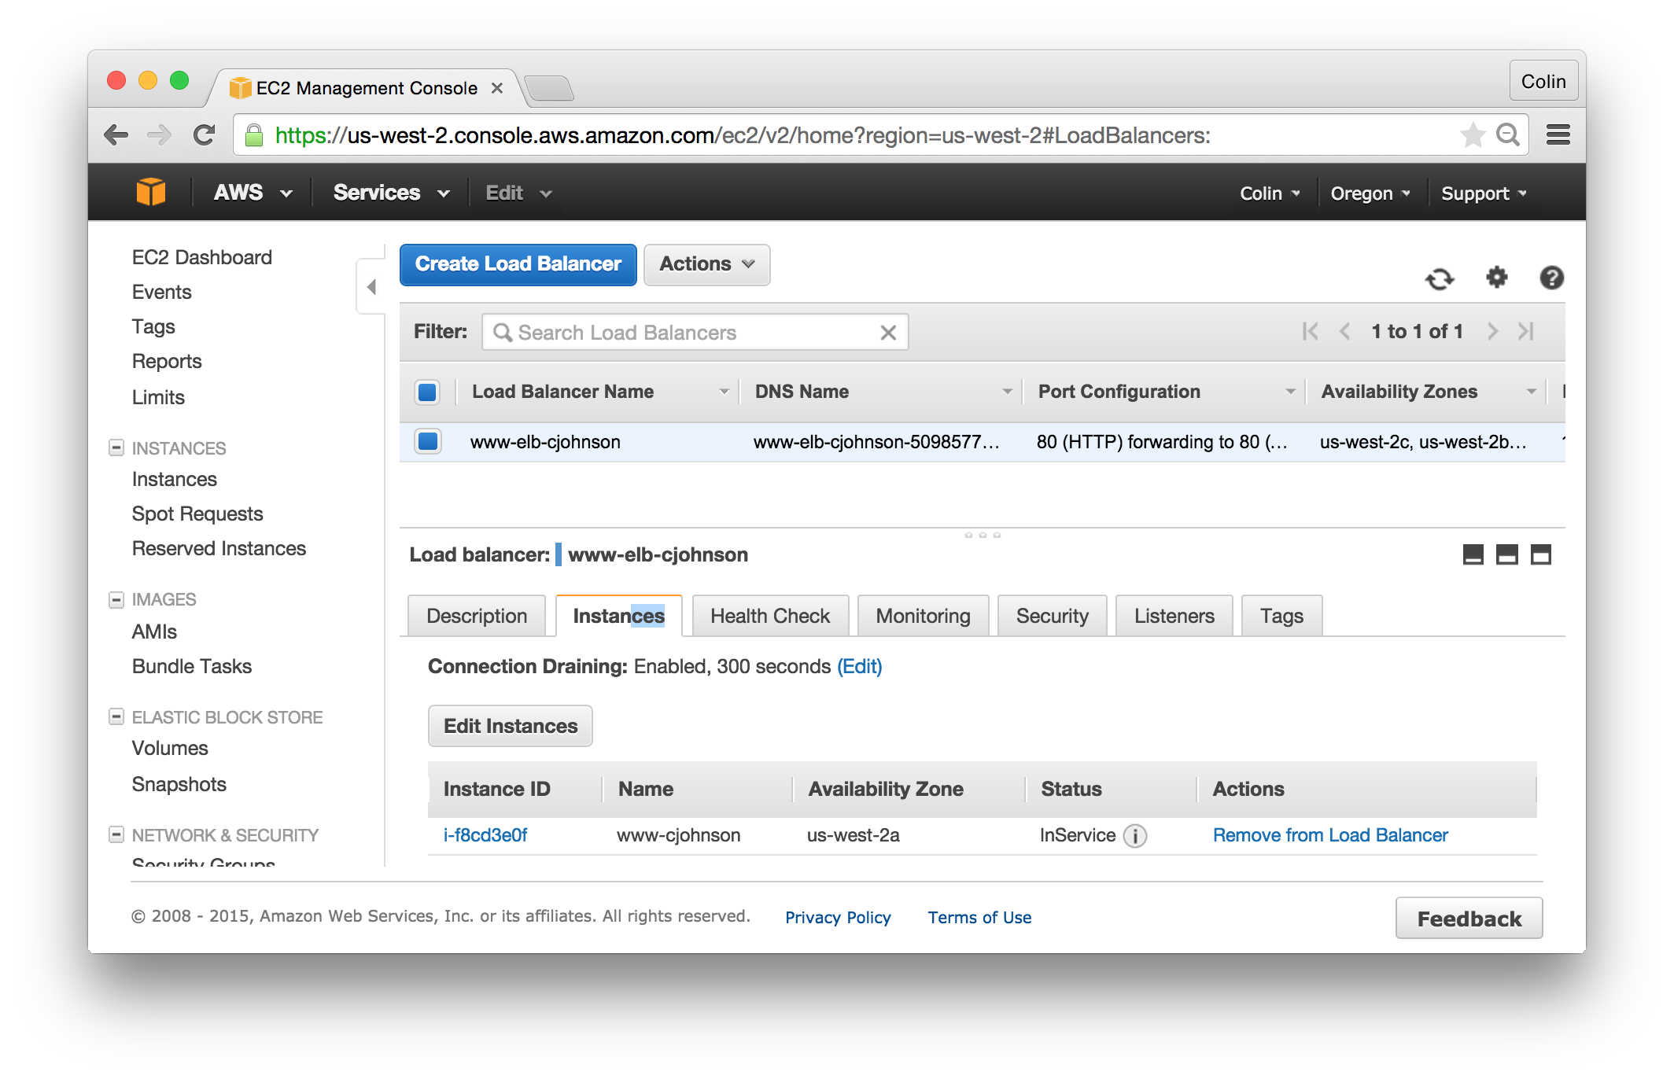
Hands On: an ELB with a Healthy Instance

Slide 11
ELB: Troubleshooting
AWS Infrastructure:
Does the security group allow ELB traffic in on required ports?
ELB Console
Are all expected instances showing “InService”
CloudWatch Metrics:
Is the latency as expected?
Is the “Healthy Host Count” as expected?
Are the number of Backend 400 and 500s as expected?
Notes:
Latency: measured as how long to for data to leave the ELB and be returned. This is not client-side latency.

Slide 12
ELB: Logging
ELB Logging:
You can enable ELB logs to record events
Application Logging:
The “source IP” of the address changes as a result of the ELB
Modify logging of application to include X-Forwarded For Header

Slide 13
ELB: Testing with DNS
If testing that requires DNS is needed, you can test an ELB by:
Dig ELB name – this will return one or more IP addresses
Add the domain name under test and the ELB IP as an entry in your /etc/hosts file
When accessing the domain name under test, traffic will be directed at the given load balancer

Slide 14
ELB and Auto Scaling
Auto Scaling can use either an EC2 or ELB Health Check
ELB Metrics are published to CloudWatch
ELB Metrics can be utilized to trigger Auto Scaling events
ELB Metrics can be used for Alerts
Alert if > 20 500s in 5 minute period
ELB Metrics can be used for Analysis
Notes:
Auto Scaling EC2 or ELB Health Check: http://docs.aws.amazon.com/AutoScaling/latest/DeveloperGuide/as-add-elb-healthcheck.html

Slide 15
ELB: Practical Experience
I’ve worked with ELBs extensively:
Highly reliable – thousands of hours, few problems
Frustrations arise if needing to customize
Amazon resolved an issue where queries over 60 seconds would be dropped
Maintained a multi-region, DNS load balanced infrastructure that utilized ELBs and Auto Scaling Groups

