Slide 1
AWS SQS (Simple Queue Service)
Created By Colin Johnson

Slide 2
SQS: Introduction
A Message Queue Service
Similar to ActiveMQ, AMQP, RabbitMQ
Guaranteed Delivery of Messages
Distributes workloads evenly amongst systems
Managed Service, Infinitely Scalable
A Regional Service

Slide 3
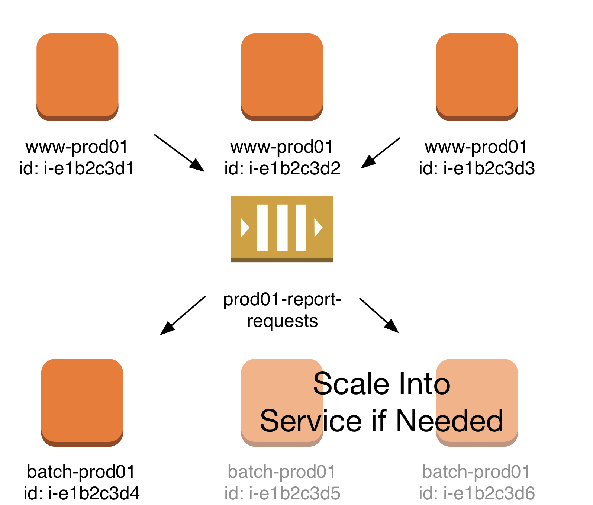
SQS: Scalability

Slide 4
SQS: Use Cases
Distribute work amongst multiple hosts
Delay Processing: if real-time processing not needed, “smooth” work over time
Cost Savings: combine with Auto Scaling to process requests at a later time
Deliver messages to multiple systems: combine with SNS to distribute one request to multiple workers

Slide 5
SQS: Benefits and Challenges
Integrates with Auto Scaling
Avoids problem of persistent data storage in cloud
Fast to deploy, no infrastructure to maintain
May deliver message more than once
Does not provide FIFO queuing or selectors
Does not natively provide one to many delivery
Does not natively provide message priority

Slide 6
SQS: Message Flow
System sends message to SQS
System receives message from SQS
Message is marked as “Invisible” for a period of time
System processes message, marks message as deleted
If system fails to delete message, message will be marked visible again
If message fails to be processed for a particular number of times, sent to Dead Letter Queue

Slide 7
SQS: Best Practices
Combine with Auto Scaling to enable Elastic Infrastructure
Don’t build applications that require FIFO or Message Selectors
Use long-polling if queues will be empty when polled: save money.
Do Not
Batch messages to reduce cost
Automated batching with BufferedIOClient
Notes:
References:
http://aws.amazon.com/sqs/details/

