Slide 1
AWS VPC (Virtual Private Cloud)
Created By Colin Johnson

Slide 2
VPC: Introduction
An isolated portion of AWS
Comprised of one or more subnets, mapped to Availability Zones
Choice of IP addressing schemes: public or private
Various Network Connectivity Options

Slide 3
VPC: Benefits and Challenges
Improved security, including additional depth from NACLs and Private IP addressing
Egress Traffic Filtering
Single-Tenant Hardware
Access to some “only in VPC” resources
Management of NAT servers
Increased complexity
Increased cost resulting from infrastructure
Notes:
References:
http://docs.aws.amazon.com/AWSEC2/latest/UserGuide/using-vpc.html#concepts-vpc

Slide 4
VPC: Constituent Components
VPC: specifies a CIDR Range
Subnets:
Public (can receive Internet traffic directly) or Private Subnets
One to One relationship between subnets and Availability Zone
Notes:
VPC, definition of “Public” and “Private” subnet: http://docs.aws.amazon.com/AmazonVPC/latest/UserGuide/VPC_Scenario2.html

Slide 5
VPC: Network Components
Route Table
Determine where traffic is directed, example:
172.16.0.0/16 to vpn-c76cb0d9 (a VPN Connection)
0.0.0.0.0/0 to igw-3547bf50 (an Internet Gateway)
Network ACLs
Inbound and Outbound matching
Stateless
Example:
Inbound: Source = 0.0.0.0/0, Allow
Outbound: Destination = 0.0.0.0/0, Allow
Notes:
References:
http://cloudavail.com/2014/07/04/vpc-intro-part-1/

Slide 6
VPC: Network Components
Internet Gateway
Provides a route to the Internet
Hosts using Internet Gateway must still have Public IP Address
EC2-VPC Security Group
Like EC2 Classic Security Group, only better
Inbound and Outbound Rules
Notes:
References:
http://cloudavail.com/2014/07/04/vpc-intro-part-2/

Slide 7
VPC: ELB and Auto Scaling
Auto Scaling Group
Must include association with VPC subnets
Launch Configuration
Can include "AssociatePublicIpAddress" : "true” to ensure hosts given Public IP addresses
ELB
Offered as “Internet Facing” or Internal
Notes:
References:
http://cloudavail.com/2014/07/04/vpc-intro-part-2/

Slide 8
VPC: Overall Design Choices
1 VPC
1 VPC per Environment
1 VPC per Application
1 VPC per Environment per Application

Slide 9
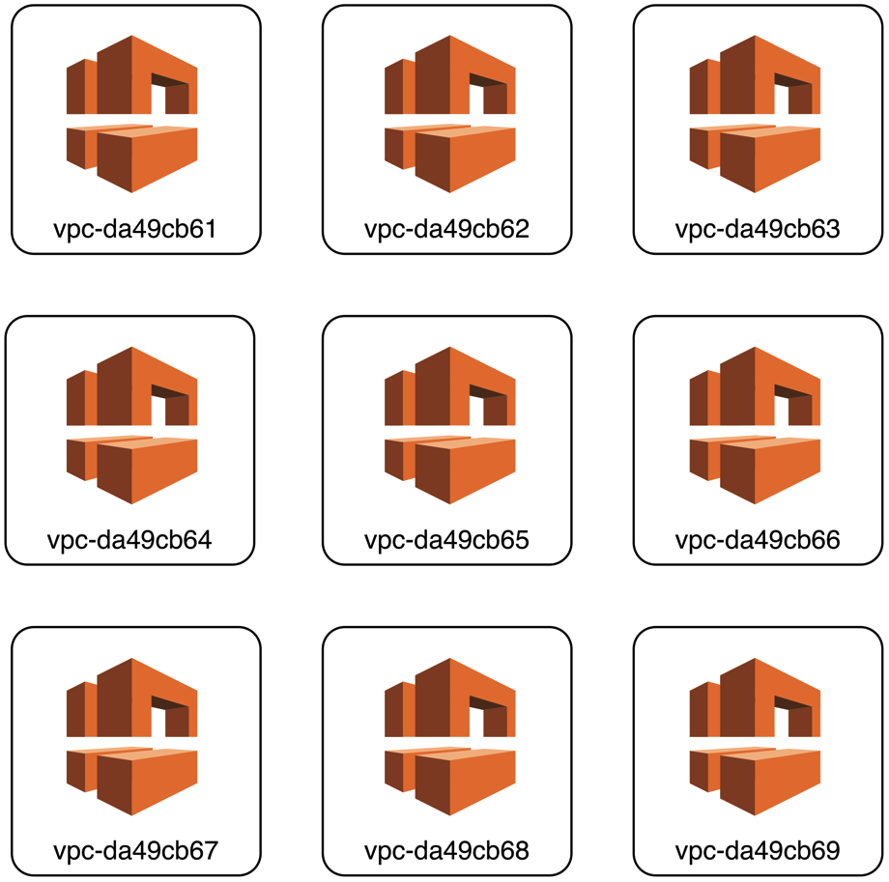
1 VPC per Environment, per Application
Pro:
Isolation of Resources
Con:
Many VPCs
Many Subnets
Potential lack of consistency
Increased administration effort
Multiply again if multi-region
Notes:
Reference:
http://www.slideshare.net/AmazonWebServices/cpn208selecting-the-best-vpc-network-architecture-cpn208-aws-reinvent-2013

Slide 10
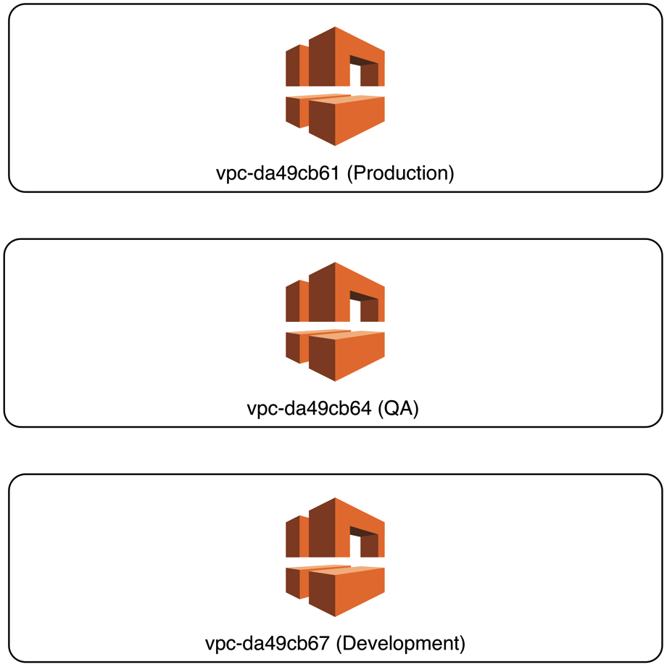
1 VPC per Environment (or Application)
Pro:
Isolation by Environment
Example: allow creation of EC2 only in particular VPC
Prevent Cross Environment Access by Default
Con:
Some Additional Complexity
May need VPC Peering
Notes:
Reference:
http://www.slideshare.net/AmazonWebServices/cpn208selecting-the-best-vpc-network-architecture-cpn208-aws-reinvent-2013
Additional Complexity, as result of multiple Virtual Private Gateways needing one endpoint: https://aws.amazon.com/articles/5458758371599914
Allow Launch of EC2 Resources only in Specified VPC: http://docs.aws.amazon.com/AmazonVPC/latest/UserGuide/VPC_IAM.html#subnet-ami-example-iam

Slide 11
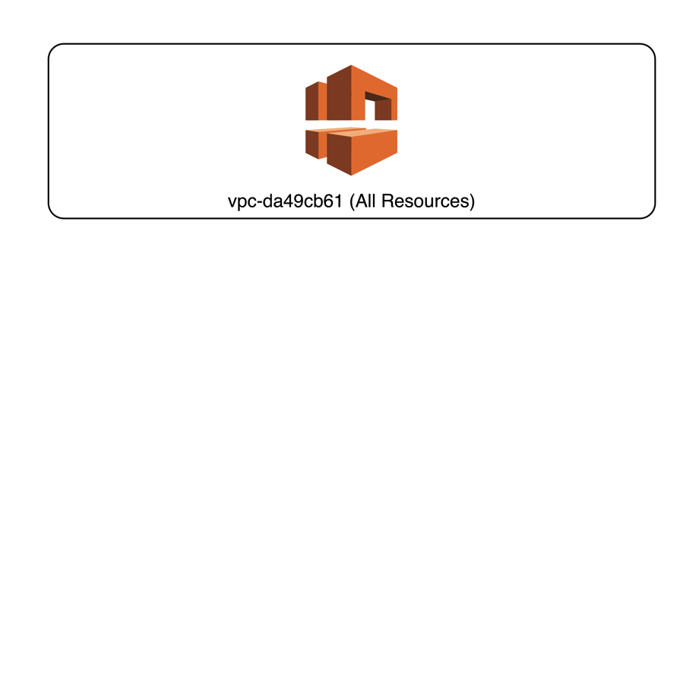
1 VPC
Pro:
Easiest Management / Fewest Resources
Con:
No Isolation of Networks
Isolating Resources is more Difficult
Notes:
Presenter’s Notes:
I’d prefer to isolate resources based on tag as opposed to VPC membership, if needed

Slide 12
VPC: Network Connectivity Options
Internet Gateway
Internet Gateway, Public Subnets
Internet Gateway, with NAT and Private Subnets
VPN to VPC
VPC Peering
Direct Connect

Slide 13
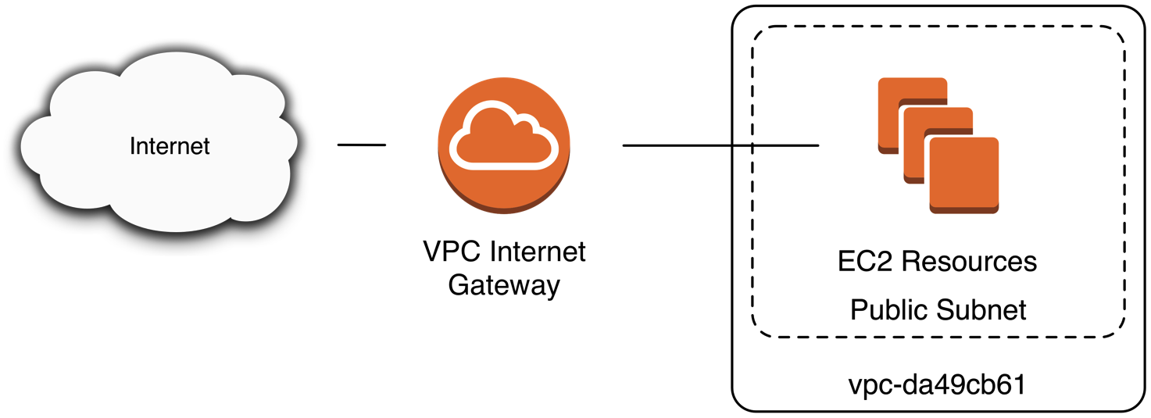
VPC: Internet Gateway
An Internet Gateway allows connectivity to Public Internet for Instances with Public IP addresses
If instances have Private IP address, use a NAT server

Slide 14

VPC: Internet Gateway EC2 Instances with Public IP

Slide 15
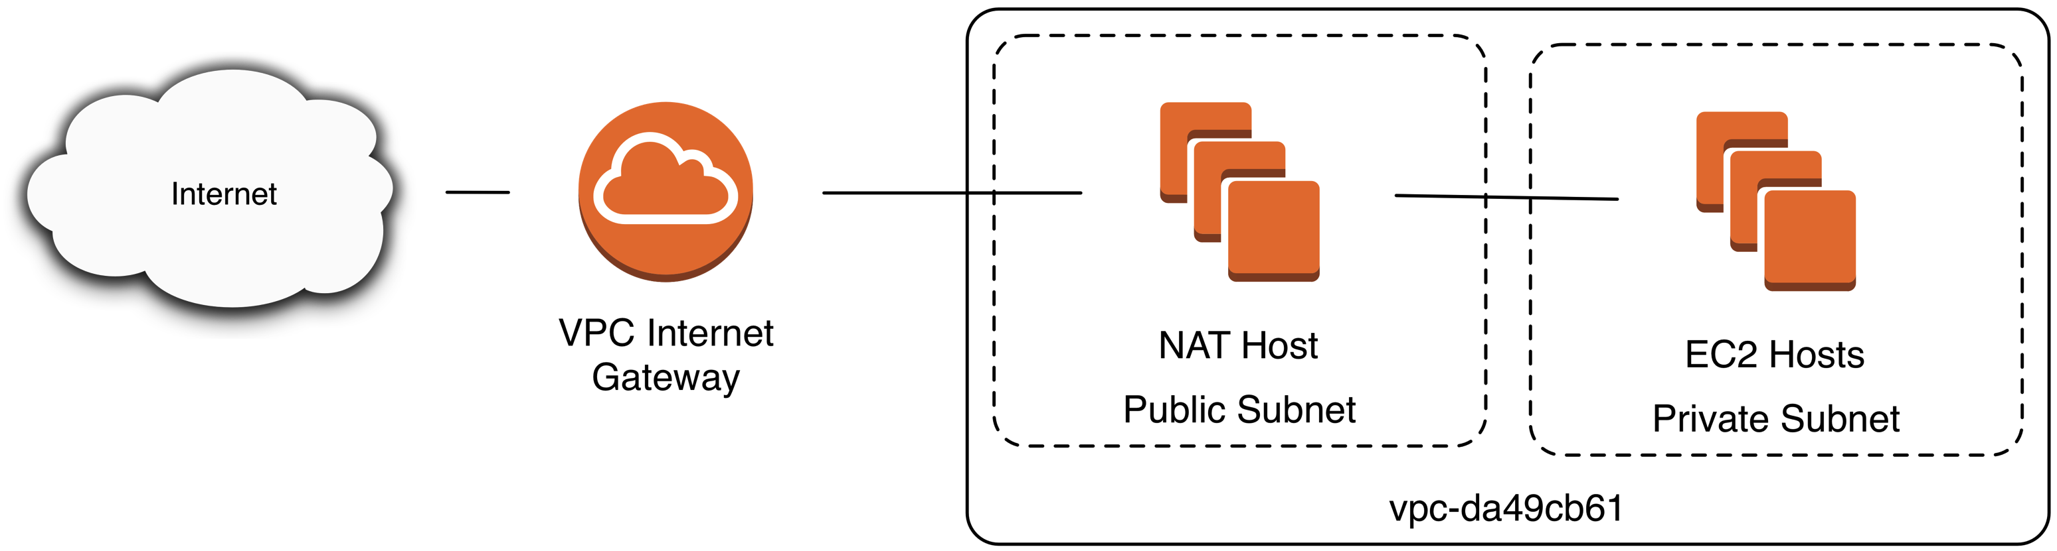
VPC: Internet Gateway NAT and EC2 Instances with Private IP

Slide 16
VPC: Site to Site VPN
Site to Site VPN using a:
Customer Gateway (Customer Equipment)
Virtual Private Gateway (AWS Equipment)
Connect a Data Center or Office Location

Slide 17
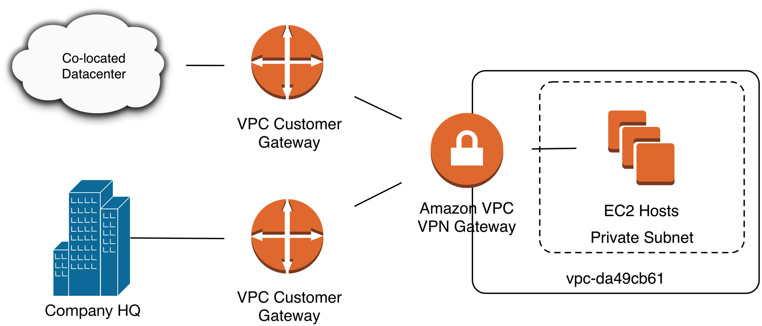
VPC: Site to Site VPN

Slide 18
VPC: Direct Connect
Connect directly from a given Data Center to a VPC
Options for AWS Customers outside of Direct Connect location also available.
Variable Speeds, see Documentation
One Direct Connect for access to All US Regions
Eliminate the need for VPN
Lower Latency, Potentially Lower Cost
Notes:
List of VPC Direct Connect Locations: http://aws.amazon.com/directconnect/details/
Variable Speeds: http://aws.amazon.com/directconnect/faqs/
One Direct Connect for all US Regions: https://aws.amazon.com/blogs/aws/aws-direct-connect-access-to-multiple-us-regions/
References:
http://aws.amazon.com/directconnect/details/

Slide 19
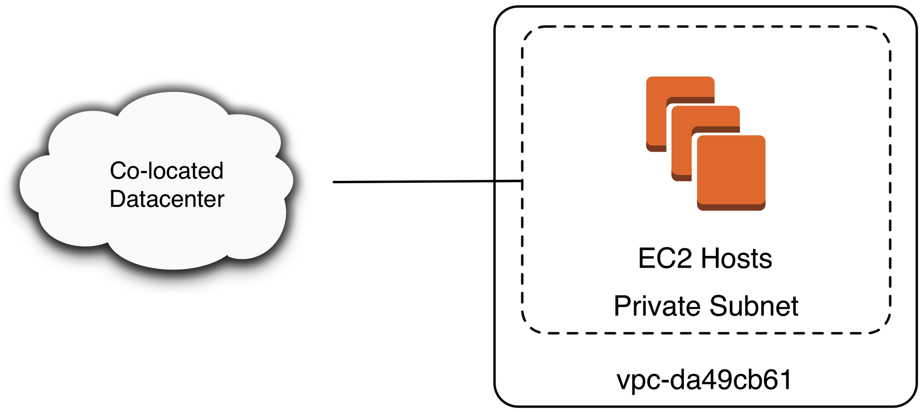
VPC: Direct Connect
Notes:
List of VPC Direct Connect Locations: http://aws.amazon.com/directconnect/details/
Variable Speeds: http://aws.amazon.com/directconnect/faqs/
One Direct Connect for all US Regions: https://aws.amazon.com/blogs/aws/aws-direct-connect-access-to-multiple-us-regions/
References:
http://aws.amazon.com/directconnect/details/

Slide 20
VPC: VPC Peering
Connect two different VPCs
Example: modify route table to add route 10.0.0.0/16, target pcx-7142bf18
VPC Peering can be between accounts
VPC Peered Traffic is not Encrypted
Not able to reference Security Group in another VPC, must utilize CIDR Ranges
VPCs must have non-overlapping CIDR Blocks
Notes:
Presenter’s Note: I’ve used VPC Peering as an intermediate step to moving from a 1 VPC per environment configuration to a 1 VPC configuration.
Not Able to Reference another VPC Security Group: http://docs.aws.amazon.com/AmazonVPC/latest/UserGuide/vpc-peering.html
Encryption: https://aws.amazon.com/blogs/aws/new-vpc-peering-for-the-amazon-virtual-private-cloud/
References:
https://aws.amazon.com/blogs/aws/new-vpc-peering-for-the-amazon-virtual-private-cloud/

Slide 21
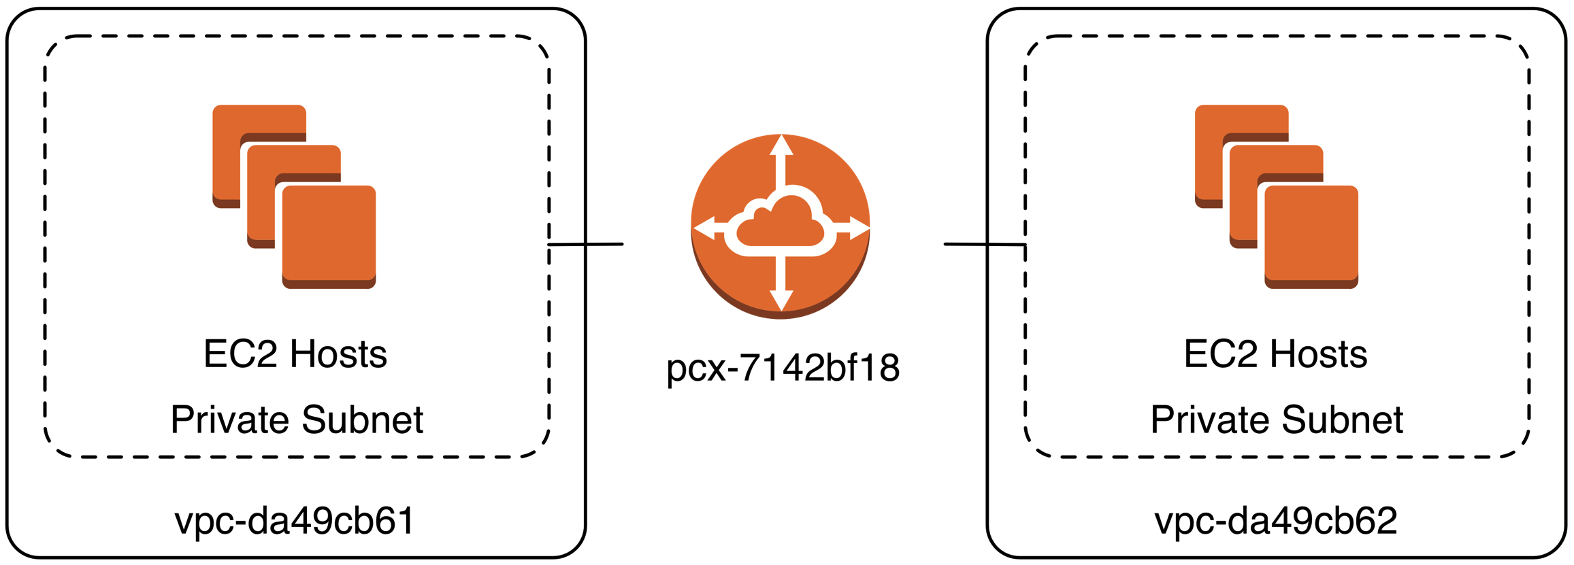
VPC: VPC Peering

Slide 22
VPC: Client Ingress Options
Direct Access
ssh Based Bastion Host
VPN Based Bastion Host
Site to Site VPN
Extends network attack space
Hybrid Approach
Note: my experience is companies simply choose the technology they are most familiar with and then switch if needed.
Notes:
Regarding Note “Companies choose the technology the are most familiar with and switch” – the level of effort to switch from one technology to another is not that great. For larger companies I might consider a hybrid approach – some developers will inevitably prefer ssh whereas some users will benefit from VPN.

Slide 23
VPC Client Ingress: ssh Bastion Host
Benefit:
ssh use familiar to most Engineers / Operations
ssh host Bastion Host easy to setup
Challenge:
ssh agent forwarding, port forwarding and/or SOCKS proxies may be unfamiliar or complicated
if running Windows hosts, ssh or ssh/RDP combination may be difficult

Slide 24
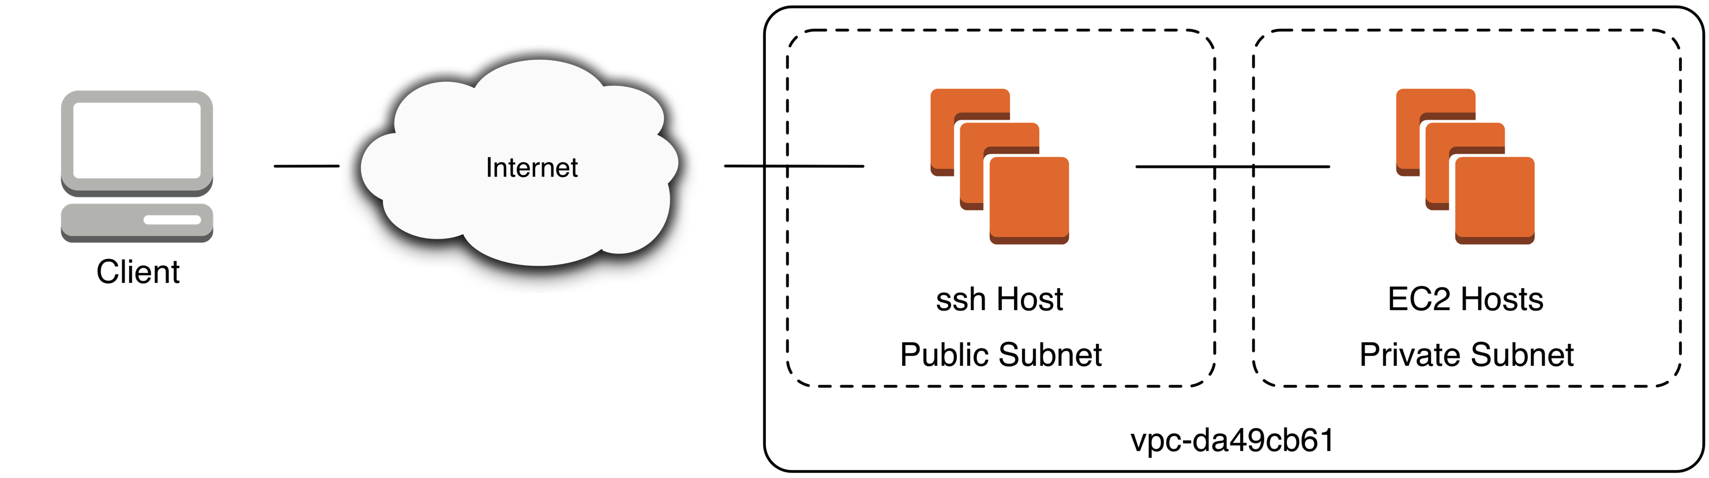
VPC Client Ingress: ssh Bastion Host

Slide 25
VPC Client Ingress: VPN Host
no configuration for services outside of SSH/RDP
VPN use generally straight-forward and familiar
VPN may be challenging to manage for smaller organizations

Slide 26
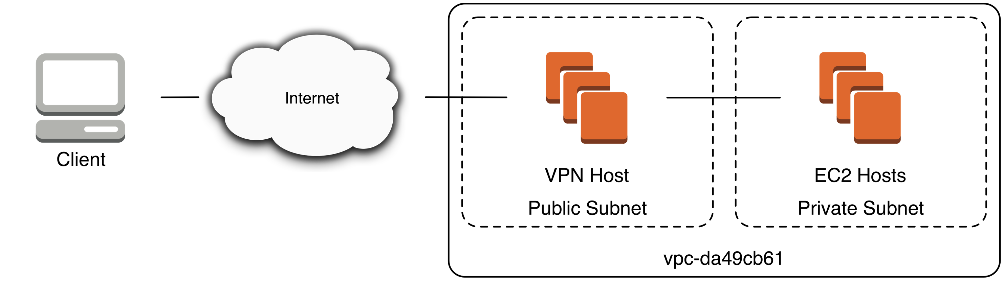
VPC Client Ingress: VPN Host

Slide 27
VPC Client Ingress: Site to Site VPN
Minimal or No Configuration when on-site
On-site network security must meet standards required by company
If off-site, clients must either VPN to on-site location or VPN directly to AWS

Slide 28
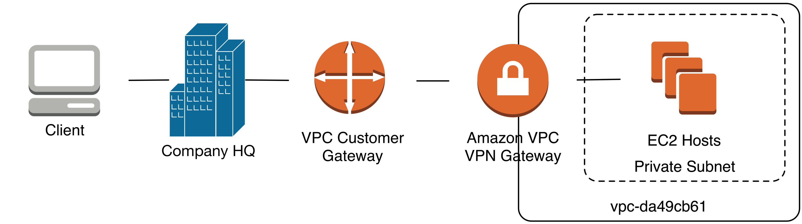
VPC Client Ingress: Site to Site VPN

Slide 29
VPC Client Ingress: Suggestions
Small, Highly-technical Company: ssh or VPN
Have supported 80 Engineers through ssh
Large, Highly-technical Company: VPN
Company with non-technical users of AWS resources: VPN
Company with non-technical users of AWS resources, all in one office and comfortable with on-site security: Site to Site VPN + VPN

Slide 30
Hands On: Create a VPC
Create a VPC
Create an Internet Gateway
Create two VPC “Public” subnets
Create a Route Table

