Slide 1
AWS S3
Created By Colin Johnson

Slide 2
S3: Introduction
Shared Access Data Storage using Blob Storage
Unlimited in Number of Objects and Total Storage
5 terabyte limit on object size
11 9’s Durable (99.999999999%)
99.99% Availability of Objects
AWS Service Credit if less than 99.9% Uptime
SLA and Uptime is defined at http://aws.amazon.com/s3/sla/
Notes:
References:
S3 Overview: http://aws.amazon.com/s3/
S3 SLA: http://aws.amazon.com/s3/sla/

Slide 3
S3: Features
Granular Security
Object Level Security with Wildcards
Object Versioning
Object Archival using Glacier
Cross Region Replication
Static Website Hosting
Static Files
Redirects (using 301 Redirects)
AWS Provided Encryption of Objects in Transit (using SSL)
AWS Provided Encryption of Data at Rest
Notes:
Redirects: http://docs.aws.amazon.com/AmazonS3/latest/dev/how-to-page-redirect.html

Slide 4
S3: Storage Classes I
S3 General Purpose
No Retrieval Fee
99.999999999% Durable (11 9s)
Use Case: General Storage, Frequently Accessed
S3 Infrequent Access
Object Access is More Expensive than S3 General Purpose
Charged for 128 KB of storage regardless of object size
Immediate Retrieval
Retrieval Fee ($0.01 per GB as of December 2015)
Use Case: Infrequently Accessed Objects
Notes:
https://aws.amazon.com/s3/storage-classes/
Glacier:
3 to 5 hours, up to 24 hours: https://aws.amazon.com/glacier/faqs/

Slide 5
S3: Storage Classes II
S3 Reduced Redundancy
99.99% Durable
Less Expensive than S3 General Purpose (~20% as of December 2015)
Use Case: Objects that can be Recreated, Objects that are Unimportant
Glacier
Retrieval typically within 3 to 5 hours, up to 24 hours
Retrieval Fee if Restores Exceed 5% of Monthly Glacier Storage
Use Case: Backups and Archival
Notes:
https://aws.amazon.com/s3/storage-classes/
Glacier:
3 to 5 hours, up to 24 hours: https://aws.amazon.com/glacier/faqs/

Slide 6
S3: Benefits and Challenges
Unlimited Storage
Highly Available
Always replicates objects across AZs by default
Optionally replicates objects across Regions
Fast to Setup and Easy to Maintain
S3 Costs: should be compared against competitors
Performance can be unpredictable
Notes:
S3 costs should be compared against competitors:
Compare the cost of an Azure “PUT” operation against the cost of an AWS S3 “PUT” operation
Performance can be unpredictable

Slide 7
S3: Eventual Consistency I
The following is true for All Regions:
PUT New Objects:
Subsequent reads will always return object
Subsequent object may not be presented as result of “list” operation
AWS Documentation is inconsistent (November, 2015)
Replace Object, Read Object – may result in read of previous object
Delete Object, Read Object – deleted object may be read
Delete Object, List Objects – deleted object may presented as result of list operation
Notes:
References:
Consistency Model: http://docs.aws.amazon.com/AmazonS3/latest/dev/Introduction.html#ConsistencyMode
Consistency Model: http://aws.amazon.com/s3/faqs/

Slide 8
S3: Access Policies, ACLs and IAM, Oh My!
Resource Based Policies:
Policies that are applied on S3 Resources
Bucket Policies
Bucket ACLs
Object ACLs
User Policies
Provided by IAM
Rights that are applied to a User or Group Resource
Not Covered
Cross-Account Access
Notes:
References:
Document that makes sense of the S3 Permissions Mess: http://docs.aws.amazon.com/AmazonS3/latest/dev/access-control-overview.html

Slide 9
S3: IAM Access
IAM is a “User Policy” - applied to a user, group or resource that can assume a role
Written in JSON
Granularity:
Control Specific Actions at an Object Level (example: allow write of object named: s3://mybucket/test.txt)
Scope:
Can only grant access to the user/group the policy is applied to
Can not grant anonymous access

Slide 10
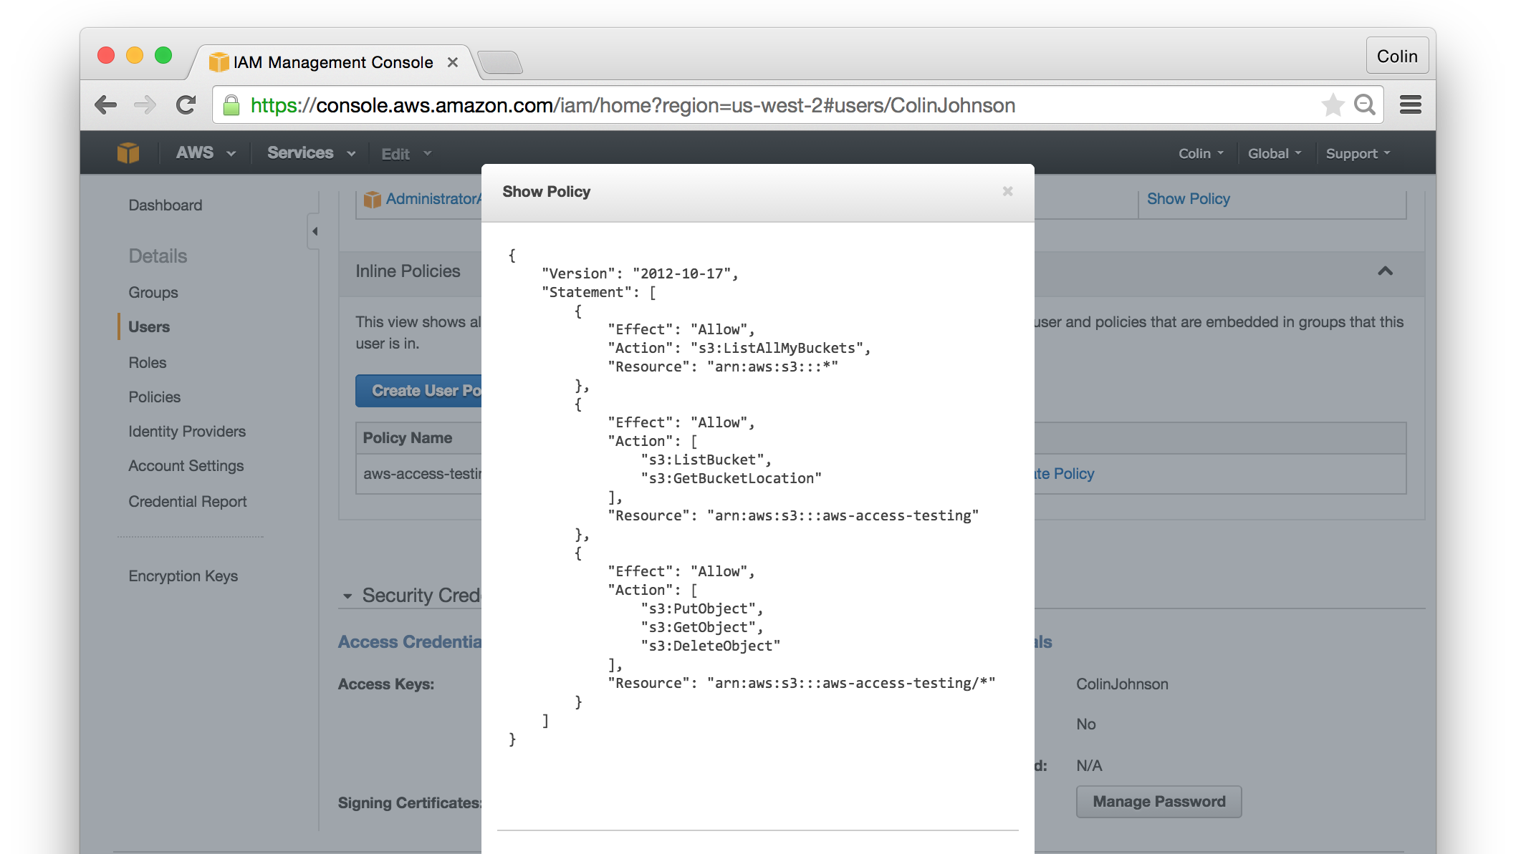
S3: IAM Access
Notes:
Reference:
Example IAM Policy for S3 Bucket Access: http://docs.aws.amazon.com/IAM/latest/UserGuide/ExampleIAMPolicies.html#iampolicy-example-s3

Slide 11
S3: Bucket Policy
Considered a “Resource Policy” because assigned to an S3 resource
Written in JSON
Granularity:
Control Specific Actions at an Object Level (example: allow write of object named: s3://mybucket/test.txt)
Scope:
Can grant anonymous access
Can grant access to any ARN Resource
Can grant access by other attributes, such as IP address
Is inherited by objects within bucket
Typical Use:
Apply sweeping changes to entire bucket
Notes:
References:
Grant Access By IP Address: http://docs.aws.amazon.com/AmazonS3/latest/dev/example-bucket-policies.html#example-bucket-policies-use-case-3

Slide 12
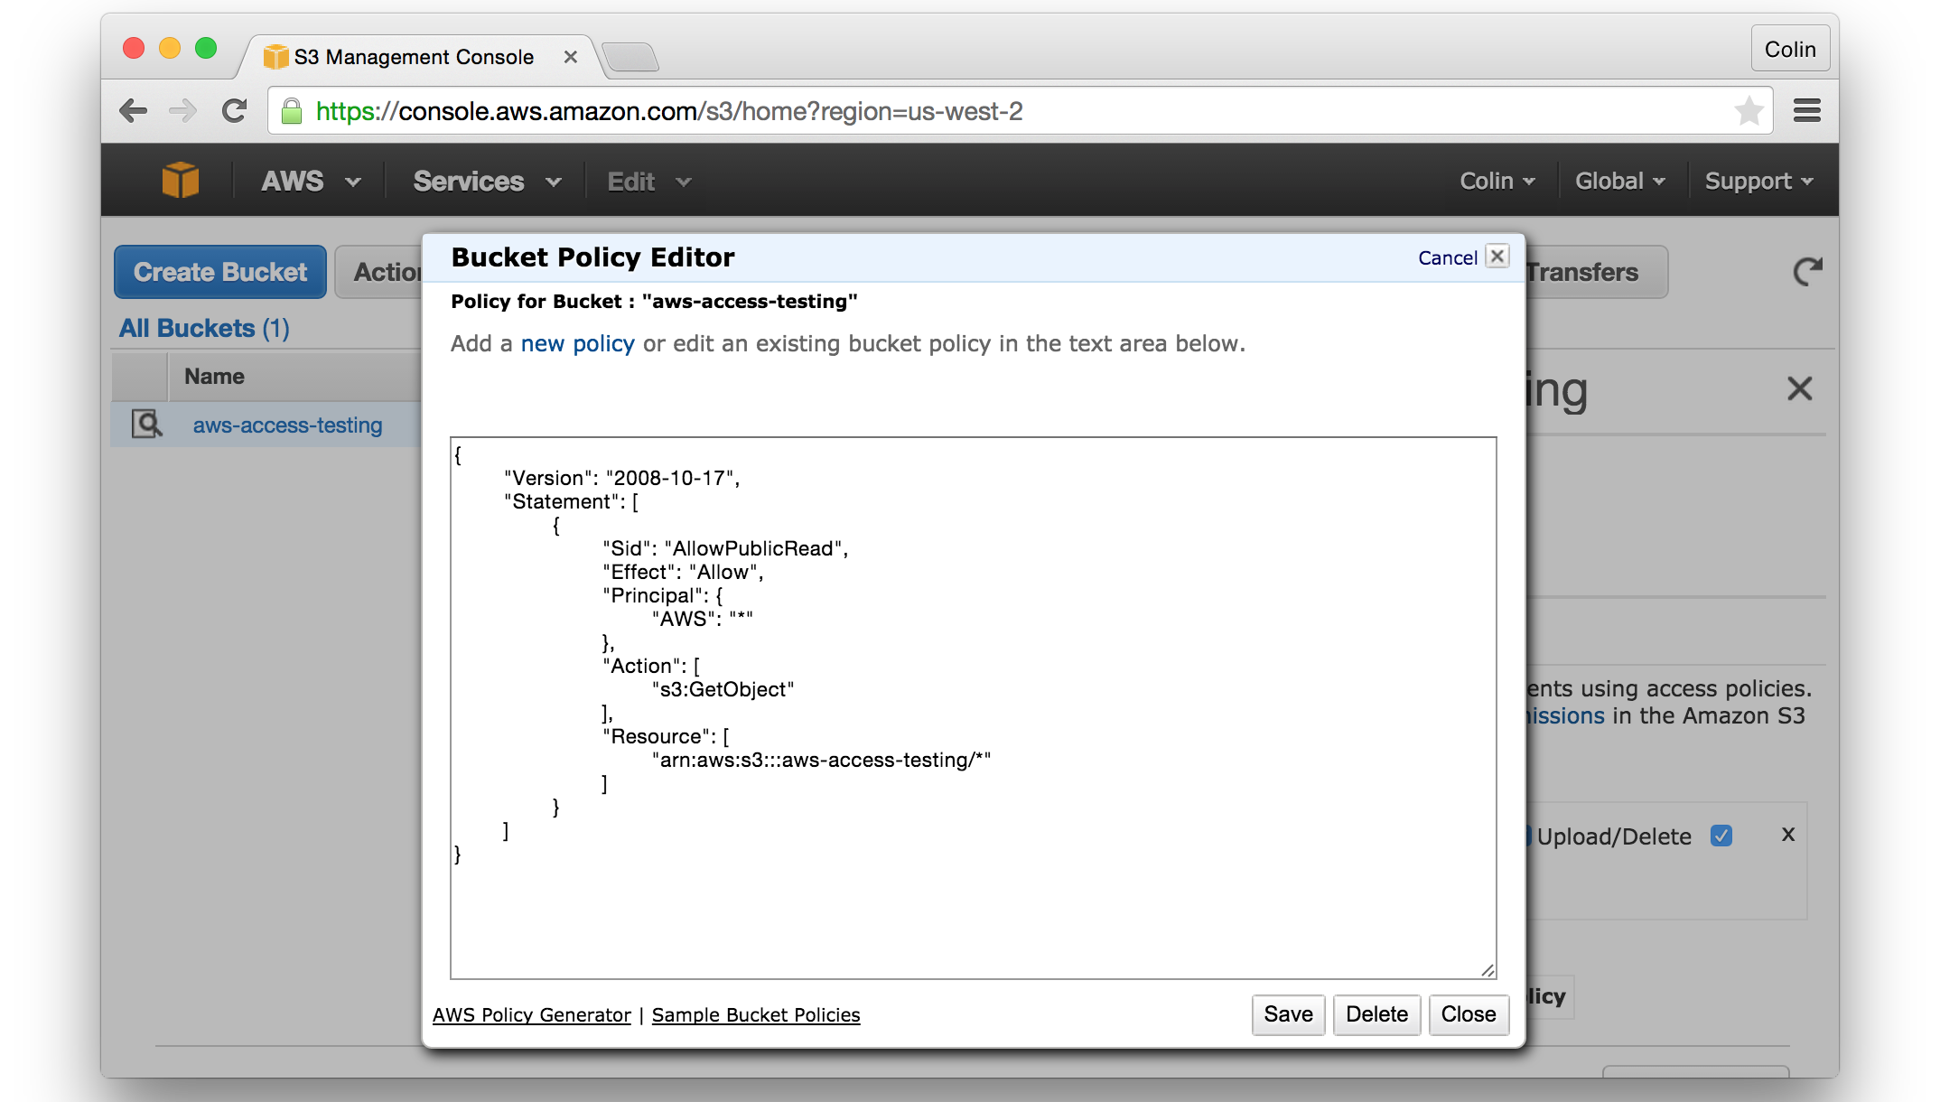
S3: Bucket Policy

Slide 13
S3: Bucket ACL
Considered a “Resource Policy” because assigned to a resource
Written in XML
Granularity:
Control Specific Actions at an Bucket Level (example: allow write into a bucket named: s3://mybucket/)
Scope:
Can grant access to any AWS Account
A bucket’s objects do not inherit from the Bucket ACL
Typical Use:
AWS recommends only for “Log Delivery”
Notes:
References:
Bucket ACLs Effectively Deprecated: http://docs.aws.amazon.com/AmazonS3/latest/dev/access-policy-alternatives-guidelines.html

Slide 14
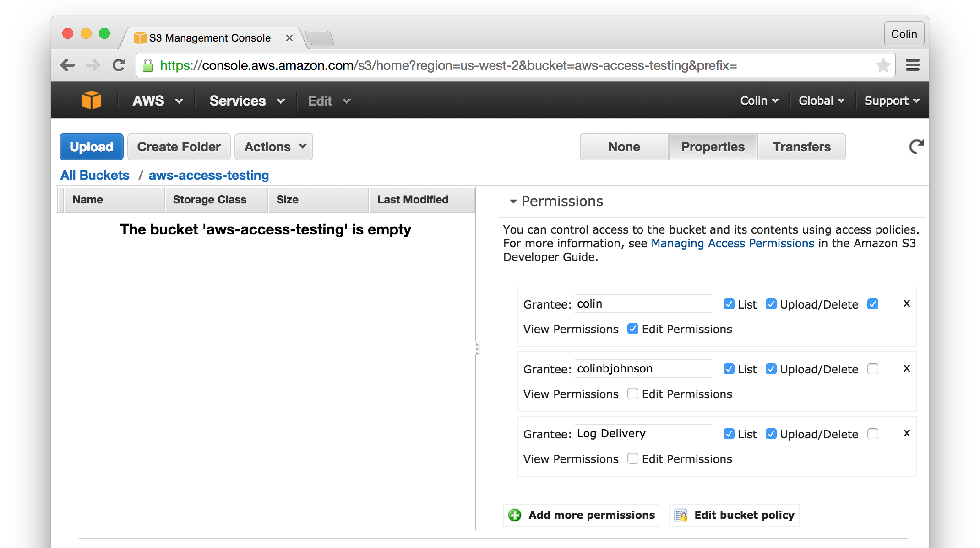
S3: Bucket ACL
Notes:
References:

Slide 15
S3: Object ACL
Considered a “Resource Policy” because assigned to a resource
Written in XML
Granularity:
Control Specific Actions at an Object Level (example: allow write of object named: s3://mybucket/test.txt)
Scope:
Can grant access to any AWS Account
Typical Use:
Making a single object public
Notes:
References:

Slide 16
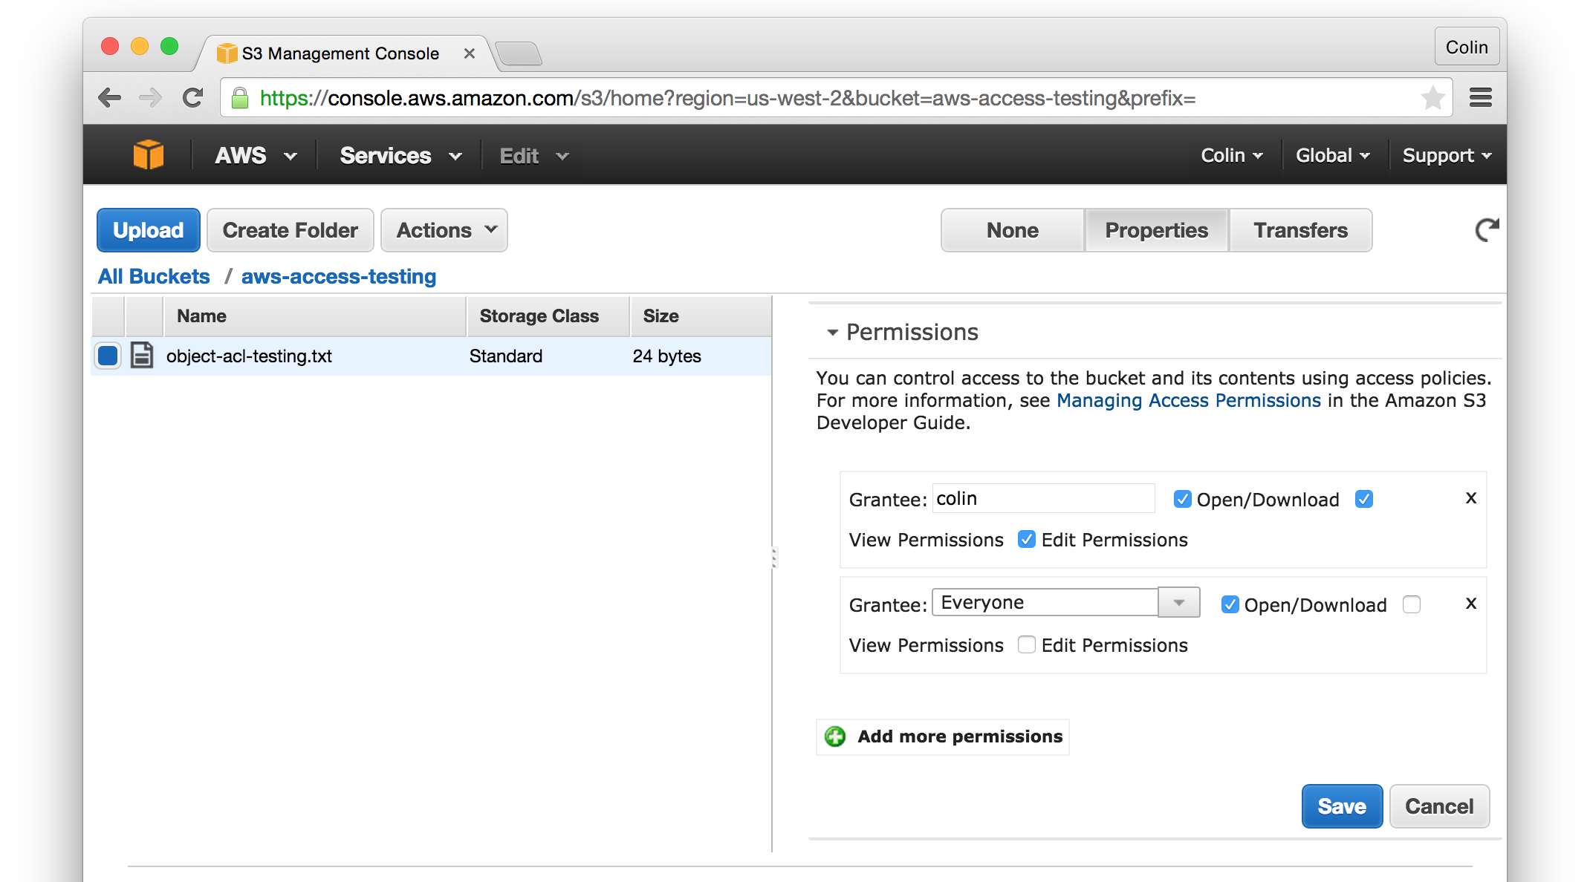
S3: Object ACL
Notes:
References:

Slide 17
S3: Access Best Practices
Keep Access Rules Simple and Consistent
For Users: use IAM Policies
For Applications: use IAM Policies or IAM Roles
For Public Access:
choose either Bucket Policies or Object ACLs

Slide 18
S3: Best Practices
Use region closest to majority of customers
Do not use “.” in bucket name
The “.” will prevent use of SSL for requests
For best performance do not use sequential keys
Sequential keys all written to same S3 partition
Use random keys to spread writes to different partition
Soft-limit of 100 Buckets
Call Amazon if you believe you will go over 100 buckets
Notes:
References:
Sequential Keys: https://aws.amazon.com/blogs/aws/amazon-s3-performance-tips-tricks-seattle-hiring-event/
100 Bucket soft-limit: http://docs.aws.amazon.com/AmazonS3/latest/dev/BucketRestrictions.html

Slide 19
S3: Key Selection and Performance
Disclaimer: I have not yet verified the suggested S3 performance optimization through testing.
Key selection can improve the retrieval rate of objects from S3
In particular, if you require performance of S3 that exceeds the following measures:
A routine workload 100 PUT/LIST/DELETE/”list object” requests per second
A routine workload of 300 GET requests per second
A “large number of GETS”
Notes:
References:
http://docs.aws.amazon.com/AmazonS3/latest/dev/request-rate-perf-considerations.html

Slide 20
S3: Key Selection Problem and Solution
The problem:
Object keys are stored in S3 “Lexicographically”
Lexicographically = essentially alphabetically
Object key dictates which partition the objects are stored in
if object key are sequential, it increases the likelihood that the data is stored in the same partition (aka: “Hot Spot”)
The solution:
use a hexadecimal hash prefix of 3 to 4 characters to spread requests across multiple partitions
Notes:
References:
http://docs.aws.amazon.com/AmazonS3/latest/dev/request-rate-perf-considerations.html

Slide 21
S3: Key Selection Described
Example of lexicopgrahic (alphabetic) keys:
s3://photos/9770527/volvo_74085.jpg
s3://photos/9770527/acura_integra02.jpg
s3://photos/9770527/honda_accord05.jpg
Example of hashed keys:
s3://photos/3636a/9770527/acura_integra02.jpg
s3://photos/737a/9770527/honda_accord05.jpg
s3://photos/d66a/9770527/volvo_74085.jpg
Notes:
References:
http://docs.aws.amazon.com/AmazonS3/latest/dev/request-rate-perf-considerations.html

Slide 22
S3: Practical Experience
Storage of all user and auto photos for a Ride Sharing network
Origin for a CDN used by all company websites
Archival Storage and Backup
Performed analysis where Azure was less expensive due to cost of “PUTS” on AWS being higher than Azure
Notes:
Cost of PUTS on AWS higher than Azure:
PUT is $0.005 on AWS: http://aws.amazon.com/s3/pricing/
All Transactions are $0.0036 on Azure: http://azure.microsoft.com/en-us/pricing/details/storage/

