Slide 1
AWS S3
Created By Colin Johnson

Slide 2
S3: Introduction
Shared Access Data Storage using Blob Storage
Unlimited in Capacity
11 9’s Durable (99.999999999%)
99.99% Available
99.9% uptime, per SLA
Notes:
References:
S3 Overview: http://aws.amazon.com/s3/
S3 SLA: http://aws.amazon.com/s3/sla/

Slide 3
S3: Features
Object Level Security with Wildcards
Object Versioning
Object Archival using Glacier
Cross Region Replication
Static Website Hosting
Static Files
Redirects
SSL Access
Notes:
References:
S3 Overview: http://aws.amazon.com/s3/
S3 SLA: http://aws.amazon.com/s3/sla/

Slide 4
S3: Benefits and Challenges
Unlimited Storage
Highly Available
Replicates across AZs by default
Replicates across Regions
Fast to Setup and Easy to Maintain
Costs should be compared against competitors
Performance can be unpredictable

Slide 5
S3: Eventual Consistency I
The following is true for All Regions:
Replace Object, Read Object – may result in read of previous object’s data
Delete Object, Read Object – deleted object may be read
Delete Object, List Objects – deleted object may show in list
Notes:
References:
Consistency Model: http://docs.aws.amazon.com/AmazonS3/latest/dev/Introduction.html#ConsistencyMode
Consistency Model: http://aws.amazon.com/s3/faqs/

Slide 6
S3: Eventual Consistency II
All Regions except US-Standard allow “Read-After-Write” Consistency for New Objects
Write Object, Read Object = Object Read
US-Standard Region Only:
Write Object, Read Object – may result in “key does not exist”
Write Object, List Keys – may result in object not appear in list
Notes:
References:
Consistency Model: http://docs.aws.amazon.com/AmazonS3/latest/dev/Introduction.html#ConsistencyMode
Consistency Model: http://aws.amazon.com/s3/faqs/

Slide 7
S3: Access Policies, ACLs and IAM, Oh My!
Resource Based Policies:
Policies that are applied on a S3 Resource
Bucket Policy
Bucket ACL
Object ACL
User Policies
Rights that are applied to a User or Group Resource
IAM
Not Covered
Cross-Account Access
Notes:
References:
Document that makes sense of the S3 Permissions Mess: http://docs.aws.amazon.com/AmazonS3/latest/dev/access-control-overview.html

Slide 8
S3: IAM Access
“User Policy” - applied to a user, group or resource that can assume a role
Written in JSON
Granularity:
Control Specific Actions at an Object Level (example: allow write of object named: s3://mybucket/test.txt)
Scope:
Can only grant access to the user/group the policy is applied to
Can not grant anonymous access

Slide 9
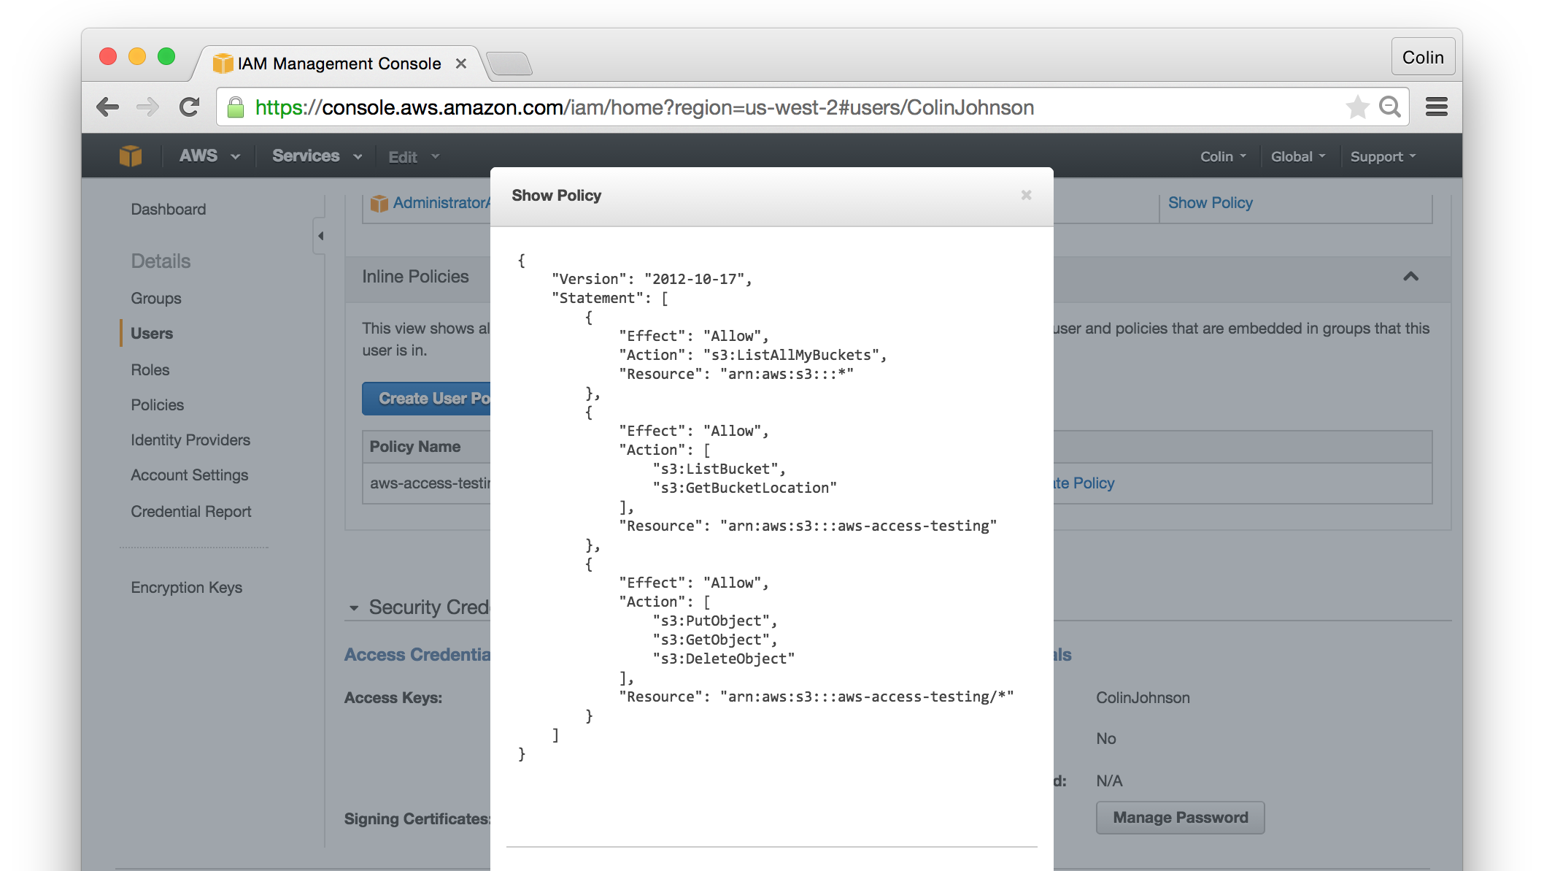
S3: IAM Access
Notes:
Reference:
Example IAM Policy for S3 Bucket Access: http://docs.aws.amazon.com/IAM/latest/UserGuide/ExampleIAMPolicies.html#iampolicy-example-s3

Slide 10
S3: Bucket Policy
Considered a “Resource Policy” because assigned to an S3 resource
Written in JSON
Granularity:
Control Specific Actions at an Object Level (example: allow write of object named: s3://mybucket/test.txt)
Scope:
Can grant anonymous access
Can grant access to any ARN Resource
Can grant access by other attributes, such as IP address
Is inherited by objects within bucket
Typical Use:
Apply sweeping changes to entire bucket
Notes:
References:
Grant Access By IP Address: http://docs.aws.amazon.com/AmazonS3/latest/dev/example-bucket-policies.html#example-bucket-policies-use-case-3

Slide 11
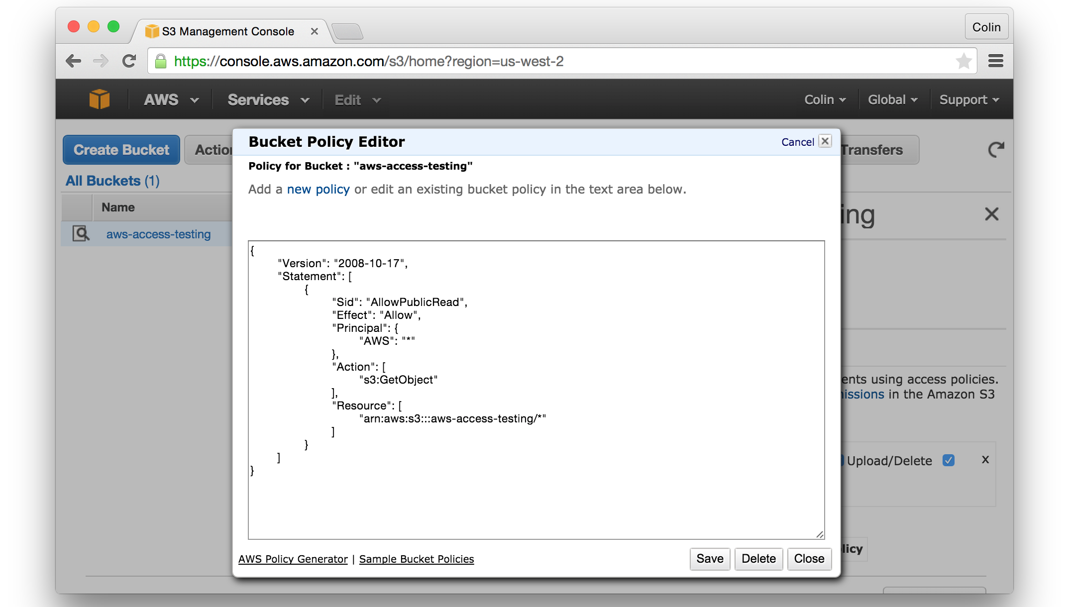
S3: Bucket Policy

Slide 12
S3: Bucket ACL
Considered a “Resource Policy” because assigned to a resource
Written in XML
Granularity:
Control Specific Actions at an Bucket Level (example: allow write into a bucket named: s3://mybucket/)
Scope:
Can grant access to any AWS Account
A bucket’s objects do not inherit from the Bucket ACL
Typical Use:
AWS recommends only for “Log Delivery”
Notes:
References:
Bucket ACLs Effectively Deprecated: http://docs.aws.amazon.com/AmazonS3/latest/dev/access-policy-alternatives-guidelines.html

Slide 13
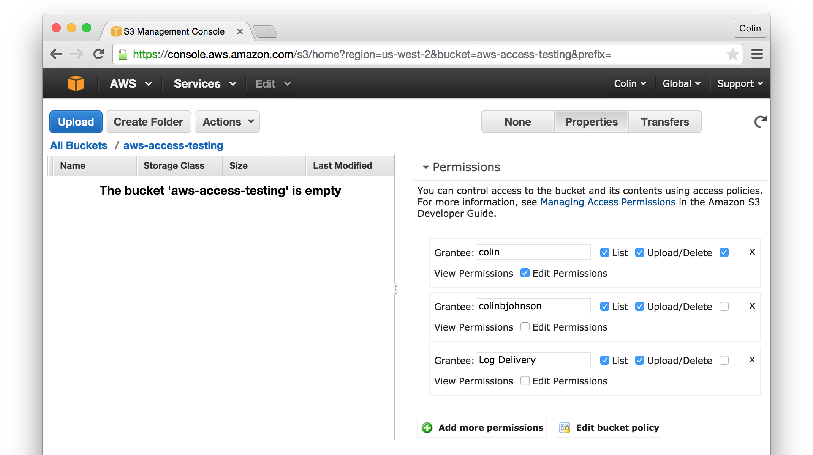
S3: Bucket ACL
Notes:
References:

Slide 14
S3: Object ACL
Considered a “Resource Policy” because assigned to a resource
Written in XML
Granularity:
Control Specific Actions at an Object Level (example: allow write of object named: s3://mybucket/test.txt)
Scope:
Can grant access to any AWS Account
Typical Use:
Making a single object public
Notes:
References:

Slide 15
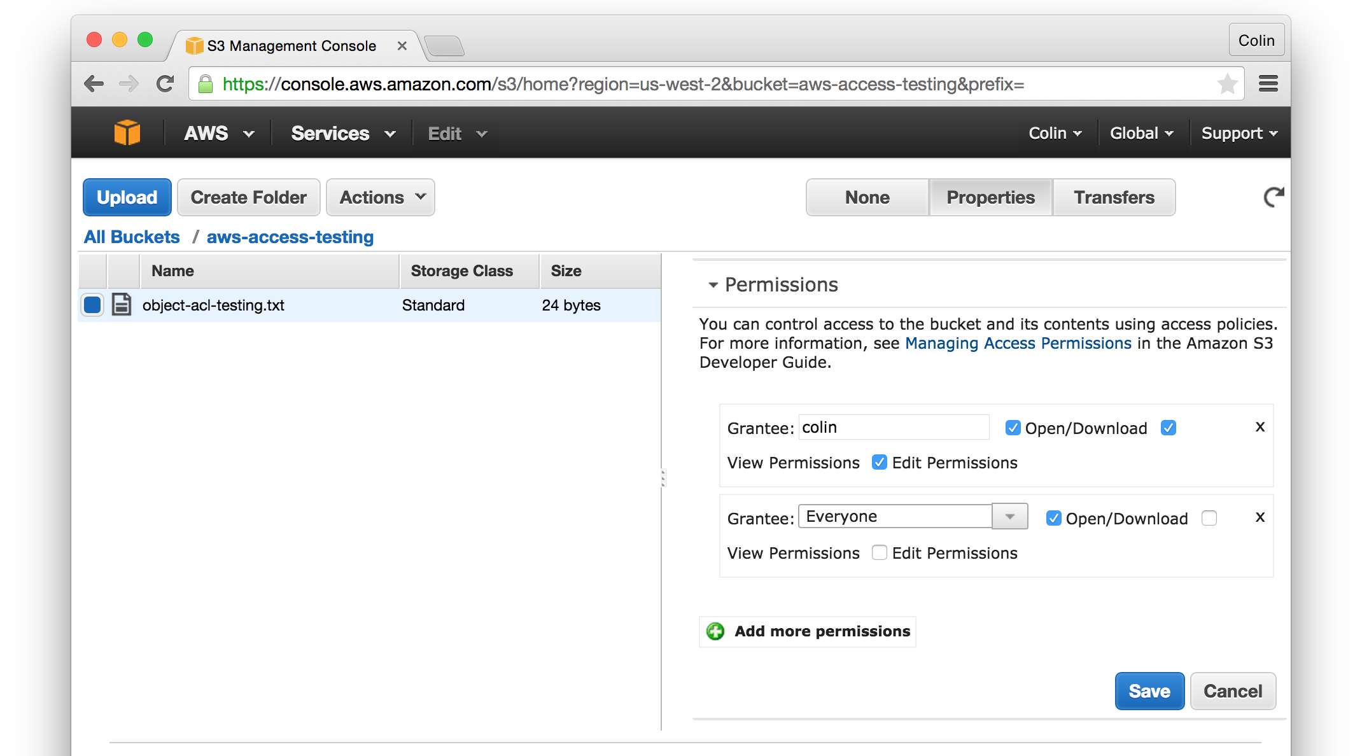
S3: Object ACL
Notes:
References:

Slide 16
S3: Access Best Practices
Keep Access Rules Simple and Consistent
For Users: use IAM Policies
For Applications: use IAM Policies or IAM Roles
For Public Access:
choose either Bucket Policies or Object ACLs

Slide 17
S3: Best Practices
Use region closest to majority of customers
Do not use “.” in bucket name
The “.” will prevent valid SSL requests
For best performance do not use sequential keys
Sequential keys all written to same S3 partition
Use random keys to spread writes to different partition
Do not go over 100 Buckets
Notes:
References:
Sequential Keys: https://aws.amazon.com/blogs/aws/amazon-s3-performance-tips-tricks-seattle-hiring-event/

Slide 18
S3: Performance Optimization I
Disclaimer: I have not yet verified the suggested S3 performance optimization through testing.
Key selection can improve the retrieval rate of objects from S3
In particular, if you require performance of S3 that exceeds the following:
Routine workload 100 PUT/LIST/DELETE/”list object” requests per second
Routine workload of 300 GET requests per second
Large number of GETS
Notes:
References:
http://docs.aws.amazon.com/AmazonS3/latest/dev/request-rate-perf-considerations.html

Slide 19
S3: Performance Optimization II
The problem:
Object keys are stored in S3 alphabetically
Object keys dictates which partition the objects are stored in
if object key are sequential, it increases the likelihood that the data is stored in the same partition
The solution:
use a hexadecimal hash prefix of 3 to 4 characters to spread requests across multiple partitions
Notes:
References:
http://docs.aws.amazon.com/AmazonS3/latest/dev/request-rate-perf-considerations.html

Slide 20
S3: Performance Optimization II
Example of lexicopgrahic (alphabetic) keys:
s3://photos/9770527/volvo_74085.jpg
s3://photos/9770527/acura_integra02.jpg
s3://photos/9770527/honda_accord05.jpg
Example of hashed keys:
s3://photos/3636a/9770527/acura_integra02.jpg
s3://photos/737a/9770527/honda_accord05.jpg
s3://photos/d66a/9770527/volvo_74085.jpg
Notes:
References:
http://docs.aws.amazon.com/AmazonS3/latest/dev/request-rate-perf-considerations.html

Slide 21
Hands On: S3 Cross Region Replication
Have Instructions for Configuration
Released on March 24, 2015
Use Cross Region Replication to Automatically push Objects from one Region to Another
Replication includes object ACLs, metadata and Reduced Redundancy Storage setting
Notes:
References:
https://aws.amazon.com/blogs/aws/new-cross-region-replication-for-amazon-s3/

Slide 22
Hands On: S3 IAM Access
Create an IAM user that:
has the ability to PUT/GET/DELETE objects in a given bucket
has no further permissions:
Sample use case (1): ensuring an application can only access a particular S3 bucket (or S3 bucket / prefix)
Sample use case (2): allowing users to upload or read from only a particular S3 bucket
Notes:
References:
https://aws.amazon.com/blogs/aws/new-cross-region-replication-for-amazon-s3/

Slide 23
S3: Practical Experience
Storage of all user and auto photos for a Ride Sharing network
Origin for a CDN used by all company websites
Archival Storage and Backup
Performed analysis where Azure was less expensive due to cost of “PUTS” on AWS being higher than Azure
Notes:
Cost of PUTS on AWS higher than Azure:
PUT is $0.005 on AWS: http://aws.amazon.com/s3/pricing/
All Transactions are $0.0036 on Azure: http://azure.microsoft.com/en-us/pricing/details/storage/

