Slide 1
AWS RDS (Relational Database Service)
Created By Colin Johnson

Slide 2
RDS: Introduction
Hosted SQL Database
Aurora, MySQL, PostgreSQL, Oracle or Microsoft SQL
Available in Multi-AZ Configuration
Available with Provisioned IOPS
Unofficially: backed by EC2 and EBS
Capacity Limits: vary by SQL server engine, but:
Up 6 TB
Up to 30,000 IOPS
Notes:
6 TB Limit:
https://aws.amazon.com/about-aws/whats-new/2015/06/amazon-rds-increases-storage-limits-to-6TB-for-piops-and-gp2/

Slide 3
RDS: Benefits
Provision a Database in Minutes
RDS Instance Types lag EC2 Instance Types
Scale CPU and Storage Easily
Read-Replicas
Multi-AZ: solve challenging problem of multi-AZ database

Slide 4
RDS: Challenges
Monitoring outside of CloudWatch is challenging
Example: get percentage of free storage
Multi-AZ configuration issues
AWS vague on downtime as result of modifications
Not all configuration parameters are Exposed
No SSH into an RDS Server
Automatic Backups are deleted when an RDS instance is deleted
Notes:
Automatic Backups deleted on RDS Deletion: http://docs.aws.amazon.com/AmazonRDS/latest/UserGuide/USER_WorkingWithAutomatedBackups.html
AWS Claims “little to no downtime” downtime as result of RDS changes (http://aws.amazon.com/rds/details/multi-az/) - I have been unable to get a definitive answer

Slide 5
RDS: Best Practices
Do not rely on Automatic Backups
Manually set Backup and Maintenance Windows
Supplement CloudWatch monitoring
1 to 1 relationship between RDS and Parameter Groups
Security Best Practices:
Provide database with own security group
Private database IP address
Utilize RDS Encryption, per AWS
Notes:
References:
RDS Best Practices: http://docs.aws.amazon.com/AmazonRDS/latest/UserGuide/CHAP_BestPractices.html
Security Best Practices: http://www.slideshare.net/AmazonWebServices/amazon-rds-for-mysql-diagnostics-security-and-data-migration-dat302-aws-reinvent-2013
Utilize RDS Encryption – note that I have not worked with RDS Encryption yet

Slide 6
Hands On: Create an RDS Instance
We will:
Create a Security Group for our RDS Instance
Create an RDS Instance
Snapshot our RDS Instance
Change a Parameter Value (max_connections) used by our RDS Instance
Modify the Storage, CPU parameters of our RDS Instance
Notes:
Hands On Exercises consist of multiple files:
rds-create-console.docx
rds-snapshot-console.docx
rds-modify-console.docx

Slide 7
RDS: Memory Usage
Amazon suggests having enough RAM to store “Working Set”
Is “ReadIOPS” small/stable? If not, MySQL is hitting disk
CloudWatch’s FreeableMemory metric see-sawing downward regularly is typical, as MySQL uses all cache available
CloudWatch’s Swap Usage metric increasing = investigate or scale up
Notes:
References:
Estimate working set size: http://www.tocker.ca/2013/05/31/estimating-mysqls-working-set-with-information_schema.html

Slide 8
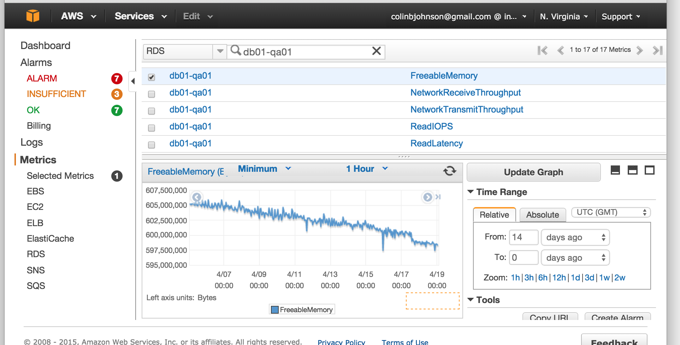
RDS: FreeableMemory Pattern
Notes:
References:
Estimate working set size: http://www.tocker.ca/2013/05/31/estimating-mysqls-working-set-with-information_schema.html

Slide 9
RDS: Practical Experience
I’ve used RDS everywhere I’ve been:
Cost at Ad network was half of AWS spend ($60K/mo)
Thousands of hours of use, few problems
Database restore time periods are hard to predict
Suffered an 10 hour+ RDS outage as result of EBS volumes being unable to be brought online
Choices were “wait it out” or automated snapshot and sacrifice recent data
Notes:
Automatic Backups deleted on RDS Deletion: http://docs.aws.amazon.com/AmazonRDS/latest/UserGuide/USER_WorkingWithAutomatedBackups.html

