Slide 1
AWS VPC (Virtual Private Cloud)
Created By Colin Johnson

Slide 2
VPC: Introduction
An isolated portion of AWS
Comprised of one or more subnets, mapped to Availability Zones
Choice of IP addressing schemes: public or private
Various Network Connectivity Options, examples:
Site to Site VPN
Internet Gateway
Etc.

Slide 3
VPC: Benefits and Challenges
Improved security, including additional depth from NACLs and Private IP addressing
Egress Traffic Filtering
Single-Tenant Hardware
Access to some “only in VPC” resources
Increased complexity
Possible management of NAT servers
Additional Resources such as Internet Gateways
Increased cost resulting from additional infrastructure
Notes:
References:
http://docs.aws.amazon.com/AWSEC2/latest/UserGuide/using-vpc.html#concepts-vpc
Increased Cost Resulting from Infrastructure
NAT Boxes

Slide 4
VPC: IP Range and Subnets
VPC: specifies a CIDR Range
Subnets:
Associated with Route Table
Associated with Network ACL
One to One Relationship between AZ and Subnet
Connectivity:
By Default, inter-subnet communication allowed
Can be Isolated via use of Network ACLs
Notes:
VPC, definition of “Public” and “Private” subnet: http://docs.aws.amazon.com/AmazonVPC/latest/UserGuide/VPC_Scenario2.html

Slide 5
VPC: Route Table
Determine where traffic is Directed
Each subnet must be associated with a Route Table
Always includes VPC CIDR Range
Examples:
10.0.0.0/16 -> Local
172.16.0.0/16 to vpn-c76cb0d9 (a VPN Connection)
0.0.0.0.0/0 to igw-3547bf50 (an Internet Gateway)
Notes:
References:
http://cloudavail.com/2014/07/04/vpc-intro-part-1/

Slide 6
VPC: Route Table
Example: VPC Route Table
Notes:
References:
http://cloudavail.com/2014/07/04/vpc-intro-part-1/

Slide 7
VPC: Network ACL
Default Network ACL is Allow All Inbound, Allow All Outbound
Stateless
Network ACLs Comprised of Multiple Rules
Associated with one or more Subnets
Inbound and Outbound Matching
Provides both Allow and Deny Rules
Notes:
References:
http://cloudavail.com/2014/07/04/vpc-intro-part-1/

Slide 8
VPC: Default Network ACL
Notes:
References:
http://cloudavail.com/2014/07/04/vpc-intro-part-1/

Slide 9
VPC: Network ACL - Restricted
Example shows Network ACL being used to restrict access to:
inbound HTTP
Responses to HTTP
Use to supplement Security Groups, if needed
Notes:
References:
http://cloudavail.com/2014/07/04/vpc-intro-part-1/

Slide 10
VPC: Network Components
Internet Gateway
Provides a route to the Internet
Hosts using Internet Gateway must still have Public IP Address
Use with NAT EC2 instance to allow servers with private IP addresses access to Public Internet
EC2-VPC Security Group
Like EC2 Classic Security Group, only better
Inbound and Outbound Rules
Notes:
References:
http://cloudavail.com/2014/07/04/vpc-intro-part-2/

Slide 11
VPC: Overall Design Choices
Examples:
1 VPC
1 VPC per Environment
1 VPC per Application
1 VPC per Environment per Application
And so on….

Slide 12
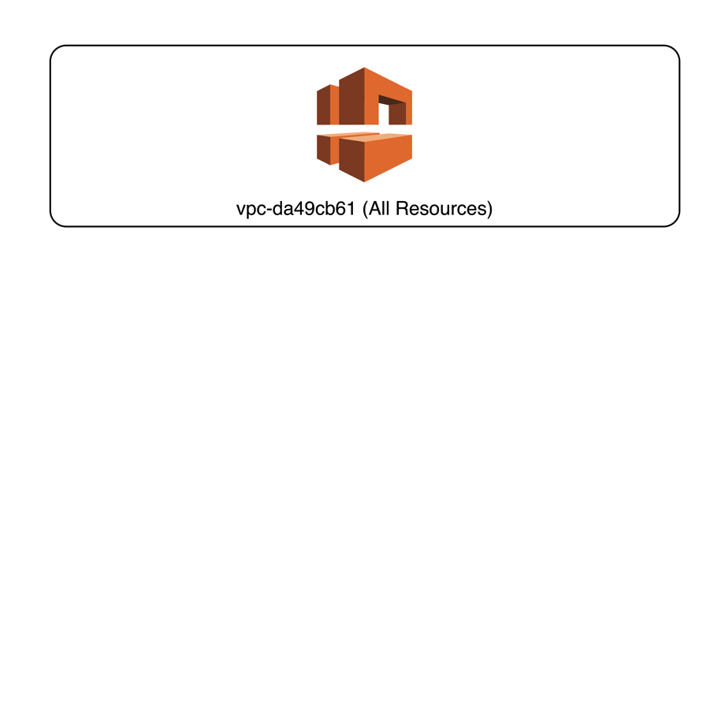
1 VPC
Pro:
Easiest Management / Fewest Resources
Con:
No Isolation of Networks
Isolating Management of Resources is more Difficult
Notes:
Presenter’s Notes:
I’d prefer to isolate management of resources based on tag as opposed to VPC membership, if needed

Slide 13
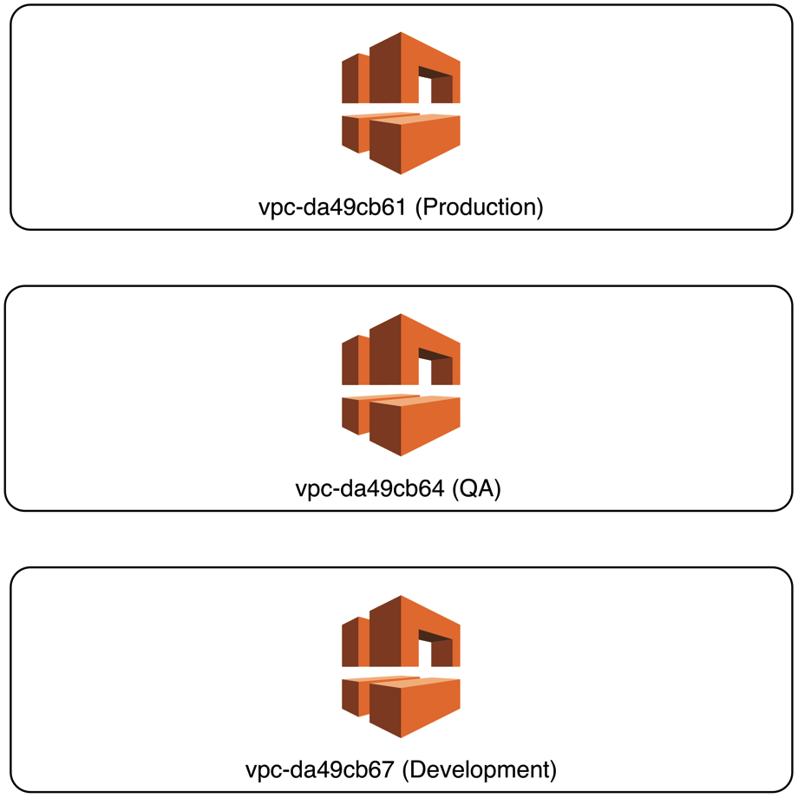
1 VPC per Environment (or Application)
Pro:
Isolation by Environment
Example: allow creation of EC2 only in particular VPC
Prevent Cross Environment Access by Default
Con:
Some Additional Complexity
May need VPC Peering
Notes:
Reference:
http://www.slideshare.net/AmazonWebServices/cpn208selecting-the-best-vpc-network-architecture-cpn208-aws-reinvent-2013
Additional Complexity, as result of multiple Virtual Private Gateways needing one endpoint: https://aws.amazon.com/articles/5458758371599914
Allow Launch of EC2 Resources only in Specified VPC: http://docs.aws.amazon.com/AmazonVPC/latest/UserGuide/VPC_IAM.html#subnet-ami-example-iam

Slide 14
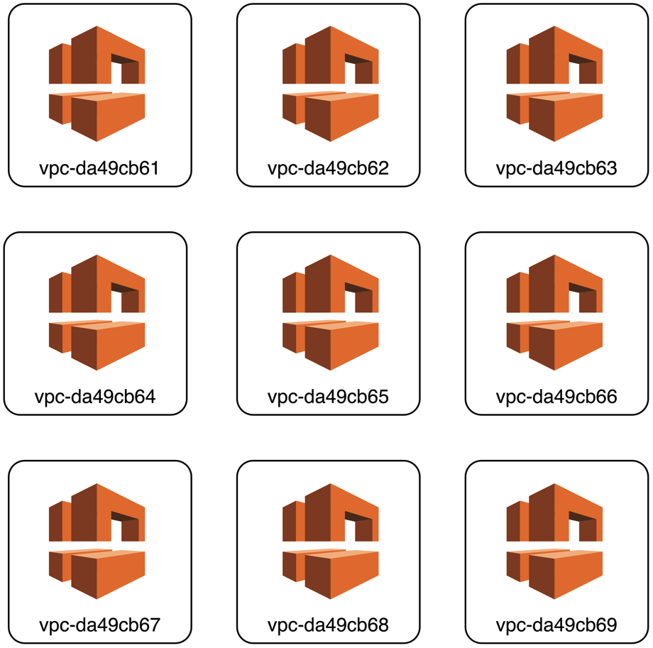
1 VPC per Environment, per Application
Pro:
Isolation of Resources
Con:
Many VPCs
Many Subnets
Potential lack of consistency
Increased administration effort
Multiply again if multi-region
Notes:
Reference:
http://www.slideshare.net/AmazonWebServices/cpn208selecting-the-best-vpc-network-architecture-cpn208-aws-reinvent-2013

Slide 15
VPC: Network Connectivity Options
Internet Gateway
Internet Gateway, Public Subnets
Internet Gateway, with NAT and Private Subnets
Site to Site VPN
Client to Gateway
ssh Server
RDP Server
VPN Server
VPC Peering
Direct Connect

Slide 16
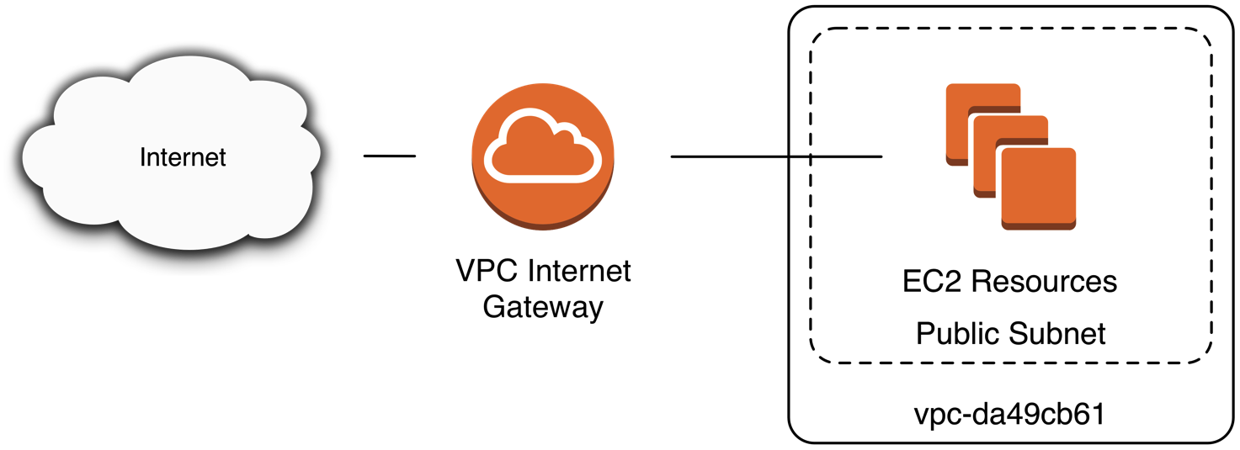
VPC: Internet Gateway
An Internet Gateway allows connectivity to Public Internet for Instances with Public IP addresses
If instances have Private IP address, require use of a NAT server

Slide 17

VPC: Internet Gateway EC2 Instances with Public IP

Slide 18
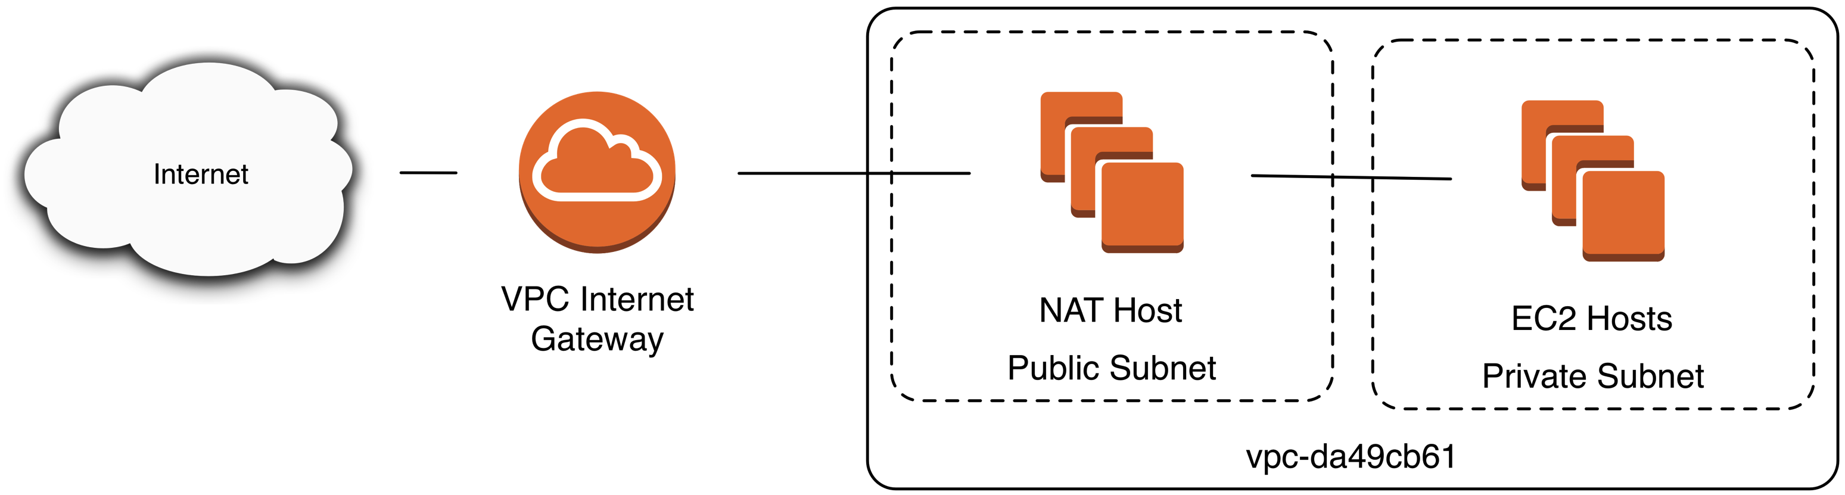
VPC: Internet Gateway NAT and EC2 Instances with Private IP

Slide 19
VPC: Site to Site VPN
Site to Site VPN requires the following:
A Customer Gateway (Customer Equipment)
A Virtual Private Gateway (AWS Equipment)
Example use cases:
Connect a Data Center to a VPC
Connect an Office to a VPC
Connect a VPC to a VPC

Slide 20
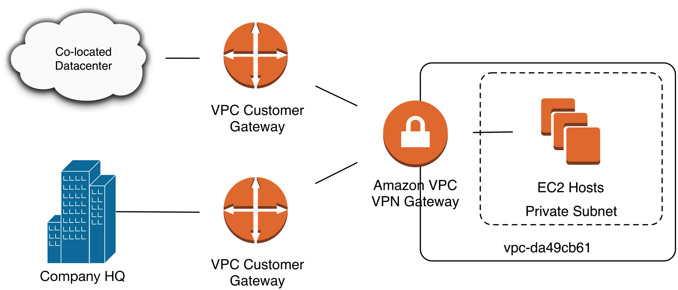
VPC: Site to Site VPN

Slide 21
VPC: Direct Connect
Connect directly from a given Data Center to a VPC
Options for AWS Customers outside of Direct Connect location also available.
Variable Speeds, see Documentation
One Direct Connect for access to All US Regions
Eliminate the need for VPN
Lower Latency, Potentially Lower Cost
Notes:
List of VPC Direct Connect Locations: http://aws.amazon.com/directconnect/details/
Variable Speeds: http://aws.amazon.com/directconnect/faqs/
One Direct Connect for all US Regions: https://aws.amazon.com/blogs/aws/aws-direct-connect-access-to-multiple-us-regions/
References:
http://aws.amazon.com/directconnect/details/

Slide 22
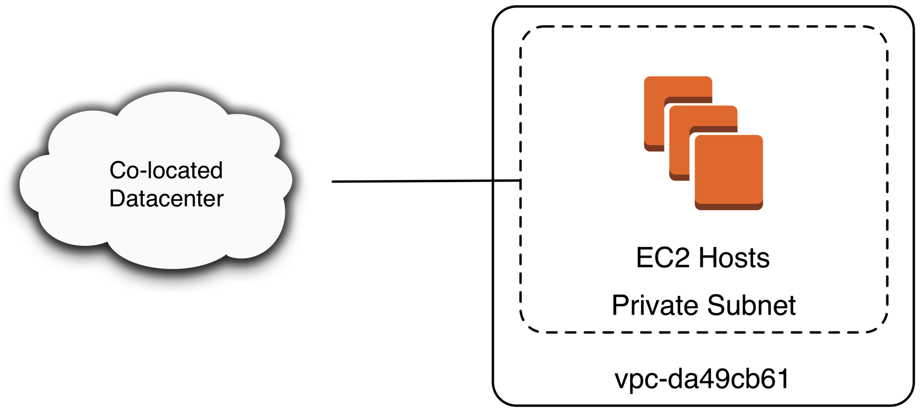
VPC: Direct Connect
Notes:
List of VPC Direct Connect Locations: http://aws.amazon.com/directconnect/details/
Variable Speeds: http://aws.amazon.com/directconnect/faqs/
One Direct Connect for all US Regions: https://aws.amazon.com/blogs/aws/aws-direct-connect-access-to-multiple-us-regions/
References:
http://aws.amazon.com/directconnect/details/

Slide 23
VPC: VPC Peering
Connect two different VPCs
Example: modify route table to add route 10.0.0.0/16, target pcx-7142bf18
VPC Peering can be between accounts
VPC Peered Traffic is not Encrypted
Not able to reference Security Group in another VPC, must utilize CIDR Ranges
VPCs must have non-overlapping CIDR Blocks
Notes:
Presenter’s Note: I’ve used VPC Peering as an intermediate step to moving from a 1 VPC per environment configuration to a 1 VPC configuration.
Not Able to Reference another VPC Security Group: http://docs.aws.amazon.com/AmazonVPC/latest/UserGuide/vpc-peering.html
Encryption: https://aws.amazon.com/blogs/aws/new-vpc-peering-for-the-amazon-virtual-private-cloud/
References:
https://aws.amazon.com/blogs/aws/new-vpc-peering-for-the-amazon-virtual-private-cloud/

Slide 24
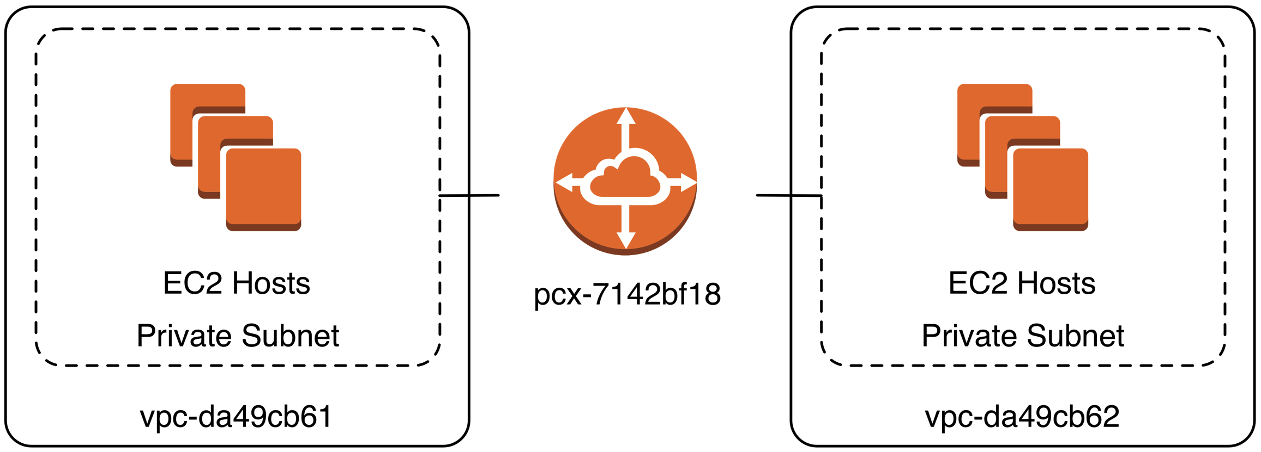
VPC: VPC Peering

Slide 25
VPC: Client Connectivity Options
Connect Directly to Hosts (ssh or RDP)
Connect to ssh Based Bastion Host
Connect to VPN Based Bastion Host
Site to Site VPN
Potentially Extends network attack space
Hybrid Approach
Site to Site VPN with a Bastion Host
Note: my experience is companies simply choose the technology they are most familiar with and then switch if needed.
Notes:
Regarding Note “Companies choose the technology the are most familiar with and switch” – the level of effort to switch from one technology to another is not that great. For larger companies I might consider a hybrid approach – some developers will inevitably prefer ssh whereas some users will benefit from VPN.

Slide 26
VPC Client Connectity: ssh Bastion Host
Benefit:
ssh use familiar to most Engineers / Operations
ssh host Bastion Host is easy to setup
Challenge:
ssh agent forwarding, port forwarding and/or SOCKS proxies may be unfamiliar or complicated
if running Windows hosts, ssh or ssh/RDP combination may be difficult
ssh Bastion host may be a single point of failure

Slide 27
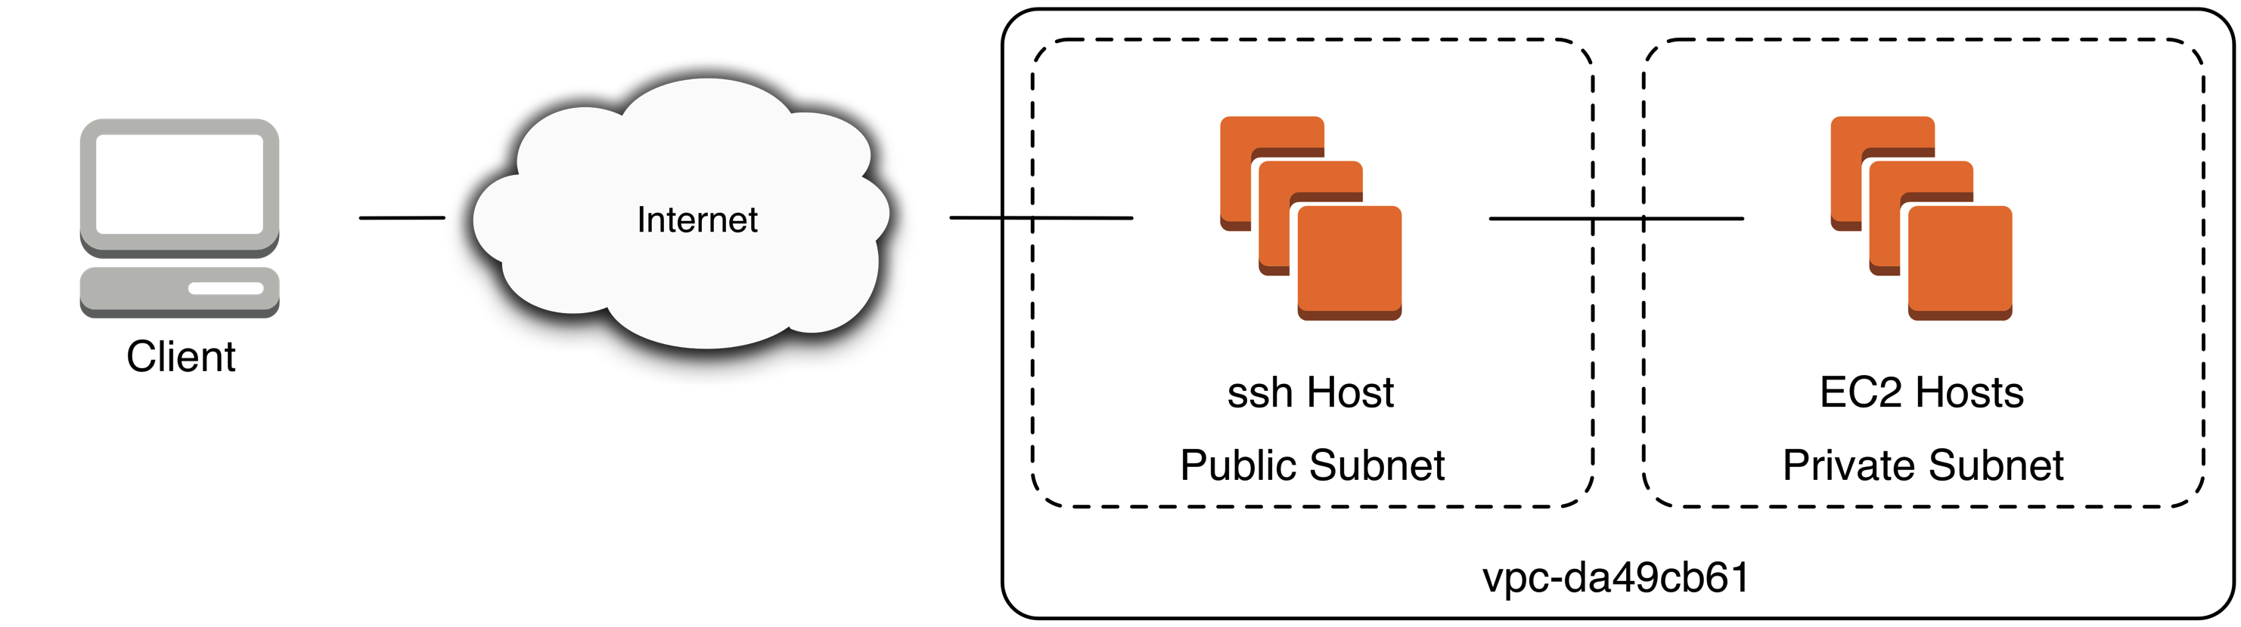
VPC Client Ingress: ssh Bastion Host
Notes:
Presenter’s Note:
ssh Host does not necessarily need to be in Public Subnet

Slide 28
VPC Client Connectivity: VPN Host
VPN use generally straight-forward and familiar
VPN may be challenging to manage for smaller organizations
VPN endpoint may be a single point of failure

Slide 29
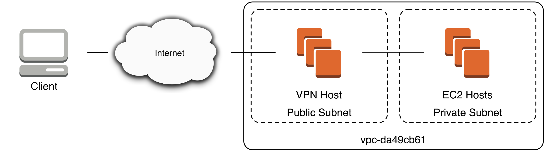
VPC Client Ingress: VPN Host

Slide 30
VPC Client Connectivity: Site to Site VPN
Minimal or No Configuration when on-site
On-premise network security should meet security standards required by company
Example: if on-site network is open and on-site network is allowed to access VPC
If off-site, clients will not be able to utilize Site to Site VPN:
Off-site clients will need to use client VPN to VPC or client ssh to VPC or VPN into on-site network

Slide 31
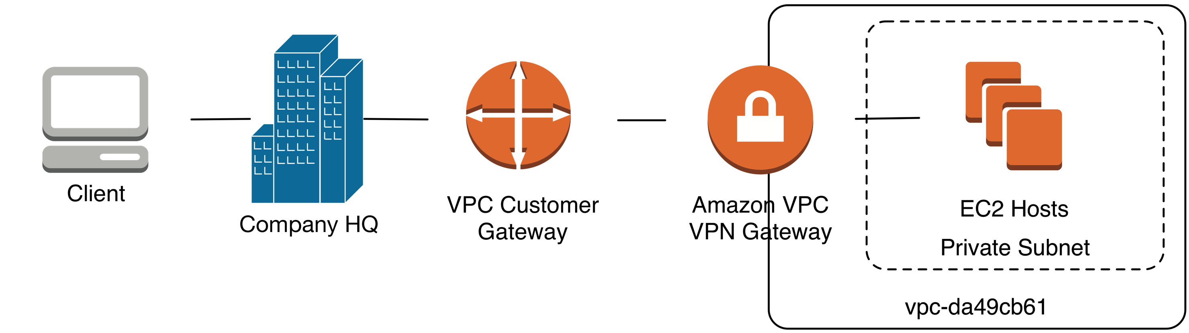
VPC Client Ingress: Site to Site VPN

Slide 32
VPC Client Connectivity: Suggestions
Small, Highly-technical Company: ssh or VPN
Have supported 80 Engineers through ssh
Large, Highly-technical Company: VPN
Company with non-technical users of AWS resources: VPN
Company with non-technical users of AWS resources, all in one office and comfortable with existing on-premise network security: Site to Site VPN + off-premise VPN
Notes:
Company with non-technical users of AWS resources: VPN
ssh tricks such as SOCKS proxy can be tricky for non-technical users

Slide 33
Lab: Create a VPC
Create a VPC
Create an Internet Gateway
Create two VPC “Public” subnets
Create a Route Table

