Slide 1
AWS Introduction

Slide 2
Intro: Colin Johnson
Who am I?
DevOps Engineer and occasional Programmer
What experience do I have?
Lyft: ride-sharing startup in San Francisco
NetShelter: multi-region ad-network
Certified?
AWS Certified Solutions Architect
AWS Certified SysOps
Projects?
Contributed some cool features to SaltStack project

Slide 3
AWS Intro: Objectives
Design Available and Scalable Infrastructure on AWS
Availability Zones and Regions
Scaling, including scaling “Up or Out”:
High-Level understanding of AWS Resources
Understand Benefits (and Challenges) of AWS
Understand AWS Costs
Pay for Usage

Slide 4
What is Cloud Computing?
On-demand Self-Service - customer can provision own compute resources
Rapid Elasticity - services can be purchased/released, often automatically
Shared Resources - resources are shared amongst different tenants (business units or customers)
Measured Service - cloud provider measures usage of services, typically for billing purposes
Notes:
Cloud Computing definition, as taken the “The NIST Definition of Cloud Computing” “http://csrc.nist.gov/publications/nistpubs/800-145/SP800-145.pdf

Slide 5
AWS: Benefits
Fast: resources provisioned within minutes
Elastic: add/remove capacity as needed
Cost Model: variable as opposed to up-front expense
Low Cost: benefit from economies of scale and competition amongst cloud providers
Efficient: spend less time managing infrastructure
Highly Available: globally distributed and fault resistant infrastructure
Notes:
6 Advantages and Benefits of Cloud Computing: http://aws.amazon.com/what-is-cloud-computing/?nc2=h_l2_cc.

Slide 6
AWS: Challenges I
Architecture – applications may need to be modified to meet AWS Best Practice Architecture
Cost
difficulty in comparing AWS (or any public cloud provider) cost to traditional data center cost
cost optimization a continual process
Configuration of Resources – not all resources (ELB, RDS) may expose desired configuration
Control of Infrastructure – finding a balance between empowerment and control
Notes:
AWS Challenges are based on my own experience working with AWS.
Architecture, two challenges:
challenge when working with AWS up through 2015 was when working with applications (Jenkins, Perforce) that stored data on file systems – this required EBS which is not multi-availability zone
Cost:
Determining what is and is not included when measuring costs comparing a physical versus public cloud infrastructure
Cost optimization a continual process – optimizing beyond elasticity is challenging – Amazon’s model is “pay as you go” – if you keep going, you keep paying
Configuration of Resources: certain tunables not exposed – for inability to modify ELB’s idle timeout (fixed in 2014) https://aws.amazon.com/blogs/aws/elb-idle-timeout-control/)
Control of Infrastructure: the empowerment offered to developers may result in cowboy infrastructure

Slide 7
AWS: Challenges II
Familiarity - staff may be unfamiliar with use of AWS
Lock-in - some AWS services inhibit portability of applications
Performance:
performance of resources may be inconsistent
cloud and physical infrastructure performance may not be equivalent
Security and Compliance – meeting compliance requirements on AWS may be difficult
Notes:
AWS Challenges are based on my own experience working with AWS.
Familiarity: staff may not be familiar or on-board with Auto Scaling and the fact it obviates DNS
Lock-in: some resources are only available on AWS, requiring AWS specific code and making move to other technologies difficult
Performance: as an example, AWS “CPU Steal” on particular instances
Security and Compliance. As an example, customers requiring a HIPAA BAA will need to work with AWS to ensure a HIPAA compliant environment and processes.

Slide 8
Regions and Availability Zones
Regions
11 Available Regions (as of November, 2015)
Including GovCloud and China
Costs are Different in Each Region (~50% difference between lowest/most expensive EC2 instance)
Use Regions to Meet Availability, Compliance or Performance Requirements
not all Services Available in All Regions
Availability Zones:
Each Availability Zone is Isolated, typically 3-4 AZs per-region
Meet Availability or Scalability Requirements
Availability Zones are connected via low-latency links
Notes:
Regions:
Costs: as of April 2015, difference between us-west-2 and sa-east-1
not all Services Available in All Regions: http://aws.amazon.com/about-aws/global-infrastructure/regional-product-services
Availability Zones:
Availability Zones aid in meeting availability requirements:
A majority of AWS failures occur only in one AZ
Availability Zones are Isolated from one another (http://aws.amazon.com/ec2/faqs/ - How isolated are Availability Zones from one another?)

Slide 9
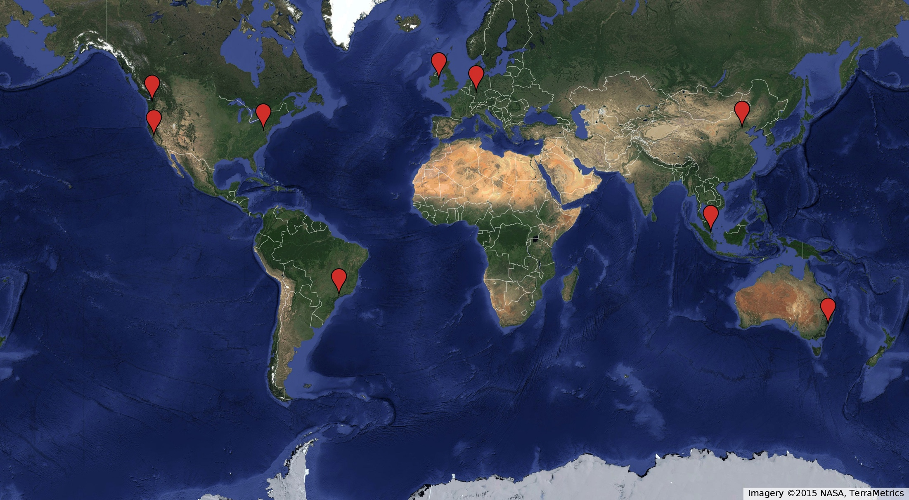
AWS: Global Regions

Slide 10
Regions and Availability Zones
Regions (Do):
Use Regions to meet performance and compliance requirements
Code for multi-region compliance (future proof)
Availability Zones (Do):
Use all available Availability Zones
Availability Zones (Don’t):
Use Single-AZ resources
Build in a single AZ
Hard-code AZs in Tools
Notes:
Regions:
Not all large or well-known AWS customers are multi-region: NetFlix was not in 2011 (https://twitter.com/adrianco/status/61459359229681666)

Slide 11
Example: Multi-AZ Architecture
Notes:
Slide is a representation of a highly available, multi-AZ architecture.
The Load Balancer is run in both the us-west-2a and us-west-2b Availability Zones
The Auto Scaling Group is also run in both the us-west-2a and us-west-2b Availability Zones.
The Multi-AZ RDS Database runs in both us-west-2a and us-west-2b

Slide 12
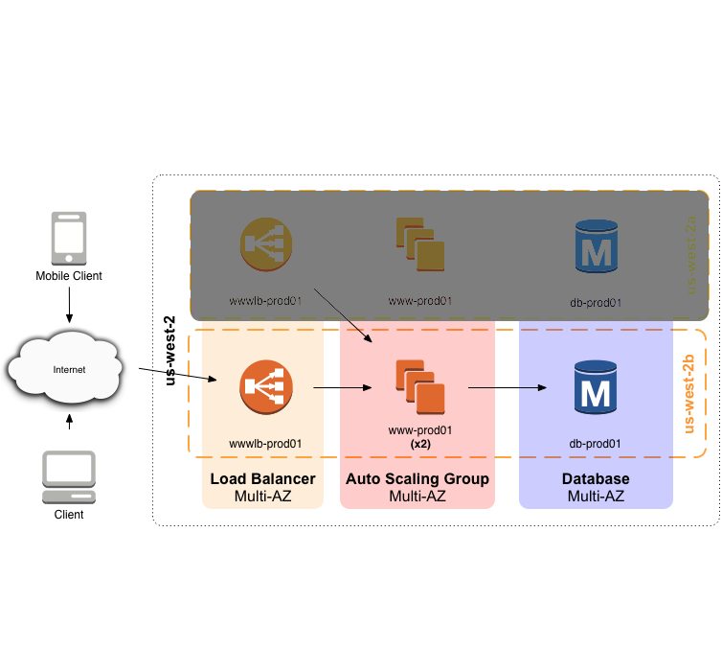
Example: Multi-AZ Architecture during Failure
Notes:
Slide is a representation of the result of a us-west-2a Failure:
The ELB will most likely stop making the IP address(es) of the instances in the us-east-2a availability zone available, at which point clients will begin sending to alternative IP addresses (there are exceptions)
The Auto Scaling Group will notice that the capacity of the Auto Scaling Group has dropped from 2 EC2 instances to 1 EC2 instance, and will respond by increasing the number of instances in the us-east-2b availability zone.
The RDS instance will failover to the standby node in the us-west-2b availability zone.

Slide 13
AWS Resources
AWS Resources covered Presentation
Compute
EC2, Auto Scaling and Security Groups
Ingress
ELB, SQS and Other
Data Storage
RDS, DynamoDB, S3 and Other

Slide 14
Compute: EC2 and Auto Scaling
EC2
Provisioned in seconds
Different Instance Types and Operating Systems
Instances should be considered Ephemeral
Able to be Resized Easily
Auto Scaling
Manually or Automatically set Capacity
Use all available Availability Zones
Use Spot Instance Pricing for Batch Processing
Notes:
References:
EC2 SLA: http://aws.amazon.com/ec2/sla/

Slide 15
Compute: Scaling Up versus Out
Scaling Up (Vertical Scaling):
Typically works with existing applications/infrastructure
Maximum size of largest system “Up”
Scaling typically requires planning / offline servers
Scaling Out (Horizontal Scaling):
Scale Automatically Based on Need
More Cost Effective (decreases overprovisioning)
Scale without Downtime
May be more complex (more resources)
Notes:
References:
http://en.wikipedia.org/wiki/Scalability#Horizontal_and_vertical_scaling

Slide 16
Security Groups
Inbound Rules
Example Rules by CIDR IP Range
Allow 0.0.0.0/0, tcp port 80
Allow 76.102.228.41/32, tcp port 3306
Example Rules by Security Group
Allow gateway-prod01, tcp port 22
Allow www_loadbalancer-prod01, tcp port 80
Outbound Rules (same rule usage as above)
By IP Address Range
By Security Group
Security Groups are Stateful
Notes:
References: http://docs.aws.amazon.com/AWSEC2/latest/UserGuide/using-network-security.html
Rules referencing IP Addresses: generally a poor practice due to difficulty in maintaining rules and changing IP addresses as result of DHCP, IP address changes or changes in physical infrastructure.
Rules referencing Security Groups: generally a good practice, particularly as new instances “scale” into service and inherit security group membership from Auto Scaling Group

Slide 17
Security Groups: Example of Ingress Security

Slide 18
Lab: Create an EC2 Instance
Select “Oregon” Region
Create a security group named “web-yourname”
Where your name is first initial + last name
Allow in TCP protocol port 80, source “Anywhere”
Allow in TCP protocol port 22, source “Anywhere”*
Create an EC2 Instance named “web-yourname”
AMI: ami-5189a661 (Ubuntu 14.04 LTS)
Instance Type: t2.micro
Tag: Name = www-yourname
Security Group: www-yourname
Notes:
*Exposing port 22 to the Internet is generally regarded as a poor practice

Slide 19
AWS Architecture: Typical Data Flow
Ingress: ELB, SQS or other Ingress
Compute: EC2 Instances, ideally an Auto Scaling Group
Data Storage: RDS, S3, DynamoDB or other Data Storage

Slide 20
AWS Architecture: Typical Data Flow

Slide 21
Ingress: ELB, SQS or Other
ELB: Elastic Load Balancer
Immediate Response
Distribute Requests amongst EC2 Instances
Built-in CloudWatch Metrics Allow Auto Scaling
SQS: Simple Queue Service
Batch/Delayed Processing
Distribute Tasks amongst EC2 Instances
Built-in CloudWatch Metrics Allow Auto Scaling
Other Ingress Methods:
Examples: ActiveMQ, Redis, various Proxies
If you need to Auto Scale, create custom CloudWatch Metrics

Slide 22
Data Storage: RDS, DynamoDB, S3, EBS and EFS
RDS
MySQL, PostgreSQL, Microsoft SQL, Oracle
Multi-AZ Replication
DynamoDB
NoSQL Database
Pay as You Go / Pay for IO
S3
Highly Available and Highly Durable
Eventually Consistent
Shared Storage
EBS
Direct Attached Storage
Single Availability Zone
EFS
Currently in Preview
Shared Block Storage
Notes:
S3:
One of the few AWS Services with an SLA
Variable Performance
Performance Optimizations are Available (http://docs.aws.amazon.com/AmazonS3/latest/dev/request-rate-perf-considerations.html)
RDS:
EC2 Backed by EBS
Not all tunables are exposed
Multi-AZ has not been foolproof – for instance, the June 29, 2012 outage triggered failover events that failed to bring about database availability: http://aws.amazon.com/message/67457/. Bug since resolved.
EBS:
No feature exists to replicate an EBS volume across availability zones in real-time, frequently resulting in single-AZ systems

Slide 23
Monitoring: CloudWatch
All AWS Resources provide metrics to CloudWatch
not all encompassing
Example: no free memory or disk space utilization on EC2
able to be extended through custom metrics
Works in tandem with AWS Resources – can trigger email alerts or Auto Scaling events

Slide 24
AWS: Practical Examples
Fleet of web scrapers that extract the content of articles and collected count of social media “Shares”
Used SQS for articles to be scraped, scaled based on queue size, scaled from 0 to 600 servers
Fleet of web servers to process real-time location of vehicles and store in MongoDB
Manual scaling on weekends, and automating scaling based on CPU Utilization, scaled from 30 to 60 servers
Redirection of all requests to a given URL using S3’s ability to serve HTTP requests

Slide 25
AWS Intro: What’s Next?
Compare cost of an Application that is hosted on AWS versus hosted in co-located Datacenter
Design an elastic infrastructure for an existing Application
Determine which existing applications present an availability or performance challenge when running on AWS

