Slide 1
AWS RDS (Relational Database Service)
Created By Colin Johnson

Slide 2
RDS: Introduction
Hosted SQL Database
Aurora, MariaDB, Microsoft SQL, MySQL, PostgreSQL or Oracle
Available in Multi-AZ Configuration
Available with Provisioned IOPS
Unofficially: backed by EC2 and EBS
Capacity Limits: vary by SQL server engine, but:
Up 6 TB
Up to 30,000 IOPS
Notes:
6 TB Limit:
https://aws.amazon.com/about-aws/whats-new/2015/06/amazon-rds-increases-storage-limits-to-6TB-for-piops-and-gp2/

Slide 3
RDS: Benefits
Provision a Database in Minutes
RDS Instance Types lag EC2 Instance Types
Scale CPU and Storage Easily
Easily Available Read-Replica Database Servers
Multi-AZ Offering: solve challenging problem of multi-AZ storage
Notes:
RDS Instance Types lag EC2 Instance Types
Meaning an EC2 Instance Type may be available but a corresponding RDS Instance Type may not be available

Slide 4
RDS: Challenges
Monitoring outside of CloudWatch is challenging
Example: get percentage of free storage
Occasional issues with Multi-AZ
AWS vague on downtime as result of storage space and CPU modifications
Not all SQL configuration parameters are Exposed
Not all database server configuration options are available
Automatic Backups are deleted when an RDS instance is deleted
Notes:
Automatic Backups deleted on RDS Deletion: http://docs.aws.amazon.com/AmazonRDS/latest/UserGuide/USER_WorkingWithAutomatedBackups.html
AWS Claims “your availability impact is limited only to the time required for automatic failover to complete” as result of RDS changes (http://aws.amazon.com/rds/details/multi-az/) – but Amazon won’t commit to “No Downtime”

Slide 5
RDS: Costs
AWS RDS is Pay as You Go
AWS RDS in Multi-AZ configuration is 2x cost of Single-AZ
AWS RDS offers Provisioned IOPS for
AWS RDS offers Reserved Instances, with the following payment plans:
No Up Front
Partial Up Front
Full Up Front
AWS RDS SLA will provide a service credit if a given RDS database was less than 99.95% available during a given month
Notes:
AWS RDS SLA: https://aws.amazon.com/rds/sla/

Slide 6
RDS: Best Practices
Do not rely on Automatic Backups for DR
Automate the creation of Manual Backups
Manually set Backup and Maintenance Windows
Supplement CloudWatch monitoring
Use a 1 to 1 relationship between RDS and Parameter Groups
Security Best Practices:
Provide database with own security group
Use VPC and Private database IP addresses
Utilize RDS Encryption, per AWS
Notes:
References:
RDS Best Practices: http://docs.aws.amazon.com/AmazonRDS/latest/UserGuide/CHAP_BestPractices.html
Security Best Practices: http://www.slideshare.net/AmazonWebServices/amazon-rds-for-mysql-diagnostics-security-and-data-migration-dat302-aws-reinvent-2013
Utilize RDS Encryption – note that I have not worked with RDS Encryption yet

Slide 7
RDS: What is FreeableMemory?
Amazon suggests having enough RAM to store “Working Set”
Is “ReadIOPS” small/stable? If not, MySQL is hitting disk
CloudWatch’s FreeableMemory metric see-sawing downward regularly is typical, as MySQL uses all cache available
CloudWatch’s Swap Usage metric increasing = investigate or scale up
Notes:
References:
Estimate working set size: http://www.tocker.ca/2013/05/31/estimating-mysqls-working-set-with-information_schema.html

Slide 8
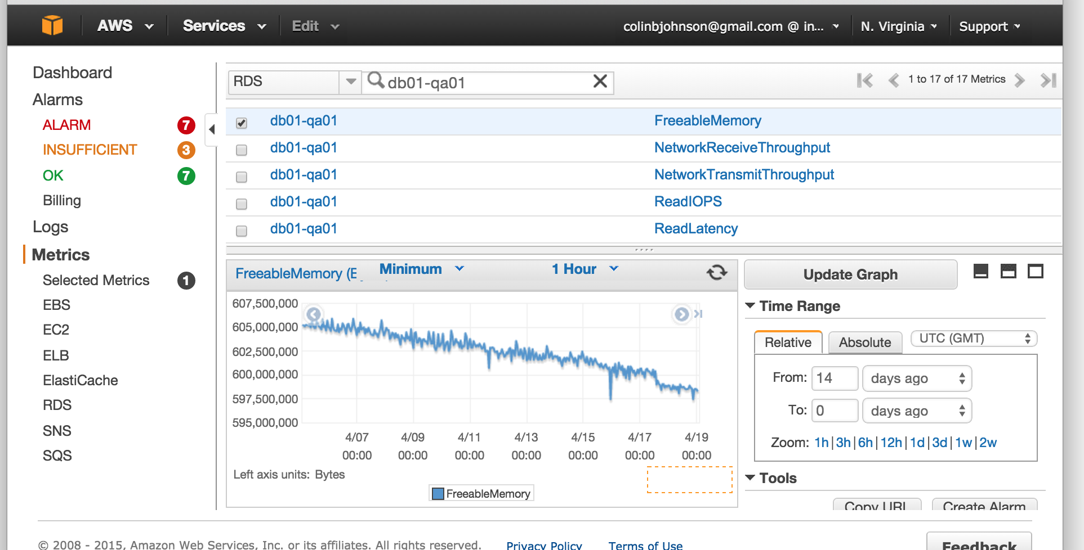
RDS: FreeableMemory Pattern
Notes:
References:
Estimate working set size: http://www.tocker.ca/2013/05/31/estimating-mysqls-working-set-with-information_schema.html

Slide 9
RDS: Practical Experience
I’ve used RDS everywhere I’ve been:
Cost at Ad network was half of AWS spend ($60K/mo)
Thousands of hours of use, few problems
Database restore time periods are hard to predict
Suffered an 10 hour+ RDS outage as result of EBS volumes being unable to be brought online
Choices were “wait it out” or automated snapshot and sacrifice recent data
Notes:
Automatic Backups deleted on RDS Deletion: http://docs.aws.amazon.com/AmazonRDS/latest/UserGuide/USER_WorkingWithAutomatedBackups.html

Slide 10
Labs: Create an RDS Instance
We will:
Create a Security Group for our RDS Instance
Create an RDS Instance
Snapshot our RDS Instance
Change a Parameter Value (max_connections) used by our RDS Instance
Modify the Storage, CPU parameters of our RDS Instance
Notes:
Labs Exercises consist of multiple files:
rds-create-console.docx
rds-snapshot-console.docx
rds-modify-console.docx

