Slide 1

JUKEBOX
B .SRIKRISHNAN

Slide 2
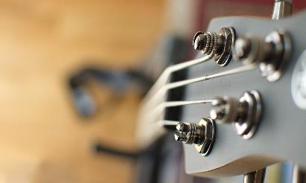


Agenda
Problem Statement
Program Design
Database Creation and Coding
Java8 Features
Points To Improve

Slide 3




introduction
Jukebox is a music playing device used to play a music of the given choice from its stored music.
The jukebox java project aims to create a modern jukebox java program, which can play a song or a podcast of the user’s choice from the list of tracks in the database. Other features include registering users, creating playlists for the user.

Slide 4


Problem Statement
My Understanding of the problem

Slide 5
Songs
Jukebox should contain songs of different genres and by different artists.
The user should be able to search for a song by typing full or part of the song name , artist name or album name.
Allow the user to add the song to an existing playlist or create a new one and add the song.

Slide 6
Podcasts
Podcasts by different celebrities should be available.
Can search a podcast by its entering full or part of the podcast or celebrity name.
Allow the user to podcasts to an existing playlist or create a new playlist and add the podcast to it.
Adding a podcast should add all the episodes in the podcast by date.

Slide 7
Playlists
All the songs and podcasts in the playlist should be displayed upon selection and user should be able to select any track from them.
Must be able to go to the next and previous track in the playlist. Looping and shuffling should also be included .
The time remaining in the track should be displayed. Also user should be able to pause and resume the track playing.

Slide 8
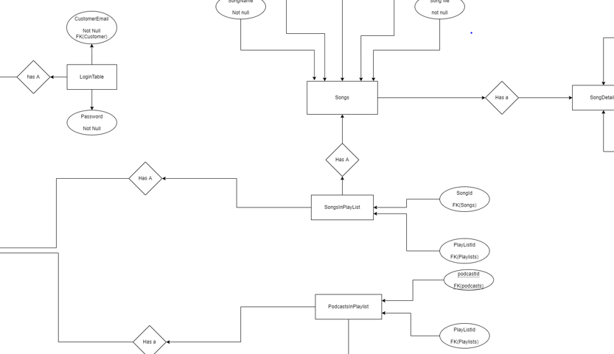
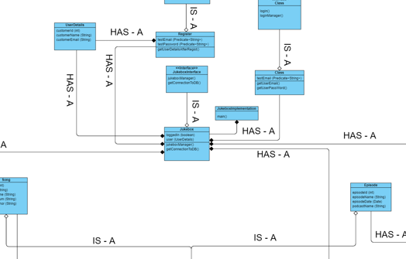
Program design
How should my code work

Slide 9
Database Design
The database stores the songs, podcasts, playlists and user details and is hence the first step in design.
The database should ensure integrity of the data saved and must offer the flexibility to add or remove data.
The database should avoid redundant repetition of rows(should be 3NF normalised ).
The database is designed by using an Entity-Relation diagram, showing how different tables are related in the database.

Slide 10
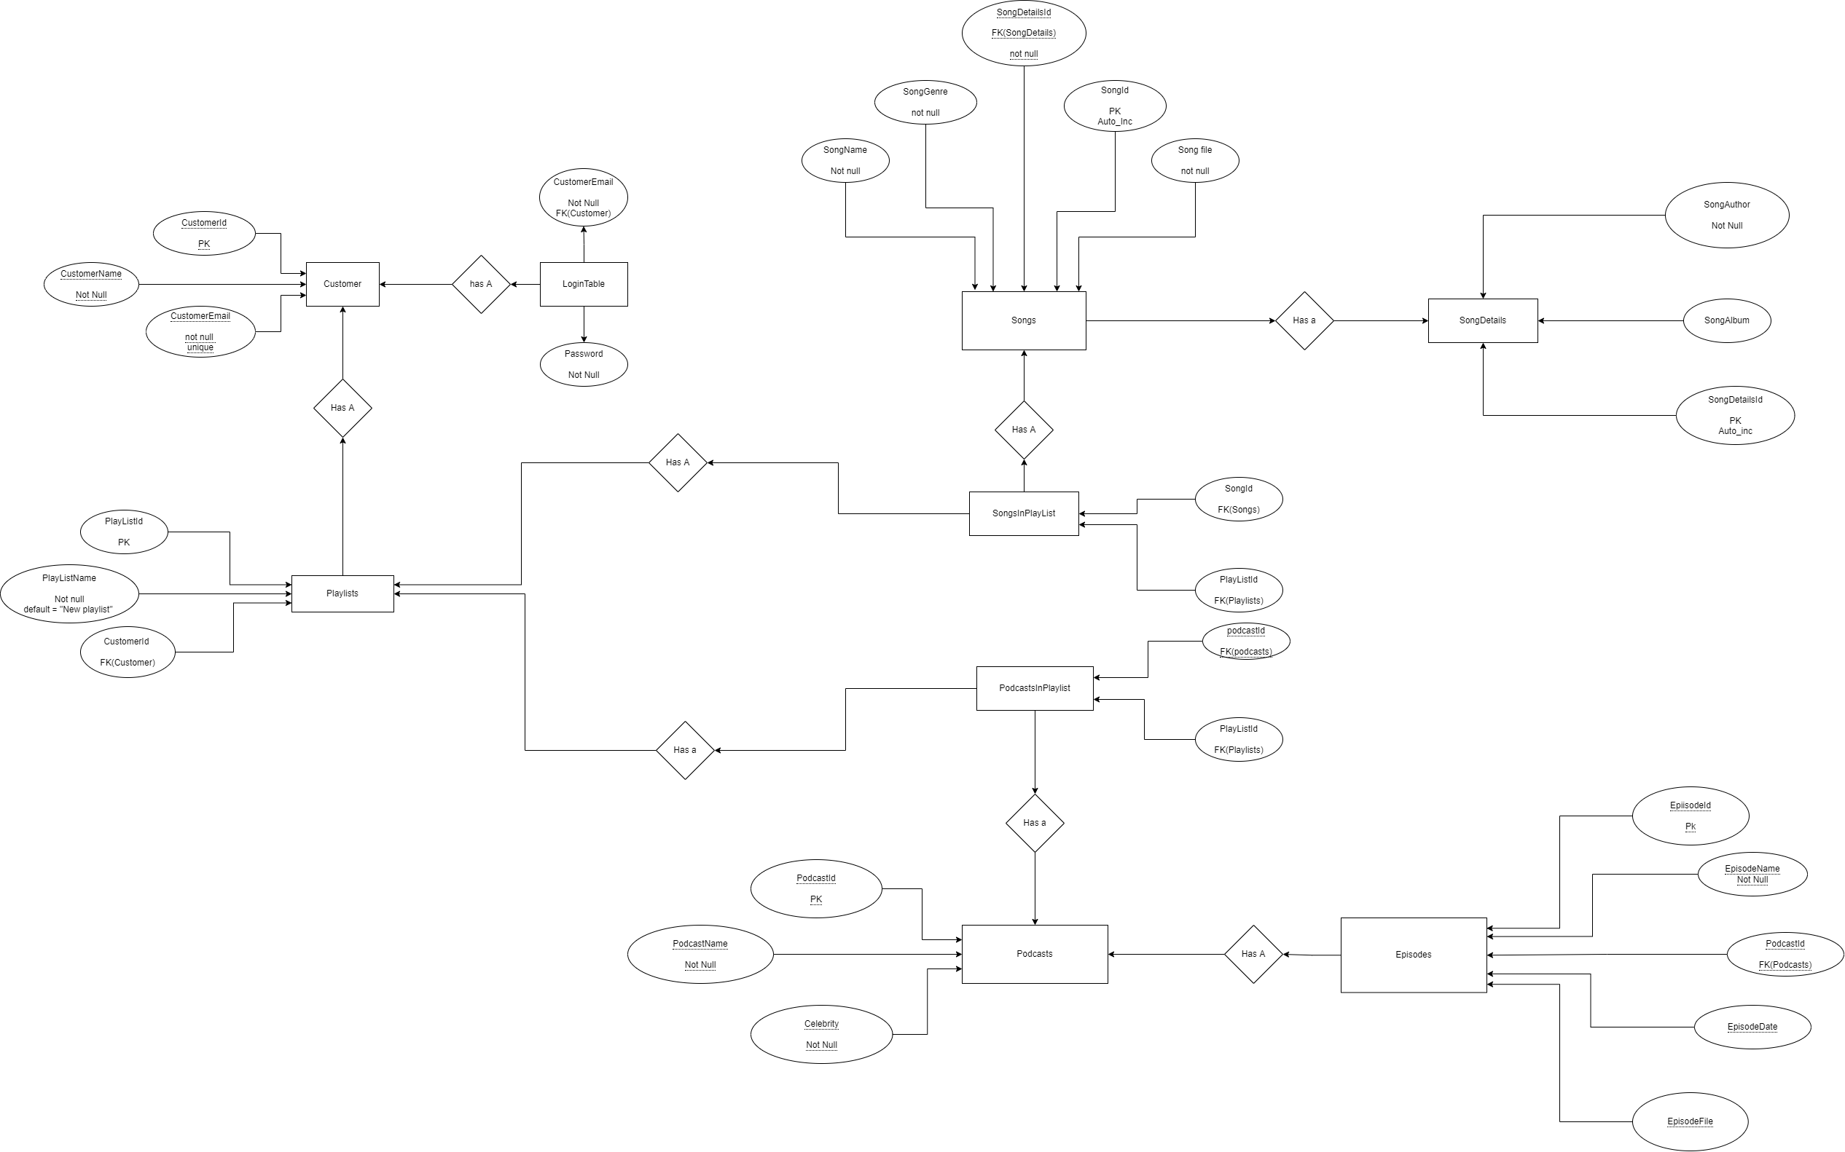
Entity-Relation diagram

Slide 11
Program flow Design
Program flow decides how my program works and what it should do after a particular input or event.
Clean and organised program flow ensures that it is easier to code and the also easier to add new features.
A flow diagram or algorithm can be used to describe the program flow.

Slide 12
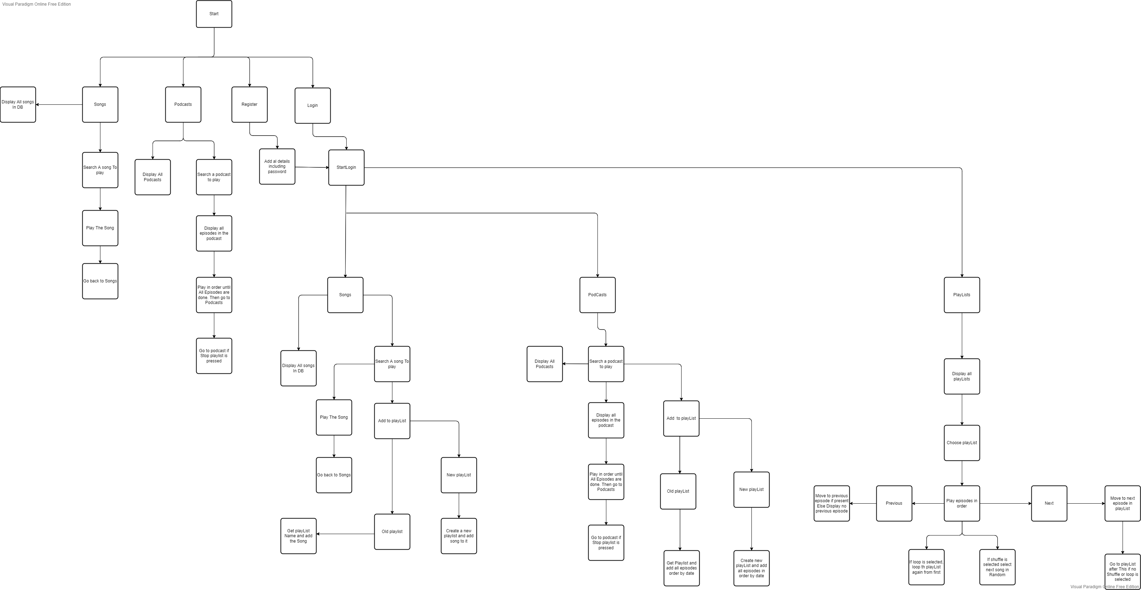
Flow diagram

Slide 13
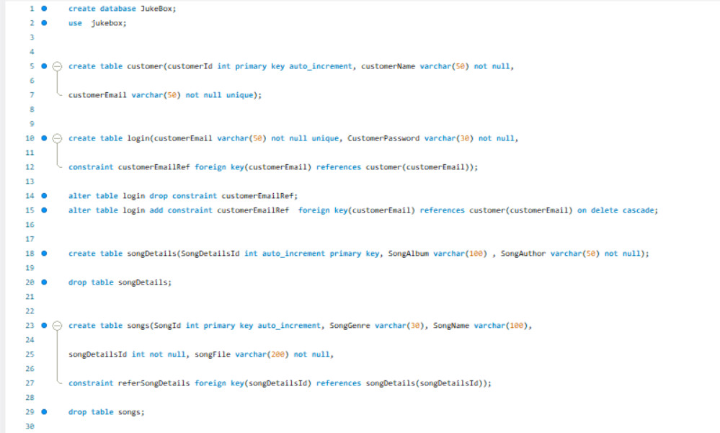
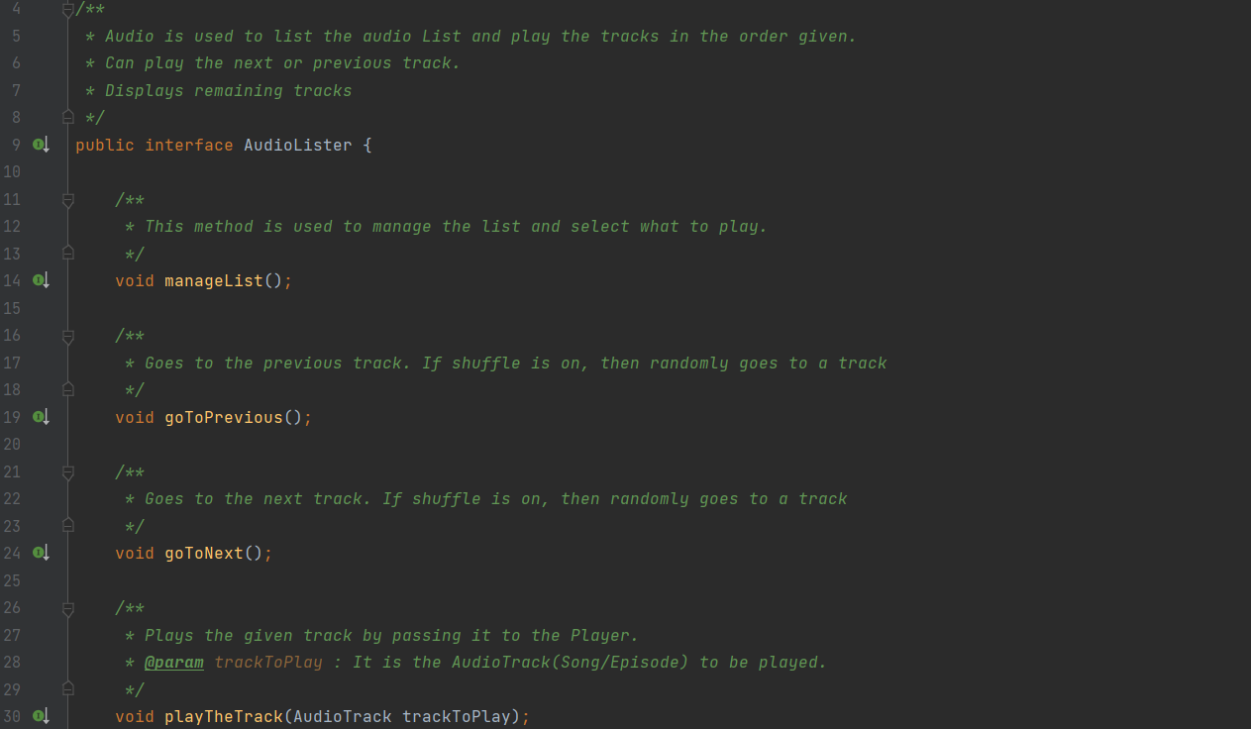
Database Creation and Coding
The fun part

Slide 14
Database Creation
Create the tables in the database using the E.R diagram.
Ensure integrity of data like non- duplicate user email, non-duplicate songs in a playlist.
Test the database by inserting values.
Ensure that the tables are 3NF normalised
(1NF- No duplicate columns (Use primary or composite key) ),
(2NF- non-dependence of irrelevant non primary key attribute on primary key(Separate tables)),
(3NF- non transitive dependence of non primary key attribute on primary key (Use foreign keys)).

Slide 15
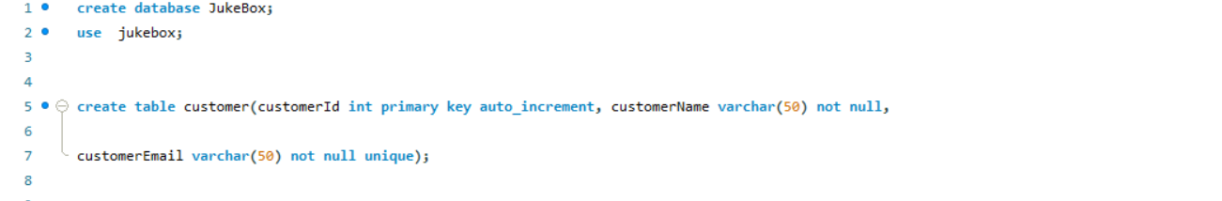
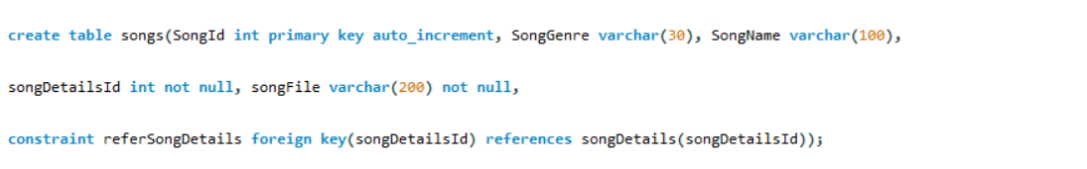
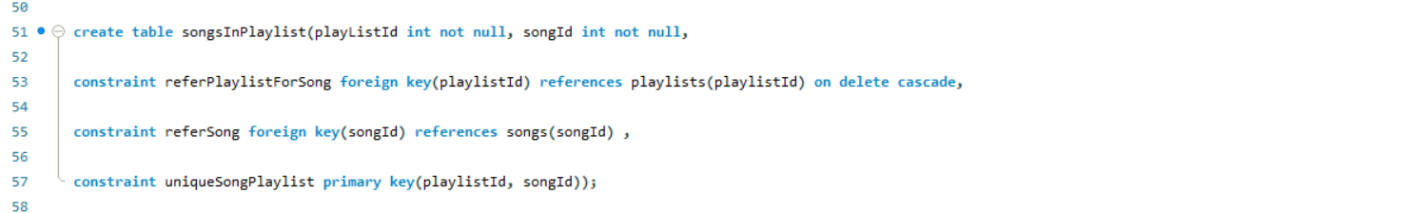
Query Samples

Slide 16
Coding principles USED
The code should follow the SOLID principles of coding to ensure that it is easy to read and update.
The code has been designed following the program flow determined beforehand.
Single-Responsibility principle was used to segregate classes based on its function.
Liskov Substitution principle have been implemented by creating a parent class ‘AudioTrack’, from which any audio file(‘Song’, ‘Episode’) is created as a subclass.
Dependency Inversion principle has been implemented by using Interfaces, to ensure we can change the program by implementing the interface in our new class without losing functionality.

Slide 17
JAVA 8 features used
Java 8 features include collections and lambdas.
Optional has been used to verify whether a value is null.
List has been used to create a list of AudioTracks, which should be played.
Predicate has been used to test values like email or password.
Supplier has been used to get random number for shuffling tracks
Streams have been used to display the songs and podcasts in the playlist.
Consumer has been used to print the track details in the Stream.

Slide 18
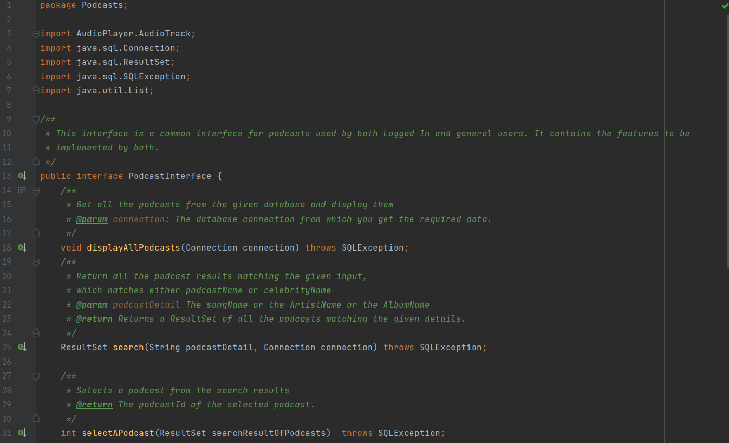
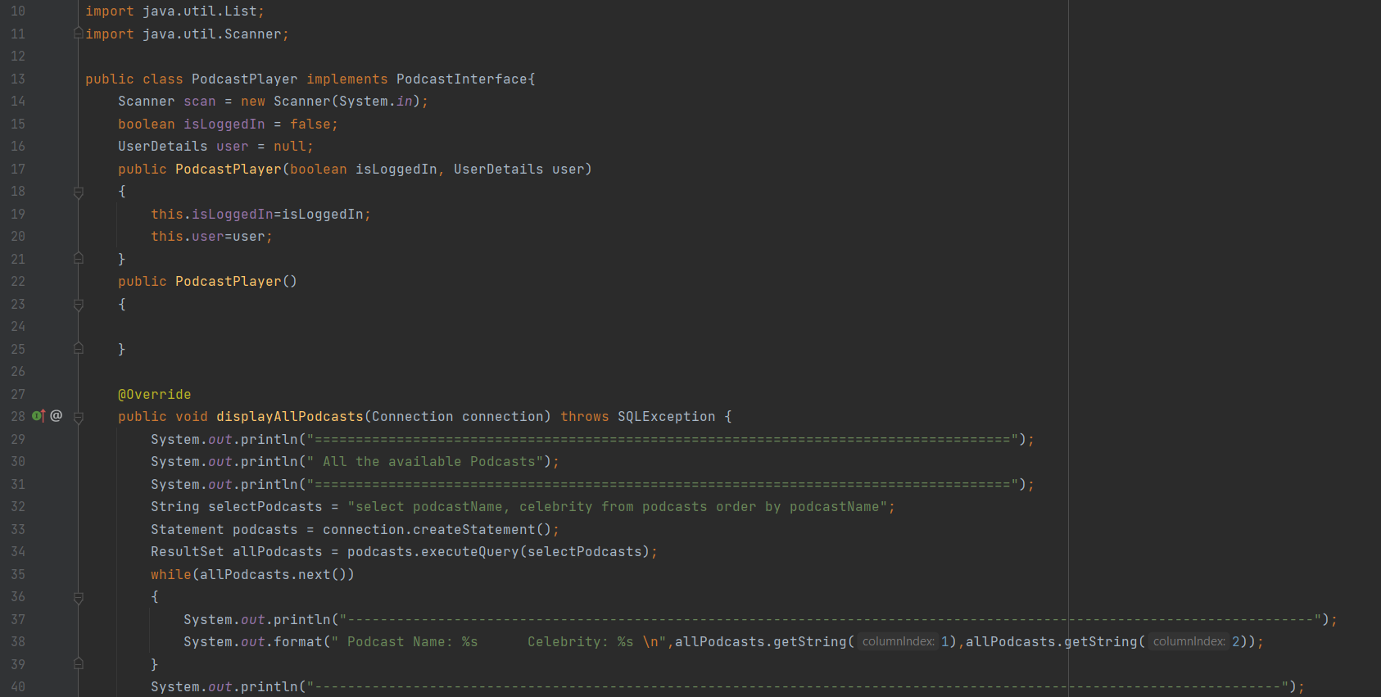
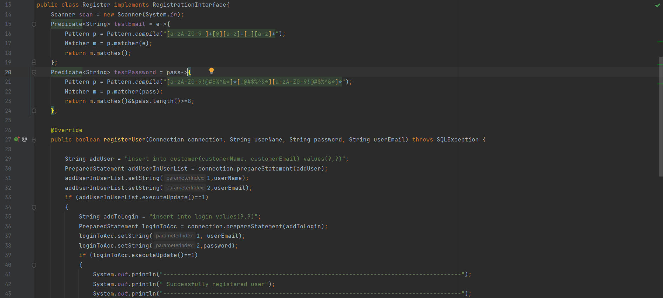
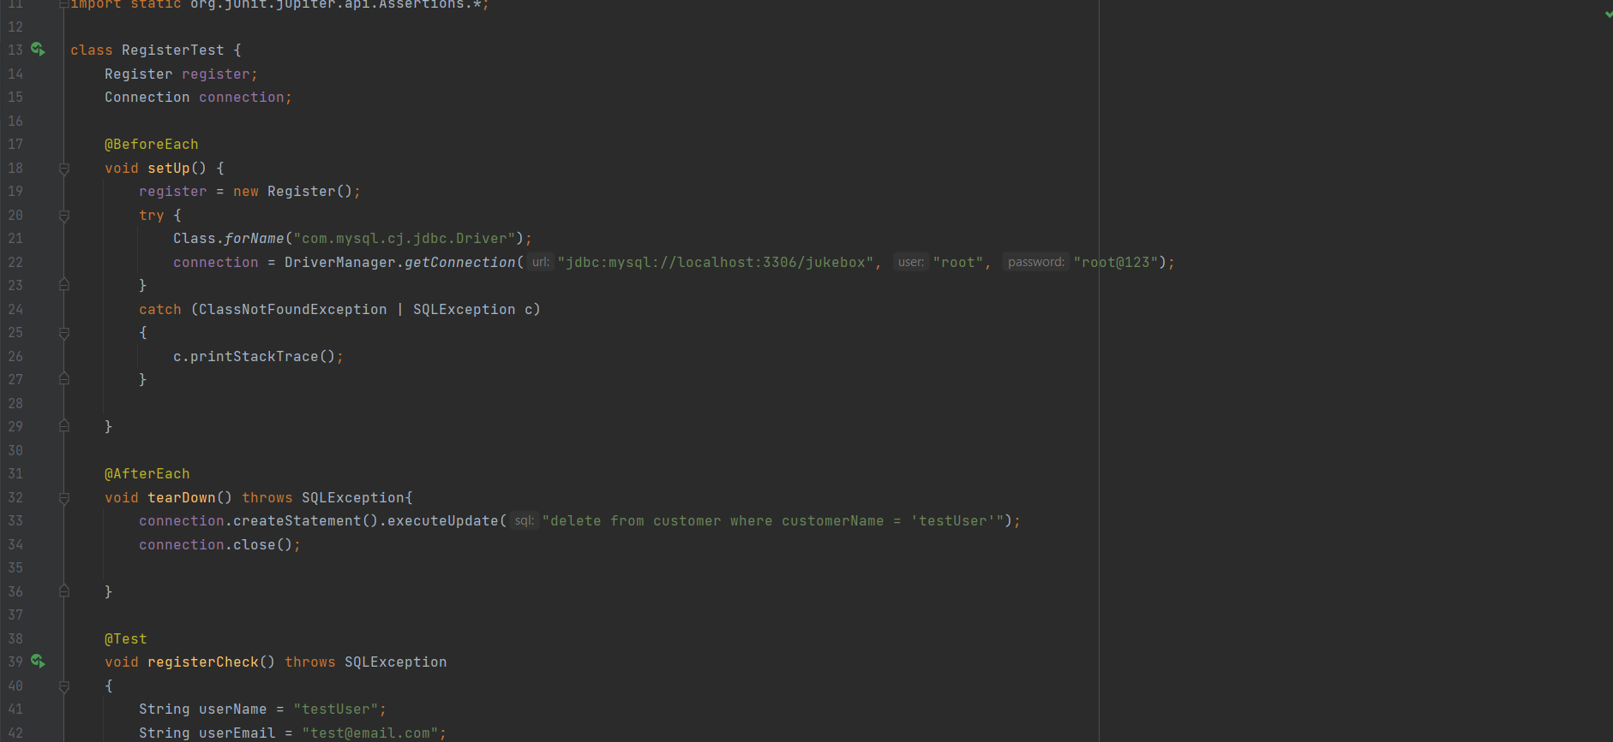
Code Samples

Slide 19
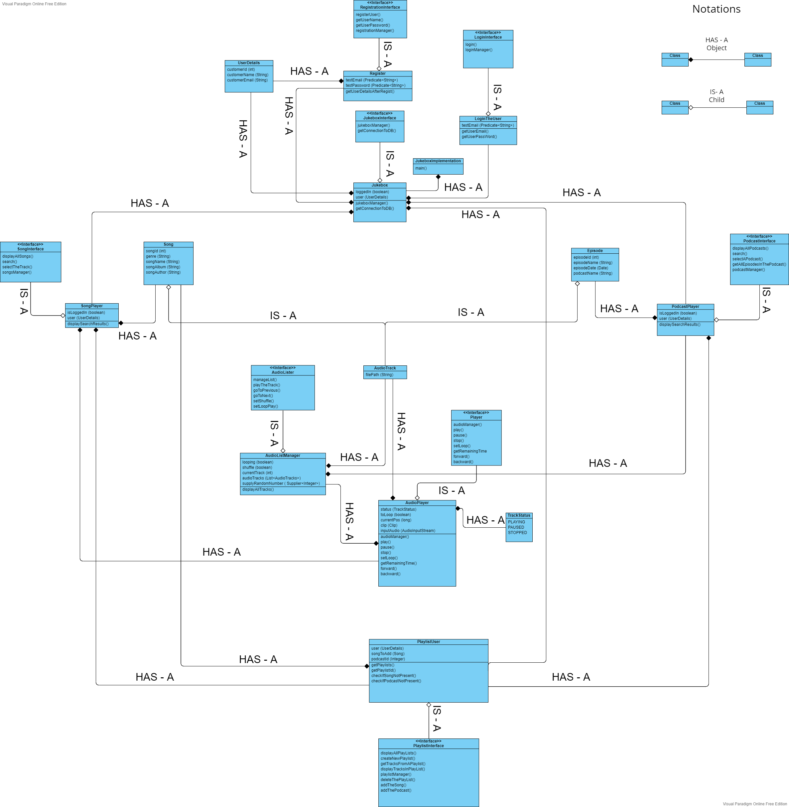
Class diagram

Slide 20
Summary of steps
E.R Diagram
Create E.R diagram for database table structure.
Flow Diagram
Create Flow diagram to analyze and optimize the program flow.
Database
Create tables in the using the E.R diagram and insert data into them.
Code
Test
Write the code referring the flow diagram and following SOLID principles .
Verify the code manually and using test cases.

Slide 21
Points to improve
Can use Interface-segregation principle to ensure that future classes are not forced to implement all the methods in the interface.
This can be done by using functional interfaces.
Can find a way to make the audio track stop upon completion automatically and go back to the previous window.
Can make the program user friendly by reducing the number of steps needed to use a feature like playing a song.

Slide 22

Thank you
B SRIKRISHNAN

