Slide 1
Applications of TM1637 Display ELECTRONICS AND COMMUNICATION DEPARTMENT, SUK
By BHIMASHANKAR (SG20ECE027)

Slide 2
INTRODUCATION
Explore the versatility of the TM1637 4-Digit 7-Segment Display Module in this project, showcasing its applications through step-by-step guides, sample code, and circuit diagrams, inspiring creativity in electronics enthusiasts.
Demonstrating how the TM1637 can be used to showcase real-time data, such as the current time and ambient temperature. We will explore various sensor options to collect this data and then present it on the display in a user-friendly format.
Creating digital counters and timers using the TM1637 display module. This will be useful for applications where event tracking, elapsed time, or countdowns are essential, such as in sports timing, kitchen timers, or data logging.
Unveiling the Potential: Discover Innovative Uses of the TM1637 Display Module in Electronics and Embedded Systems.

Slide 3
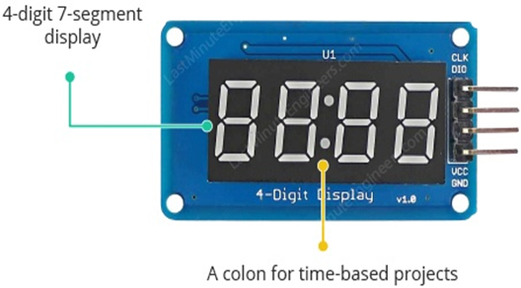
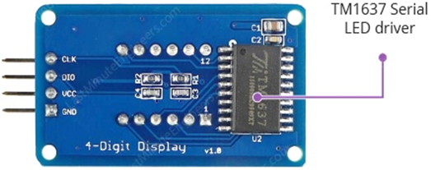
TM1637 4-Digit 7-Segment Display
CLK PIN : A clock input pin. Connect to any digital pin on Arduino.
DIO PIN : A Data I/O pin. Connect to any digital pinon Arduino.
VCC PIN : A pin supplies power to the module. Connect it to the 3.3V to 5V power supply.
GND PIN : A ground pin.

Slide 4
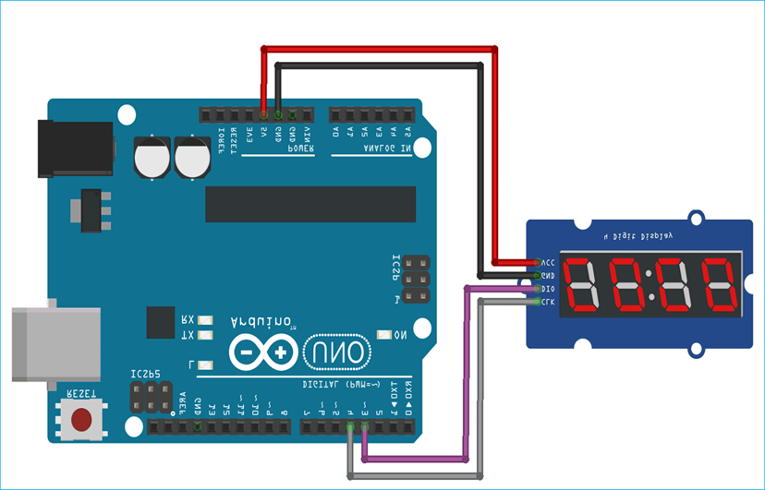
Interfacing of Arduino with tm1637 display
To connect TM1637 display to an Arduino, connect four wires: Two for power lines (3.3V or 5V pin) and two for controlling the display.
The module can be powered from the 3.3V or 5V output of the Arduino. Connect the CLK and DIO pins to any digital pins of Arduino.

Slide 5

EXAMPLE 1: DISPLAYING STRING AND A NUMBER
STEPS,
Initialize Communication
Data Format
Data Transmission
String Display
Number Display

Slide 6
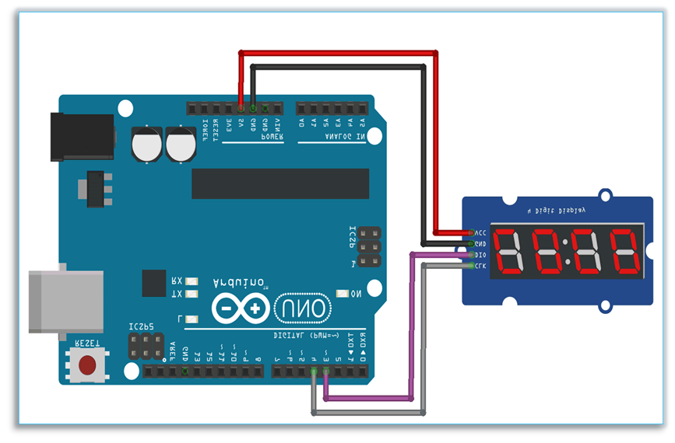
EXAMPLE 2: DISPLAYING SCROLLING AND BLINKING TEXT
STEPS,
Initialize Communication
Data Format
Scrolling Text
Text Display
Display Update Frequency
Looping

Slide 7
EXAMPLE 3: CREATING 4-DIGIT COUNTER
STEPS,
Initialize Communication
Data Format
Counter Logic
Update Display
Send Data
Delay
Looping

Slide 8
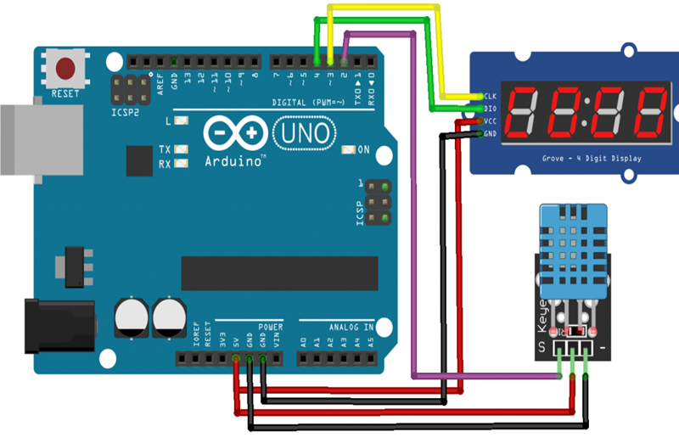
EXAMPLE 4: DISPLAYING TEMPERATURE USING DTH11/22
STEPS,
Initialization
Sensor Setup
Read Temperature
Convert to Fahrenheit: F=(Celsius * 9/5) + 32.
Segment Conversion
Update Display
Loop and Delay

Slide 9
ADVANTAGES AND DISADVANTAGES
DISADVANTAGES
Limited Text Display
Lack of Graphics
Limited Animation
Limited Text Length
Limited Digits
Limited Interactivity
Limited Sensor Integration
Precision and Resolution
ADVANTAGES
Ease of Implementation
High Readability
Low Complexity
Real-Time Updates
Basic Temperature Information
Compact Size
Easy Integration

Slide 10
APPLICATIONS
1. Displaying String and a Number
2. Displaying Scrolling and Displaying Text
3. Creating a 4-Digit Counter
4. Displaying Temperature (°C and F) using DHT11/22
5. Advertising and Promotions
Other Applications

Slide 11
THANK YOU!❤

