Slide 1
ENHANCED DISEASE PREDICTION USING MACHINE LEARNING AND APPOINTMENT BOOKING SYSTEM
Batch No :1
Team Members:
PENNADA KAVYA RASI(16A91A05G3)
PENTAPATI SASMITHA(16A91A05G4)
KESHAB MANNI(16A91A05I6)
HEROJIT NGANGOM(16A91A05E0)
Under the guidance of:
Ms. T. Sudha Rani ,M.Tech(ph.D)
Associate Professor
Department of CSE
Aditya Engineering College (A)
Notes:
Aditya Enginnering College(A)

Slide 2

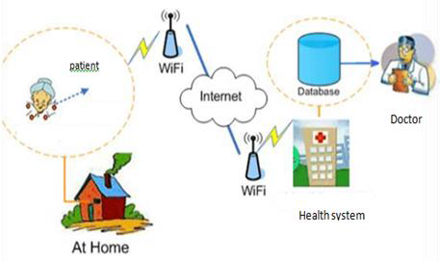
ABSTRACT
Aditya Engineering College (A)
The system allows user to share their symptoms and get result without doctor.
Here we use some supervised machine learning algorithm to guess the most accurate illness that could be associated with patient’s symptoms.
Patients can book appointment for their required time and date as per their convenience.
ENHANCED DISEASE PREDICTION USING MACHINE LEARNING AND APPOINTMENT BOOKING SYSTEM

Slide 3
EXISTING SYSTEM
Aditya Engineering College (A)
In conventional system doctors make the decisions based on their knowledge. Even if they did have access to the massive amounts of data needed to compare treatment outcomes for all the diseases they encounter, they would still need time and expertise to analyze that information and integrate it with the patient's own medical profile. Patient also have to meet doctor personally which can take massive time to reach medical centre.
Drawbacks:
For minor disease also we have to visit doctor.
It may cost lot of time for the patient.
Doctor may not have all the knowledge for every situation.
ENHANCED DISEASE PREDICTION USING MACHINE LEARNING AND APPOINTMENT BOOKING SYSTEM

Slide 4
PROPOSED SYSTEM
Aditya Engineering College (A)
To overcome the drawback of existing system we have developed Enhanced Disease Prediction System. Sometimes the situation occurs when you need the doctor’s help immediately, but they are not available due to some reason. User will be asked to enter the symptoms, then system will processes those symptoms for various illness or disease that user could be matched by using machine learning. Appointments can be booked as per our convenient dates.
Features:
It lowers the cost of visiting doctor for minor disease.
Human error while decision making can be avoided.
It allows the patients to book doctors appointment.
Doctors can get more patients online.
It will be available for anyone and anywhere with internet access.
ENHANCED DISEASE PREDICTION USING MACHINE LEARNING AND APPOINTMENT BOOKING SYSTEM

Slide 5
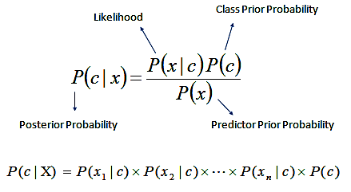
NAIVE BAYES CLASSIFIER
Aditya Engineering College (A)
Bayes’ Theorem finds the probability of an event occurring given the probability of another event that has already occurred. Bayes’ theorem is stated mathematically as the following equation:
where c and x are events and p(x) ? 0.
Basically, we are trying to find probability of event c, given the event x is true. Event x is also termed as evidence.
p(c) is the priori of c (the prior probability, i.e. Probability of event before evidence is seen). The evidence is an attribute value of an unknown instance(here, it is event x).
p(c | x) is a posteriori probability of x, i.e. probability of event after evidence is seen.
ENHANCED DISEASE PREDICTION USING MACHINE LEARNING AND APPOINTMENT BOOKING SYSTEM

Slide 6
NAIVE BAYES CLASSIFIER
Aditya Engineering College (A)
Start
Analyze the training dataset, summarize the properties so that it is easy to calculate probabilities and make predictions.
By using summaries of the dataset to generate a single prediction.
Generate predictions given dataset and summarized training dataset.
Evaluate the probability of predictions made for a test dataset as the percentage correct out of all predictions.
The top three diseases having higher than 20%(0.2) probability will be showed.
For each input attribute
Find its probability against all output
Multiply all the probabilities w.r.t each attributes
Select the maximum value of probability
Attributes will belong to class variable with maximum value
End
ENHANCED DISEASE PREDICTION USING MACHINE LEARNING AND APPOINTMENT BOOKING SYSTEM

Slide 7
MODULES
Aditya Engineering College (A)
Patient:
Login
Predict disease
Book Appointments
View Appointments
Update details
Change Password
Search Disease overview
Doctor:
Login
View Appointments
Update details
Change Password
Admin:
Login
Add and delete Doctor and Patient
Upload training and testing dataset files
Manage Bookings
ENHANCED DISEASE PREDICTION USING MACHINE LEARNING AND APPOINTMENT BOOKING SYSTEM

Slide 8
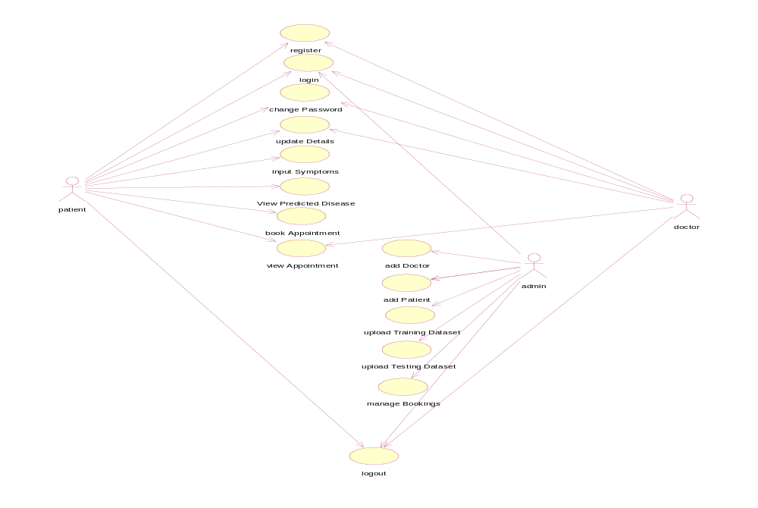
UML DIAGRAMS
Aditya Engineering College (A)
    Use Case Diagram For Entire System
ENHANCED DISEASE PREDICTION USING MACHINE LEARNING AND APPOINTMENT BOOKING SYSTEM

Slide 9
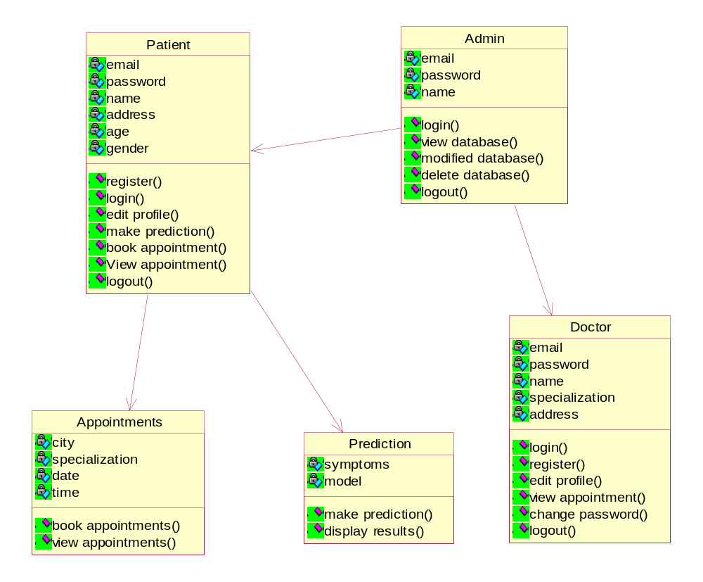
Class Diagram For Entire System
Aditya Engineering College (A)
ENHANCED DISEASE PREDICTION USING MACHINE LEARNING AND APPOINTMENT BOOKING SYSTEM

Slide 10
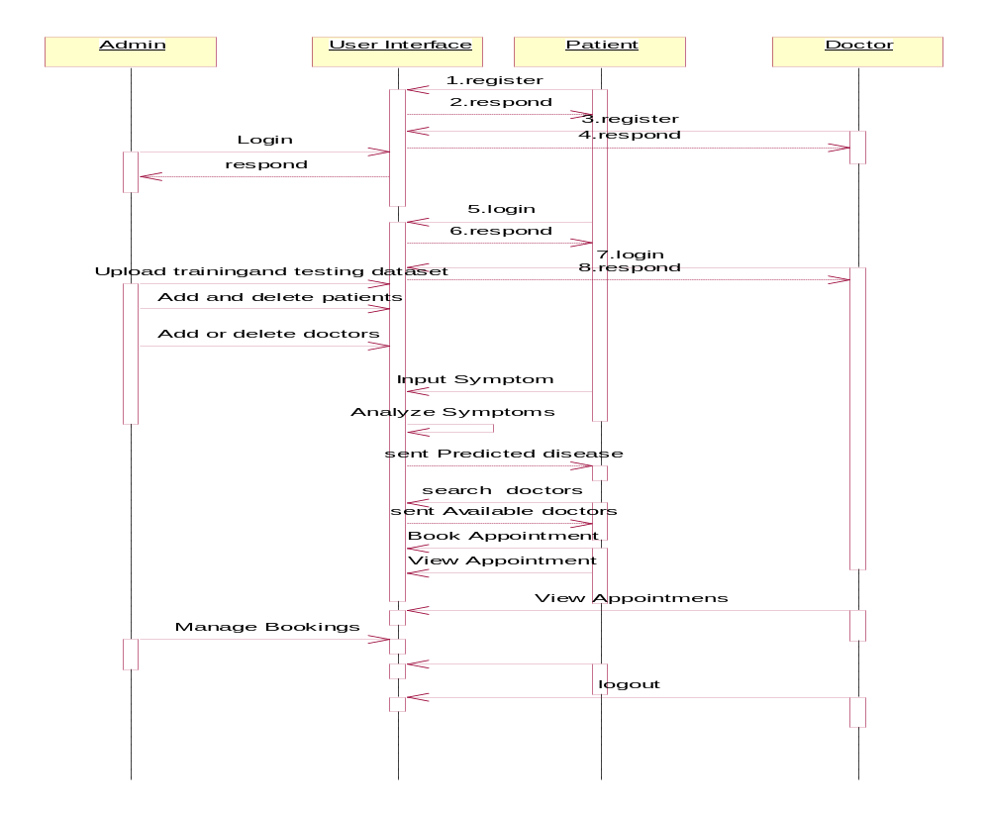
Sequence Diagram For Entire System
Aditya Engineering College (A)
ENHANCED DISEASE PREDICTION USING MACHINE LEARNING AND APPOINTMENT BOOKING SYSTEM

Slide 11
TECHNOLOGIES USED
Aditya Engineering College (A)
OS: Windows 10
Platform: PyCharm, Google Chrome
Language: Python(v 3.8)
Server/Database: Django Framework
Libraries: NumPy, Pandas, Scikit-learn, navigator.geolocation
API: https://api/opencagedata.com/geocode/v1/json (reverse-geocoding)
News Feed: Google news with RSS Feed
ENHANCED DISEASE PREDICTION USING MACHINE LEARNING AND APPOINTMENT BOOKING SYSTEM

Slide 12
MODULES AND PACKAGES
Aditya Engineering College (A)
NumPy: It is an open source python package for scientific computing. NumPy supports large multi dimensional arrays and matrices. NumPy is written in python and c. NumPy arrays are faster compared to python lists.
Pandas: It is an open source library that allows to you perform data manipulation in python. Pandas library is built on top of NumPy.
Scikit-Learn: It is a free software machine learning library for the python programming-language. It features various classification, regression and clustering algorithms
ENHANCED DISEASE PREDICTION USING MACHINE LEARNING AND APPOINTMENT BOOKING SYSTEM

Slide 13
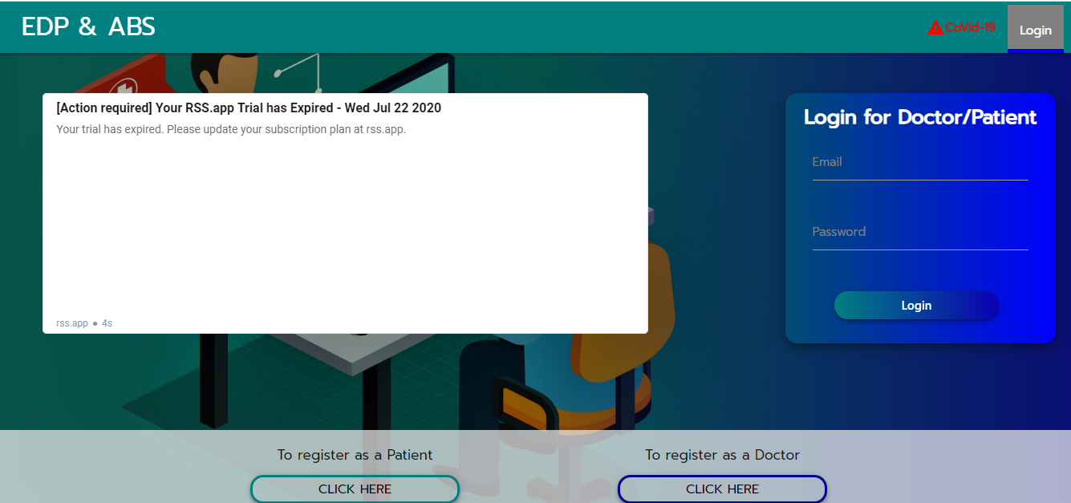
HOME PAGE
Aditya Engineering College (A)
ENHANCED DISEASE PREDICTION USING MACHINE LEARNING AND APPOINTMENT BOOKING SYSTEM

Slide 14
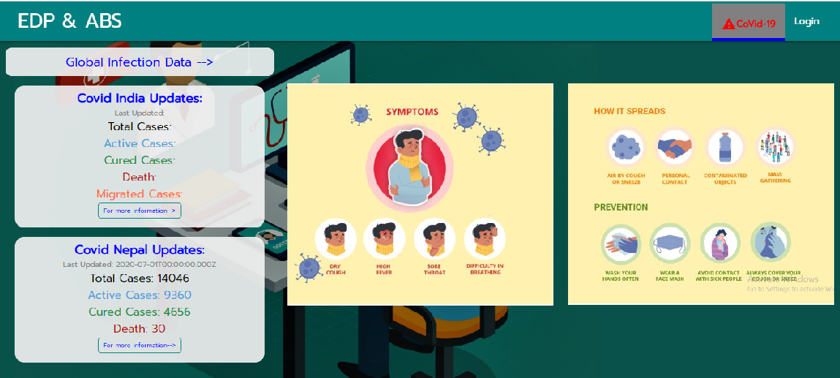
COVID-19
Aditya Engineering College (A)
ENHANCED DISEASE PREDICTION USING MACHINE LEARNING AND APPOINTMENT BOOKING SYSTEM

Slide 15
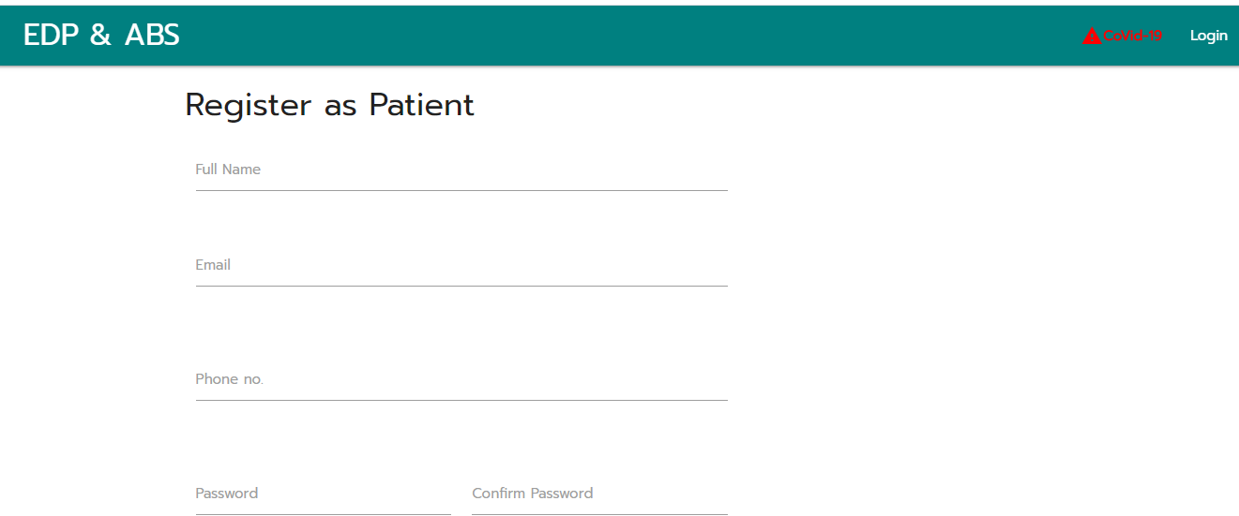
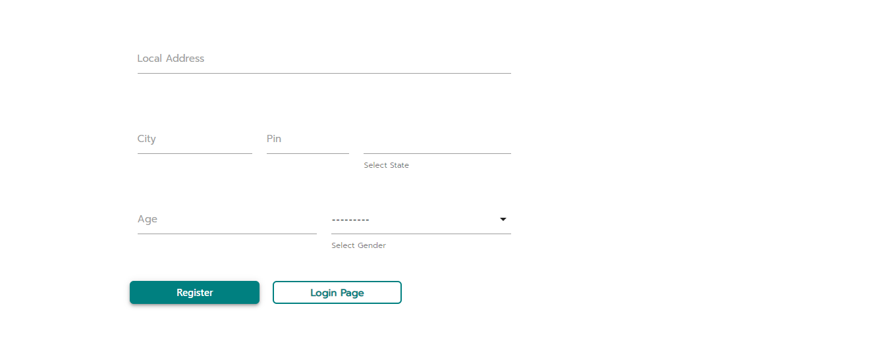
Patient Registration Form
Aditya Engineering College (A)
ENHANCED DISEASE PREDICTION USING MACHINE LEARNING AND APPOINTMENT BOOKING SYSTEM

Slide 16
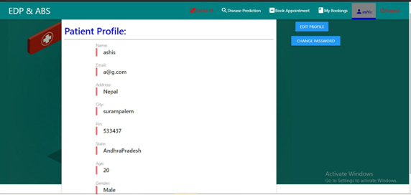
Patient Profile View
Aditya Engineering College (A)
ENHANCED DISEASE PREDICTION USING MACHINE LEARNING AND APPOINTMENT BOOKING SYSTEM

Slide 17
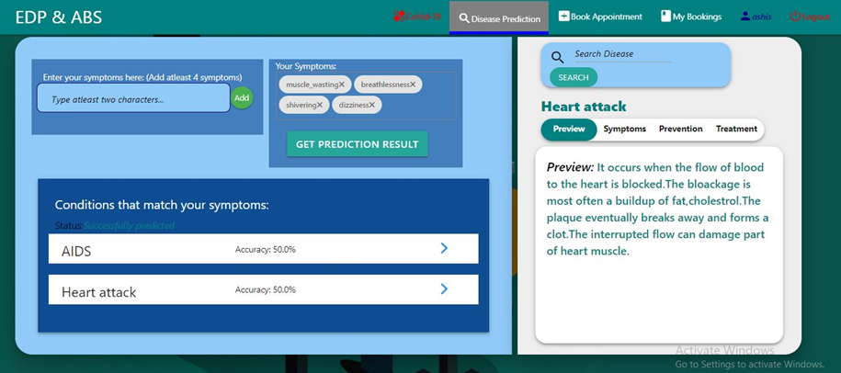
Predicting Disease By Their Symptoms
Aditya Engineering College (A)
ENHANCED DISEASE PREDICTION USING MACHINE LEARNING AND APPOINTMENT BOOKING SYSTEM

Slide 18
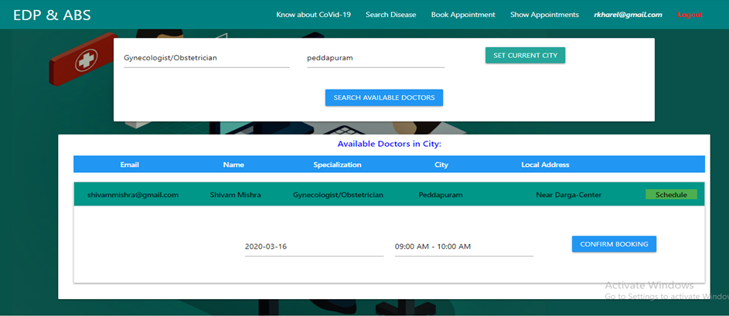
Book Appointment
Aditya Engineering College (A)
ENHANCED DISEASE PREDICTION USING MACHINE LEARNING AND APPOINTMENT BOOKING SYSTEM

Slide 19
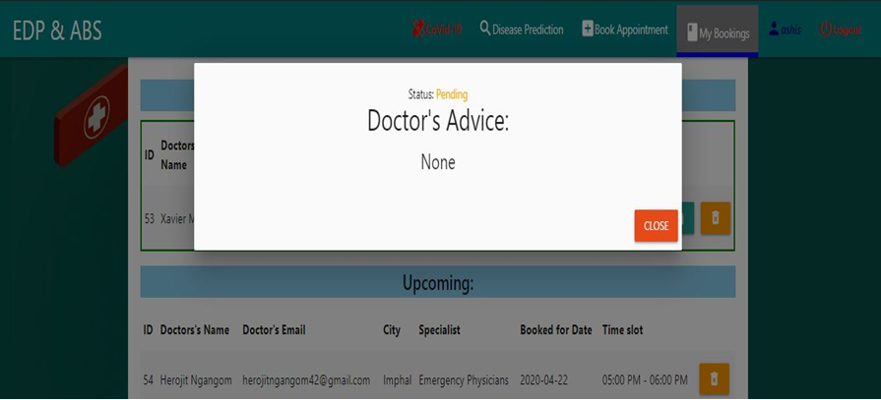
Appointment Status For Patient
Aditya Engineering College (A)
ENHANCED DISEASE PREDICTION USING MACHINE LEARNING AND APPOINTMENT BOOKING SYSTEM

Slide 20
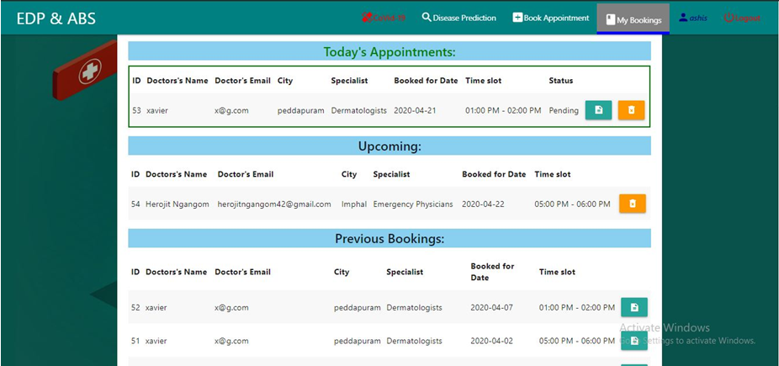
Appointment Details View For Patient
Aditya Engineering College (A)
ENHANCED DISEASE PREDICTION USING MACHINE LEARNING AND APPOINTMENT BOOKING SYSTEM

Slide 21
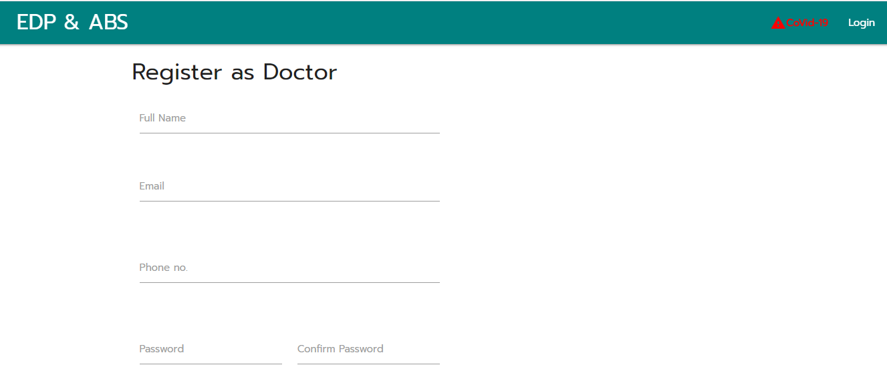
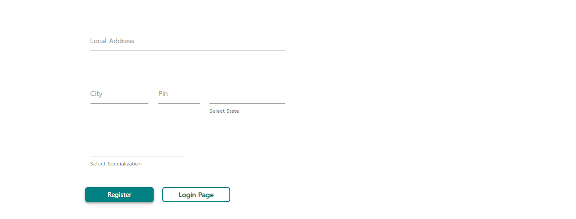
Registration Page For Doctors
Aditya Engineering College (A)
ENHANCED DISEASE PREDICTION USING MACHINE LEARNING AND APPOINTMENT BOOKING SYSTEM

Slide 22
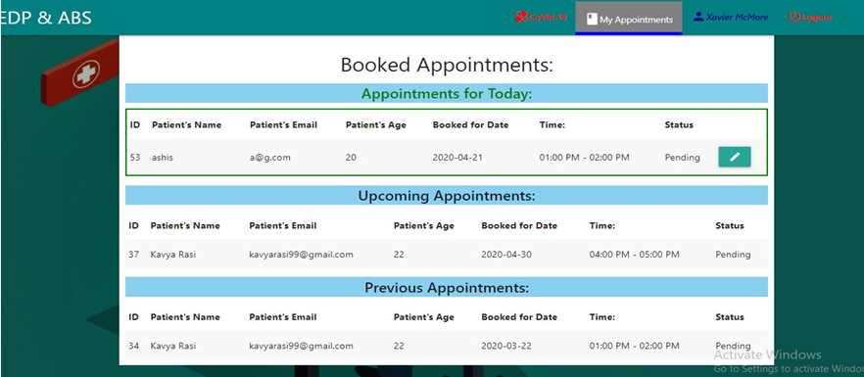
Patient Appointment Booking Details
View For Doctors
Aditya Engineering College (A)
ENHANCED DISEASE PREDICTION USING MACHINE LEARNING AND APPOINTMENT BOOKING SYSTEM

Slide 23
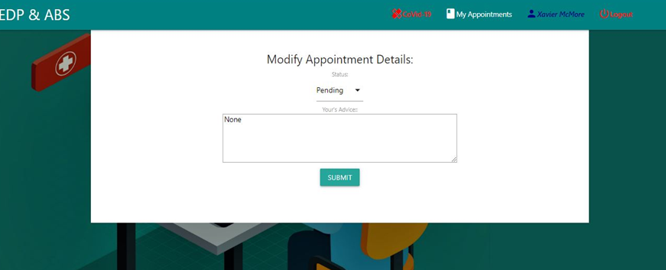
Modify Appointment Details page
For Doctors
Aditya Engineering College (A)
ENHANCED DISEASE PREDICTION USING MACHINE LEARNING AND APPOINTMENT BOOKING SYSTEM

Slide 24
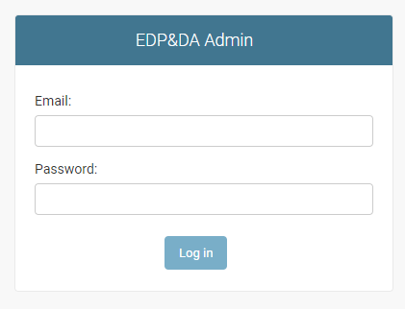
Admin Page
Aditya Engineering College (A)
ENHANCED DISEASE PREDICTION USING MACHINE LEARNING AND APPOINTMENT BOOKING SYSTEM

Slide 25
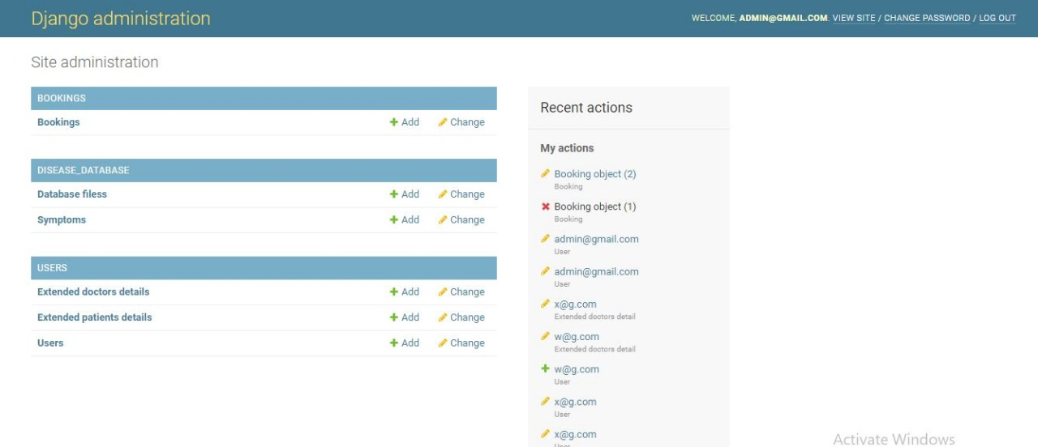
Main Admin Dash Board
Aditya Engineering College (A)
ENHANCED DISEASE PREDICTION USING MACHINE LEARNING AND APPOINTMENT BOOKING SYSTEM

Slide 26
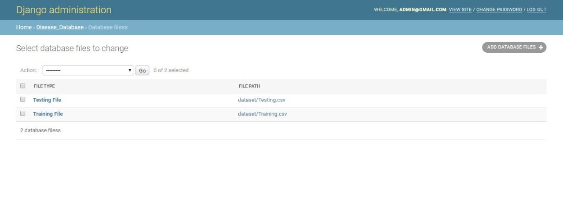
Datasets Files Pages
Aditya Engineering College (A)
ENHANCED DISEASE PREDICTION USING MACHINE LEARNING AND APPOINTMENT BOOKING SYSTEM

Slide 27
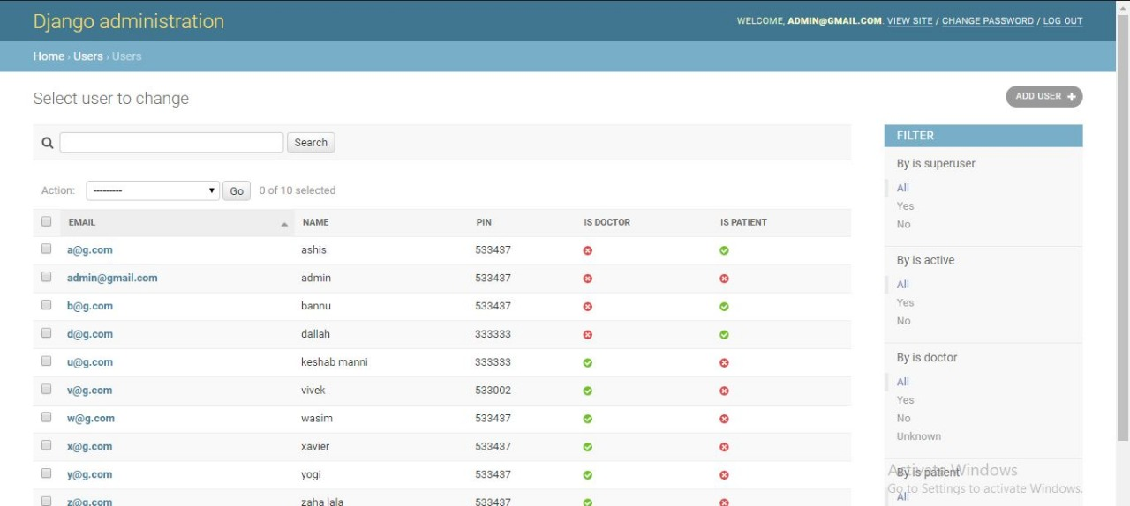
Users Table Page
Aditya Engineering College (A)
ENHANCED DISEASE PREDICTION USING MACHINE LEARNING AND APPOINTMENT BOOKING SYSTEM

Slide 28
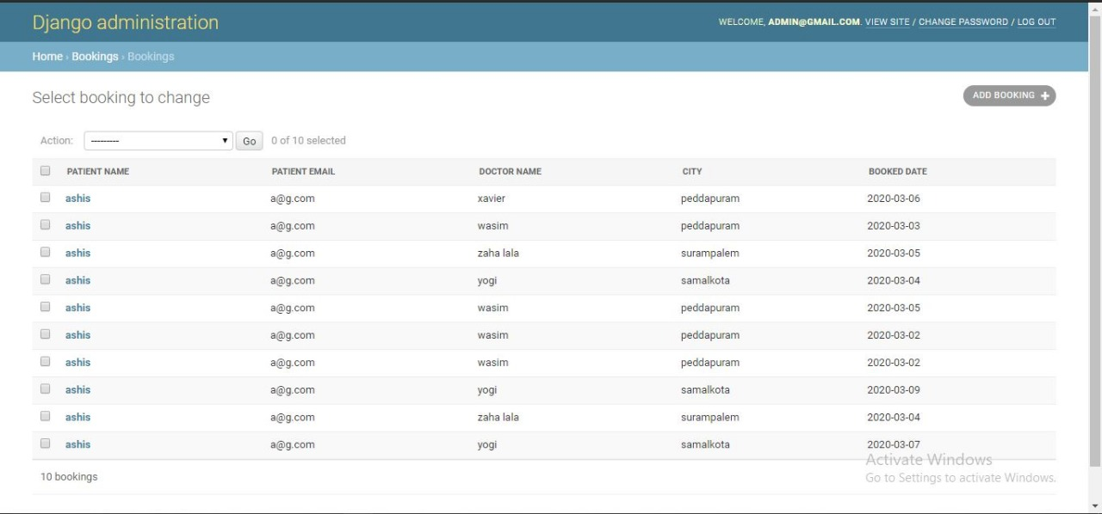
Bookings Table Page
Aditya Engineering College (A)
ENHANCED DISEASE PREDICTION USING MACHINE LEARNING AND APPOINTMENT BOOKING SYSTEM

Slide 29
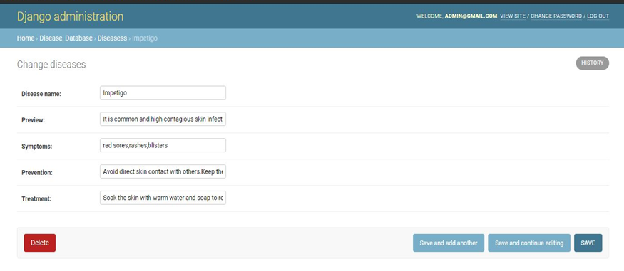
Disease Information Page
Aditya Engineering College (A)
ENHANCED DISEASE PREDICTION USING MACHINE LEARNING AND APPOINTMENT BOOKING SYSTEM

Slide 30
REFERENCES
Aditya Engineering College (A)
Smart Health Care System Using Data Mining” by Subasish Mohapatra(Department of Computer Science and Engineering, College of Engineering and Technology, Bhubaneswar, India ).
Min Chen, Yixue Haol, Kai Hwang, Lu Wangi and Lin Wang, "Disease detection by Machine Learning Over Big Data From Healthcare Communities," IEEE 2017,vol.19,no.2,pp.171-209.
Http://nevoprojects.com/smart-health-prediction-using-data-mining-php/
ENHANCED DISEASE PREDICTION USING MACHINE LEARNING AND APPOINTMENT BOOKING SYSTEM

Slide 31
CONCLUSION
Aditya Engineering College (A)
In the proposed system, hidden knowledge will be extracted from the historical data by preparing datasets by applying Machine Learning algorithm.
Sometimes the situation occurs when you need the doctor’s help immediately, but they are not available due to some reason. In our project, we have designed a new health prediction system, which is an online system, and various patients from any locations can view it.
ENHANCED DISEASE PREDICTION USING MACHINE LEARNING AND APPOINTMENT BOOKING SYSTEM

Slide 32
Aditya Engineering College (A)
ANY QUERIES?
ENHANCED DISEASE PREDICTION USING MACHINE LEARNING AND APPOINTMENT BOOKING SYSTEM

Slide 33
Aditya Engineering College (A)
THANK YOU !!!
ENHANCED DISEASE PREDICTION USING MACHINE LEARNING AND APPOINTMENT BOOKING SYSTEM

