Slide 1
AdaBoost
Presented by Group 7
Bruce, Travis, Vivien

Slide 2
Introduction
Boosting algorithms combine multiple low accuracy(or weak) models to create a high accuracy(or strong) models.
Boosting algorithms such as AdaBoost(adaptive boosting), Gradient Boosting, and XGBoost are widely used machine learning algorithms.
AdaBoost is adaptive in the sense that subsequent weak learners are tweaked in favor of those instances misclassified by previous classifiers.

Slide 3
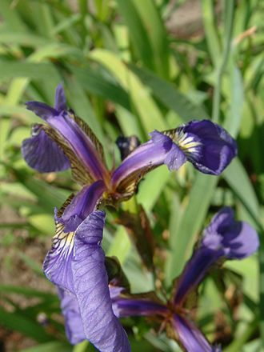
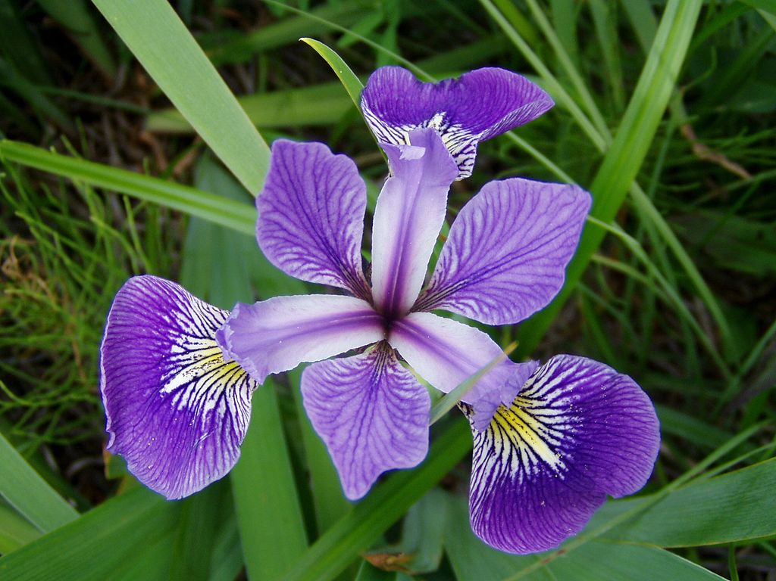
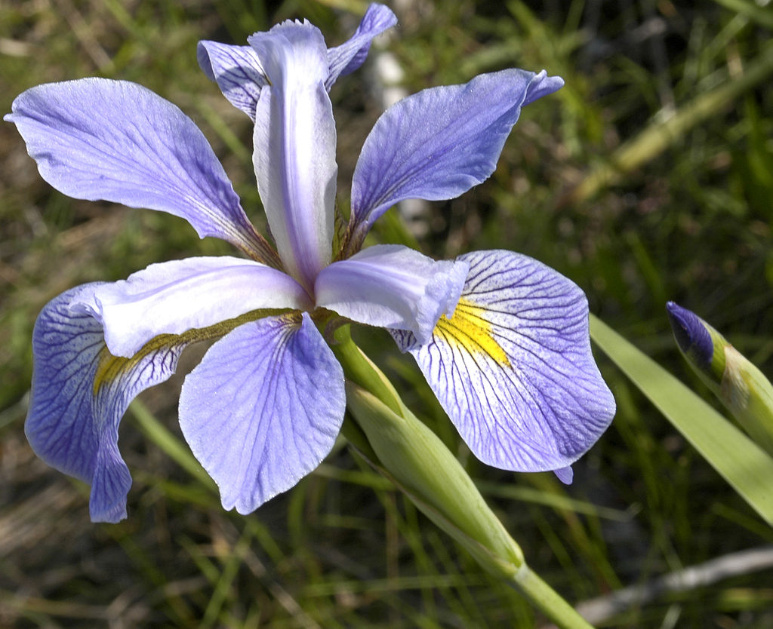
Dataset Introduction
We use Iris as our dataset.
The data set consists of 50 samples from each of three species of Iris (Iris setosa, Iris virginica and Iris versicolor). Four features were measured from each sample: the length and the width of the sepals and petals, in centimeters.
setosa
versicolor
virginica

Slide 4

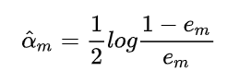

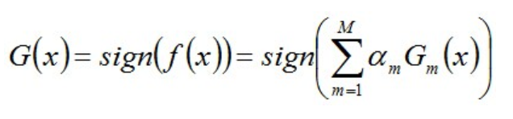
How To Do AdaBoost
1. Initialize the observation weights w_{i} = 1/N, i = 1,2,…,N.
2. For m = 1 to M:
（a）Fit a classifier G_{m}(x) to the training data using weights w_{i.}
（b）Compute
（c）Compute
（d）Update
3. Output G(x)

Slide 5




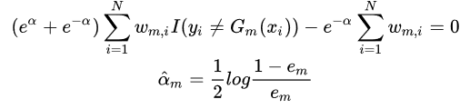

Math Logic
Final model expression of the AdaBoost：
additive
model
Optimization goal of the AdaBoost：
Substitute the exponential loss function：
For any alpha>0,we can get the Gm(x) as：
To get alpha,we expand the optimization goal and derive alpha and make the derivative 0：

Slide 6
Code Logic
cross_val_score package and load_iris package
Implement Adaboost:
calculateAlpha (error)
updateWeight (alpha, originalWeight, y, g)
sign (value)
predict (x, alpha, featureValue)
findBestCut (dataset, target, weights)
adaBoost (dataset, target, weakClassifierNo)

Slide 7
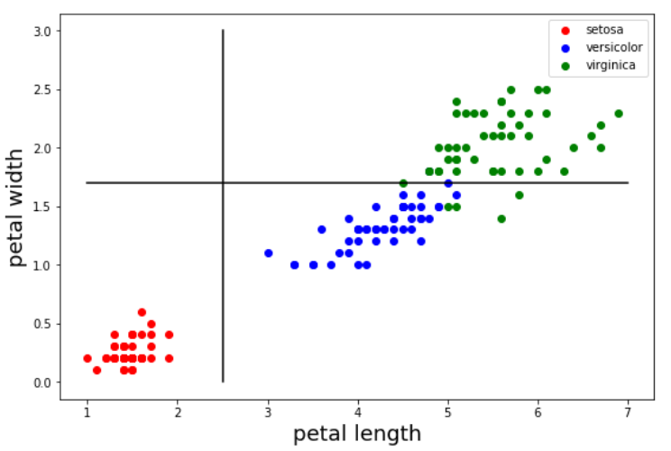
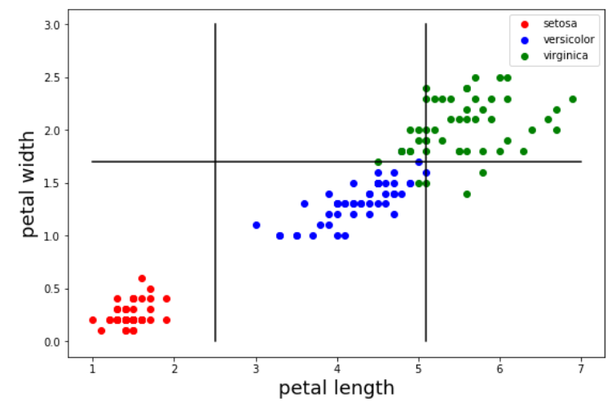
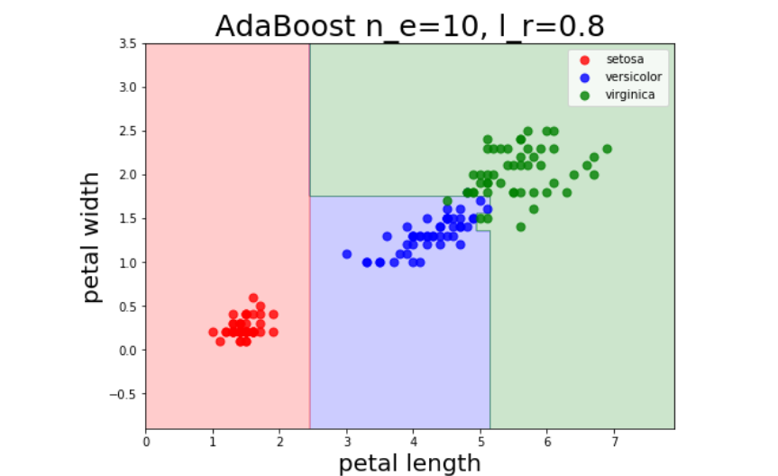
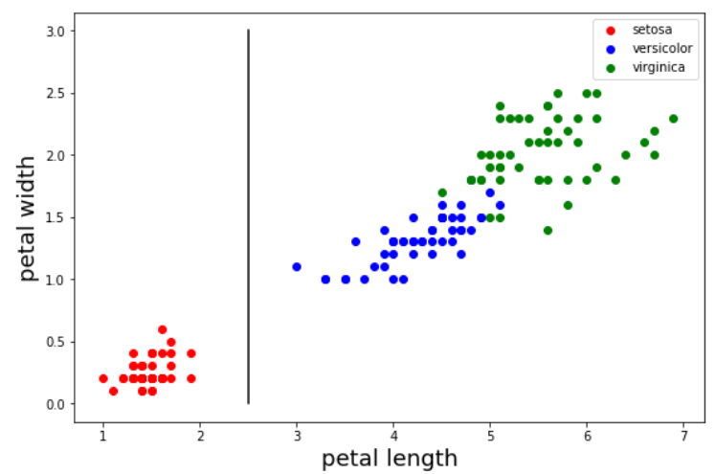
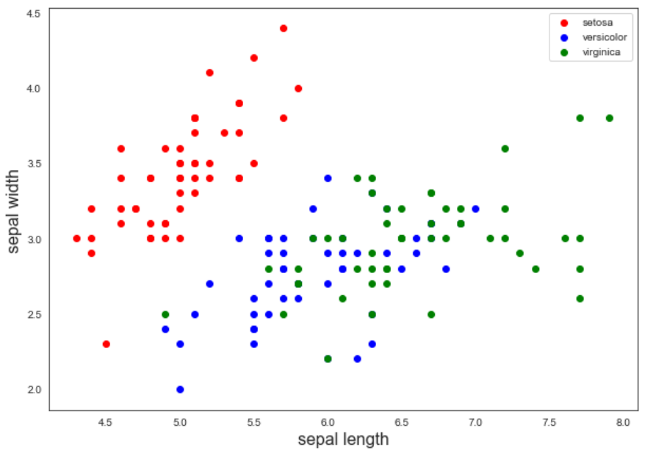
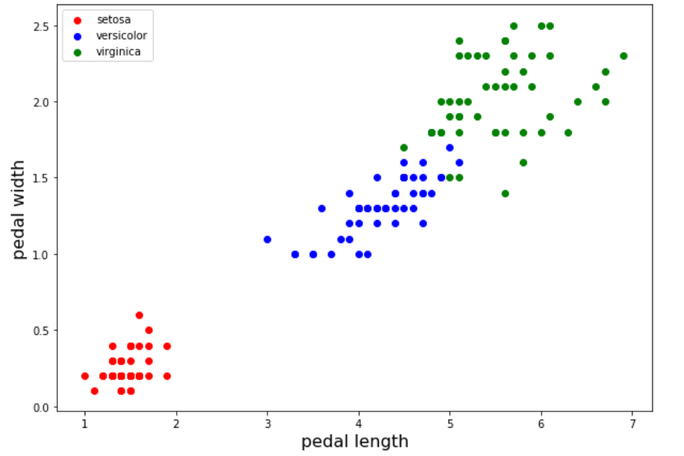
AdaBoost

Slide 8
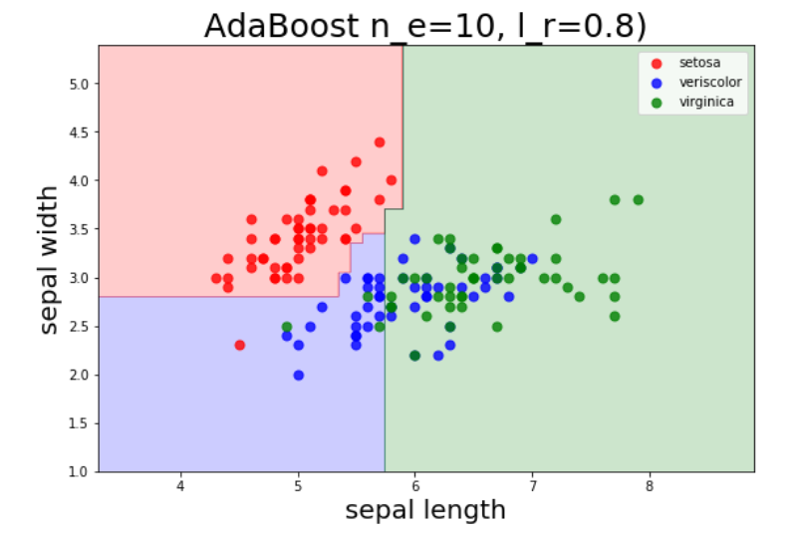
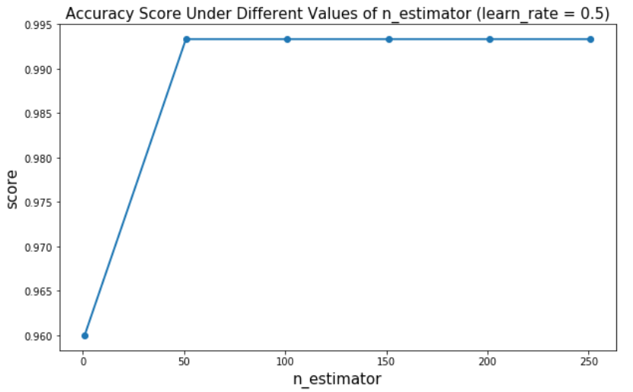
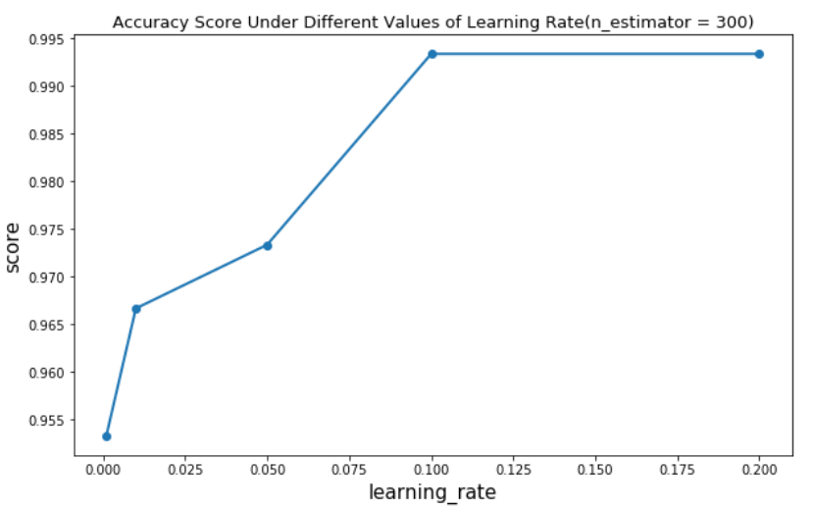
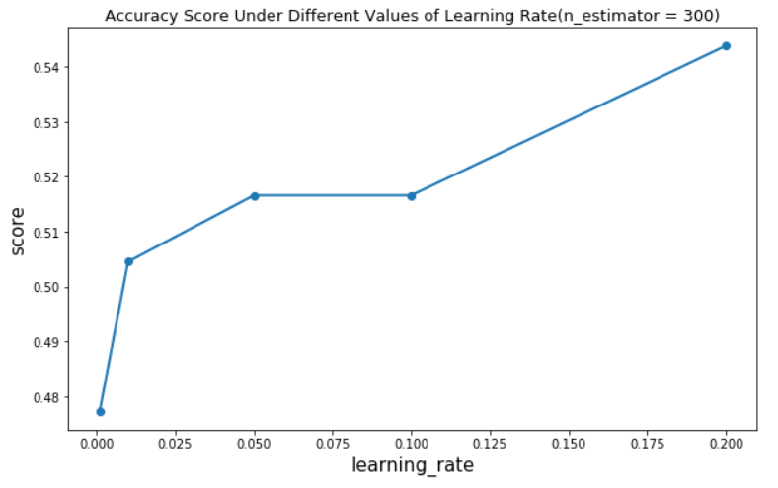
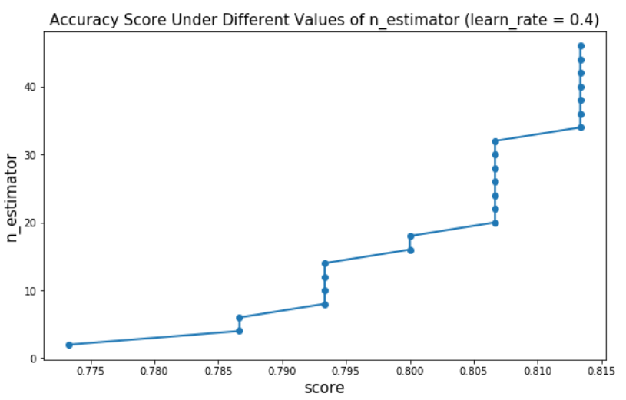
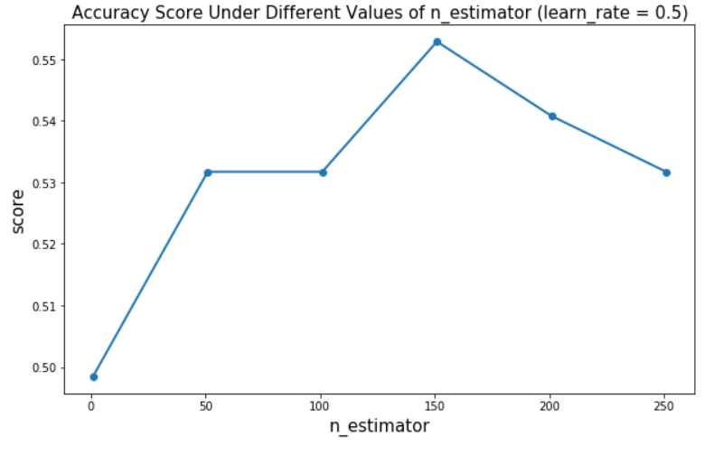
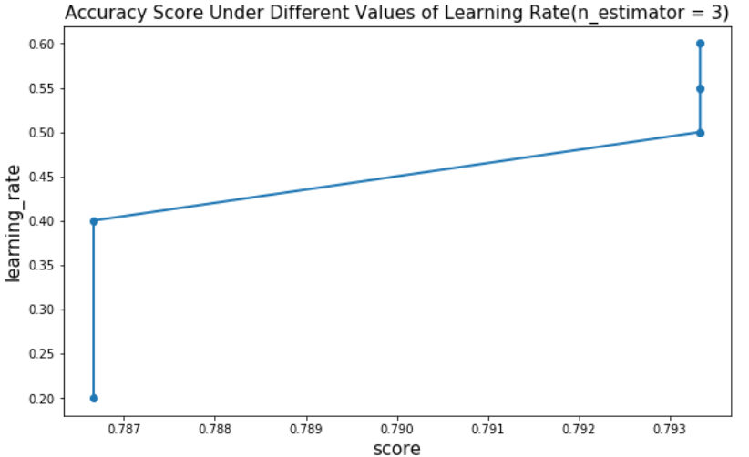
Accuracy Score of AdaBoost
Question: How do n_estimator and learning rate influence the performance of AdaBoost?

Slide 9
Conclusion
What we learned
How AdaBoost works
Team work
What can be improved
Multi classification implementation
Test our implementation on more datasets

Slide 10
Citation
Jaimeps. “Jaimeps/Adaboost-Implementation.” GitHub, 25 Aug. 2016, github.com/jaimeps/adaboost-implementation.
Katiyal, Anuj. “Adaboost Algorithm Using Numpy in Python.” Anuj Katiyal, 24 Oct. 2017, anujkatiyal.com/blog/2017/10/24/ml-adaboost/#.XnxXBohKguV.
Navlani, Avinash. “AdaBoost Classifier in Python.” DataCamp Community, 20 Nov. 2018, www.datacamp.com/community/tutorials/adaboost-classifier-python.
Sicotte, Xavier Bourret. “AdaBoost: Implementation and Intuition.” AdaBoost: Implementation and Intuition - Data Blog, 10 July 2018, xavierbourretsicotte.github.io/AdaBoost.html.

