Slide 1
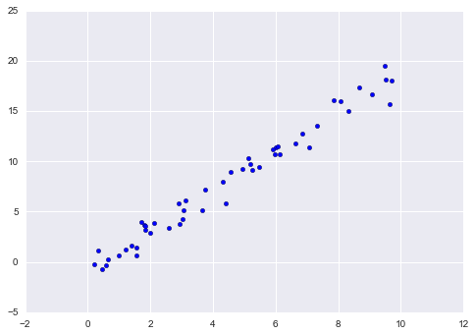
Linear Regression
In regression we predict values rather than discrete labels.

Slide 2
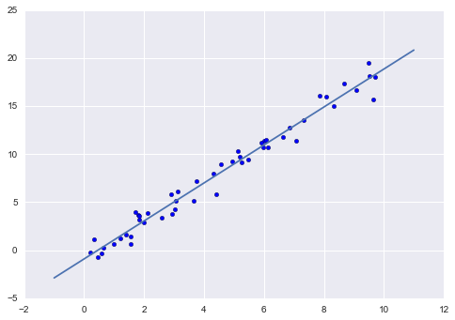
Linear Regression
In the simplest case we want to fit a line through the points.
A straight-line fit is a model of the form y=ax+b where a is commonly known as the slope, and b is commonly known as the intercept.
Here: b = -5 , a =2

Slide 3
Linear Regression
# generate the data
import matplotlib.pyplot as plt
import random
import pandas
x = pandas.DataFrame([10 * random.random() for __ in range(50)])
y = 2 * x - 1 + pandas.DataFrame([random.random() for __ in range(50)])
plt.scatter(x, y)
plt.show()
# pick model
from sklearn.linear_model import LinearRegression
model = LinearRegression(fit_intercept=True)
model.fit(x, y)
print("Model slope: ", model.coef_[0])
print("Model intercept:", model.intercept_)
# plot the model together with the data
xfit = pandas.DataFrame([i for i in range(-1, 12)])
yfit = model.predict(xfit)
plt.scatter(x, y)
plt.plot(xfit, yfit)
plt.show()
# compute the R^2 score – good models: R^2 ~ 1
print("R^2 score: {}".format(model.score(x,y)))
Model slope: [ 2.0306547]
Model intercept: [-0.64847945]
R^2 score: 0.9974134813061953

Slide 4
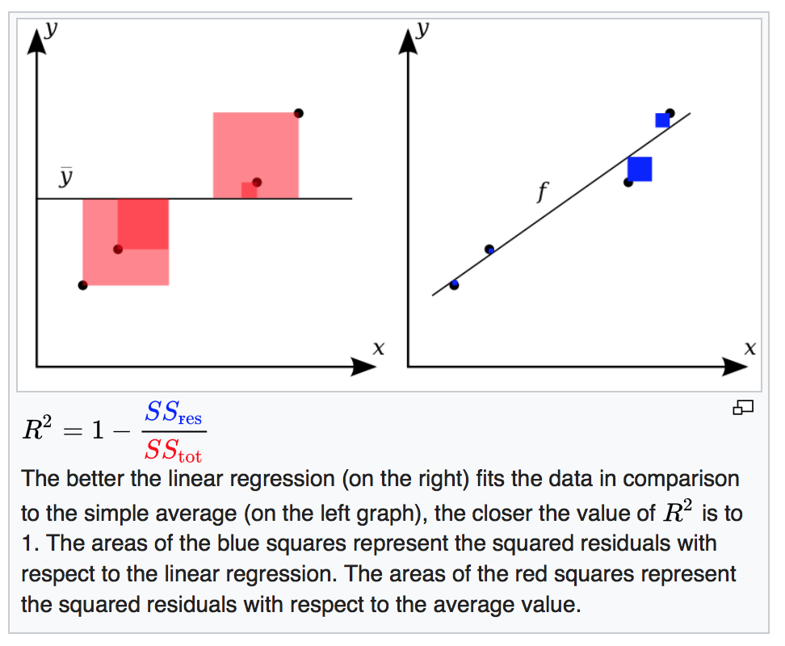
R² Score
Source: https://en.wikipedia.org/wiki/Coefficient_of_determination

Slide 5
Non-linear Regression
Neural networks, trees, and knn can also be used for regression.
Because of their underlying modeling algorithms they can not only model linear data sets but also non-linear ones.

Slide 6
Regression Trees
Trees can also be used as regression trees:
“piecewise linear regression”

Slide 7
Regression Trees
# generate the data
import matplotlib.pyplot as plt
import random
import pandas
x = pandas.DataFrame([10 * random.random() for __ in range(50)])
y = 2 * x - 1 + pandas.DataFrame([random.random() for __ in range(50)])
# pick model
from sklearn.tree import DecisionTreeRegressor
model = DecisionTreeRegressor(max_depth=3)
model.fit(x, y)
# plot the model together with the data
xfit = pandas.DataFrame([i for i in range(-1, 12)])
yfit = model.predict(xfit)
plt.scatter(x, y)
plt.plot(xfit, yfit)
plt.show()
# compute the R^2 score – good models: R^2 ~ 1
print("R^2 score: {}".format(model.score(x,y)))
See 16a-regression Notebook

Slide 8
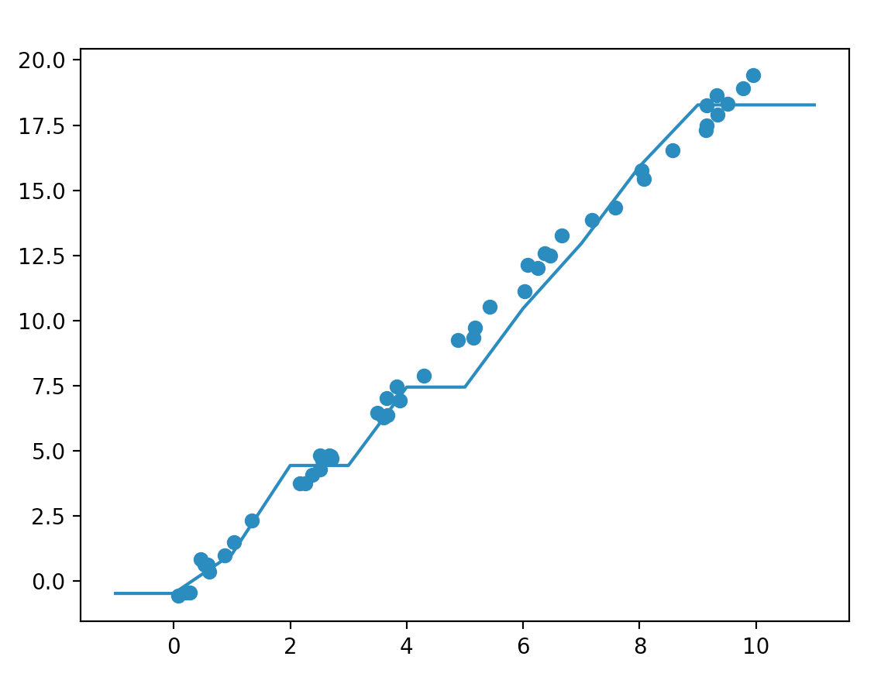
Regression Trees
R^2 score: 0.9867856696126454

Slide 9
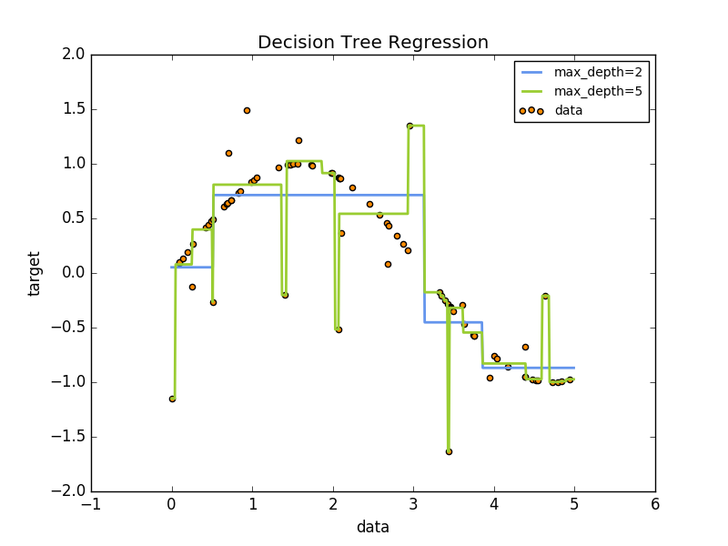
Regression Trees
Even with regression trees there is the possibility of overfitting.
Consider the noisy sine curve…
See 16a-regression Notebook

Slide 10
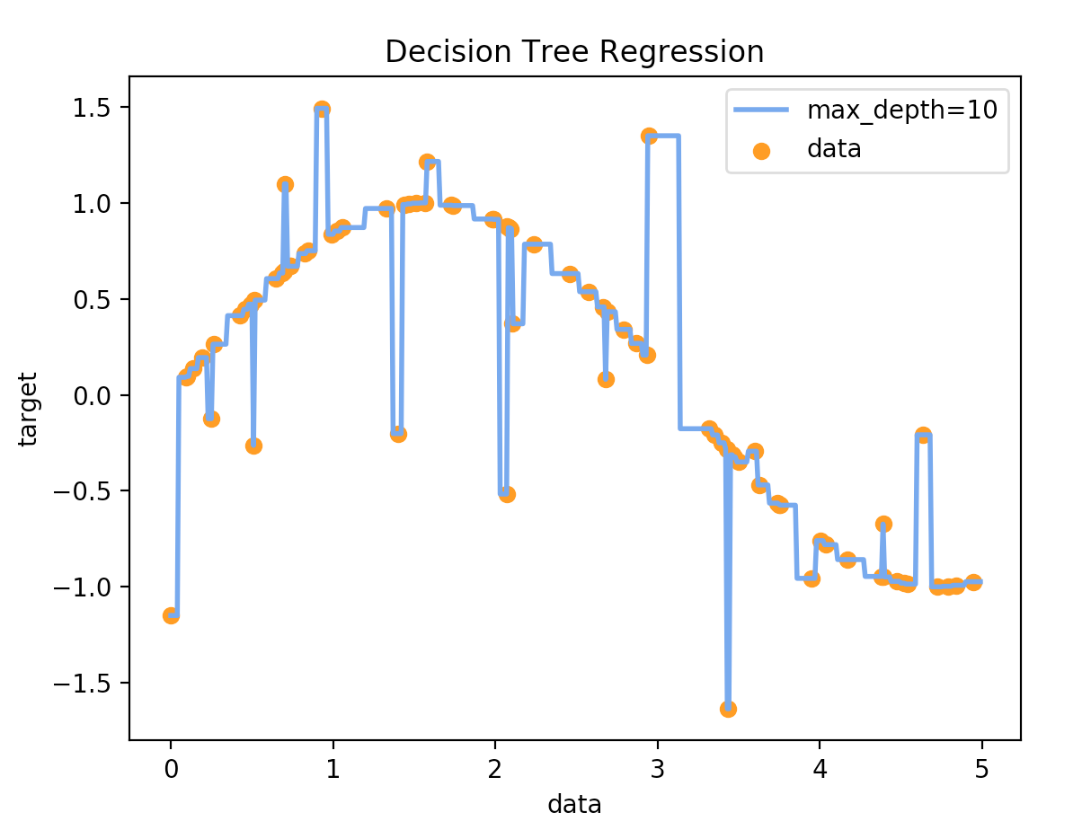
Regression Trees
With max_depth=10 the tree memorizes the data set – noise and all.
Just like in classification, when evaluating a model on the training set it is always possible to build a model with a perfect score.
R^2= 1.0

Slide 11
Regression Trees
...
# setting up the grid search
model = model = DecisionTreeRegressor()
param_grid = {'max_depth': list(range(1,25))}
grid = GridSearchCV(model, param_grid, cv=5)
# performing grid search
grid.fit(X,y)
# print out what we found
print("Best parameters: {}".format(grid.best_params_))
...
Perform a gridsearch over tree depth
The gridsearch will automatically adjust to use the R^2 score function
See 16a-regression Notebook

Slide 12
KNN Regression
# generate the data
import matplotlib.pyplot as plt
import random
import pandas
x = pandas.DataFrame([10 * random.random() for __ in range(50)])
y = 2 * x - 1 + pandas.DataFrame([random.random() for __ in range(50)])
# pick model
from sklearn.neighbors import KNeighborsRegressor
model = KNeighborsRegressor(n_neighbors=3)
model.fit(x, y)
# compute the R^2 score
print("R^2 score: {}".format(model.score(x,y)))
# plot the model together with the data
xfit = pandas.DataFrame([i for i in range(-1, 12)])
yfit = model.predict(xfit)
plt.scatter(x, y)
plt.plot(xfit, yfit)
plt.show()
We can use the k-Nearest Neighbor algorithm to do regression
knn_regression.py

Slide 13
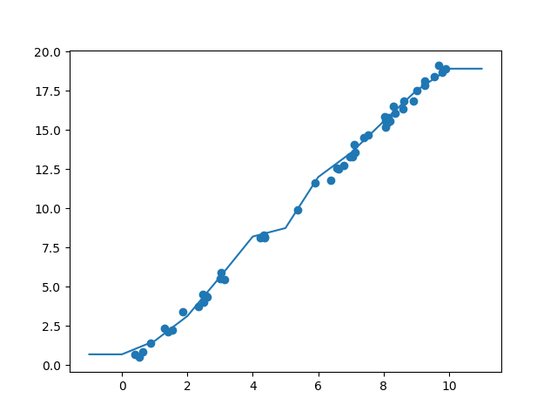
KNN Regression
R^2 score: 0.9982075337874717

Slide 14
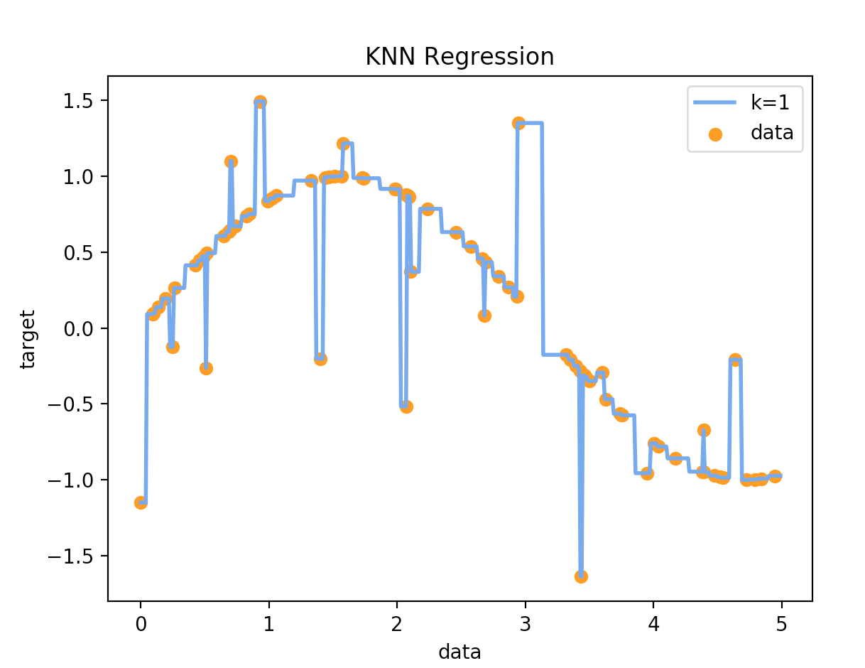
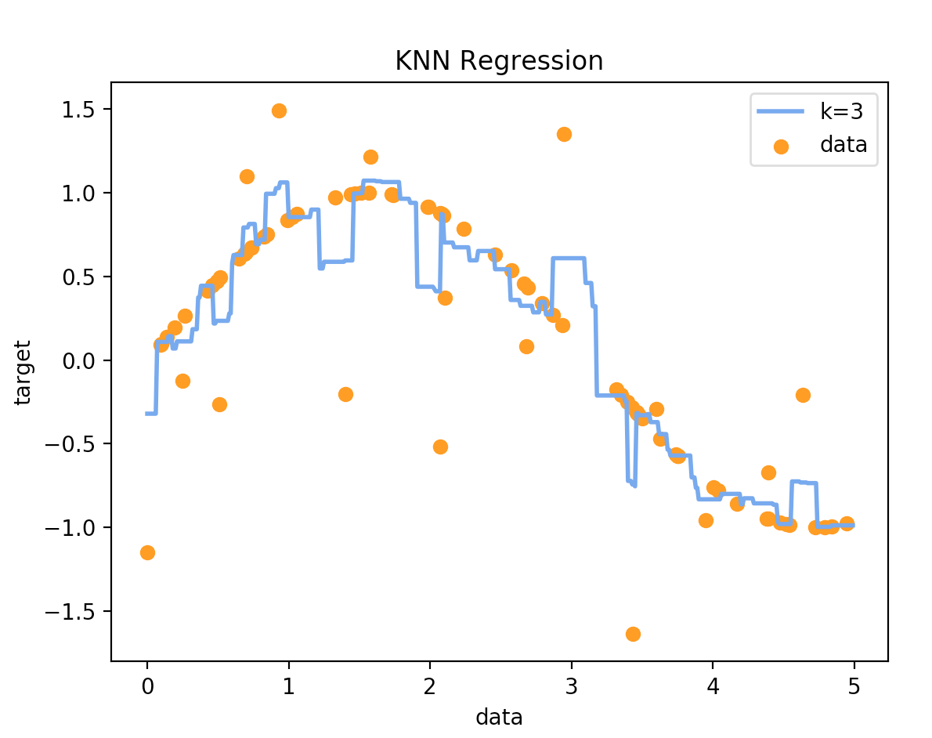
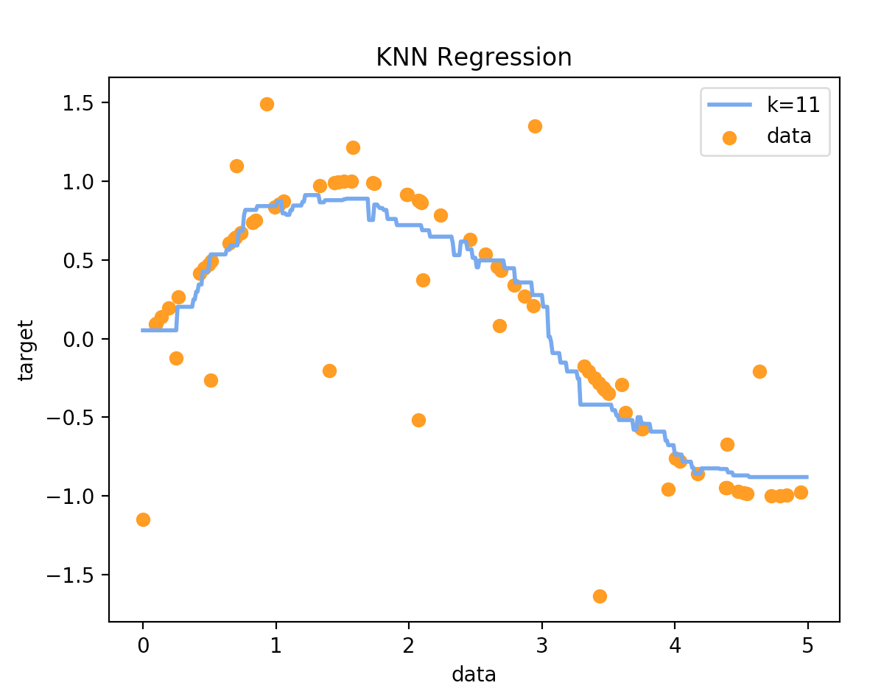
KNN Regression – Non-linear
R^2 = 1.0
R^2 = 0.841
R^2 = 0.775
knn_regression2.py

Slide 15
MLP Regression
# generate the data
import matplotlib.pyplot as plt
import random
import pandas
n = int(input('Choose a number for hidden nodes: '))
X = pandas.DataFrame([10 * random.random() for __ in range(50)])
y = 2 * X - 1 + pandas.DataFrame([random.random() for __ in range(50)])
# pick model
from sklearn.neural_network import MLPRegressor
model = MLPRegressor(hidden_layer_sizes=(n,),
activation='logistic', max_iter=10000)
model.fit(X, y)
# compute the R^2 score
print("R^2 score: {}".format(model.score(X,y)))
# plot the model together with the data
Xfit = pandas.DataFrame([i for i in range(-1, 12)])
yfit = model.predict(Xfit)
plt.scatter(X, y)
plt.plot(Xfit, yfit)
plt.show()
We can use artificial neural networks to do regression
mlp_regression.py

Slide 16
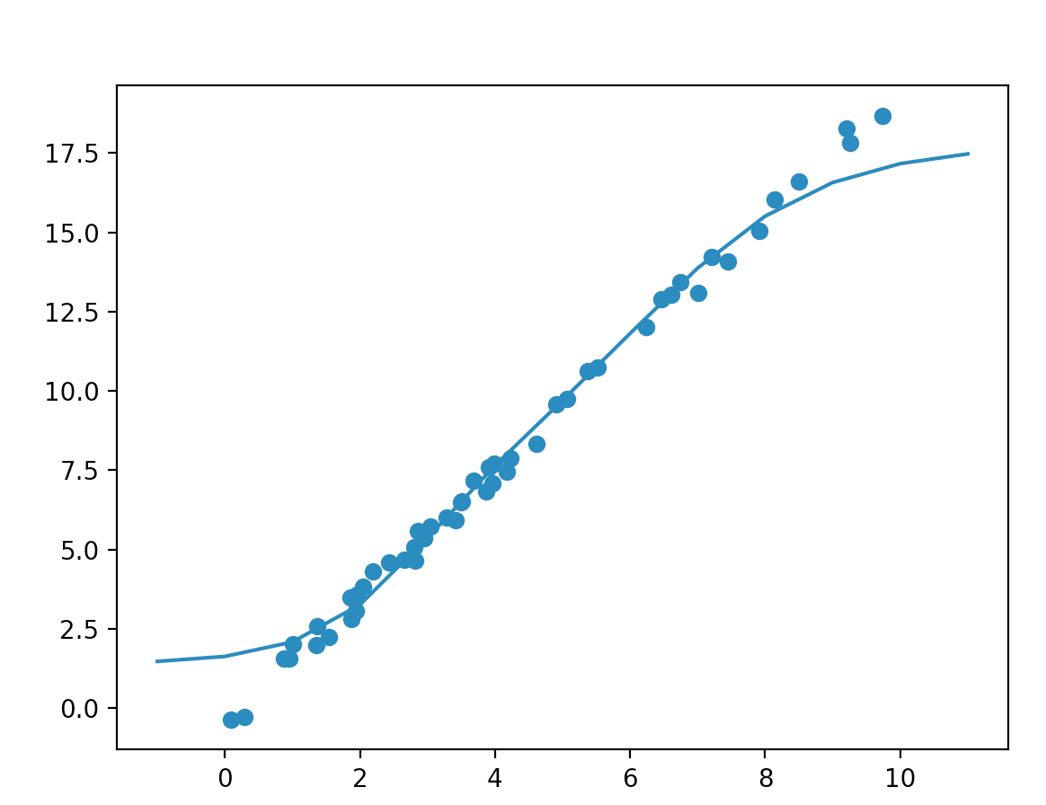
MLP Regression
n = 3
R^2 score: 0.984

Slide 17
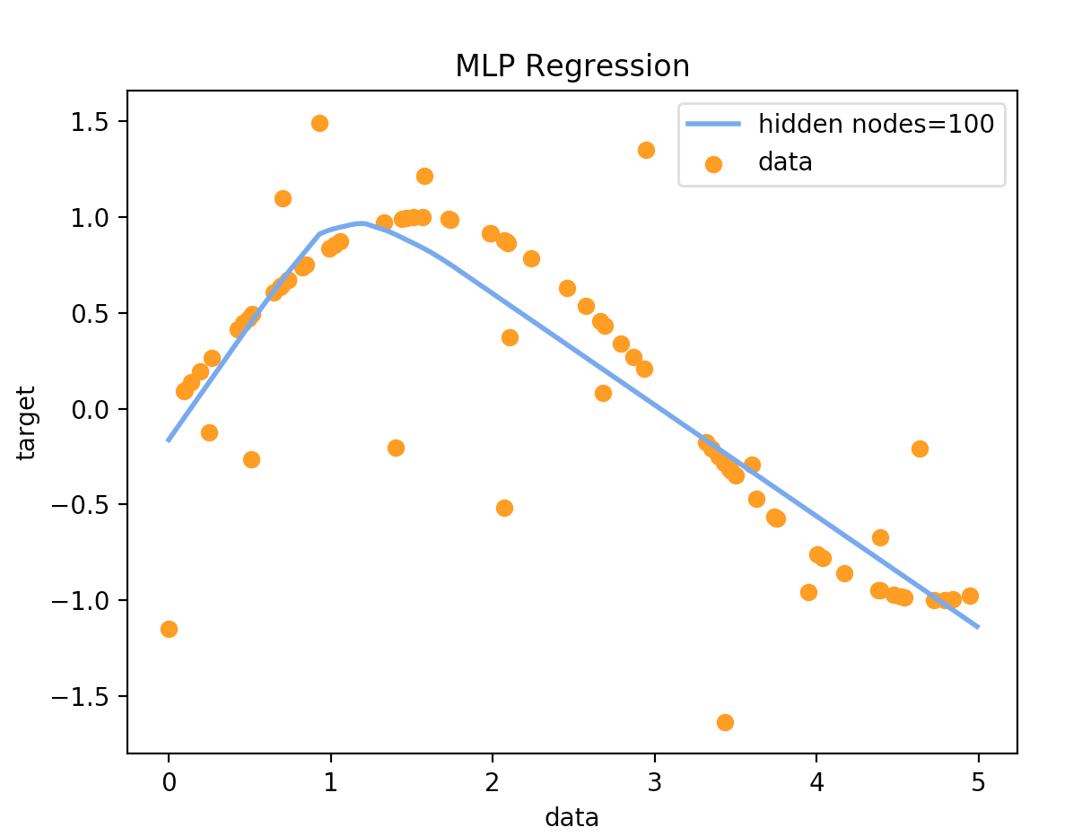
MLP Regression
R^2 score: 0.754
mlp_regression2.py

Slide 18
Exercise
Teams:
Team 0: Liam Patrick, Sabrina N., John D.,
Team 1: Ian G, Nicholas, Cameron J,
Team 2: Eben, Thomas J, Reece D,
Team 3: Sean M, Anthony, Brandon L,
Team 4: Shane R, Josh David, Jessica,
Team 5: Cassie, Alex M, Chris Joseph,
Team 6: Jacob, Geoffroy L, Christopher P,
Team 7: Logan, Jack Francis, Brevin Kordel,
Team 8: HopeRose Falco, Mark Anthony, Eric T,
Team 9: John L, Sedes, Jeffrey C,
Team 10: Rotman D, Milucy Freire, Max M,
Team 11: Aaron, Victoria, Andrew J,
Team 12: Chen, Fehmina, Jacob Daniel,
Team 13: Mikayla J, Johnny V, Christopher K,
Team 14: Eunice M, Polly, Joe Peter,
Team 15: Kurtis, Isaac Michael, Nate Arthur,
Team 16: Lydia E, John M., Matthew R,
Team 17: Alec Kai, Aman, Kyle,
Team 18: Chris, Michael,
Use the ‘cars’ data set from:
https://vincentarelbundock.github.io/Rdatasets/datasets.html
Drop the first column, target column is ‘dist’
Which one performs best on this data set: linear, mlp, tree, or knn regression? That is, which one gets the best cross-validated R^2 score?

