Slide 1
NLP and Machine Learning
We saw that we convert text document into a ‘vector model’ (bag-of-words)
The vector model allows us to perform mathematical analysis on documents - “which documents are similar to each other?”
Next question: can we construct machine learning models on document collections using the vector model?
Yes! We can construct classifiers.

Slide 2
NLP & ML
Consider again our news article data set.
We would like to construct a classifier that can correctly classifier political and science documents.
We will begin with our KNN algorithm (k nearest neighbors).

Slide 3
KNN - set up
import pandas
from sklearn.datasets import fetch_20newsgroups
from sklearn.model_selection import cross_val_score
from re import sub
from nltk.stem import PorterStemmer
print("******** setup **********")
stemmer = PorterStemmer()
cats = ['talk.politics.misc', 'sci.space']
newsgroups_train = fetch_20newsgroups(subset='train',
remove=('headers', 'footers', 'quotes'),
categories=cats)

Slide 4
KNN - data prep
print("******** prepare data **********")
new_data = []
for i in range(len(newsgroups_train.data)):
new_data.append(sub("[^a-zA-Z]", " ", newsgroups_train.data[i]))
lowercase_data = []
for i in range(len(new_data)):
lowercase_data.append(new_data[i].lower())
stemmed_data = []
for i in range(len(lowercase_data)):
words = lowercase_data[i].split()
stemmed_words = []
for w in words:
stemmed_words.append(stemmer.stem(w))
stemmed_data.append(" ".join(stemmed_words))

Slide 5
KNN - Vector Model & KNN Model
print("******** setup vector model **********")
from sklearn.feature_extraction.text import CountVectorizer
vectorizer = CountVectorizer(analyzer = "word", binary = True, min_df=2, stop_words='english')
docarray = vectorizer.fit_transform(stemmed_data).toarray()
print("******** model and XV **********")
from sklearn.neighbors import KNeighborsClassifier
model = KNeighborsClassifier(n_neighbors=4)
# do the 10-fold cross validation
scores = cross_val_score(model, docarray, newsgroups_train.target, cv=10)
print("Fold Accuracies: {}".format(scores))
print("XV Accuracy: {: 6.2f}".format(scores.mean()*100))

Slide 6
KNN - Vector Model & KNN Model
Here we introduced something new called the ‘stop list’
A stop list defines a set of words that should be excluded from the vector model.
‘Stop words’ are words that usually do not add anything to the meaning or value of a document -- usually they just appear too frequently to be of any analytic use
Here is the beginning of a popular stop list defined for text mining tools in the R programming environment.
stoplist = [ "a", "about", "above", "across", "after", "again", "against", "all", "almost", "alone", "along", "already", "also", "although",
... ]
https://github.com/arc12/Text-Mining-Weak-Signals/wiki/Standard-set-of-english-stopwords

Slide 7
KNN - Vector Model & KNN Model
******** setup **********
******** prepare data **********
******** setup vector model **********
******** model and XV **********
Fold Accuracies: [ 0.68224299 0.6635514 0.61682243 0.61320755 0.62264151 0.63809524
0.59047619 0.66666667 0.62857143 0.6 ]
XV Accuracy: 63.22%
That’s not very impressive - only a little bit better than random guessing.
Let’s try out another model: Naive Bayes

Slide 8
Naive Bayes Model
“Standard” model for text processing
Fast to train, has no problems with very high dimensional data

Slide 9
Naive Bayes Model
NB is a classification technique based on Bayes’ Theorem with an assumption of independence among predictors.
In simple terms, a NB classifier assumes that the presence of a particular feature in a class is unrelated to the presence of any other feature.
For example, a fruit may be considered to be an apple if it is red, round, and about 3 inches in diameter. Even if these features depend on each other or upon the existence of the other features, all of these properties independently contribute to the probability that this fruit is an apple and that is why it is known as ‘Naive’.
Source: https://www.analyticsvidhya.com/blog/2015/09/naive-bayes-explained/

Slide 10
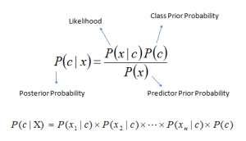
Naive Bayes Model
Bayes theorem provides a way of calculating posterior probability P(c|x) from P(c), P(x) and P(x|c). Look at the equation below, where
P(c|x) is the posterior probability of class (c, target) given predictor (x, attributes). P(c) is the prior probability of class. P(x|c) is the likelihood which is the probability of predictor given class. P(x) is the prior probability of predictor.

Slide 11
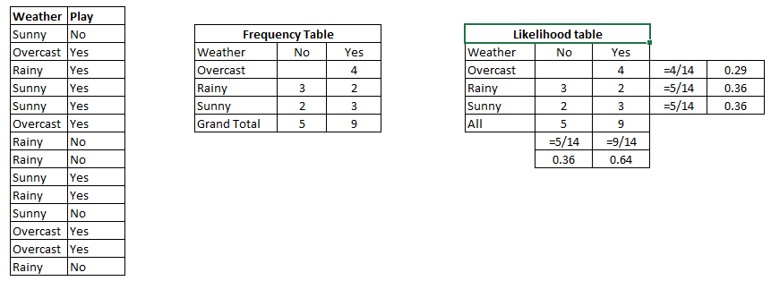
Naive Bayes Model
Let’s understand it using an example. Below isa training data set of weather and corresponding target variable ‘Play’ (suggesting possibilities of playing). Now, we need to classify whether players will play or not based on weather condition. Let’s follow the below steps to perform it. Step 1: Convert the data set into a frequency table Step 2: Create Likelihood table by finding the probabilities like Overcast probability = 0.29 and probability of playing is 0.64. Step 3: Now, use Naive Bayesian equation to calculate the posterior probability for each class. The class with the highest posterior probability is the outcome of prediction.

Slide 12
Naive Bayes Model
Naive Bayes uses a similar method to predict the probability of different class based on various attributes. This algorithm is mostly used in text classification and with problems having multiple classes.
Problem: Players will play if weather is sunny. Is this statement is correct? We can solve it using above discussed method of posterior probability. P(Yes | Sunny) = P( Sunny | Yes) * P(Yes) / P (Sunny) Here we have P (Sunny |Yes) = 3/9 = 0.33, P(Sunny) = 5/14 = 0.36, P( Yes)= 9/14 = 0.64 Now, P (Yes | Sunny) = 0.33 * 0.64 / 0.36 = 0.60, which has higher probability than not playing.

Slide 13
Naive Bayes Model
Let’s take our text classification and use a Naive Bayes classifier on it.
The setup and data prep is the same as in the case of the KNN classifier

Slide 14
Naive Bayes - Vector Model & NB Model
print("******** setup vector model **********")
from sklearn.feature_extraction.text import CountVectorizer
vectorizer = CountVectorizer(analyzer = "word", binary = True, min_df=2, stop_words='english')
docarray = vectorizer.fit_transform(stemmed_data).toarray()
print("******** model and XV **********") from sklearn.naive_bayes import MultinomialNB model = MultinomialNB()
# do the 10-fold cross validation
scores = cross_val_score(model, docarray, newsgroups_train.target, cv=10)
print("Fold Accuracies: {}".format(scores))
print("XV Accuracy: {: 6.2f}".format(scores.mean()*100))

Slide 15
NB - Vector Model & NB Model
******** setup ********** ******** prepare data ********** ******** setup vector model ********** ******** model and XV ********** Fold Accuracies: [ 0.94392523 0.93457944 0.95327103 0.96226415 0.93396226 0.94285714 0.93333333 0.80952381 0.91428571 0.8952381 ] XV Accuracy: 92.23%

Slide 16
Exercise
For this exercise you will build a classifier that can distinguish real news from fake news. A training set for this is available here:
https://raw.githubusercontent.com/lutzhamel/fake-news/master/data/fake_or_real_news.csv
The fields you are interested in are ‘text’ and ‘label’ with the obvious interpretations.
Here are the action items for this exercise:
Use the vector model and text preprocessing techniques from class to construct a training data set.
Determine the dimensions of your vector model and print out the first 10 dimensions
Use that training data set to construct a Naive Bayes classifier.
Use 5 or 10-fold cross-validation to compute the accuracy of your naïve bayes classifier.
Try your analysis with and without data preprocessing, is there a difference in accuracy of the models.
The data set contains a large number of articles (takes a long time to train), you can downsample this to something like a 1,000 articles or so in order to speed up training and evaluation (see pandas.DataFrame documentation for sampling)
You are free to pick your own team (max three members)
Extra Credit: Try the same thing but instead of ‘text’ use ‘title’ for your training text. How does a classifier built on this data set compare to the original classifier.

