Slide 1
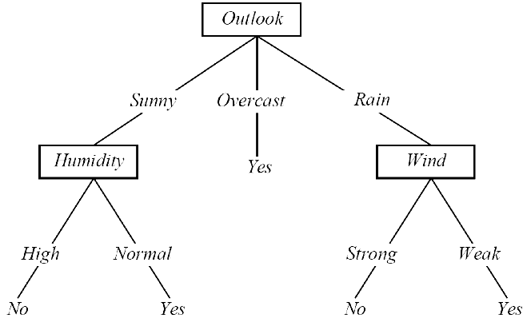
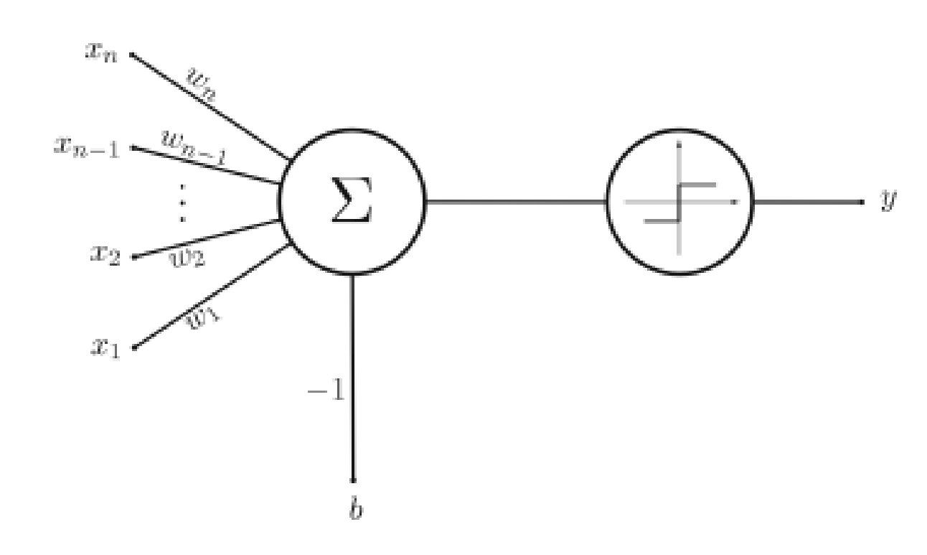
Learning
We have seen machine learning with different representations:
Decision trees -- symbolic representation of various decision rules -- “disjunction of conjunctions”
Perceptron -- learning of weights that represent alinear decision surface classifying a set of objects into two groups
Different representations give rise to different hypothesis or model spaces.
Machine learning algorithms search these model spaces for the best fitting model.
Notes:
1

Slide 2
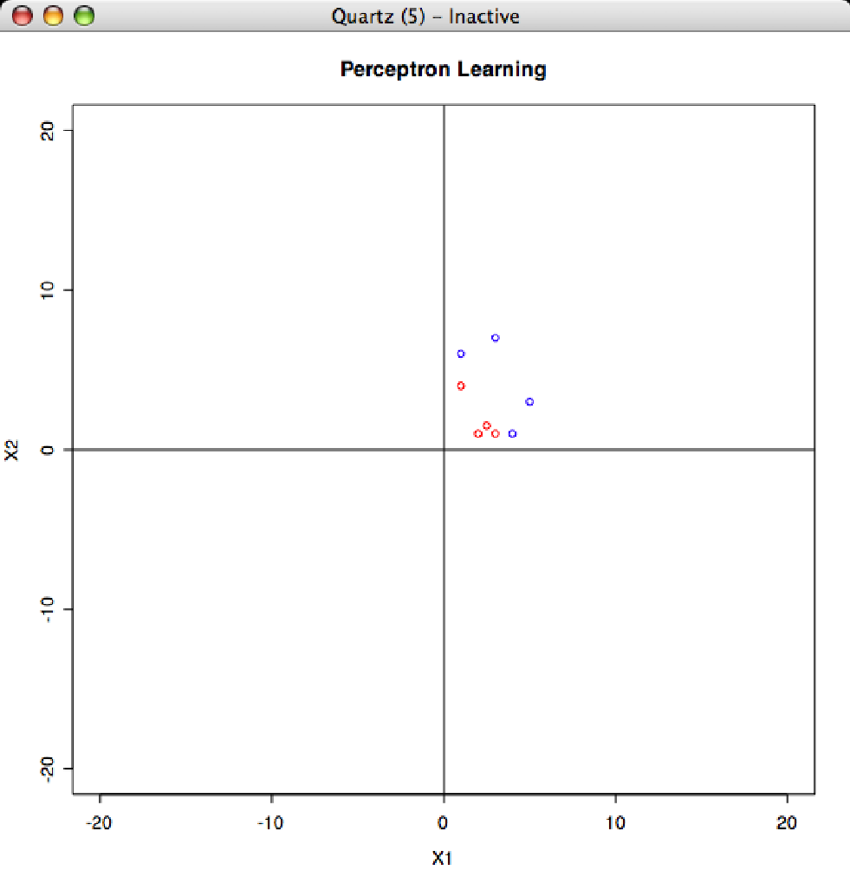
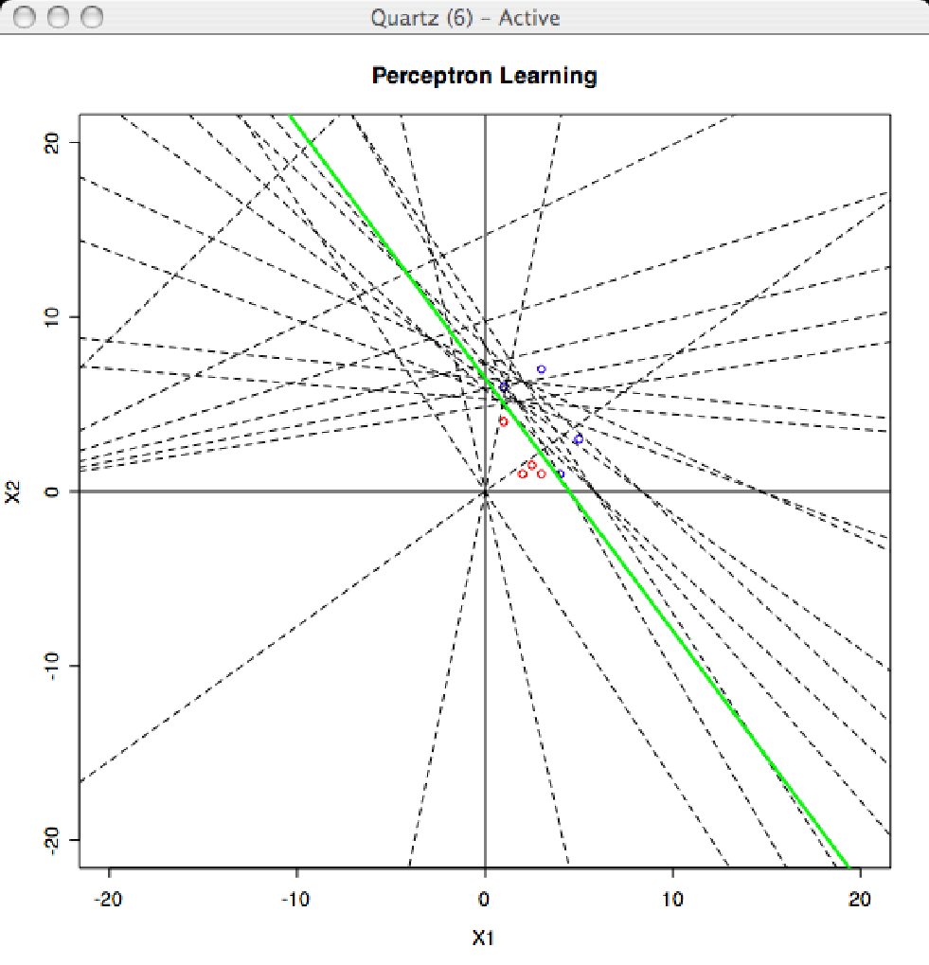
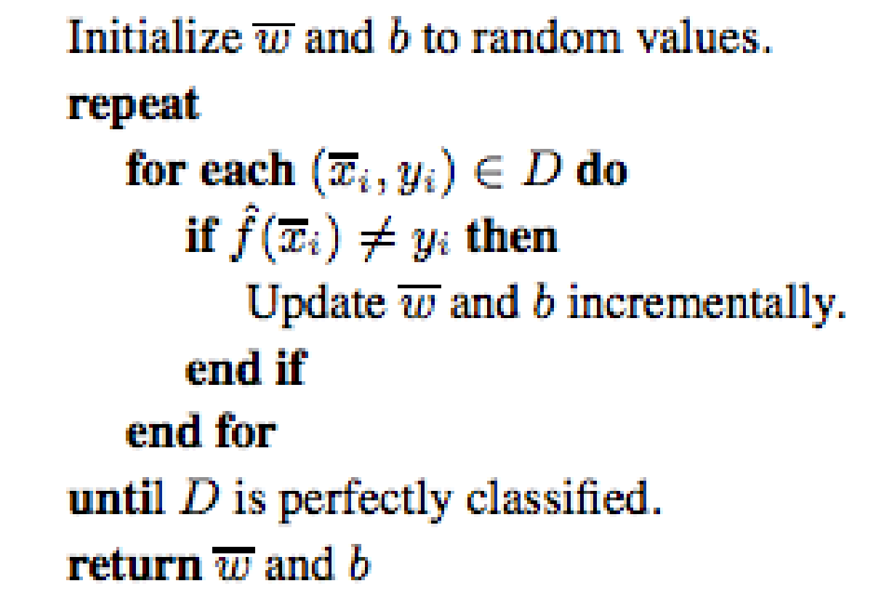
Perceptron Learning Revisited
Constructs a line (hyperplane) as a classifier.
R Demo
Notes:
2

Slide 3
What About Non-Linearity?
x₂
= +1
= -1
Decision Surface
x₁
Can we learn this decision surface? …Yes! Multi-Layer Perceptronsl.
Notes:
3

Slide 4
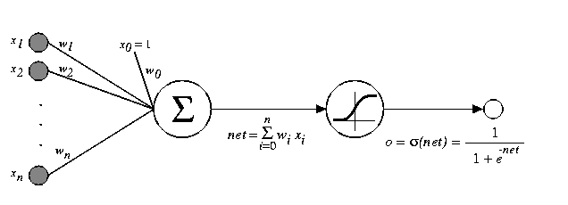
Multi-Layer Perceptrons
Input Layer
Hidden Layer
Output Layer
x_{n}
X_{n-1}
…
y
x₂
x₁
x₀
≡
≡
Linear Unit
Combination
Function
Transfer
Function
Notes:
4

Slide 5
How do we train?
Perceptron was easy:
error
Every time we found an error of the predicted value f(x_{i}) compared to the label in the training set y_{i}, we update w and b.

Slide 6
Artificial Neural Networks
Feed-forward with Backpropagation
Input Layer
Hidden Layer
Output Layer
We have to be a bit smarter in the case of ANNs: compute the error (feed forward) and then use the error to update all the weights by propagating the error back.
x_{n}
X_{n-1}
…
y
x₂
x₁
x₀
Signal Feed-forward
Error Backpropagation

Slide 7
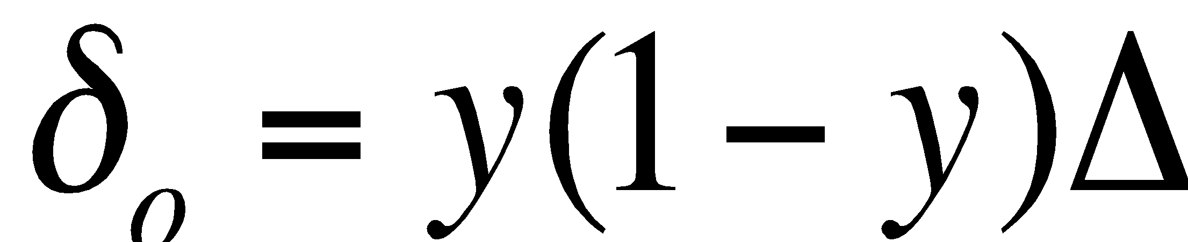
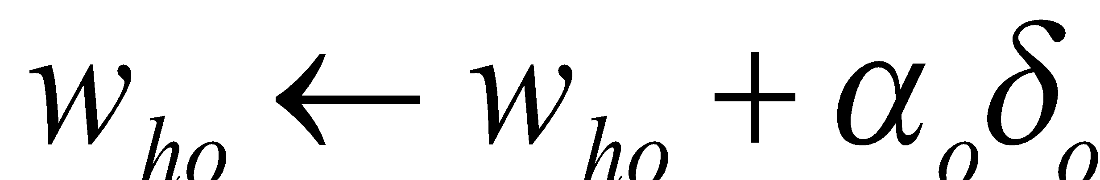
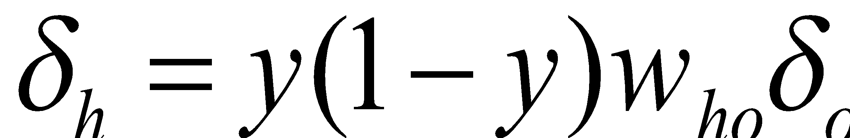
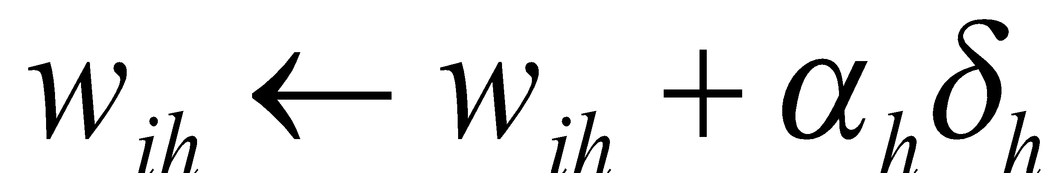
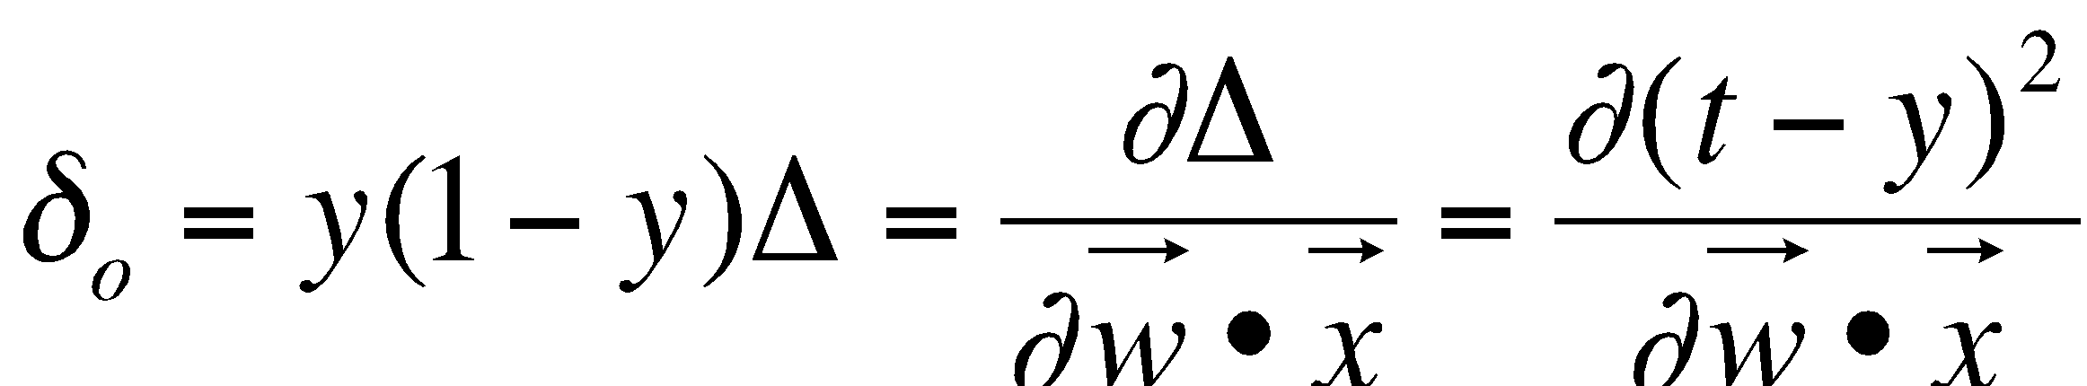
Backpropagation
Input Layer
Hidden Layer
Output Layer
Δ = (t - y)²
x_{n}
i
w_{ih}
δ_{h}
X_{n-1}
h
w_{ho}
δ_{o}
…
o
y
x₂
x₁
x₀
This only works because
and the output y is differentiable because the transfer function is differentiable. Also note, everything is based on the rate of change of the error…we are searching in the direction where the rate of change will minimize the output error.

Slide 8
Backpropagation Algorithm
Note: this algorithm is for a NN with a single output node o and a single hidden layer. It can easily be generalized.
Initialize the weights in the network (often randomly)
Do
For each example e in the training set
// forward pass
y = compute neural net output
t = label for e from training data
Calculate error Δ = (t - y)² at the output units
// backward pass
Compute error δ_{o} for weights from a hidden node h to the output node o using Δ
Compute error δ_{h} for weights from an input node i to hidden node h using δ_{o}
Update the weights in the network
Until all examples classified correctly or stopping criterion satisfied
Return the network
Source: http://en.wikipedia.org/wiki/Backpropagation
Notes:
8

Slide 9
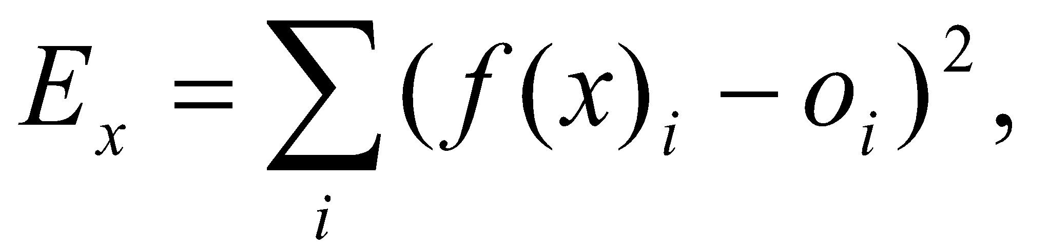
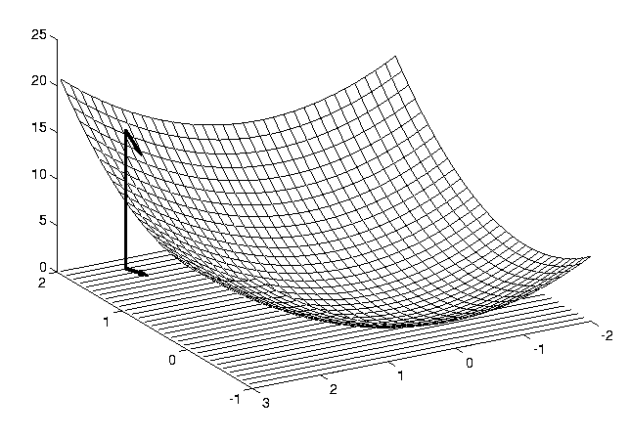
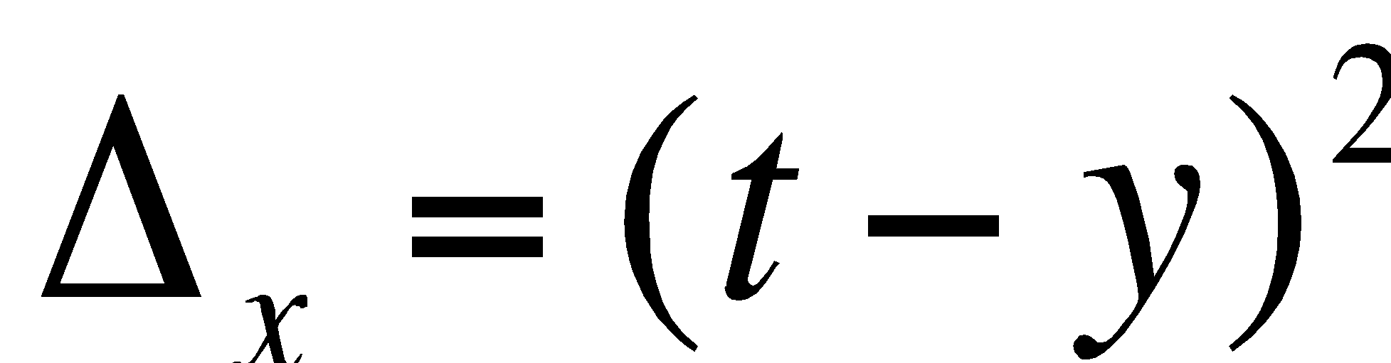
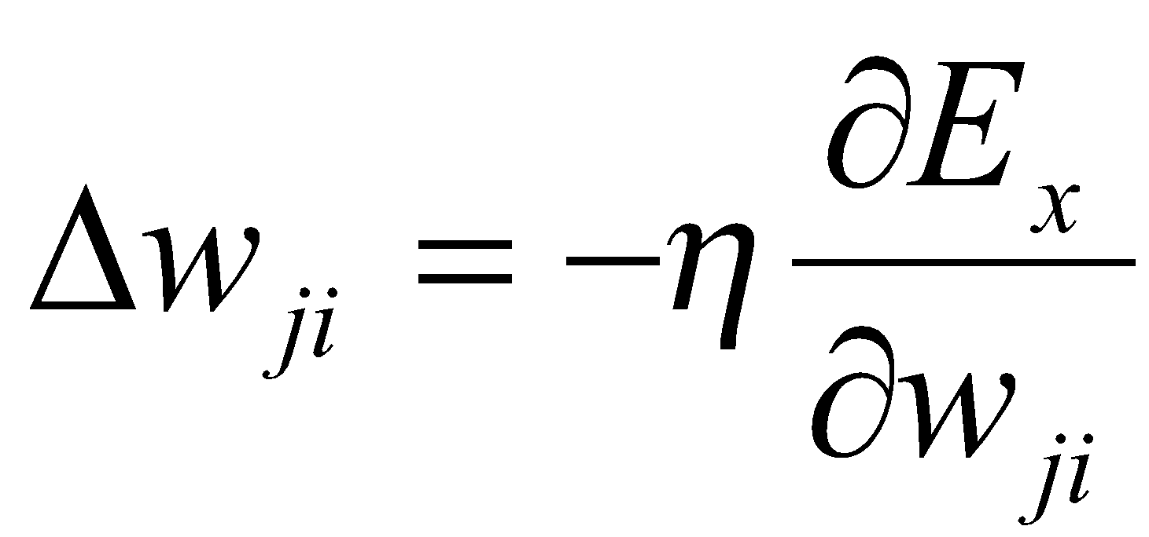
Neural Network Learning
Define the network error as for some x∈X, where i is an index over the output units.
Let ∆_{x}(w) be the error E_{x} as a function of the weights w.
Use the gradient (slope) of the error surface to guide the search towards appropriate weights:
E_{x}(w)
w₀
w₁
∂
∆
Δ
w
=
−
η
x
k
∂
w
k
Notes:
9

Slide 10
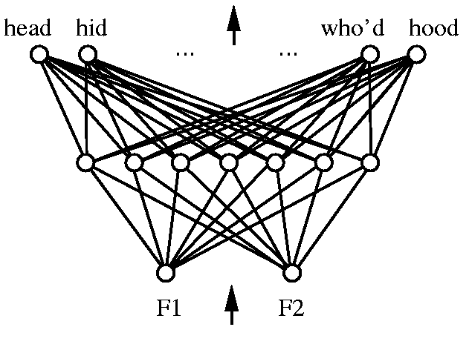
Representational Power
Every bounded continuous function can be approximated with arbitrarily small error by a network with one hidden layer.
Any function can be approximated to arbitrary accuracy by a network with two hidden layers.
Notes:
10

Slide 11
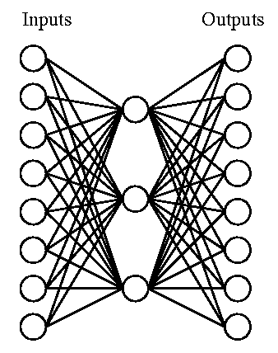
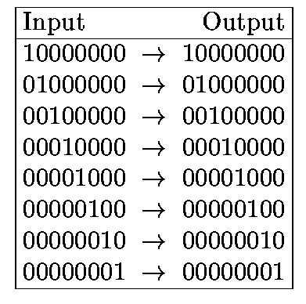
Hidden Layer Representations
Target Function:
Can this be learned?
Notes:
11

Slide 12
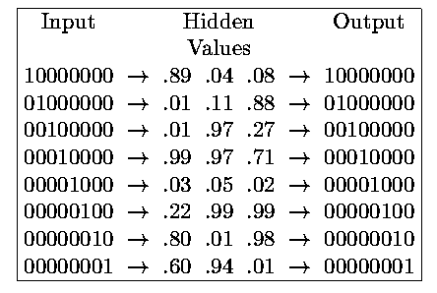
Hidden Layer Representations
1 0 0
0 0 1
0 1 0
1 1 1
0 0 0
0 1 1
1 0 1
1 1 0
Hidden layers allow a network to invent appropriate internal representations.
Notes:
12

Slide 13
MLPClassifier
import pandas as pd
from sklearn.neural_network import MLPClassifier
from sklearn.model_selection import cross_val_score
from sklearn.metrics import accuracy_score
from sklearn.metrics import confusion_matrix
# get data
df = pd.read_csv(”wdbc.csv")
df = df.drop([''ID'],axis=1)
X = df.drop([’Diagnosis'],axis=1)
y = df[’Diagnosis']
# neural network
model = MLPClassifier(hidden_layer_sizes=(15,))
# do the 5-fold cross validation
scores = cross_val_score(model, X, y, cv=5)
print("Fold Accuracies: {}".format(scores))
print("Accuracy: {}".format(scores.mean()))
Fold Accuracies: [ 0.87591241 0.95620438 0.95620438 0.98540146 0.98518519]
Accuracy: 0.9517815625844823

Slide 14
MLP Grid Search
We can also perform a grid search
BEWARE: a grid search over all possible parameters of an MLP is almost impossible - combinatoric explosion, too many different combinations possible.
Here we only perform a grid over the number of nodes in a single hidden layer.

Slide 15
MLP Grid Search
# neural network model = MLPClassifier(max_iter=2000) # grid search param_grid = {'hidden_layer_sizes': [ (5,), (6,), (7,), (8,), (9,), (10,), (11,), (12,), (13,), (14,), (15,), (16,), (17,), (18,), (19,), (20,)]} grid = GridSearchCV(model, param_grid, cv=5) grid.fit(X, actual_y) print("Grid Search: best parameters: {}".format(grid.best_params_)) # evaluate the best model best_model = grid.best_estimator_ predict_y = best_model.predict(X) print("Accuracy: {}".format(accuracy_score(actual_y, predict_y))) # build the confusion matrix labels = ['benign', 'malignant'] cm = confusion_matrix(actual_y, predict_y, labels=labels) cm_df = pd.DataFrame(cm, index=labels, columns=labels) print("Confusion Matrix:\n{}".format(cm_df)) # boostrapped confidence interval print("Confidence interval best MLP: {}".format(bootstrap(best_model,df,'class')))

Slide 16
MLP Grid Search
Grid Search: best parameters: {'hidden_layer_sizes': (9,)} Accuracy: 0.9707174231332357 Confusion Matrix: benign malignant benign 435 9 malignant 11 228 Confidence interval best MLP: (0.93412408759124088, 0.9928832116788322)

Slide 17
Team Exercise
Use the Crohn’s Disease dataset: CrohnD
https://vincentarelbundock.github.io/Rdatasets/datasets.html
You will need to preprocess this before you can use it: c1 -> 0, c2 -> 1, F -> 0, M -> 1
Build a ANN/MLP with the best cross-validated performance you can find.
Compare it to either a tree or a KNN (or both).
Report if the difference between the models is statistically significant.
Teams:
Team 0: Shehjar Harout Geron
Team 1: Aakash Cory Christopher
Team 2: Maurice Kevin Ben
Team 3: Najib Aguilar Ronil
Team 4: Joe Shamal Gabe
Team 5: Kermalyn Peter David_M
Team 6: Matt Alexander Alber
Team 7: Evelyn Susallin David_P

