Slide 1
Python - Lists, Arrays, and Data Frames
Lists are fundamental in Python
We construct them in a variety of ways
Explicit: my_list = [1,2,3]
Computationally: my_list.append(4)
List comprehension: my_list = [x for x in range(4)]
Reading from a file: with open(filename, 'r') as f: my_list = [line.split('\n') for line in f]

Slide 2
Python - Lists, Arrays, and Data Frames
Definition: In computer programming, list (array) slicing is an operation that extracts a subset of elements from a list (array) and packages them as another list (array), possibly in a different dimension from the original. (Wikipedia)
Manipulating lists: list slicing
My_list[start:stop:increment]
Start - inclusive
Stop - exclusive
Increment - positive or negative!
All can be optional
Some Examples:
>>> my_list = [1,2,3,4,5,6] >>> my_list[2:] [3, 4, 5, 6] >>> my_list[:2] [1, 2] >>> my_list[::] [1, 2, 3, 4, 5, 6] >>> my_list[::2] [1, 3, 5] >>>
>>> lst = [x for x in range(10)] >>> even = lst[::2] >>> even [0, 2, 4, 6, 8] >>> odd = lst[1::2] >>> odd [1, 3, 5, 7, 9] >>>
>>> lst = [x for x in range(10)] >>> rev = lst[::-1] >>> rev [9, 8, 7, 6, 5, 4, 3, 2, 1, 0] >>>

Slide 3
Python - Lists, Arrays, and Data Frames
We can also assign into list slices:
>>> bit_vec = [1 for i in range(16)] >>> bit_vec [1, 1, 1, 1, 1, 1, 1, 1, 1, 1, 1, 1, 1, 1, 1, 1] >>> bit_vec[1::2] = [0 for i in range(8)] >>> bit_vec [1, 0, 1, 0, 1, 0, 1, 0, 1, 0, 1, 0, 1, 0, 1, 0] >>>
>>> lst = [x for x in range(10)]
>>> lst
[0, 1, 2, 3, 4, 5, 6, 7, 8, 9]
>>> lst[2:5] = [0,0,0]
>>> lst
[0, 1, 0, 0, 0, 5, 6, 7, 8, 9]
>>>
For more info see:
http://www.i-programmer.info/programming/python/3942-arrays-in-python.html

Slide 4
Python - Lists, Arrays, and Data Frames
Python does not have arrays - they can be constructed with lists of lists.
>>> for row in arr:
... for e in row:
... print(e)
...
1
2
3
4
5
6
7
8
9
>>>
>>> arr = [[1,2,3],
... [4,5,6],
... [7,8,9]]
>>> arr[1]
[4, 5, 6]
>>> arr[1][1]
5
>>>
>>> arr[1][1] = 0
>>> print(arr)
[[1, 2, 3], [4, 0, 6], [7, 8, 9]]
>>>
>>> arr = [[0 for j in range(3)] for i in range(3)]
>>> print(arr)
[[0, 0, 0], [0, 0, 0], [0, 0, 0]]
>>>

Slide 5
Python - Lists, Arrays, and Data Frames
However, slicing does not work properly on arrays!
>>> arr = [[1,2,3],
... [4,5,6],
... [7,8,8]]
>>> arr[1][:]
[4, 5, 6]
>>> arr[:][1]
[4, 5, 6]
>>> arr[:]
[[1, 2, 3], [4, 5, 6], [7, 8, 8]]
>>>

Slide 6
Python - Lists, Arrays, and Data Frames
Pandas data frames - 2D arrays specifically designed for data processing!
We will have much more to say about data frames later on
>>> import pandas
>>> arr = [[1,2,3],
... [4,5,6],
... [7,8,8]]
>>> df = pandas.DataFrame(data=arr,columns=['a','b','c'])
>>> df
a b c
0 1 2 3
1 4 5 6
2 7 8 8
>>>
>>> df.iloc[1,1]
5
>>> df.iloc[1,1] = 0
>>> df
a b c
0 1 2 3
1 4 0 6
2 7 8 8
>>>

Slide 7
Python - Lists, Arrays, and Data Frames
In data frames slicing works as expected!
>>> df
a b c
0 1 2 3
1 4 5 6
2 7 8 8
>>> df.iloc[1,:]
a 4
b 5
c 6
>>> df.iloc[:,1]
0 2
1 5
2 8

Slide 8
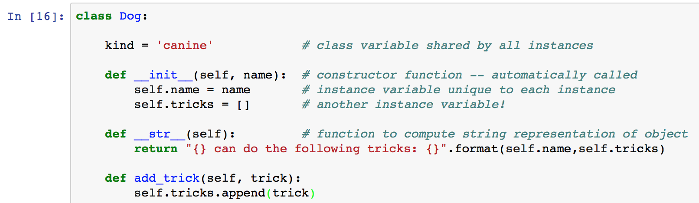
Python – Classes and Objects
Classes are dynamic objects in the spirit of Python: variables become defined when they appear in the program text.
It matters where they appear!
No protection mechanisms – everything is globally visible!
Classes also support inheritance (I let you explore that…)

Slide 9
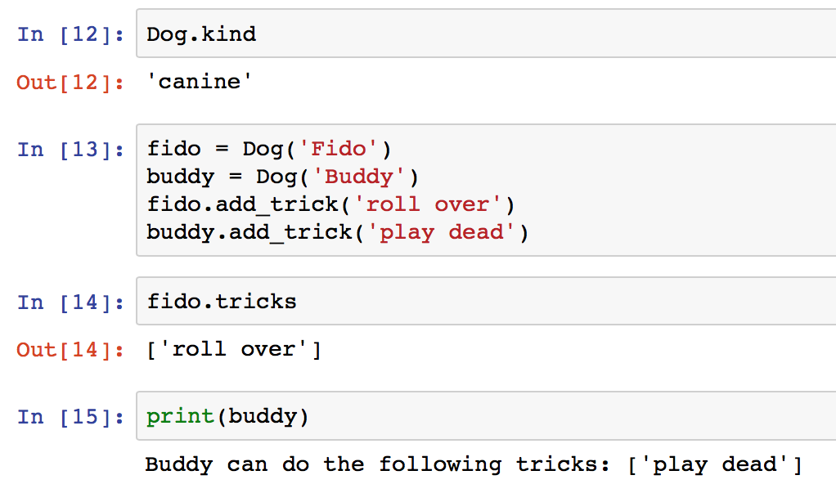
Python – Classes and Objects
Note: this is in Jupyter Notebook style – In is a program statement – Out is the interpreter output

Slide 10
Programming Exercise
You are to implement Conway’s Game of Life in Python: en.wikipedia.org/wiki/Conway's_Game_of_Life
Your board size should be a parameter so you can try it on different sized boards
Your ‘number of generations’ should also be a parameter
Your main data structure should be an array – or two if you use double buffering (recommended)
No fancy graphics necessary, just displaying ascii is fine. (see function on next slides)

Slide 11
Programming Exercise
Rules for the Game:
Any live cell with fewer than two live neighbors dies, as if caused by underpopulation.
Any live cell with two or three live neighbors lives on to the next generation.
Any live cell with more than three live neighbors dies, as if by overpopulation.
Any dead cell with exactly three live neighbors becomes a live cell, as if by reproduction.

Slide 12
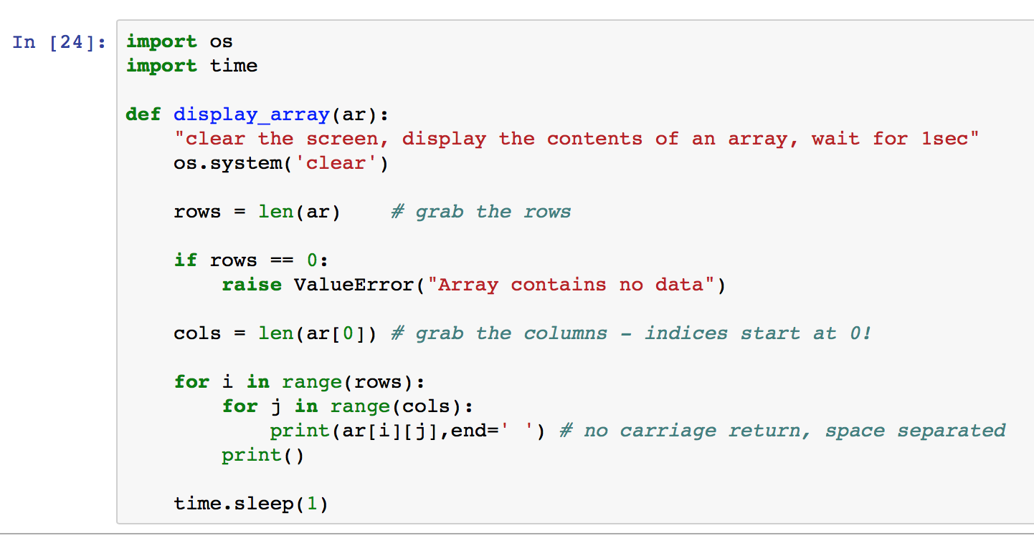
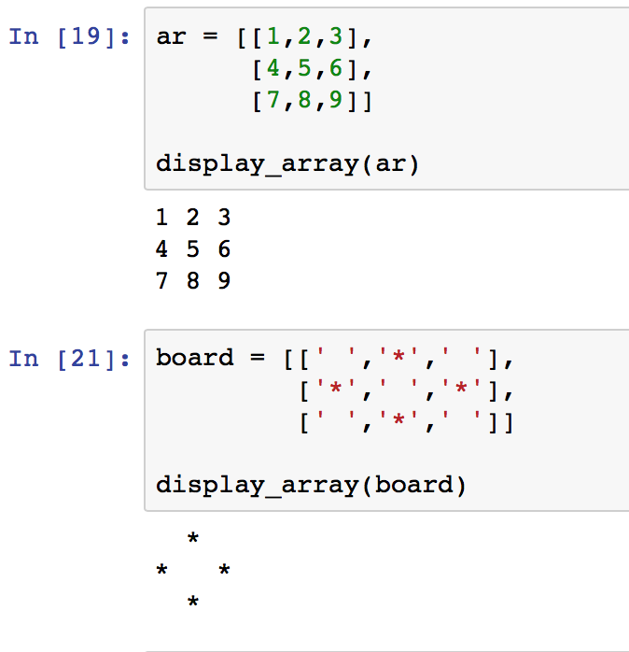
Programming Exercise

Slide 13
Programming Exercise

Slide 14
Programming Exercise
Teamwork allowed - see Teams
Group 1
St-Martin, Ben
O'Neill, Sydney
Janiszewski, Joseph
Group 2
Leonardo Polanco, Luis
Turner, Jacob
Capaldi, Ronni Sue
Group 3
Wade, Brandon
Bruno, Heather
Campbell, Ryan
Group 4
Cole, Tyler
Chenot, Samuel
Agronick, Austin
Group 5
Johnson, Ben
Caterino, Matthew
Wildenhain, Evan
Group 6
Gaines, Leah
Lehane, Robert
Behrens, Jack
Group 7
Phillips, Connor
Mason, Conor
MacDonald, Bri
Group 8
Thomas, Ryan
Mendonca, Cameron
Bakos, Sofia
Group 9
Babineau, Allie
Dunn, Kevin
Antranik, Antranik
Group 10
Stone, Chad
Moreno, Zentonio
Mullin, Jason
Group 11
Gallagher, Beibhinn
Ferrell, Baheem
Gregory, Steven
Group 12
Owen, Abraham
Cabral, Adam
O'Connell, Mark

