Slide 1
Confidence Intervals
Observation: It does not matter how careful we are with our model evaluation techniques, there remains a fundamental uncertainty about the ability of our training data to effectively represent our (possibly infinite) data universe. This uncertainty reflects into our model evaluation. If our training data is a poor representation of the data universe then the models we construct using it will generalize poorly to the rest of the data universe. If our training data is a good representation of the data universe then we can expect that our model will generalize well. Here we will deal with this uncertainty using confidence intervals. Perhaps most surprising is that we will use our training data itself in order to estimate this uncertainty using the bootstrap.

Slide 2
Confidence Intervals
First, let us define error confidence intervals formally. Given a model accuracy, acc_{D}, over some data set D, then the error confidence interval is defined as the probability p that our model accuracy acc_{D} lies between some lower bound lb and some upper bound ub, Pr(lb ≤ acc_{D} ≤ ub) = p. Paraphrasing this equation with p = 95%:
We are 95% percent sure that our accuracy acc_{D} is not worse than lb and not better than ub.

Slide 3
Percentiles
Numerical data can be sorted in increasing or decreasing order. Thus the values of a numerical data set have a rank order.
A percentile is the value at a particular rank.
For example, if your score on a test is on the 95th percentile, a common interpretation is that only 5% of the scores were higher than yours. The median is the 50th percentile; it is commonly assumed that 50% the values in a data set are above the median.

Slide 4
Percentiles
Example: Consider the sorted list:
sizes = [ 6, 7, 9, 12, 17]
The 80th percentile is a value on the list, namely 12. You can see that 80% of the values are less than or equal to it, and that it is the smallest value on the list for which this is true.
The percentile function takes two arguments: a rank between 0 and 100, and a sorted list. It returns the corresponding percentile of the list. >>> percentile(sizes, 80) 12

Slide 5
Percentiles
In practical terms, suppose there are n elements in a collection. To find the pth percentile:
Sort the collection in increasing order.
Find p% of n: (p/100)×n. Call that k.
If k is an integer, take the kth element of the sorted collection.
If k is not an integer, round it up to the next integer, and take that element of the sorted collection.

Slide 6
The Bootstrap
A particular effective and computationally straightforward way to estimate the lower and upper bounds of confidence intervals is the bootstrap. What is remarkable about the bootstrap is that we use the data set D itself to capture the uncertainty with which it represents the data universe at large. In the bootstrap we create B bootstrap samples of our data set D using sampling with replacement. We use the variation among the bootstrap samples to compute the variation in the respective model accuracies.
NOTE: the variation among the bootstrap sampled captures the quality of the original data set: if the variation is large then most likely your original data set does NOT represent the data universe very well, if the variation is small then most likely it does!

Slide 7
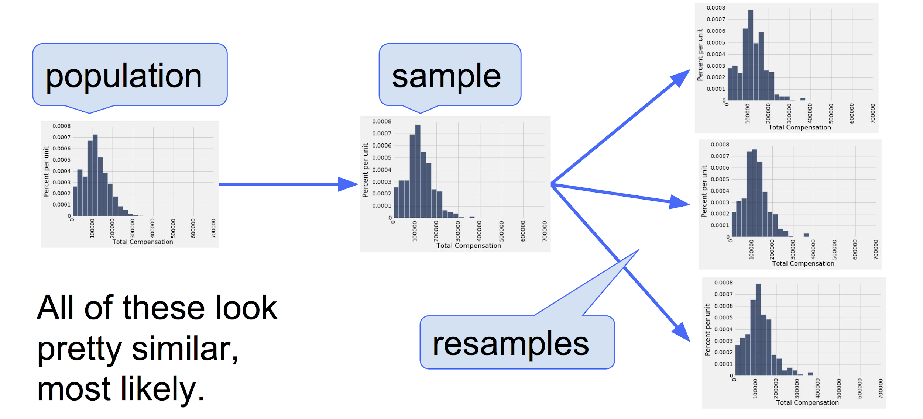
The Bootstrap - Resampling Technique

Slide 8
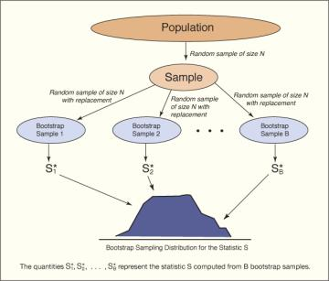
The Bootstrap
Bootstrap procedure generating B bootstrap samples
In our case the statistic is the model accuracy
We obtain a sampling distribution of the model accuracy!

Slide 9
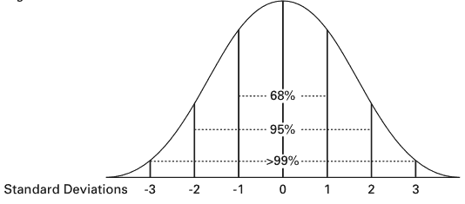
The Bootstrap
Given the distribution of our accuracies we can now estimate the probabilities and bounds of our confidence intervals.
How often does the empirical distribution of the resampled accuracies capture the actual accuracy? Let's take that to mean "the middle 95% of the resampled accuracies capture the actual accuracy" - The 95% confidence interval!

Slide 10
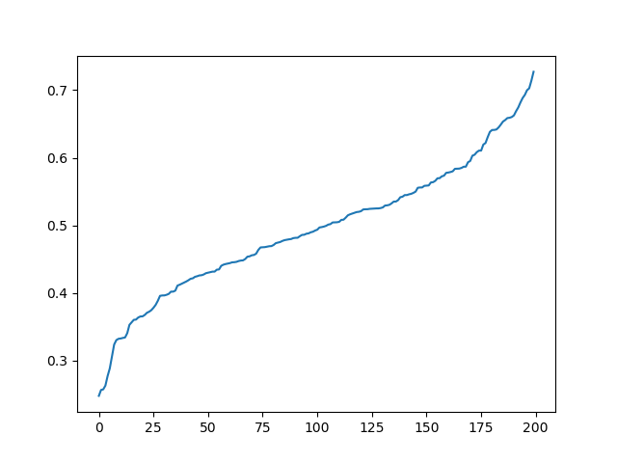
The Bootstrap – 95% Confidence Interval
lb
ub
Assume we have the list, sorted_accuracies, then the values of the bounds can be estimated: lb = percentile(sorted_accuracies, 2.5) ub = percentile(sorted_accuracies, 97.5)

Slide 11
Bootstrap Procedure
given data set D
given model M for i = 1 to 200 do B[i] ← sample D with replacement, note |B[i]| = |D|. acc[i] ← compute model M accuracy for B[i].
end for sort acc in ascending fashion ub ← percentile(acc, 97.5)
lb ← percentile(acc, 2.5)
return (lb, ub)

Slide 12
Bootstrap Procedure
import pandas as pd from sklearn.metrics import accuracy_score from sklearn.model_selection import train_test_split def bootstrap(model,D,target_name):
rows,__ = D.shape
acc_list = []
for i in range(200):
B = D.sample(n=rows,replace=True)
X = B.drop(target_name,1)
y = B[target_name]
train_X, test_X, train_y, test_y = train_test_split(X, y, train_size=0.8)
model.fit(train_X, train_y)
predict_y = model.predict(test_X)
acc_list.append(accuracy_score(test_y, predict_y))
acc_list.sort()
ub = percentile(acc_list,97.5)
lb = percentile(acc_list,2.5)
return (lb, ub)

Slide 13
Confidence Intervals
By now it should be clear that a single performance number computed on D is perhaps a poor indicator for models. As an example, consider the model M* with an accuracy, Acc = 0.9, and a 95% confidence interval (0.88, 0.92). Consider another model M’ with Acc = 0.95, and a 95% confidence interval (0.91, 0.99). By just looking at the accuracy we are tempted to say that the second model is superior to the first model. However, the confidence intervals overlap, meaning that the performance difference between the two models is statistically not significant.

Slide 14
Confidence Intervals
from sklearn import tree
from bootstrap import bootstrap
t1 = tree.DecisionTreeClassifier(criterion='entropy', max_depth=3) t2 = tree.DecisionTreeClassifier(criterion='entropy', max_depth=None) print("******** iris ***********") df = pd.read_csv("iris.csv") print("Confidence interval max_depth=3: {}".format(bootstrap(t1,df,'Species'))) print("Confidence interval max_depth=None: {}".format(bootstrap(t2,df,'Species'))) print("******** abalone ***********") df = pd.read_csv("abalone.csv") print("Confidence interval max_depth=3: {}".format(bootstrap(t1,df,'sex'))) print("Confidence interval max_depth=None: {}".format(bootstrap(t2,df,'sex')))

Slide 15
Confidence Intervals
Decision trees:
******** iris *********** Confidence interval max_depth=3: (0.93, 1.0) Confidence interval max_depth=None: (0.97, 1.0)
This means that the difference between the performances we had seen earlier for the decision trees are not statistically significant for the iris data set.
******** abalone *********** Confidence interval max_depth=3: (0.51, 0.59) Confidence interval max_depth=None: (0.74, 0.80)
For the abalone data set the difference is statistically significant!

Slide 16
Team Exercise
Teams:
Team 0: Reece D, Shane R, Brandon L,
Team 1: Mikayla J, Sedes, Polly,
Team 2: Mark Anthony, Nate Arthur, Michael,
Team 3: Logan, John D., Rotman D,
Team 4: Eunice M, Milucy Freire, Thomas J,
Team 5: Chris, Nicholas, Christopher P,
Team 6: Eric T, Johnny V, Ian G,
Team 7: Jacob, John L, Josh David,
Team 8: Kyle, John M., Andrew J,
Team 9: Chris Joseph, Sean M, Alec Kai,
Team 10: Liam Patrick, Max M, Sabrina N.,
Team 11: Chen, Brevin Kordel, Jeffrey C,
Team 12: Aaron, Matthew R, Jack Francis,
Team 13: Lydia E, HopeRose Falco, Christopher K,
Team 14: Isaac Michael, Jacob Daniel, Aman,
Team 15: Kurtis, Geoffroy L, Anthony,
Team 16: Victoria, Cameron J, Cassie,
Team 17: Joe Peter, Alex M, Eben,
Team 18: Fehmina, Jessica,
Find a classification dataset (see course website for sources)
Find the best decision tree for the dataset using 5-fold cross-validation
Recall that the decision tree has two free parameters: criterion and tree depth
You can use the grid search module to accomplish this
If your dataset has less than 50 rows then use 3-fold cross-validation
Compute the confidence interval for the optimal parameters using the bootstrap procedure.

