Slide 1
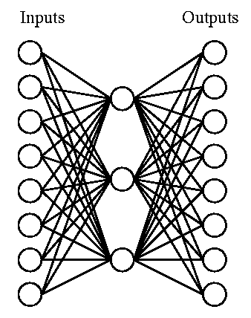
Artificial Neural Networks (ANNs)
Biologically inspired computational model:
Simple computational units (neurons).
Highly interconnected - connectionist view
Vast parallel computation, consider:
Human brain has ~10¹¹ neurons
Slow computational units, switching time ~10⁻³ sec (compared to the computer >10⁻¹⁰ sec)
Yet, you can recognize a face in ~10⁻¹ sec
This implies only about 100 sequential, computational neuron steps - this seems too low for something as complicated as recognizing a face
Parallel processing
ANNs are naturally parallel - each neuron is a self-contained
computational unit that depends only on its inputs.
Notes:
1

Slide 2
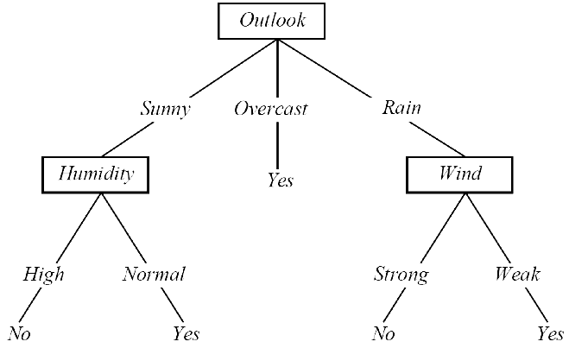
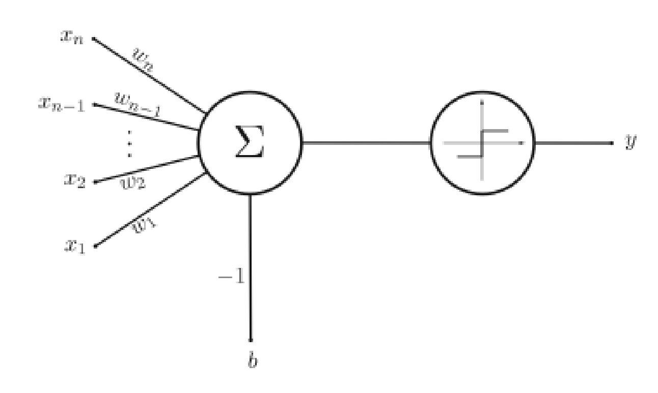
Learning
We have seen machine learning with different representations:
Decision trees -- symbolic representation of various decision rules -- “disjunction of conjunctions”
Perceptron -- learning of weights that represent alinear decision surface classifying a set of objects into two groups
Different representations give rise to different hypothesis or model spaces.
Machine learning algorithms search these model spaces for the best fitting model.
Notes:
2

Slide 3
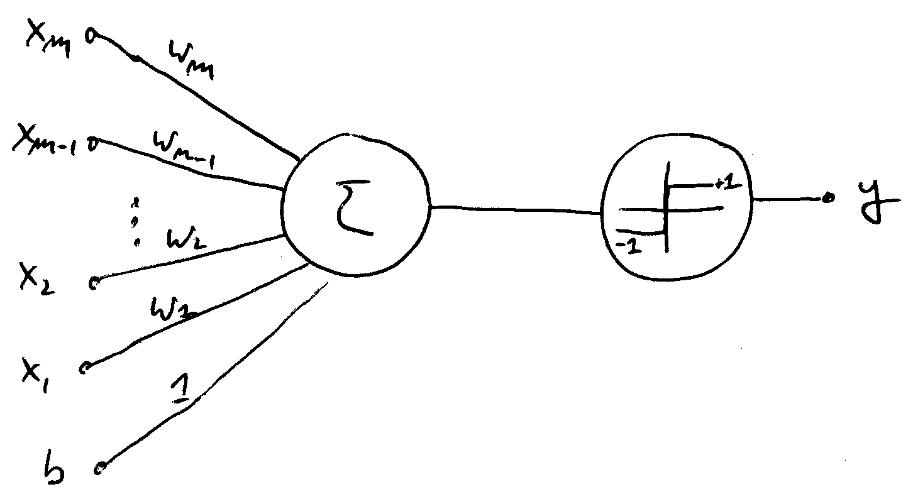
The Perceptron
A simple, single layered neural “network” - only has a single neuron.
However, even this simple neural network is already powerful enough to perform classification tasks.
Notes:
3

Slide 4
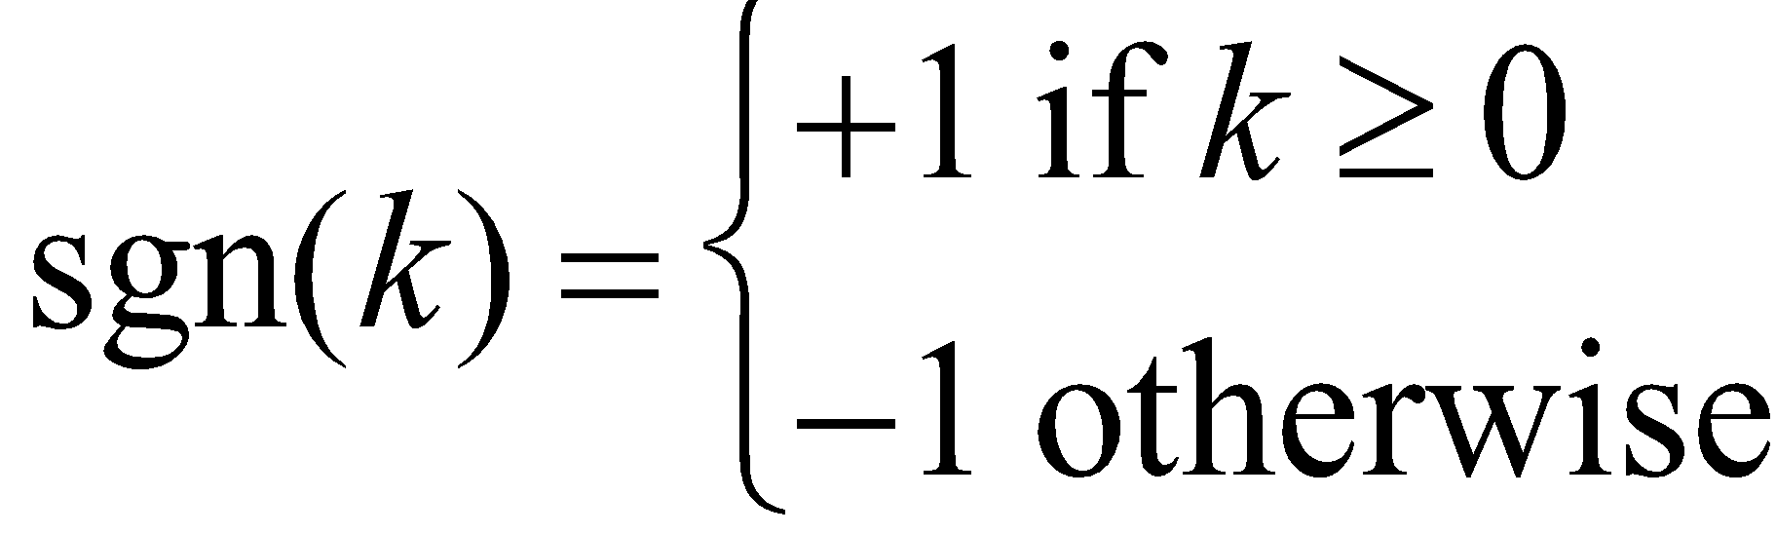
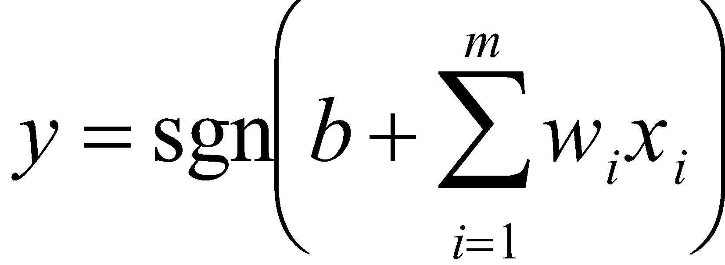
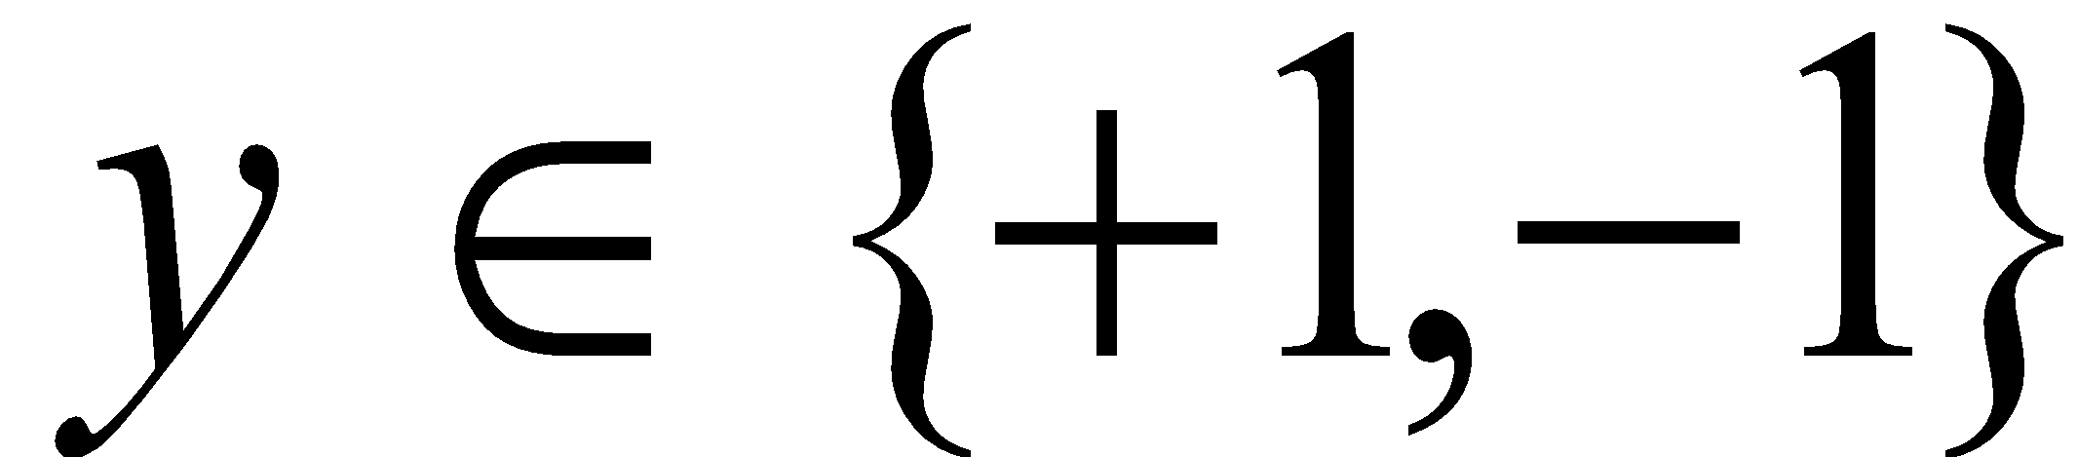
The Architecture
Weights
Computational Unit
Output
Inputs
Transfer Function:
Bias
Multiplication
Sum
Transfer Function
Perceptron Computation:
Note:
Binary Classification
Notes:
4

Slide 5
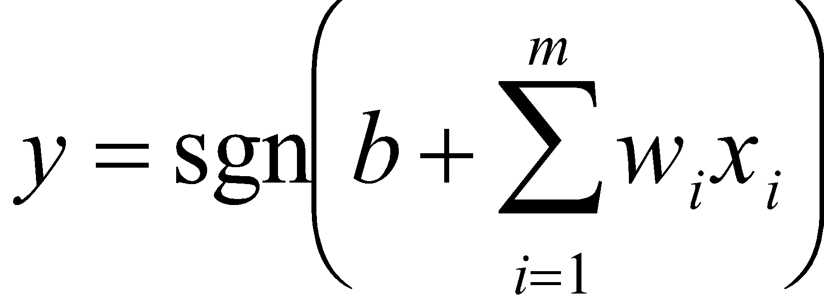
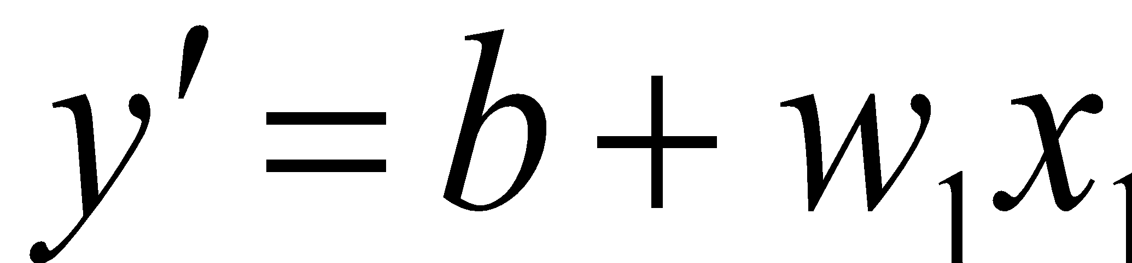
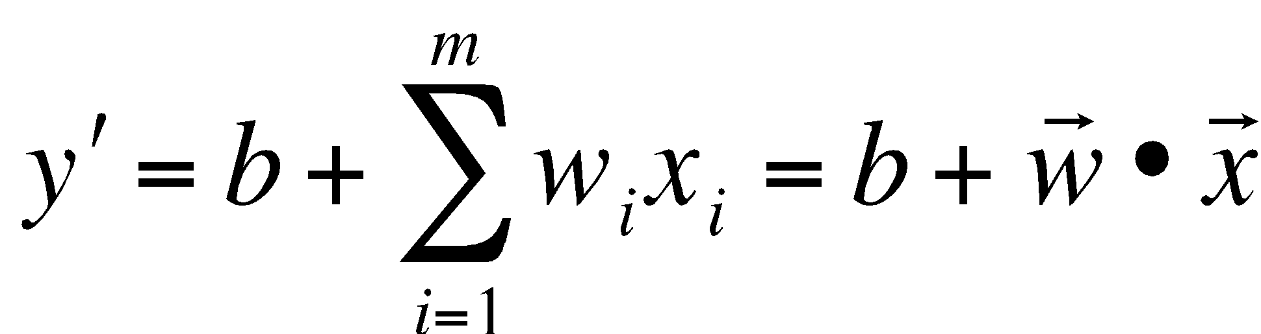
Computation
A perceptron computes the value,
Ignoring the activation function sgn and setting m = 1, we obtain,
But this is the equation of a line with slope w and offset b.
Observation: For the general case the perceptron computes a hyperplane in order
to accomplish its classification task,
Notes:
5

Slide 6
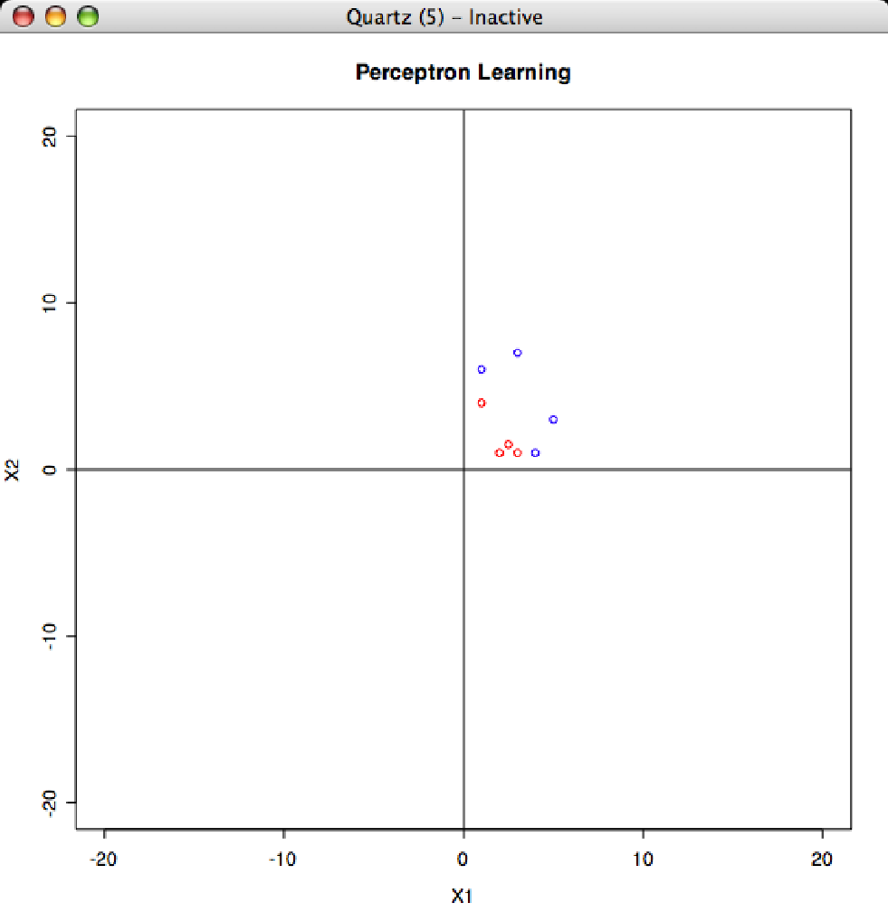
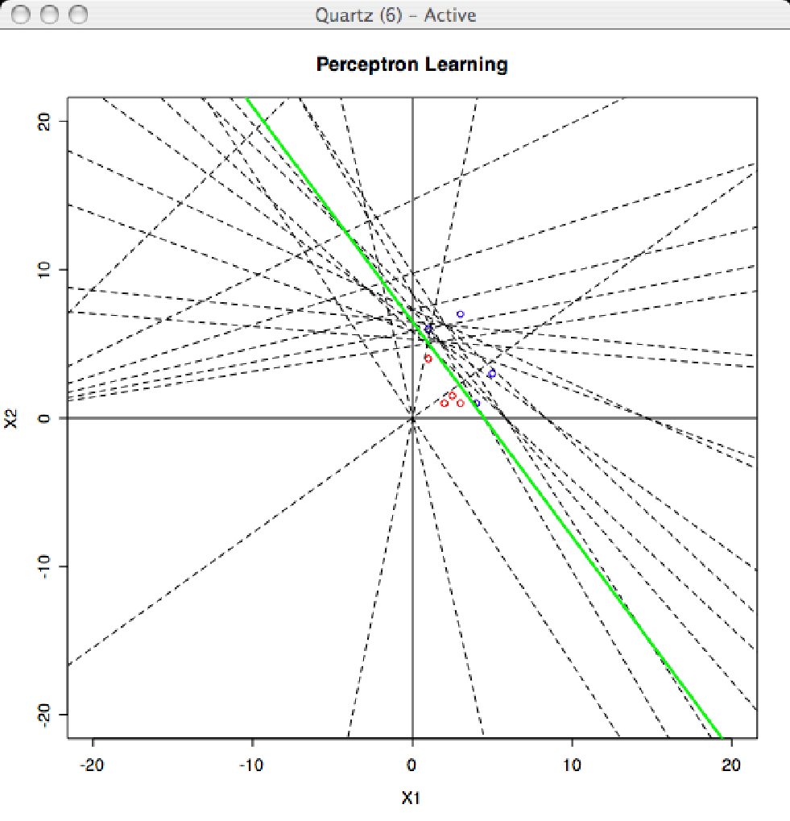
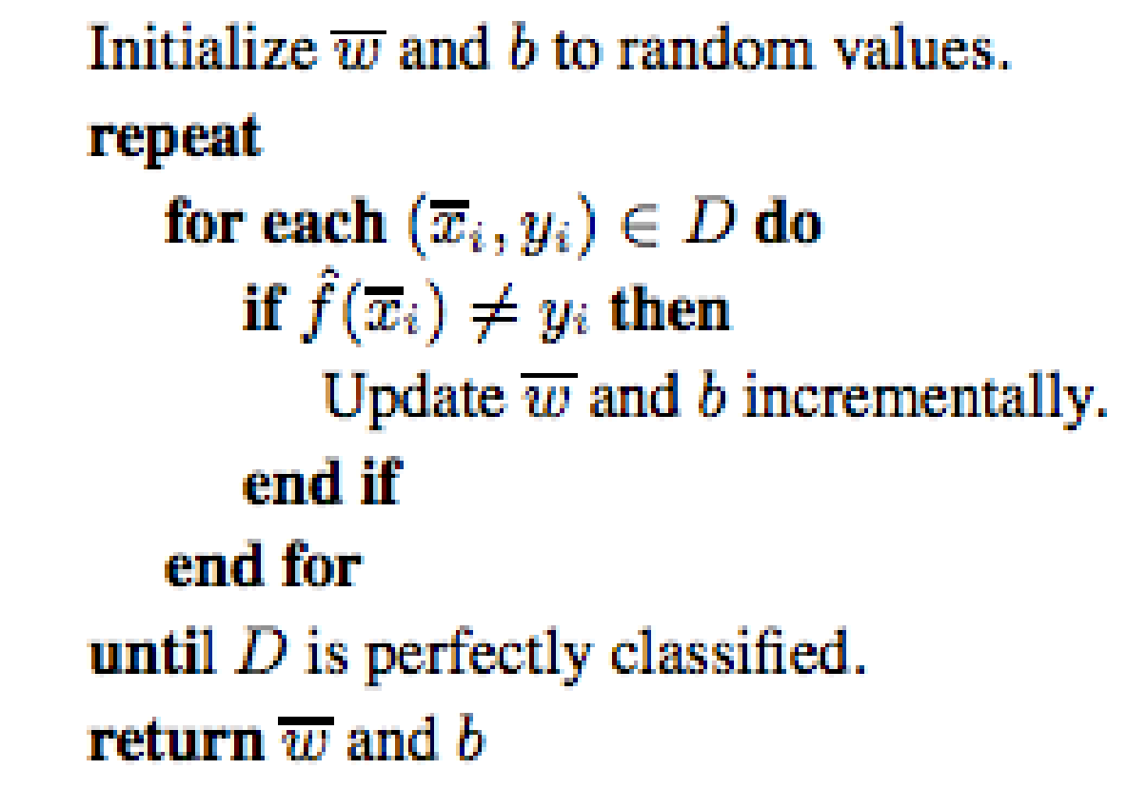
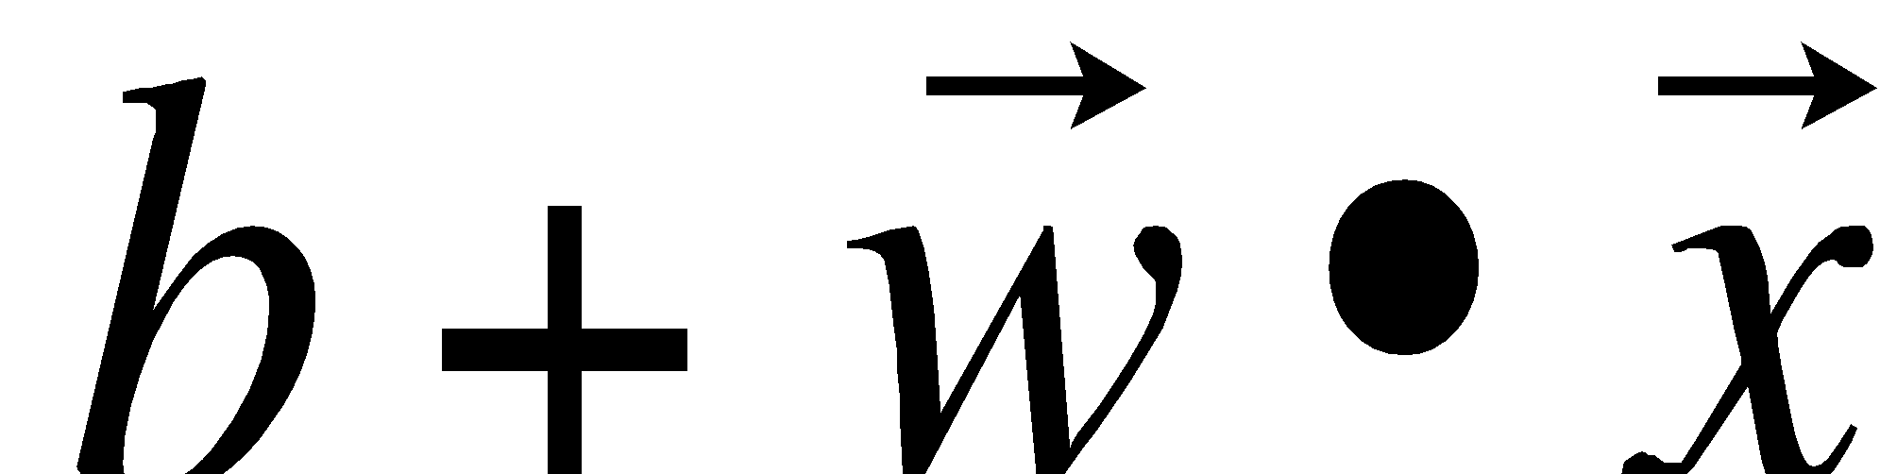
Perceptron Learning Revisited
Constructs a line (hyperplane) as a classifier
Notes:
6

Slide 7
Classification
x₂
= +1
= -1
x₁
In order for the hyperplane to become a classifier we need to find b and w => learning!
Notes:
7

Slide 8
What About Non-Linearity?
x₂
= +1
= -1
Decision Surface
x₁
Can we learn this decision surface? …Yes! Multi-Layer Perceptronsl.
Notes:
8

Slide 9
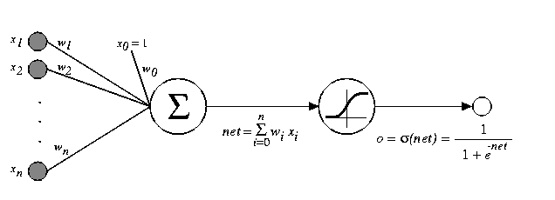
Multi-Layer Perceptrons
Input Layer
Hidden Layer
Output Layer
x_{n}
X_{n-1}
…
y
x₂
x₁
x₀
≡
≡
Linear Unit
Combination
Function
Transfer
Function
Notes:
9

Slide 10
How do we train?
Perceptron was easy:
error
Every time we found an error of the predicted value f(x_{i}) compared to the label in the training set y_{i}, we update w and b.

Slide 11
Artificial Neural Networks
Feed-forward with Backpropagation
Input Layer
Hidden Layer
Output Layer
We have to be a bit smarter in the case of ANNs: compute the error (feed forward) and then use the error to update all the weights by propagating the error back.
x_{n}
X_{n-1}
…
y
x₂
x₁
x₀
Signal Feed-forward
Error Backpropagation

Slide 12
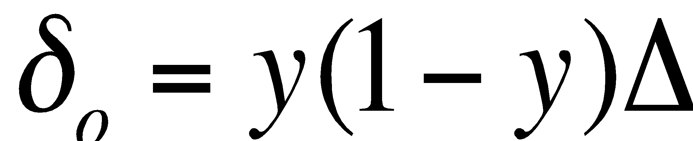
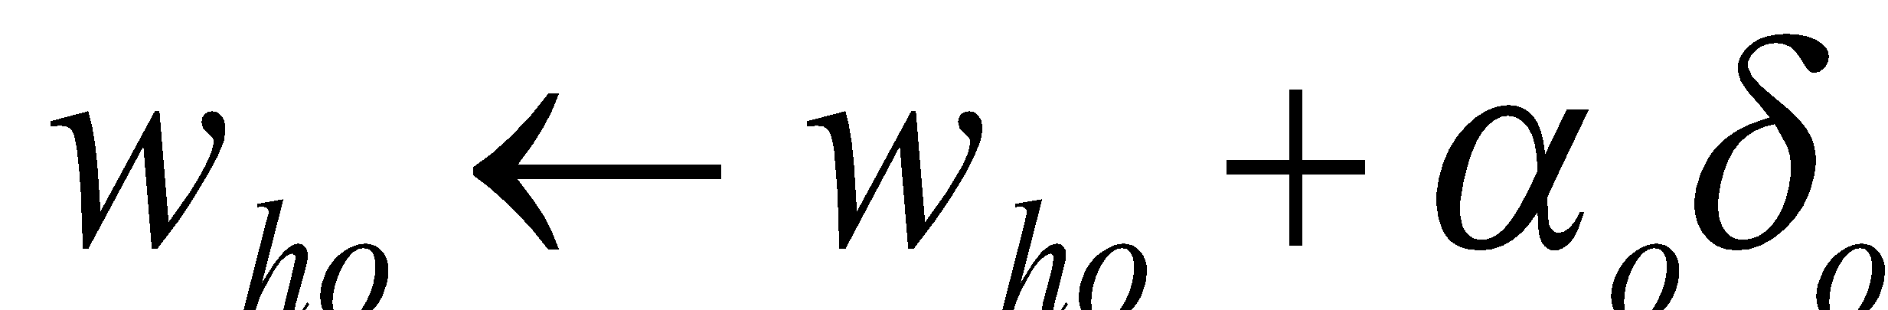
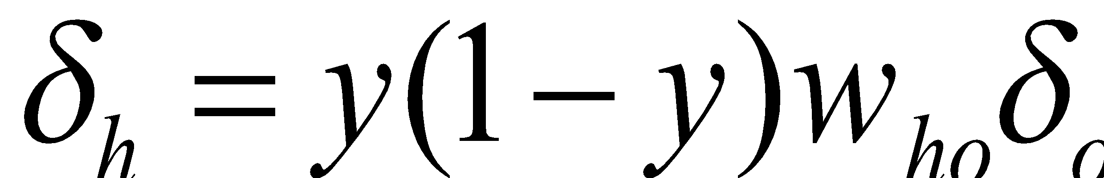
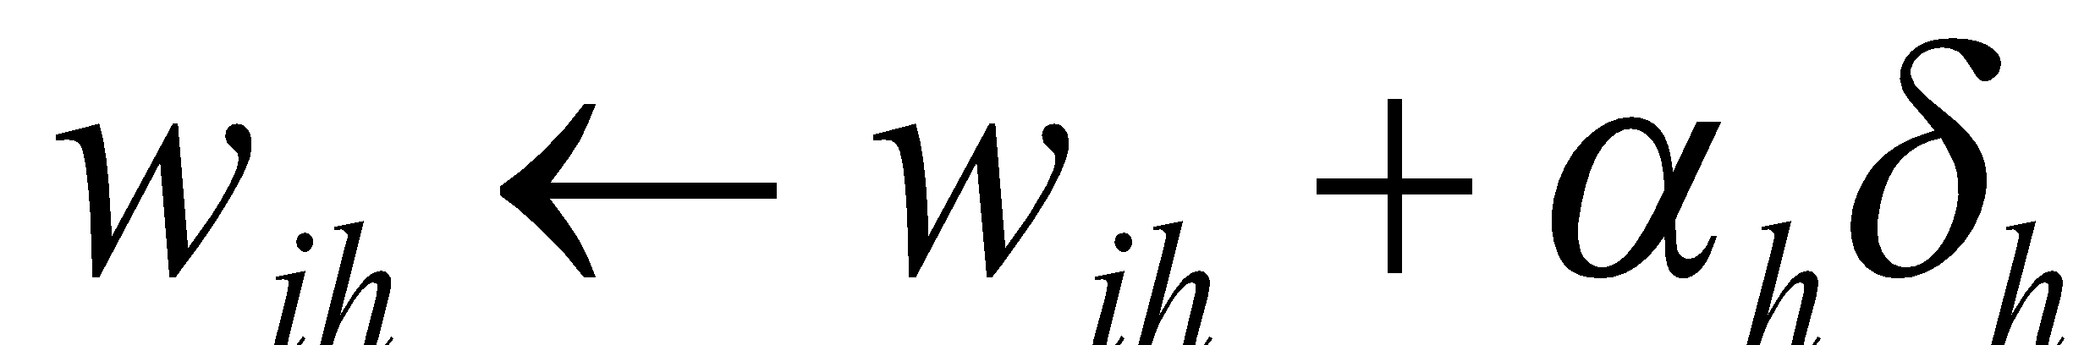
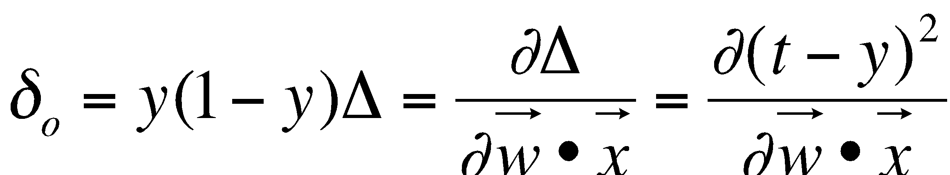
Backpropagation
Input Layer
Hidden Layer
Output Layer
Δ = (t - y)²
x_{n}
i
w_{ih}
δ_{h}
X_{n-1}
h
w_{ho}
δ_{o}
…
o
y
x₂
x₁
x₀
This only works because
and the output y is differentiable because the transfer function is differentiable. Also note, everything is based on the rate of change of the error…we are searching in the direction where the rate of change will minimize the output error.

Slide 13
Backpropagation Algorithm
Note: this algorithm is for a NN with a single output node o and a single hidden layer. It can easily be generalized.
Initialize the weights in the network (often randomly)
Do
For each example e in the training set
// forward pass
y = compute neural net output
t = label for e from training data
Calculate error Δ = (t - y)² at the output units
// backward pass
Compute error δ_{o} for weights from a hidden node h to the output node o using Δ
Compute error δ_{h} for weights from an input node i to hidden node h using δ_{o}
Update the weights in the network
Until all examples classified correctly or stopping criterion satisfied
Return the network
Source: http://en.wikipedia.org/wiki/Backpropagation
Notes:
13

Slide 14
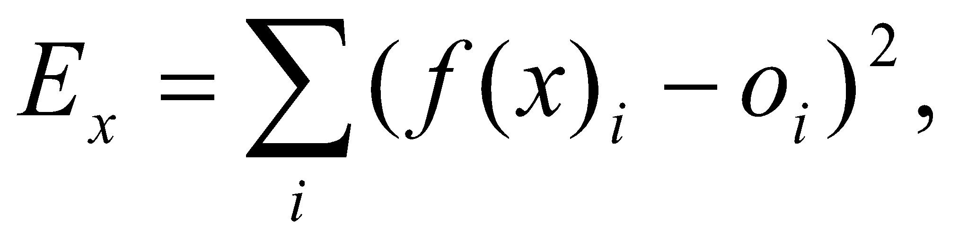
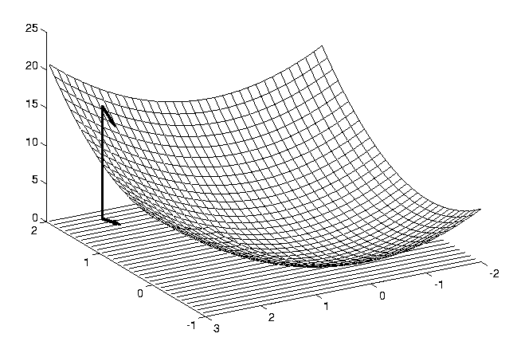
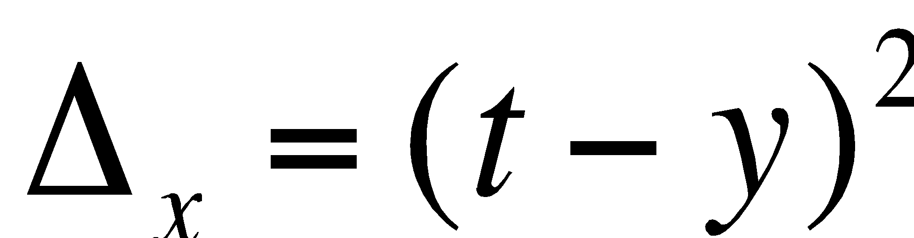
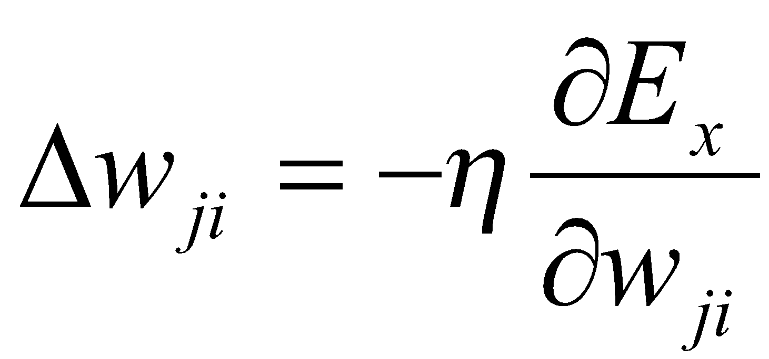
Neural Network Learning
Define the network error as for some x∈X, where i is an index over the output units.
Let ∆_{x}(w) be the error E_{x} as a function of the weights w.
Use the gradient (slope) of the error surface to guide the search towards appropriate weights:
E_{x}(w)
w₀
w₁
∂
∆
Δ
w
=
−
η
x
k
∂
w
k
Notes:
14

Slide 15
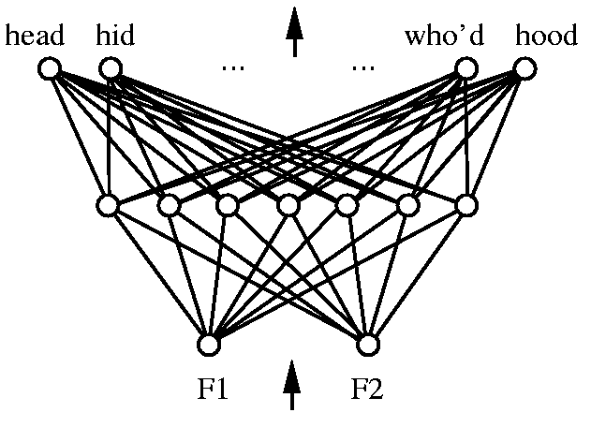
Representational Power
Every bounded continuous function can be approximated with arbitrarily small error by a network with one hidden layer.
Any function can be approximated to arbitrary accuracy by a network with two hidden layers.
Notes:
15

Slide 16
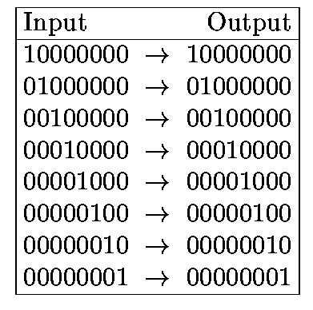
Hidden Layer Representations
Target Function:
Can this be learned?
Notes:
16

Slide 17
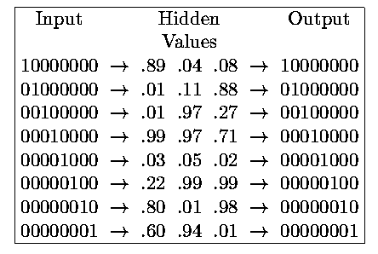
Hidden Layer Representations
1 0 0
0 0 1
0 1 0
1 1 1
0 0 0
0 1 1
1 0 1
1 1 0
Hidden layers allow a network to invent appropriate internal representations.
Notes:
17

Slide 18
MLPClassifier
import pandas as pd
from sklearn.neural_network import MLPClassifier
from sklearn.model_selection import cross_val_score
from sklearn.metrics import accuracy_score
from sklearn.metrics import confusion_matrix
# get data
df = pd.read_csv("assets/wdbc.csv")
df = df.drop(['ID'],axis=1)
X = df.drop(['Diagnosis'],axis=1)
y = df['Diagnosis']
# neural network
model = MLPClassifier(hidden_layer_sizes=(15,))
# do the 5-fold cross validation
scores = cross_val_score(model, X, y, cv=5)
print("Fold Accuracies: {}".format(scores))
print("Accuracy: {}".format(scores.mean()))
Fold Accuracies: [ 0.87591241 0.95620438 0.95620438 0.98540146 0.98518519]
Accuracy: 0.9517815625844823

Slide 19
MLP Grid Search
We can also perform a grid search
BEWARE: a grid search over all possible parameters of an MLP is almost impossible - combinatoric explosion, too many different combinations possible.
Here we only perform a grid over the number of nodes in a single hidden layer.

Slide 20
MLP Grid Search
# neural network model = MLPClassifier(max_iter=2000) # grid search param_grid = {'hidden_layer_sizes': [ (5,), (6,), (7,), (8,), (9,), (10,), (11,), (12,), (13,), (14,), (15,), (16,), (17,), (18,), (19,), (20,)]} grid = GridSearchCV(model, param_grid, cv=5) grid.fit(X, actual_y) print("Grid Search: best parameters: {}".format(grid.best_params_)) # evaluate the best model best_model = grid.best_estimator_ predict_y = best_model.predict(X) print("Accuracy: {}".format(accuracy_score(actual_y, predict_y))) # build the confusion matrix labels = ['benign', 'malignant'] cm = confusion_matrix(actual_y, predict_y, labels=labels) cm_df = pd.DataFrame(cm, index=labels, columns=labels) print("Confusion Matrix:\n{}".format(cm_df)) # boostrapped confidence interval print("Confidence interval best MLP: {}".format(bootstrap(best_model,df,'class')))

Slide 21
MLP Grid Search
Grid Search: best parameters: {'hidden_layer_sizes': (9,)} Accuracy: 0.9707174231332357 Confusion Matrix: benign malignant benign 435 9 malignant 11 228 Confidence interval best MLP: (0.93412408759124088, 0.9928832116788322)

Slide 22
Team Exercise
Use the Crohn’s Disease dataset: CrohnD
https://vincentarelbundock.github.io/Rdatasets/datasets.html
You will need to preprocess this before you can use it: c1 -> 0, c2 -> 1, F -> 0, M -> 1
Build a ANN/MLP with the best cross-validated performance you can find.
Compare it to either a tree or a KNN (or both).
Report if the difference between the models is statistically significant.
Teams:
Team 0: Shehjar Harout Geron
Team 1: Aakash Cory Christopher
Team 2: Maurice Kevin Ben
Team 3: Najib Aguilar Ronil
Team 4: Joe Shamal Gabe
Team 5: Kermalyn Peter David_M
Team 6: Matt Alexander Alber
Team 7: Evelyn Susallin David_P

