Slide 1
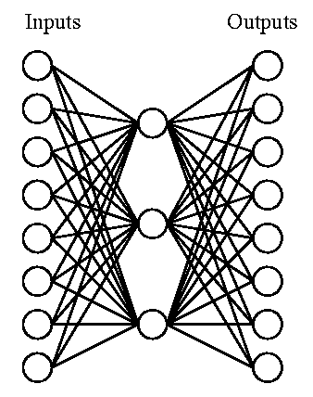
Artificial Neural Networks (ANNs)
Biologically inspired computational model:
Simple computational units (neurons).
Highly interconnected - connectionist view
Vast parallel computation, consider:
Human brain has ~10¹¹ neurons
Slow computational units, switching time ~10⁻³ sec (compared to the computer >10⁻¹⁰ sec)
Yet, you can recognize a face in ~10⁻¹ sec
This implies only about 100 sequential, computational neuron steps - this seems too low for something as complicated as recognizing a face
Parallel processing
ANNs are naturally parallel - each neuron is a self-contained
computational unit that depends only on its inputs.
Notes:
1

Slide 2
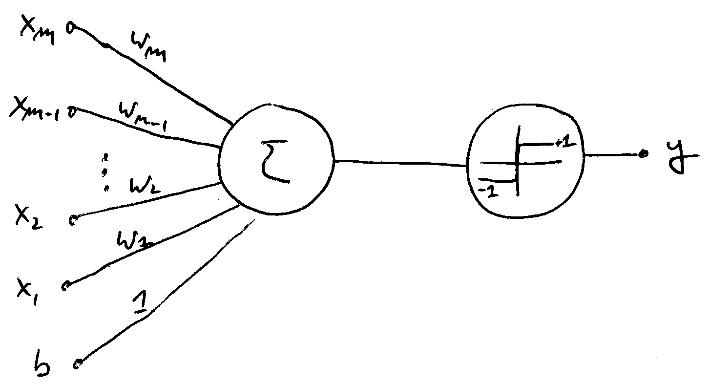
The Perceptron
A simple, single layered neural “network” - only has a single neuron.
However, even this simple neural network is already powerful enough to perform classification tasks.
Notes:
2

Slide 3
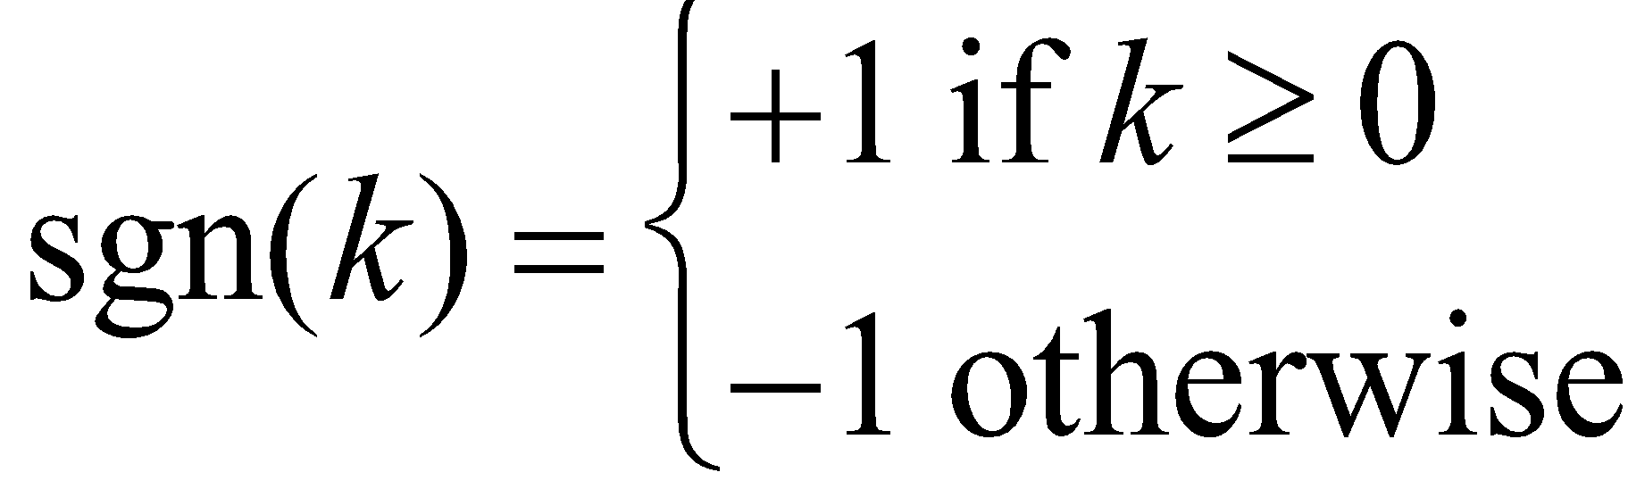
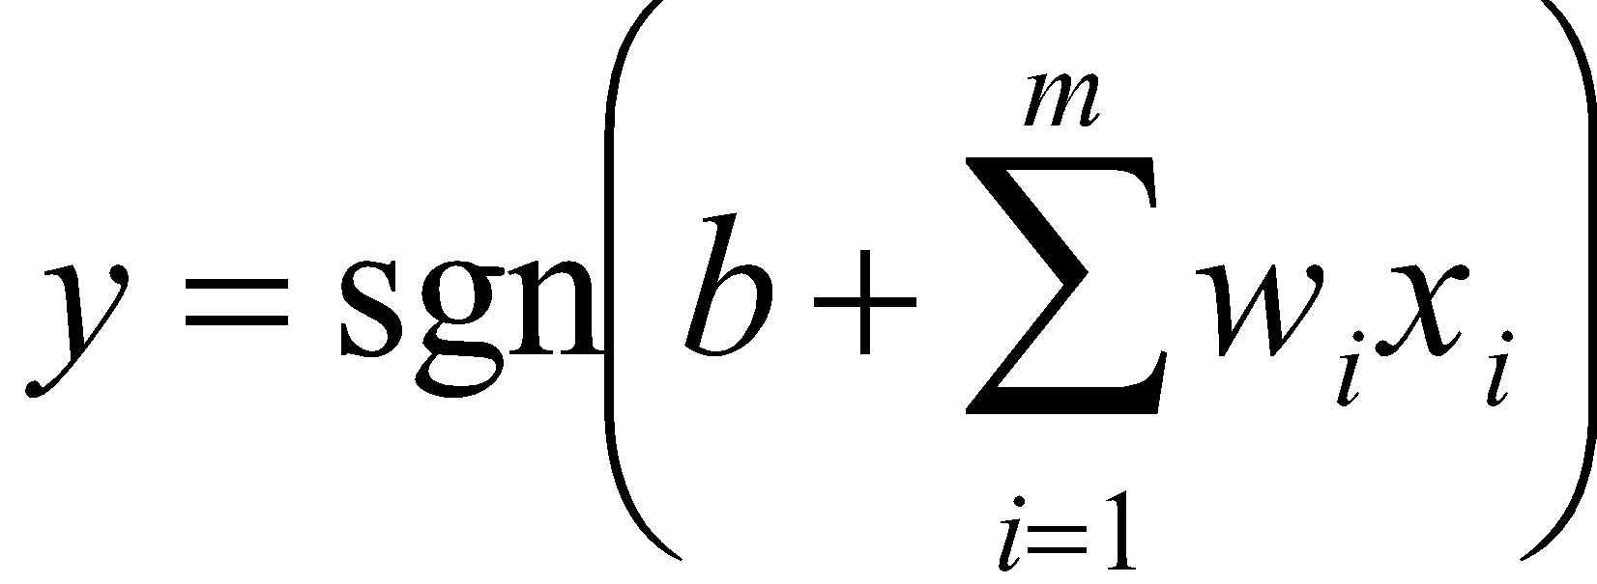
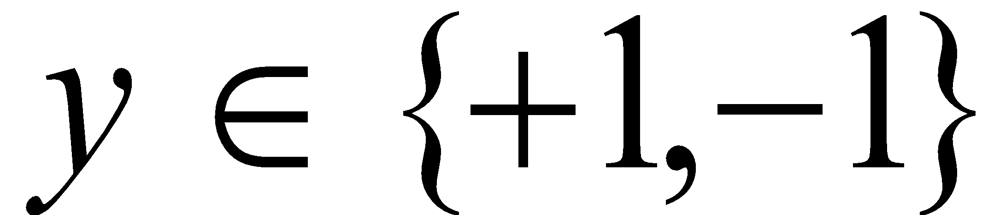
The Architecture
Weights
Computational Unit
Output
Inputs
Transfer Function:
Bias
Multiplication
Sum
Transfer Function
Perceptron Computation:
Note:
Binary Classification
Notes:
3

Slide 4
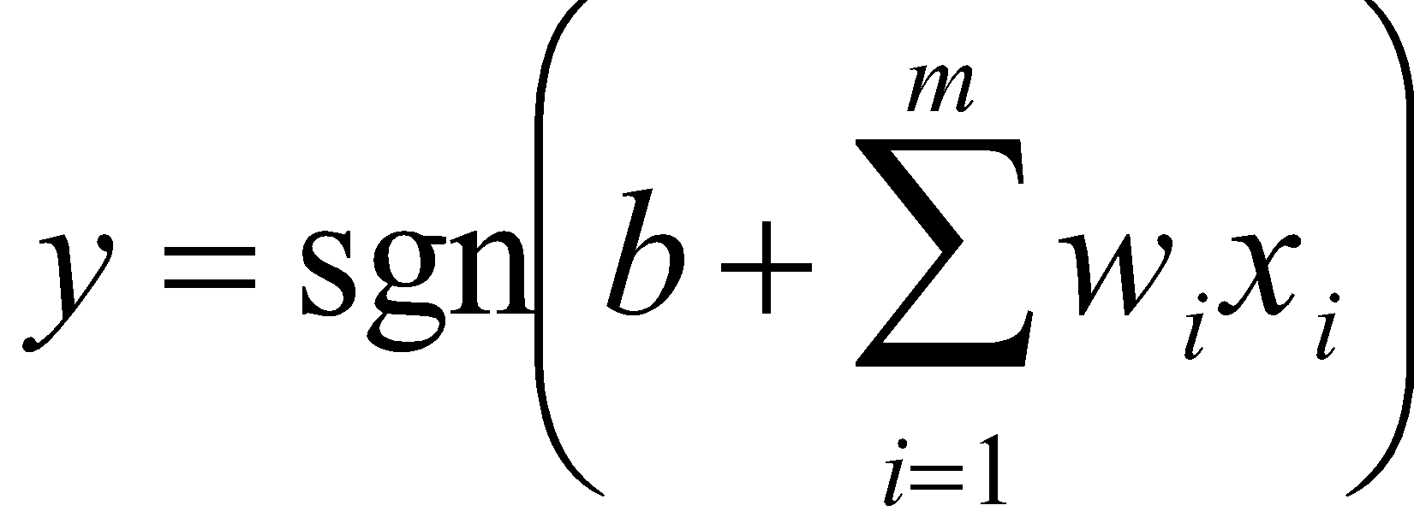
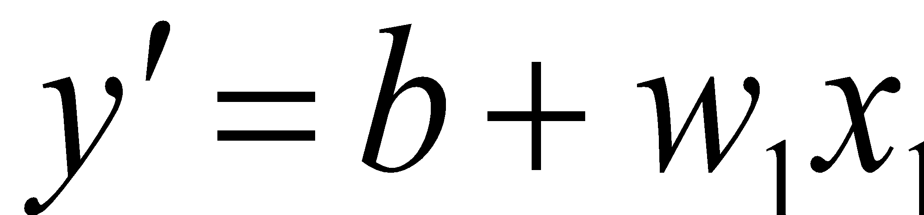
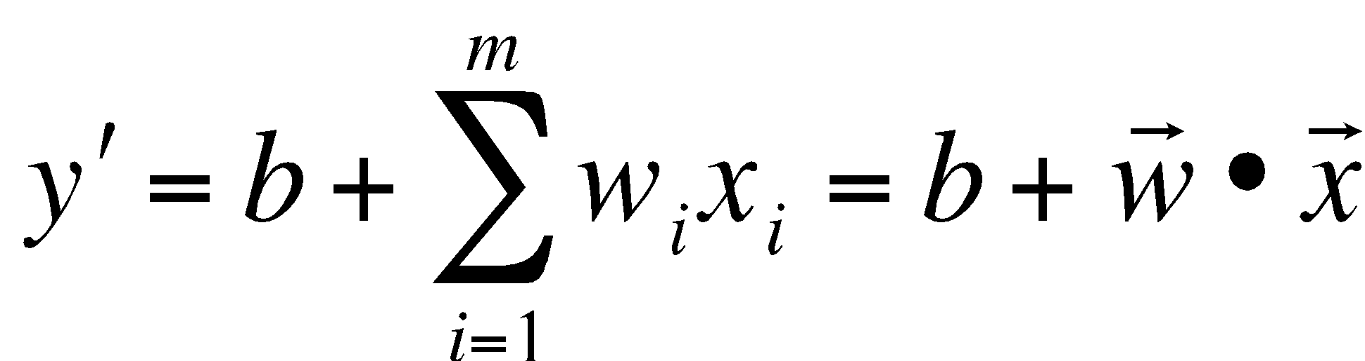
Computation
A perceptron computes the value,
Ignoring the activation function sgn and setting m = 1, we obtain,
But this is the equation of a line with slope w and offset b.
Observation: For the general case the perceptron computes a hyperplane in order
to accomplish its classification task,
Notes:
4

Slide 5
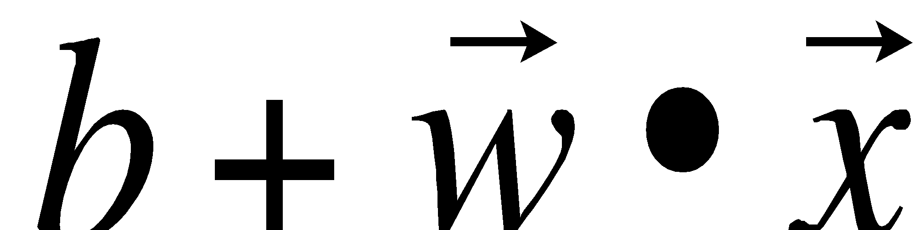
Classification
x₂
= +1
= -1
x₁
In order for the hyperplane to become a classifier we need to find b and w => learning!
Notes:
5

Slide 6
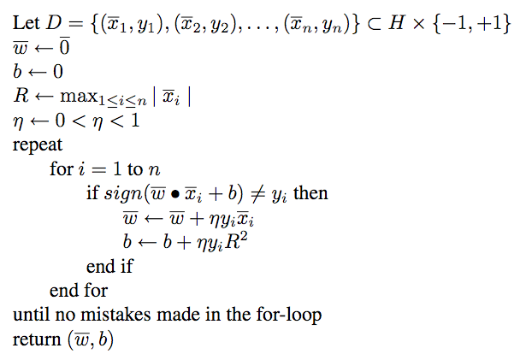
Learning Algorithm
Note: learning is very different here compared to decision trees…here we have
many passes over the data until the perceptron converges on a solution.
Notes:
6

Slide 7
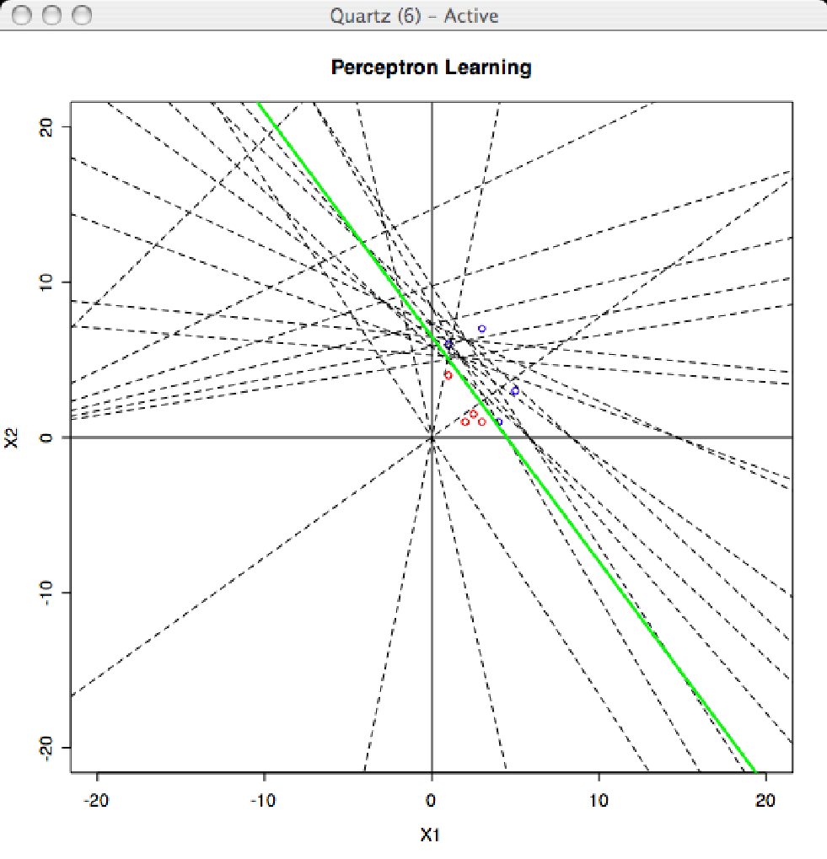
Demo
R perceptron demo
Notes:
7

Slide 8
Observations
The learned information is represented as weights and the bias ⇒ sub-symbolic learning
In order to apply this learned information we need a neural network structure
The learned information is not directly accessible to us ⇒ non-transparent model
Notes:
8

