Slide 1

Machine Learning

Slide 2
What is Machine Learning?
“The ability of a computer to learn without being explicitly programmed”
Arthur Samuel – IBM’er and Stanford Professor in 1959
“Systems that can learn from data”
“A computer program is said to learn from experience E with respect to some class of tasks T and performance measure P, if its performance at tasks in T, as measured by P, improves with experience E.”
Tom Mitchell
Notes:
E = the experience of playing checkers
T = task of playing checkers
P = probability that the program will win the game

Slide 3
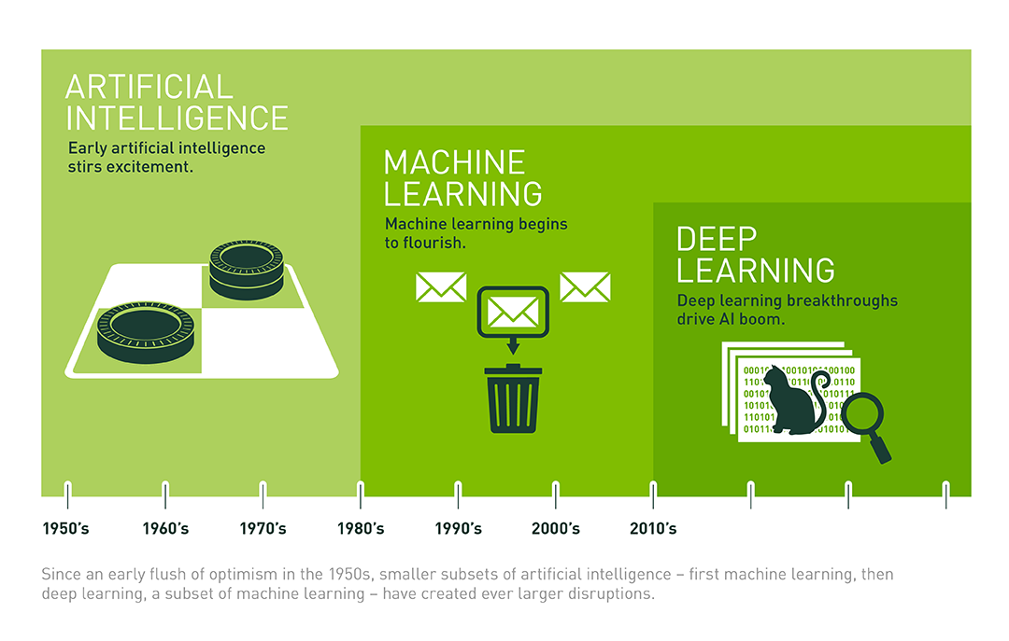
Is Machine Learning a form of Artificial Intelligence?
Notes:
Yes – and no.
Machine Learning is not artificial intelligence in the way most people would think of it. It isn’t behaving as a person would.
Machine Learning at its most basic is the practice of using algorithms to parse data, learn from it, and then make a determination or prediction about something in the world. So rather than hand-coding software routines with a specific set of instructions to accomplish a particular task, the machine is “trained” using large amounts of data and algorithms that give it the ability to learn how to perform the task.

Slide 4
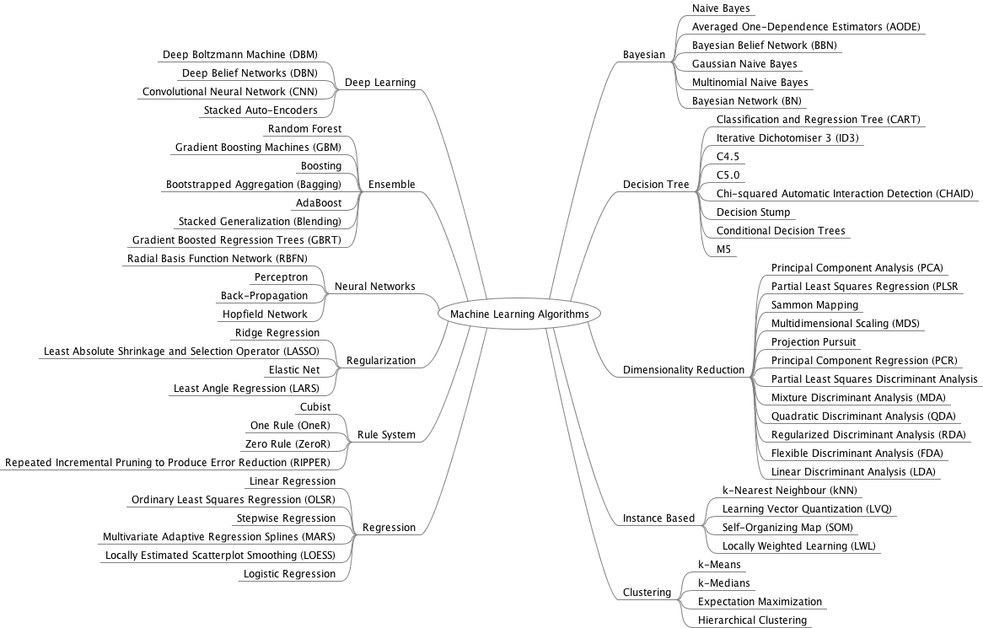
Machine Learning Algorithms
Notes:
From Machine Learning Mastery - https://s3.amazonaws.com/MLMastery/MachineLearningAlgorithms.png?__s=mjspzupssvshzononf3j

Slide 5
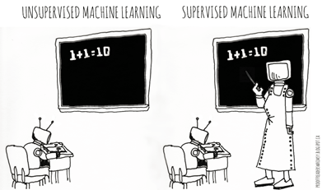
Categories of Machine Learning
Supervised learning
The program is “trained” on a pre-defined set of “training examples”, which then facilitate its ability to reach an accurate conclusion when given new data
The algorithm is presented with example inputs and their outcomes (labels)
The goal is to learn a general rule that maps inputs to outputs
Unsupervised learning
No labels are given to the learning algorithm, leaving it on its own to find structure (patterns and relationships) in its input

Slide 6
Categories of Machine Learning
 | Discrete Output | Continuous Output
Supervised Learning (require Ground-Truth) | Classification (outcome is discrete) Binary Classification Linear Models (Logistic Regression) Decision Trees Naïve Bayes Multi class Classification Decision Trees Naïve Bayes K-NN | Regression Linear Ridge Lasso Decision Trees Random Forest Gradient Boosted Trees
Unsupervised Learning (no Ground-Truth data required) | Clustering k-means FP-Growth | Clustering k-means Gaussian Mixture Dimensionality Reduction PCA SVD

Slide 7
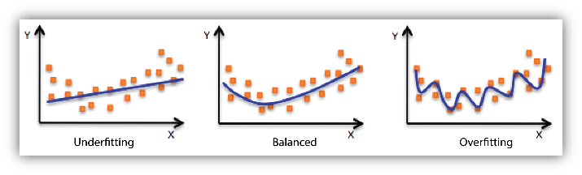
Learning challenges
Fitting: fitting the model to the underlying data
Underfitting: refers to a model that can neither model the training data nor generalize to new data.
Overfitting: refers to a model that models the training data too well. Overfitting happens when a model learns the detail and noise in the training data to the extent that it negatively impacts the performance of the model on new data.
Notes:
Poor performance on the training data could be because the model is too simple (the input features are not expressive enough) to describe the target well. Performance can be improved by increasing model flexibility. To increase model flexibility, try the following:
Add new domain-specific features and more feature Cartesian products, and change the types of feature processing used (e.g., increasing n-grams size)
Decrease the amount of regularization used
If your model is overfitting the training data, it makes sense to take actions that reduce model flexibility. To reduce model flexibility, try the following:
Feature selection: consider using fewer feature combinations, decrease n-grams size, and decrease the number of numeric attribute bins.
Increase the amount of regularization used.
Accuracy on training and test data could be poor because the learning algorithm did not have enough data to learn from. You could improve performance by doing the following:
Increase the amount of training data examples.
Increase the number of passes on the existing training data.

Slide 8
Learning challenges
Compromise between bias and variance:
Prediction
Error
Variance (over fitting)
Bias (under fitting)
Overly
simple
model
Good
model
Over-
fitted
model
Complexity of the model
Notes:
Variance:

Slide 9
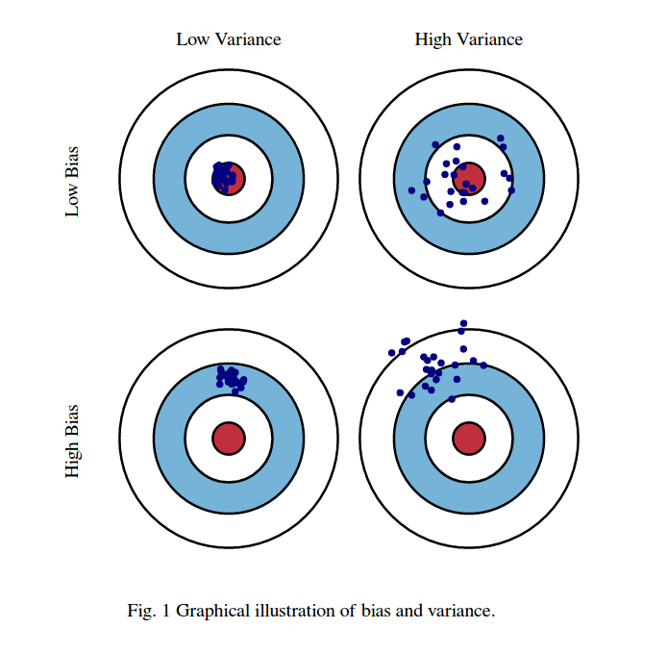
Graphical illustration of bias vs variance
Notes:
These pictures are taken from http://scott.fortmann-roe.com/docs/BiasVariance.html

Slide 10
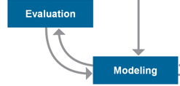
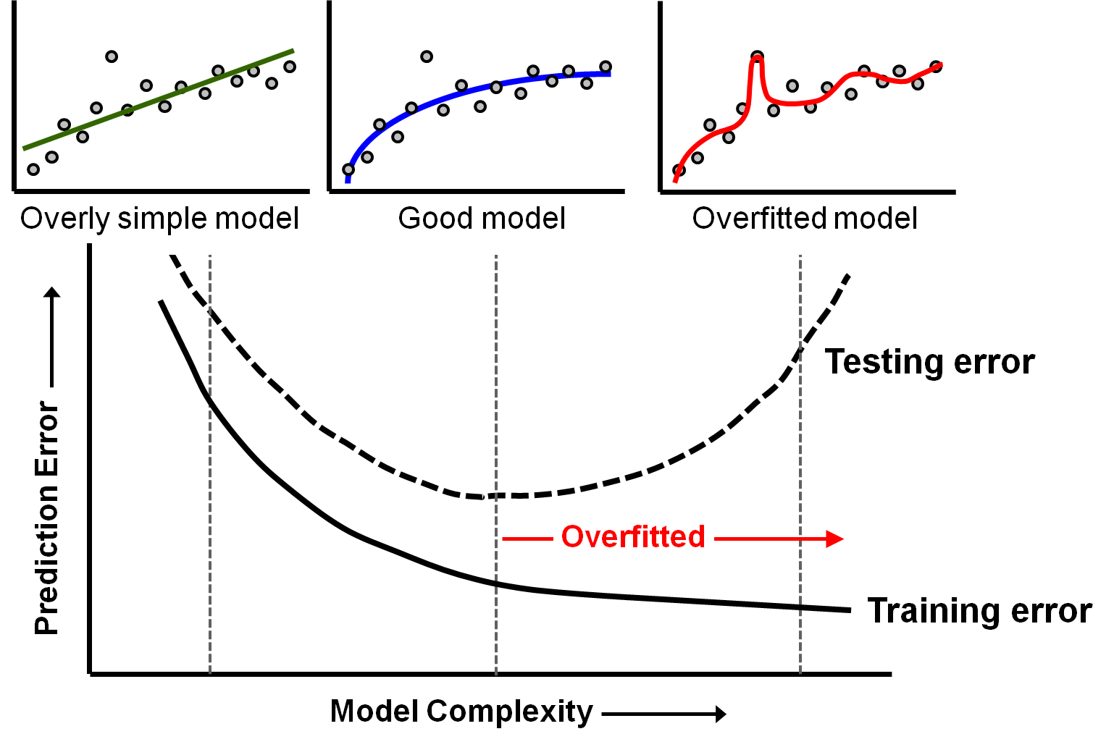
When to stop training a model
Notes:
So, how do we know when to stop the model building process?
We want to build the best model that will be useful when applied to new data.
This means that we want enough complexity to generate meaningful predictions but not so much complexity that the model will not perform well on new data.
As long as the prediction error on the testing data continues to decline with increasing model complexity, we are getting a better model.
But when the testing error begins to increase, we have begun to overfit the model to the training data. (Note that the training error will continue to decline as we fit the training data better and better with increasing model complexity.)
The optimal degree of training is where the testing error reaches its minimum point as shown in the graph.
Many model building algorithms have the ability to check for overfitting during the model building process, so that model refinement will automatically stop when it should.
Note: If this “best model” is inadequate for solving the problem, then we’ll need to go back to considering our analytic approach, data collection, and data preparation stages.
Note: Depending on how they are implemented, many machine learning algorithms have internal controls to control overfitting (such as an automatic “holdout sample” or ability to specify the testing set, for computing and comparing the testing error to the training error during model building).
Reference: Diagram is after Fig. 1 in http://scott.fortmann-roe.com/docs/MeasuringError.html

Slide 11
Learning challenges
Diminishing returns:
People can:
Have more or less talent
get bored or enthusiastic
Machines will not, however:
Making progress initially is usually more easy, but improving gets harder as we move along. We may need to try different learning methods, styles to keep going:
Machine learning algorithms have hyper-parameters which need to be tuned properly (cross validation method in Spark).
It may be necessary to use more than just one single method / algorithm to reach the goal.

Slide 12
Preprocessing: Matrix for Machine Learning
Known as:
Attributes
Features
Predictor variables
Explanatory variables
a1 a2 a3 a4 a5 a6 a7 a8 a9 t
Scale variables:
Continuous variables, which can be measured on an interval scale or ratio scale
‘Weight’, ‘Temperature’, ‘Salary’, etc…
Categorical variables:
Data with a limited number of distinct values or categories (nominal or ordinal)
‘Hair color’, ‘Gender’, ‘Grape varieties’, etc…
Known as:
Label
Target variable
Dependent variable
Can be Scale or Categorical

Slide 13
Training, testing, & validation sets
During the model development process, supervised learning techniques employ training and testing sets and sometimes a validation set.
Historical data with known outcome
Data is randomly split into training, testing, and/or validation sets (mutually exclusive records)
Why?
Training set
Build the model
Tune the parameters
Testing set
Assess model quality during training/tuning process
Avoid overfitting the model to the training set
Validation set
Estimate accuracy or error rate of model after tuning
Used to compare multiple models

Slide 14
Spark ML
Spark ML is Spark’s machine learning (ML) library
Goal is to make machine learning scalable and easy
No need to understand the detailed math!
Divides into two packages:
spark.mllib contains the original API built on top of RDDs
spark.ml provides higher-level API built on top of DataFrames for constructing ML pipelines
A pipeline is a series of stages where each stage either transforms data or runs through a machine learning algorithm.
Using spark.ml is recommended because with DataFrames the API is more versatile and flexible
spark.mllib will continue to be supported

Slide 15
Spark ML Pipeline Terminology
Spark ML standardizes APIs for machine learning algorithms to make it easier to combine multiple algorithms into a single pipeline, or workflow
DataFrame: Spark ML uses DataFrame from Spark SQL as an ML dataset, which can hold a variety of data types
Transformer: A Transformer is an algorithm which can transform one DataFrame into another DataFrame
Estimator: An Estimator is an algorithm which can be fit on a DataFrame to produce a Transformer
Pipeline: A Pipeline chains multiple Transformers and Estimators together in a sequence to specify an ML workflow
Parameter: All Transformers and Estimators share a common API for specifying parameters

Slide 16


