Slide 1
Spatiotemporal trends in salmon metapopulation contributions to portfolio effects in Western Alaska

Slide 2
Crisis in Western Alaska

Slide 3
This puts managers in a bind. Allow harvest, but protect fish

Slide 4
Portfolio effect, difference between pop health and stock health

Slide 5
Our sample set, focus on Kusko

Slide 6
Otoliths, assigning fish, ind assignment to pop assignment

Slide 7
So what does just basin returns look like
Returns * year

Slide 8
Within Quartile Run timing
Returns * CPUE over time by quartile at the basin scale

Slide 9
Within year run timing
Returns * CPUE over time by quartile, trib scale.

Slide 10
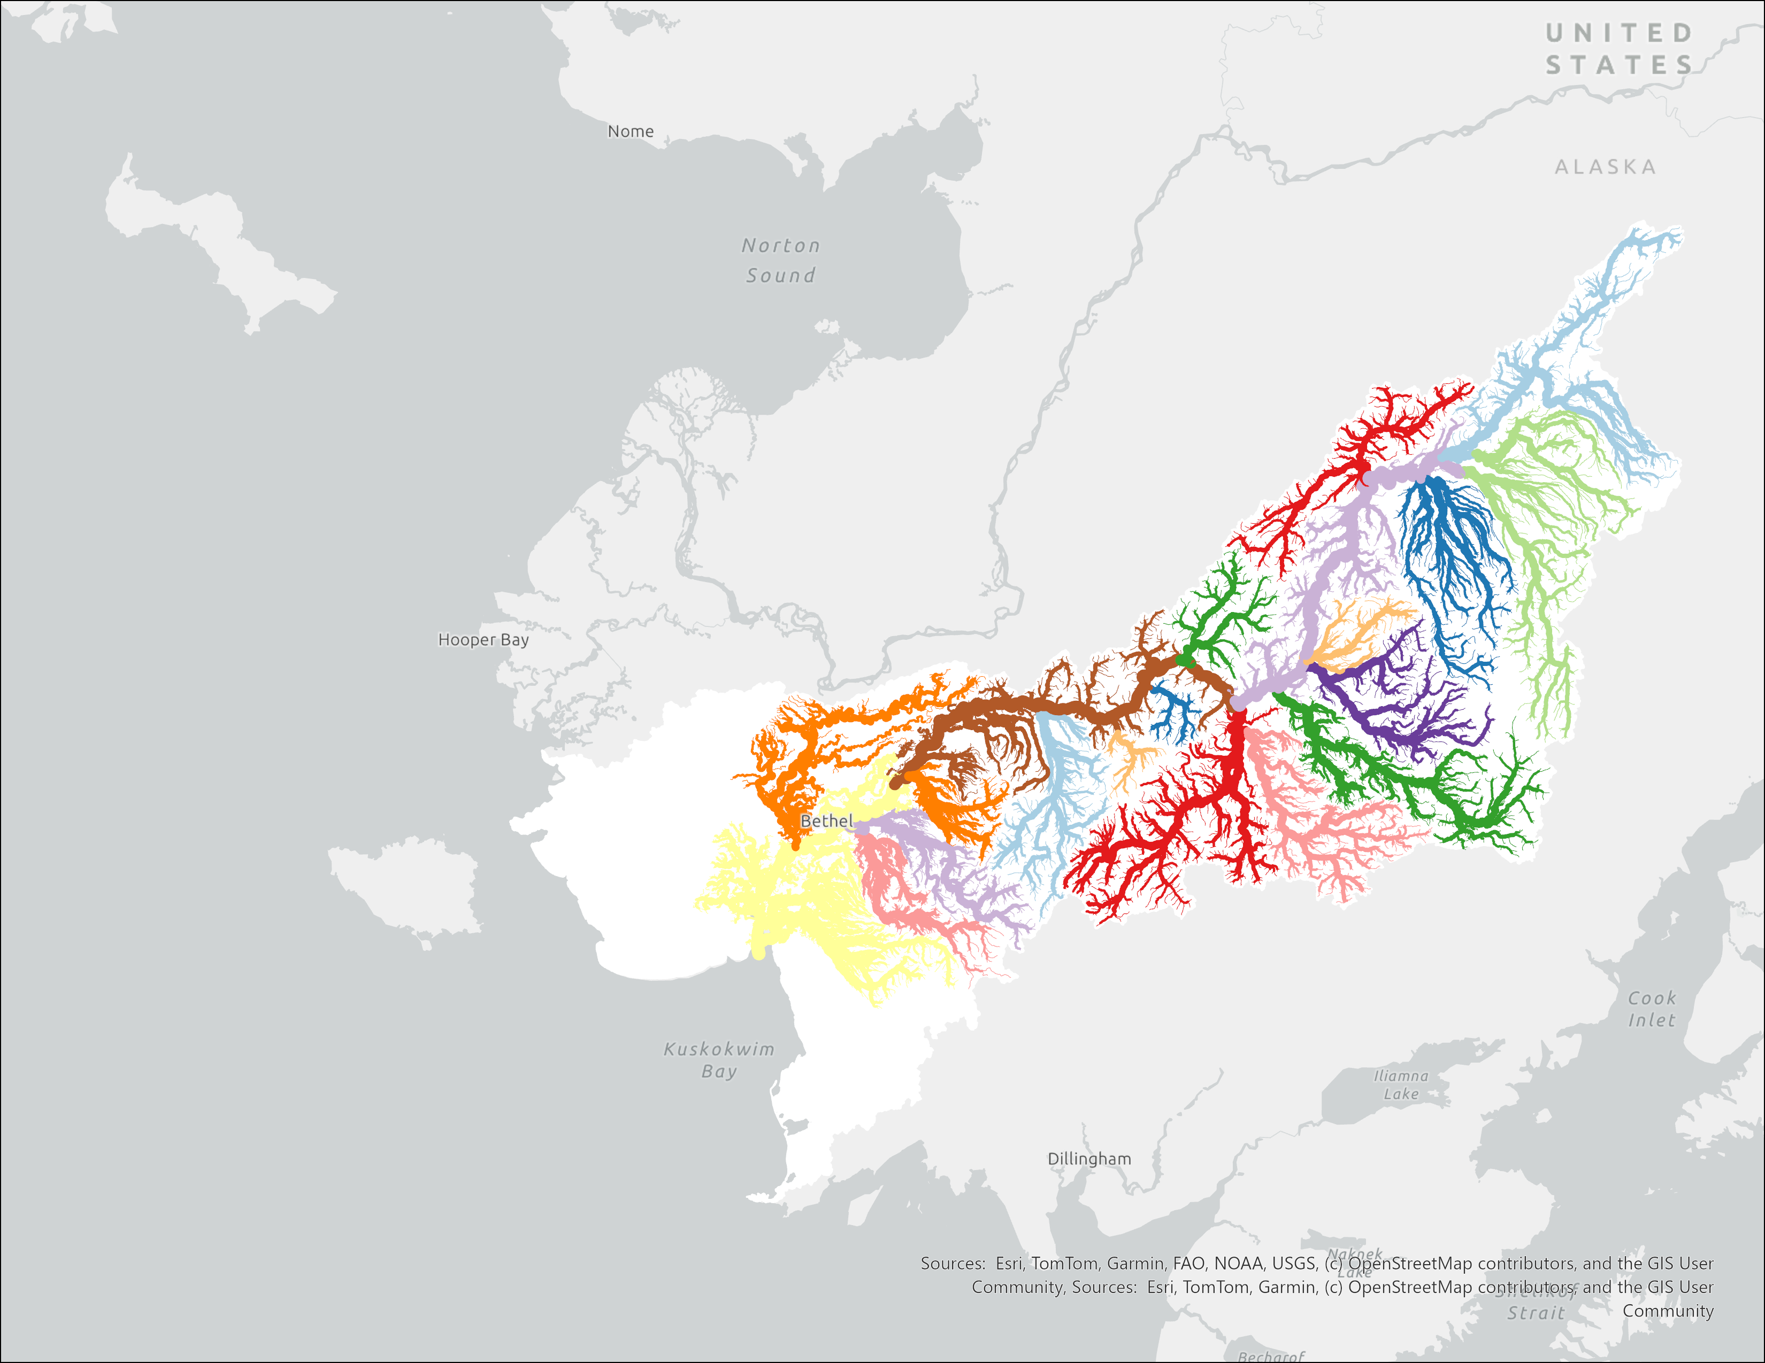
Too much going on here for the management scale, so we found these management tribs and grabbed everything upstream to make “bins”

Slide 11
What were really interested in is not TOTAL returns but the prop of returns from each group at each quartile → full run into a number of timeseries for each group

Slide 12
DFA theory and why it works here
Potential covariates as hypotheses

Slide 13
Add a Q0, normalize the ts because we want 0 to be 0

Slide 14
First, start with the most complicated model
4 Quartiles, 4 states.
We expect obs variance is not equally distributed.
Include both covs.
Compare with AIC
Best support is for a model without run size or cpue
Test different covariance structures
Best support is for diagonal and unequal.

Slide 15
Results, patterns vs loadings non spatial

Slide 16
Results, patterns vs loadings spatial

Slide 17
Pull out the individual quartile patterns from these. T1

Slide 18
T2

Slide 19
T3

Slide 20
T4

Slide 21
Discussion, increasing Q1, decreasing Q4?

Slide 22
Changes to variance among stocks?

Slide 23
Risks of consolidating to a single LH, portfolio effect degradation

Slide 24
Conclusion

