Slide 1
Shifting Habitat Mosaics II Brainstorm

Slide 2
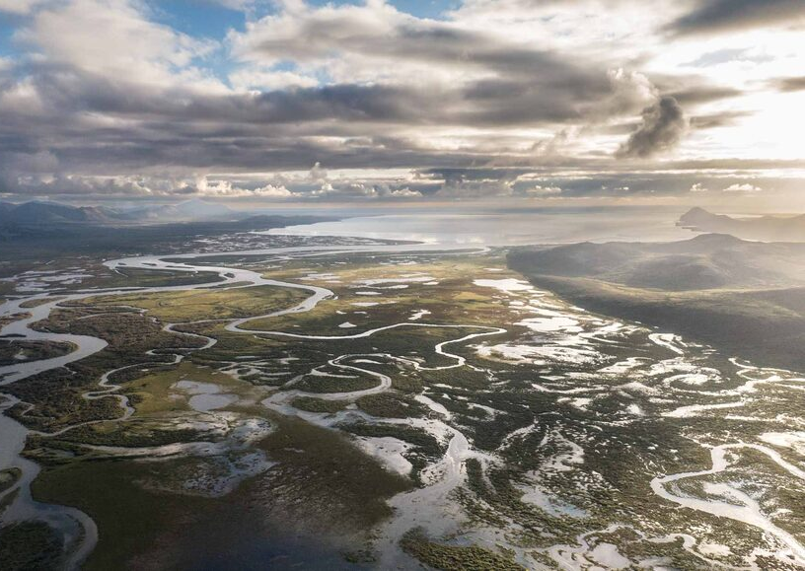
Understanding the ecological function of healthy, in tact watersheds is important for designing strategies to maintain this function and restore impacted watersheds

Slide 3
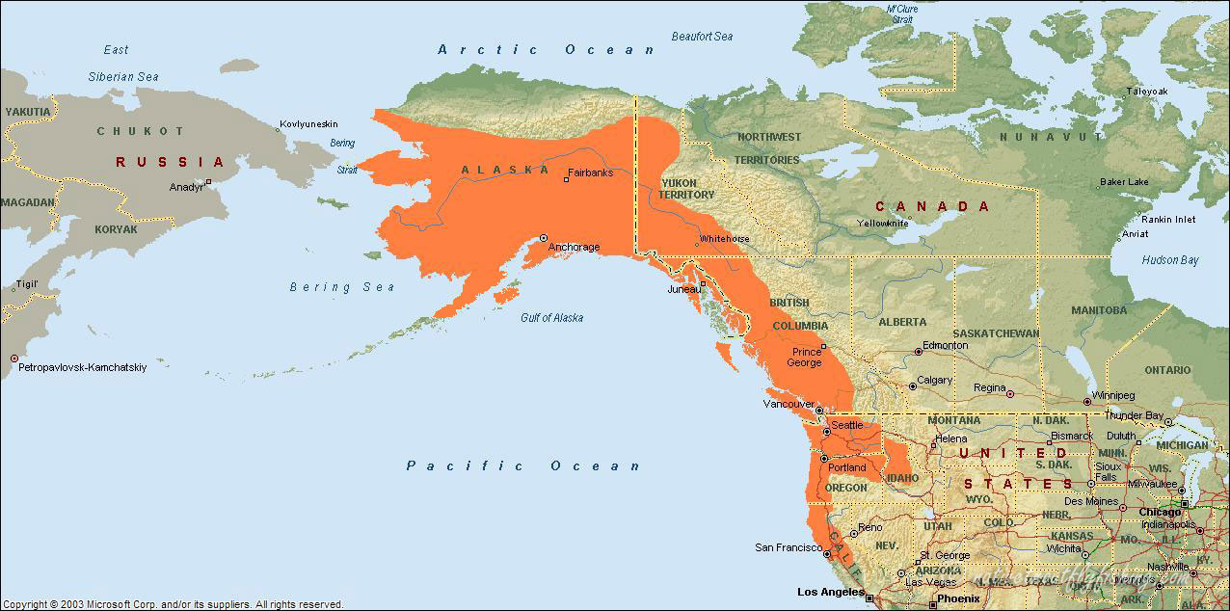

Slide 4
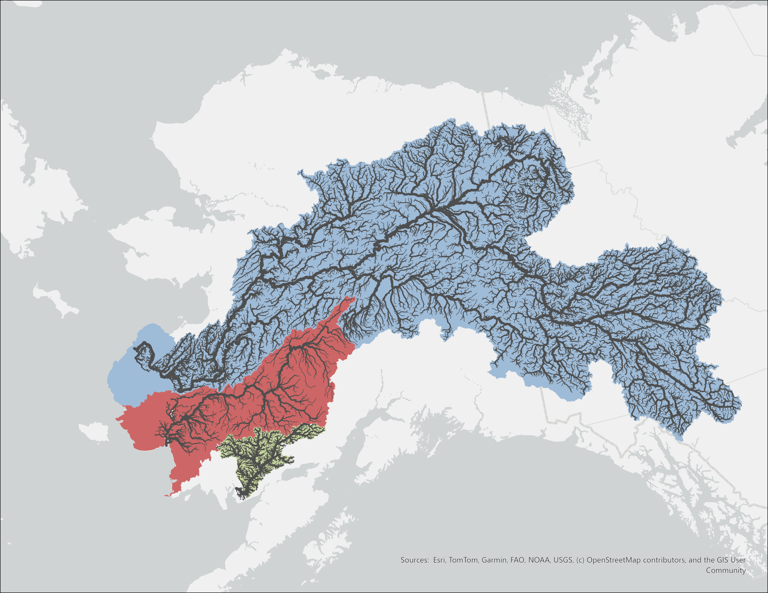
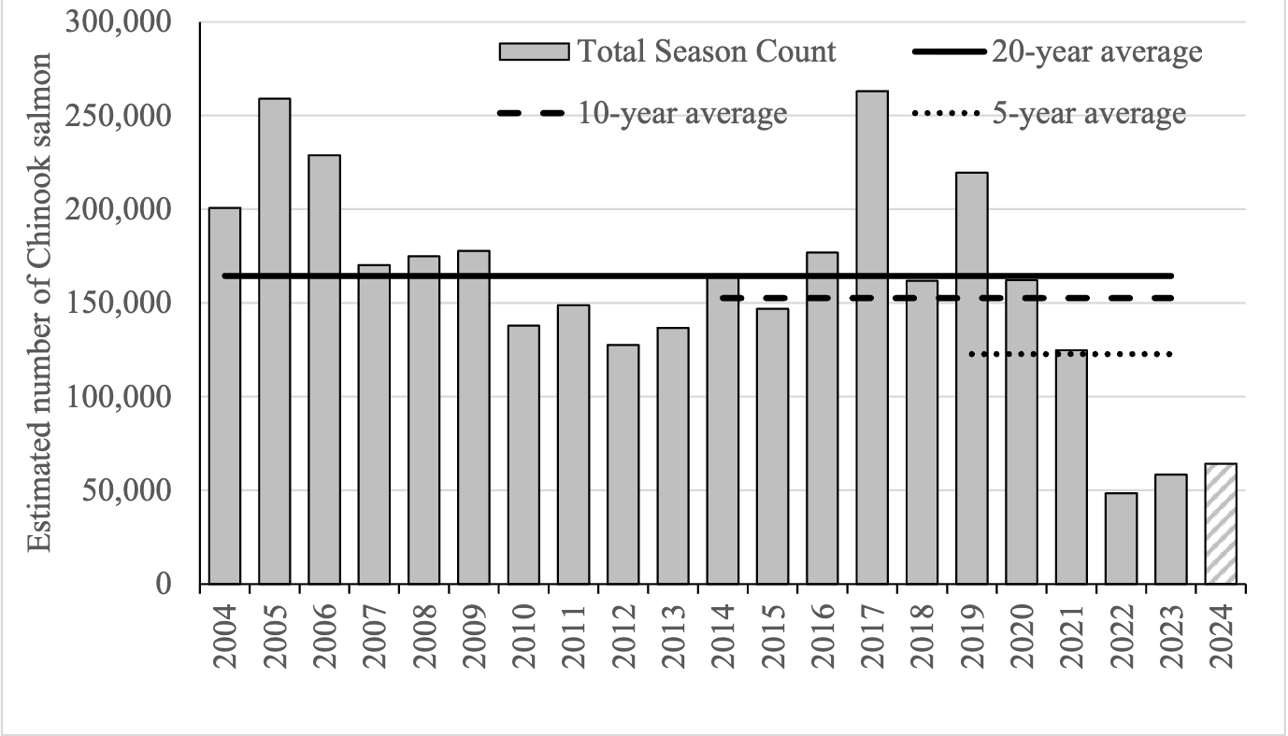

Yukon
Kuskokwim
Nushagak

Slide 5

Prevailing environmental conditions (i.e. local precip, temperature)
Locally adapted sub-populations (i.e.run timing, spatial habitat use)
Geomorphology and successional processes (i.e changes to local veg, physical habitat conditions)

Slide 6
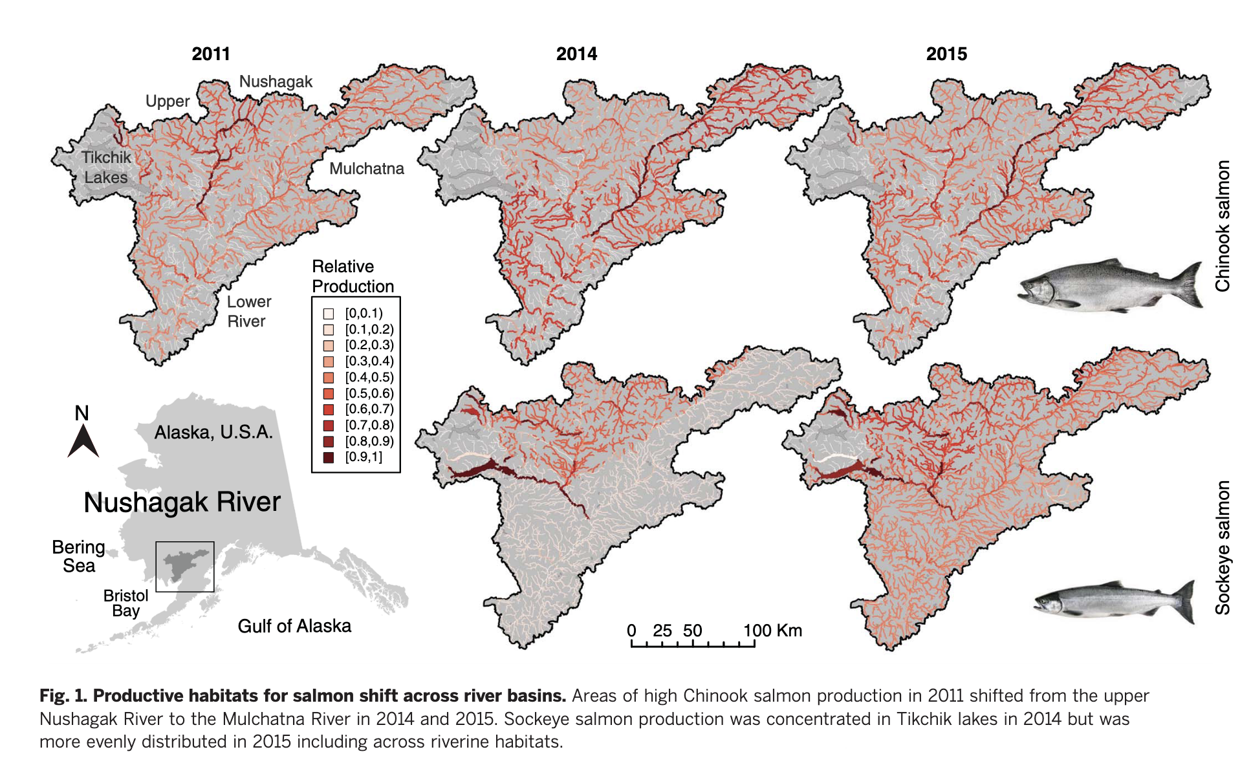
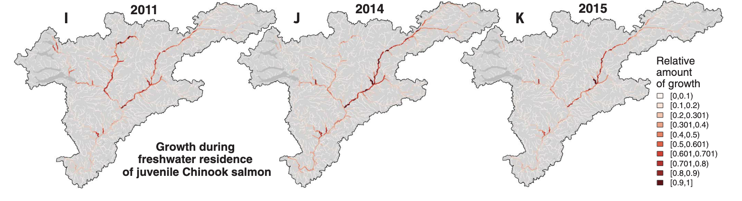
Shifting patterns of ”Production”
“Production” (Natal Origin distribution?)
Growth/individual

Slide 7
Variance buffering at scale
We expect that production among sub-components is negatively or weakly correlated. (i.e. some are more productive when others are less)
At larger spatial scales, this buffers overall return variability

Slide 8


H1 : Patterns of production (natal origin) and growth will be significantly different among years, reflecting suitability of habitat “patches”
H2; Variation is independent of relative productivity, i.e. both “weak” and “strong” stocks are subject to this shifting habitat mosaic
H3; negative correlation among components results in a stabilization effect at increasingly larger spatial scales

Slide 9
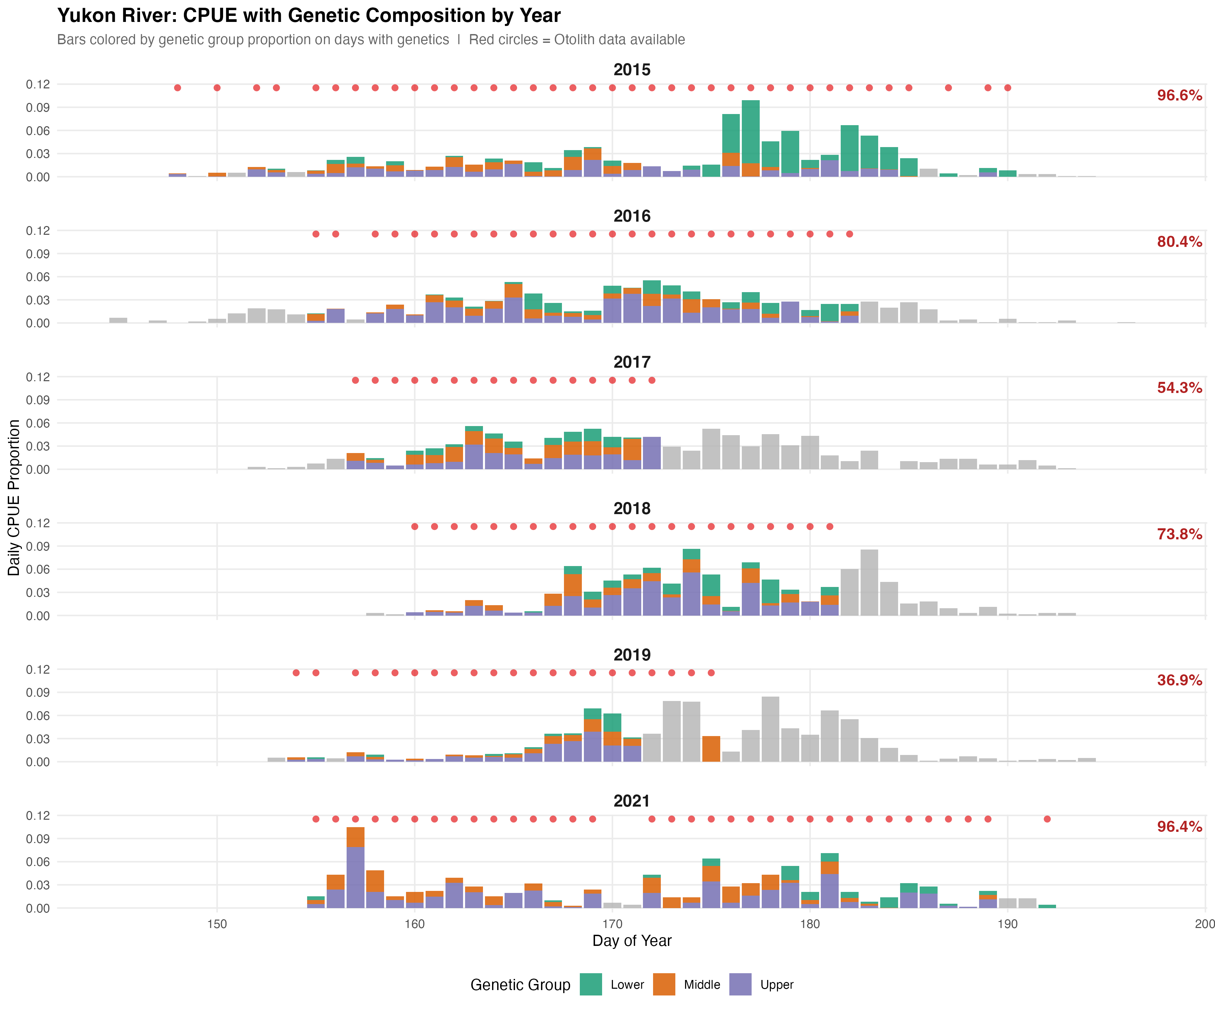
For the Yukon, we have 6 years of data. But most are incomplete:
We need
-otoliths for most of the CPUE
-Genetics data for all otoliths.

Slide 10
a) use only complete datasets (2015,2016, 2021)

Slide 11
b) Trim by date
DOY ~172 we could use all years

Slide 12
b) Trim by date
DOY ~182 we could use 2015, 2016,2018, 2021

Slide 13
b) Trim by CPUE

Slide 14
Maps with DOY 173 cutoff

Slide 15
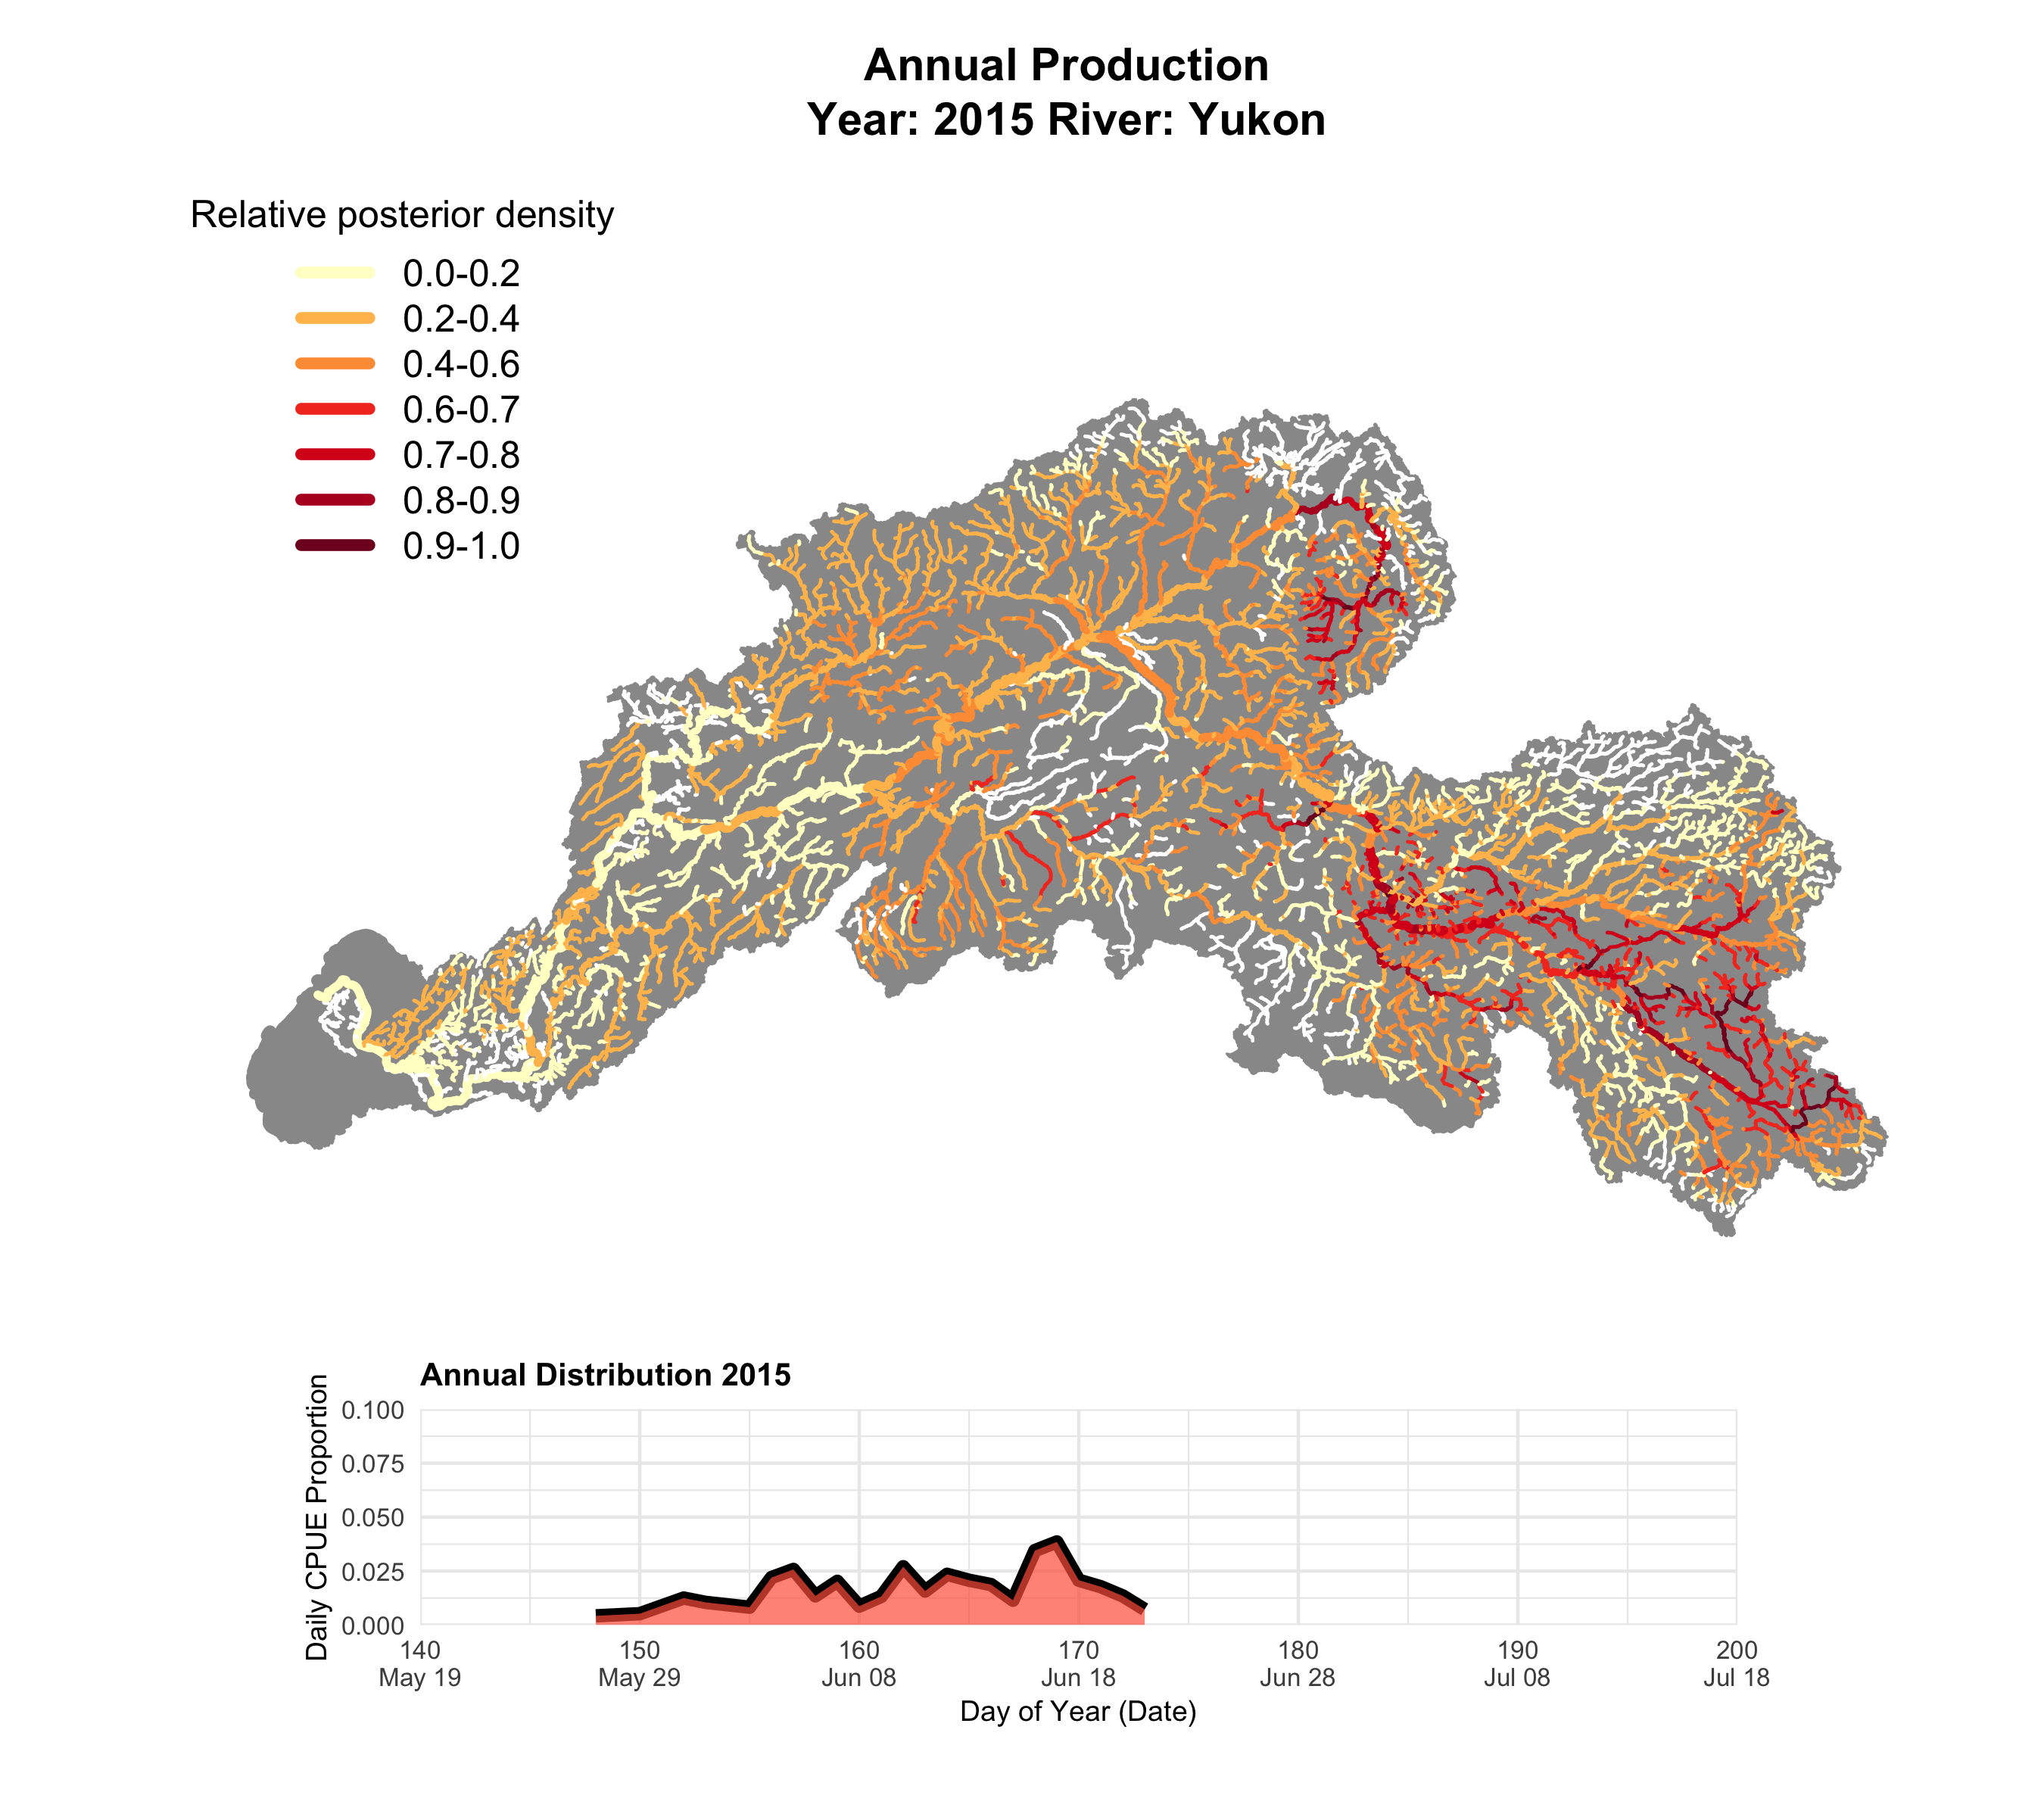

Slide 16
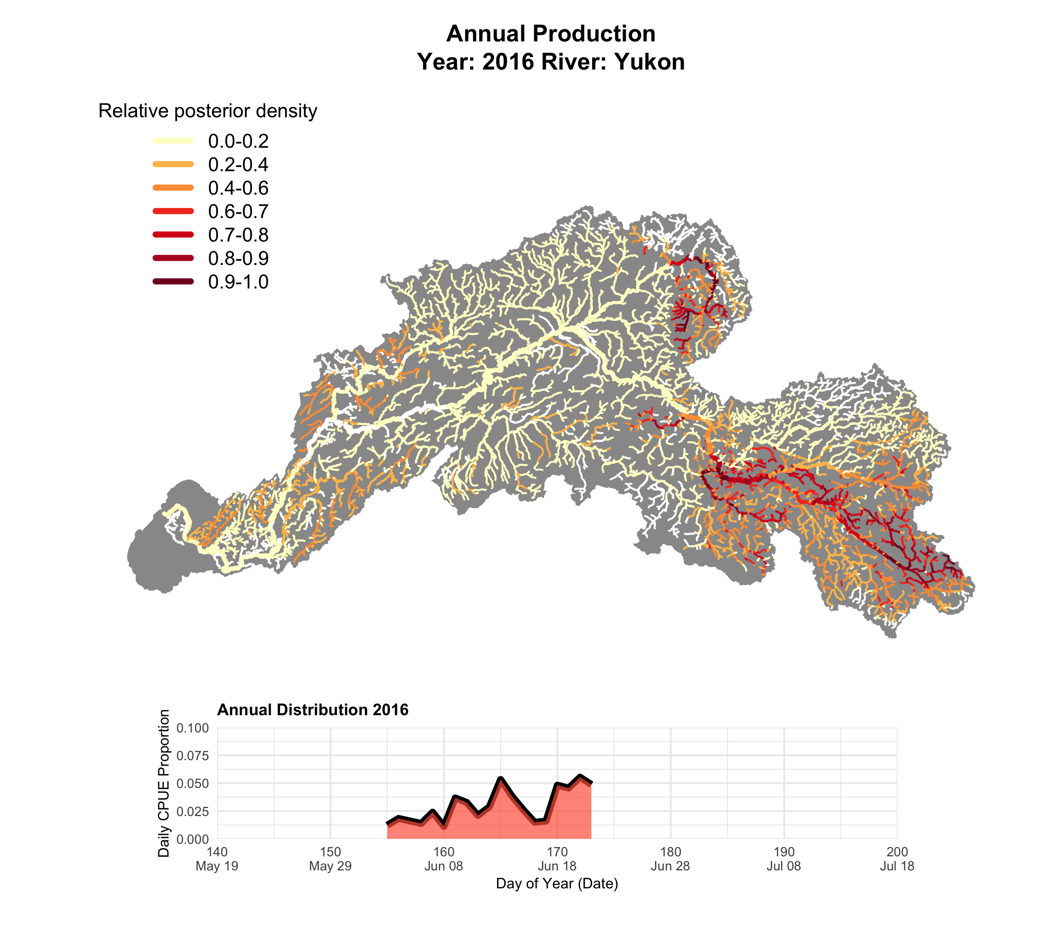

Slide 17
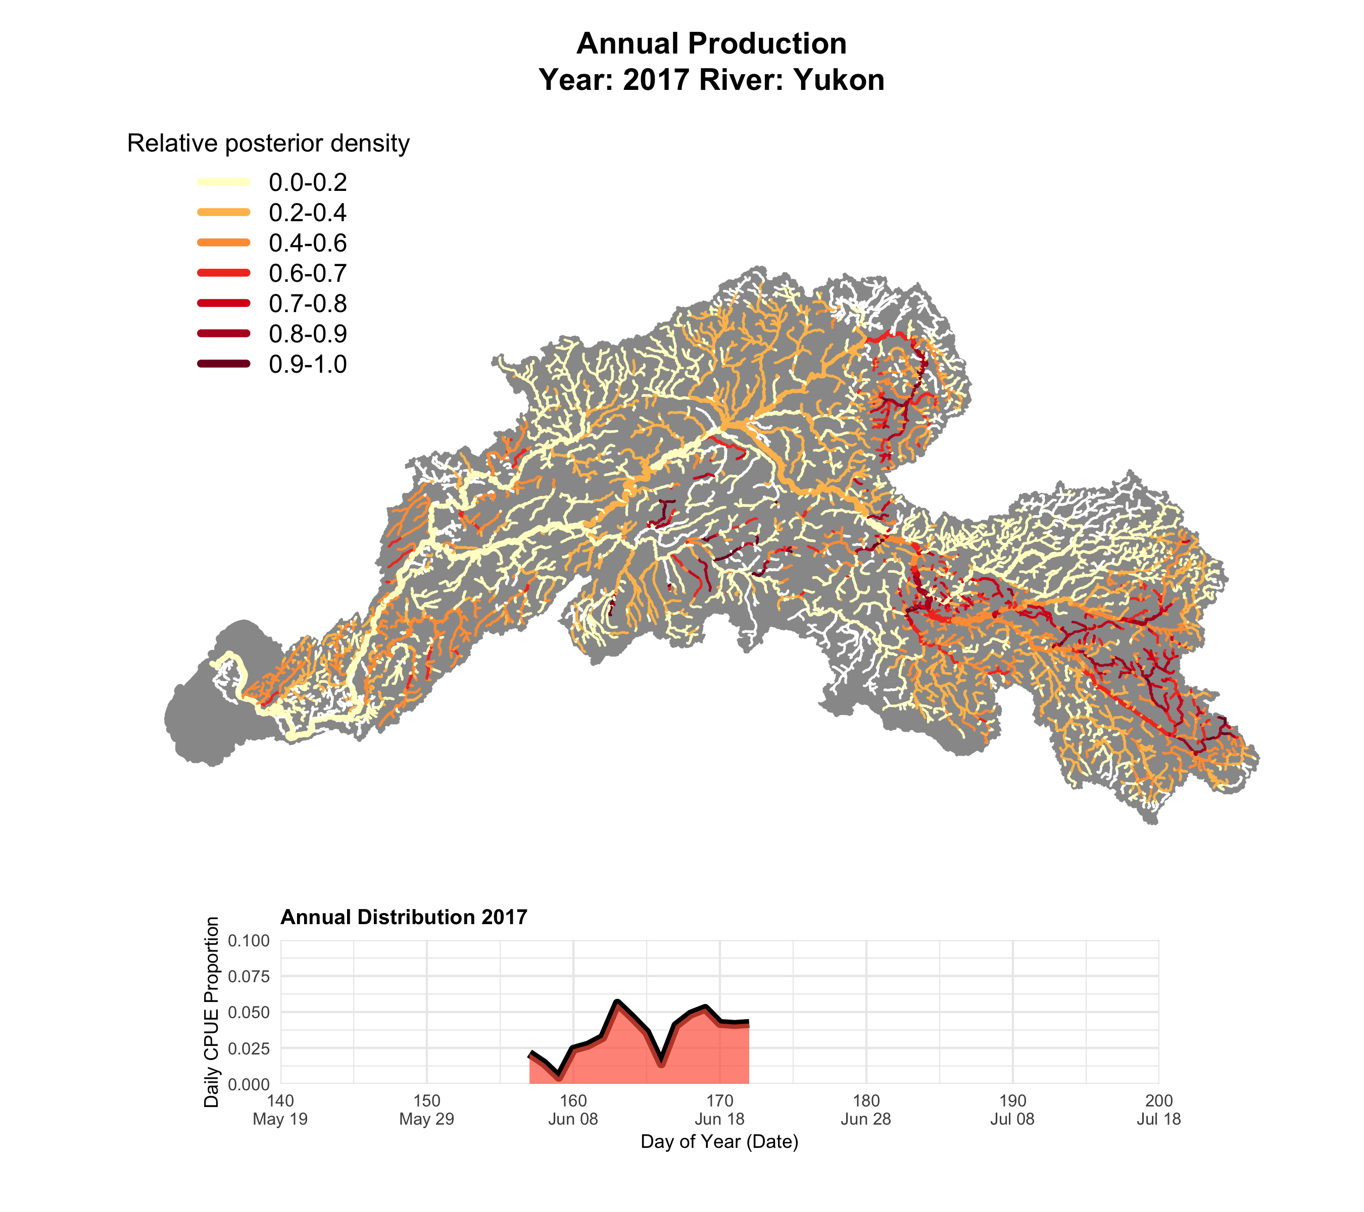

Slide 18
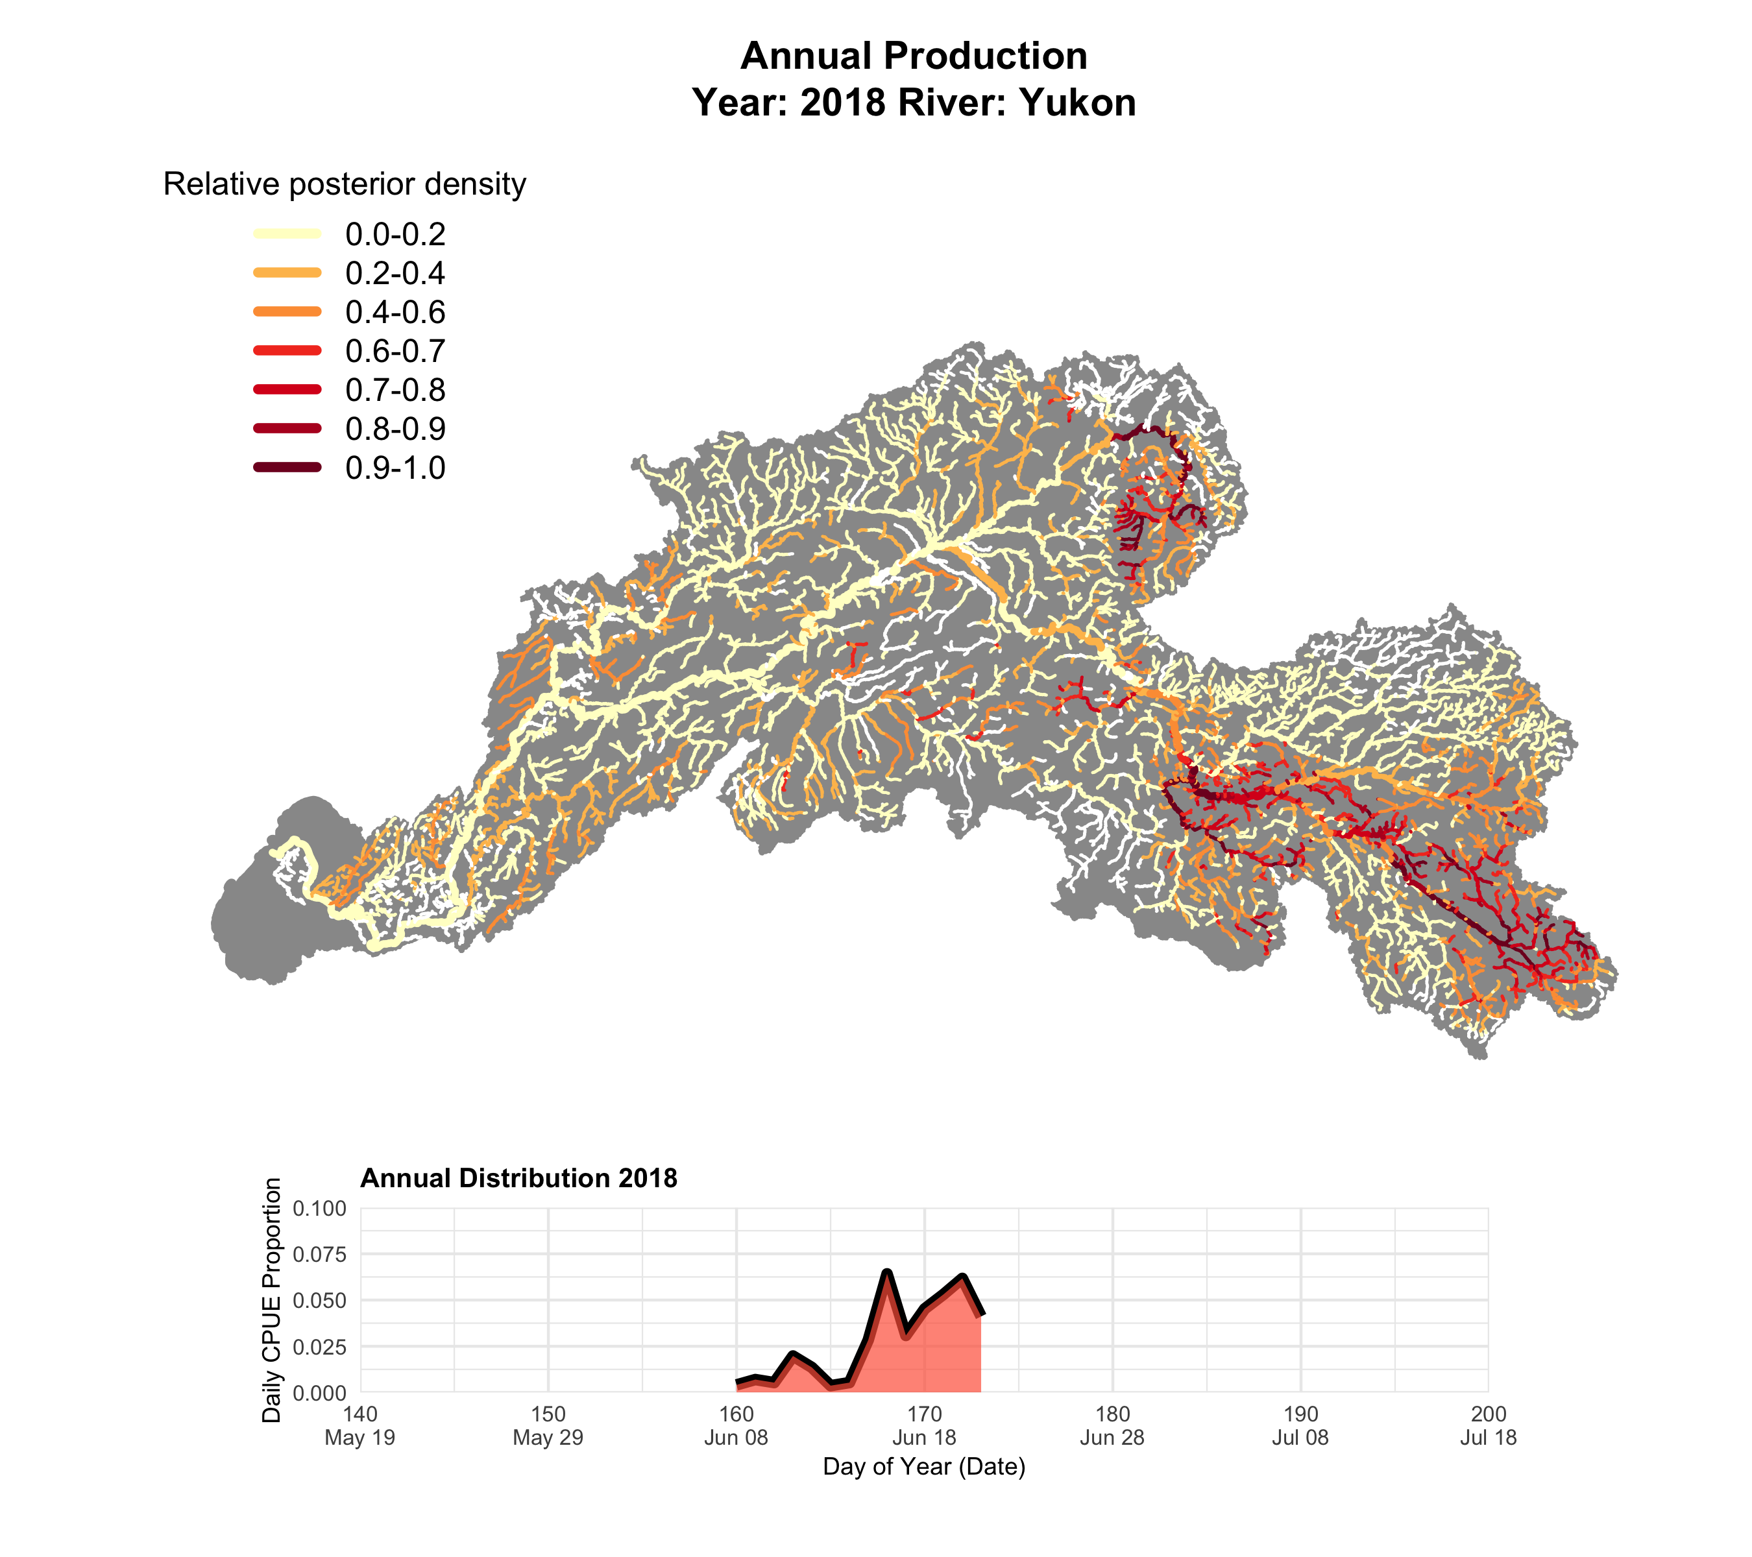

Slide 19
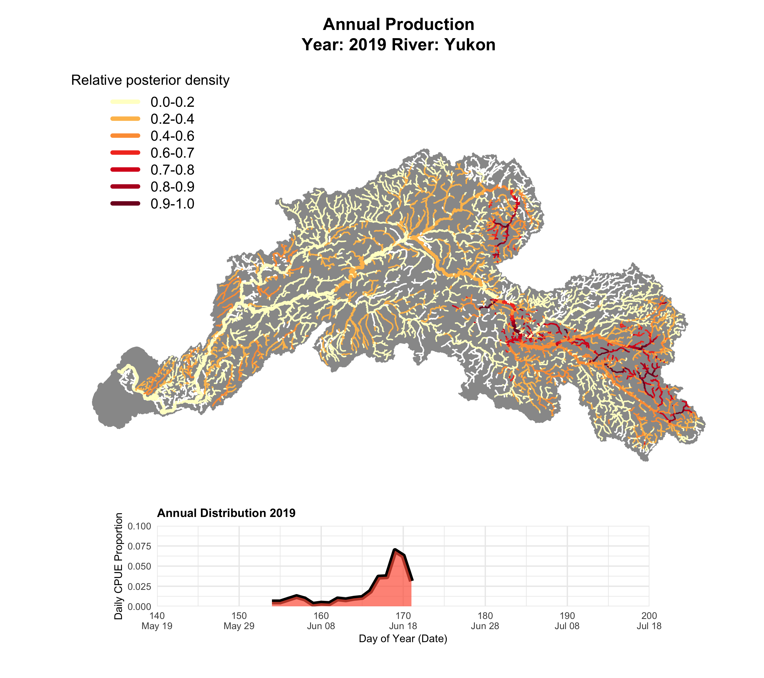

Slide 20
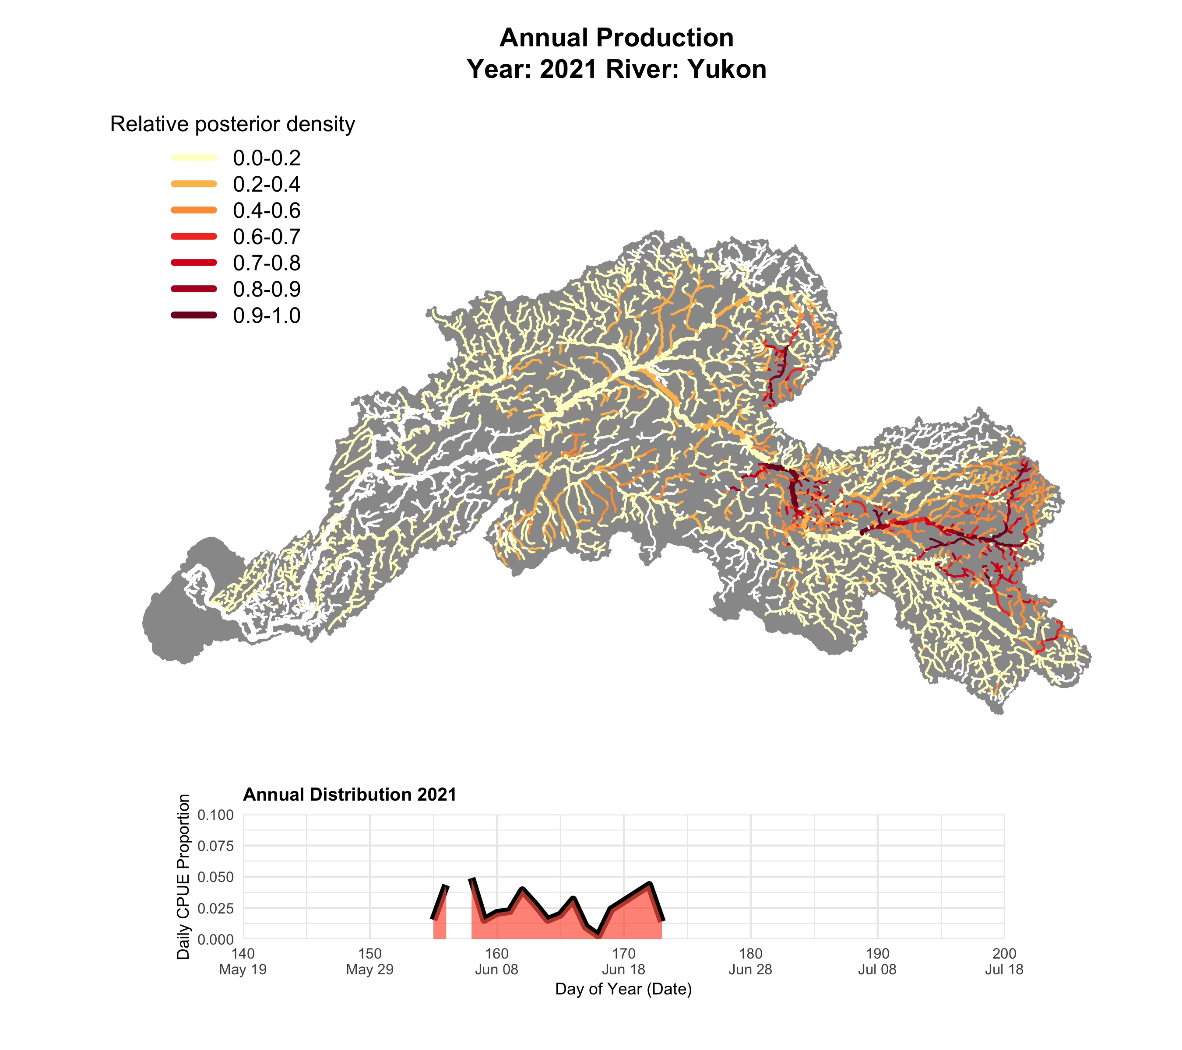

Slide 22
These maps don’t include 2 important priors
Habitat prior (turn off areas not suitable for Chinook)
Slope
Unlocked path
Etc.
“Presence” prior (turn off areas fish that have been observed not to have fish)
Much higher quality for the US portion of the basin

Slide 23
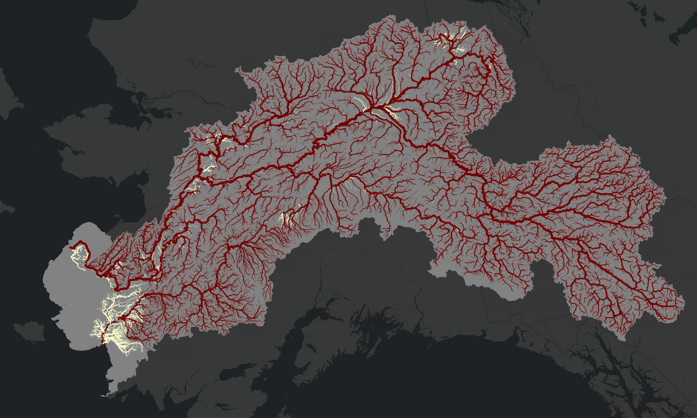
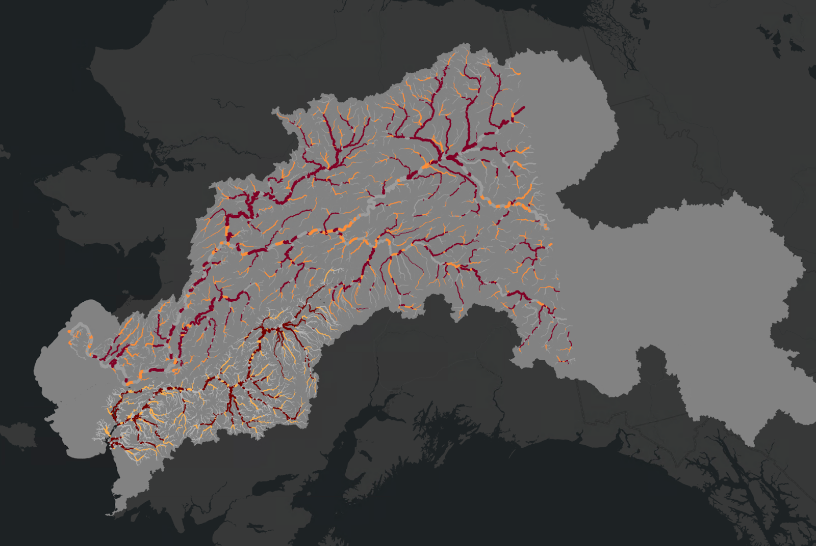
Previous habitat prior
USGS Spawner Intrinsic Potential
Dark red .8-1
Orange: .5 -.8
Grey <.5

Slide 24
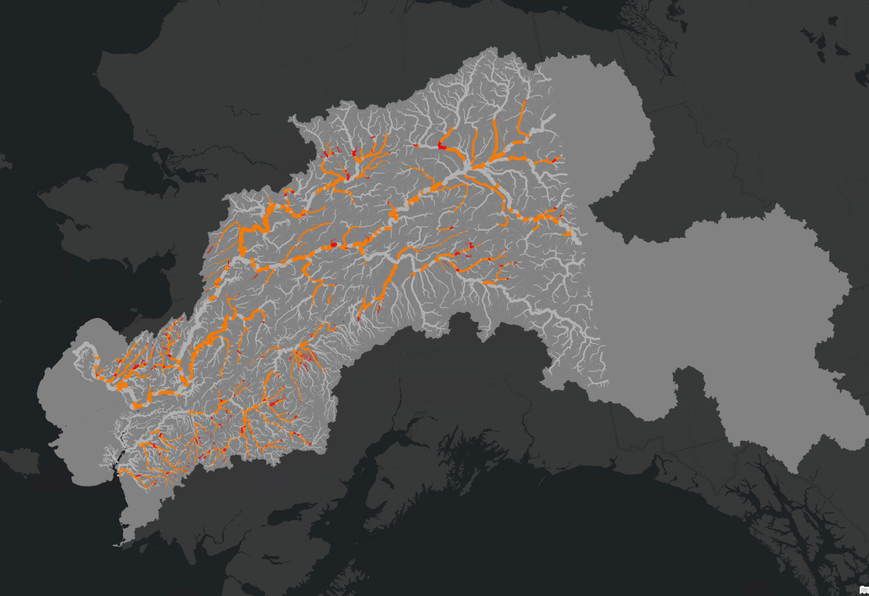
Where have Chinook salmon been observed to have been spawning?
Goereferenced spawner observation values from ..
Alaska Freshwater fish inventory
Anadromous waters catalog
Yukon Chinook Spawning catalogue (Brown et al., 2017)

Slide 25
We could…
a) Focus on the US portion of the watershed (s)
b) Pull out some general “rules from the IP/presence mapping and apply them to CA
c) Try to stitch together our own based on expert knowledge?

Slide 26
Using only the US…
Consistently the highest quality assignments
Some awkward redundancy in CA isoscape
Highest production is mostly in CA, washes out productivity in the lower watershed
2015 results conflict with other studies (sampling error?)

Slide 27
Tributary maps are visually helpful, but difficult to compare
Binning production into ”regions” would allow us to calculate meaningful statistics

Slide 28
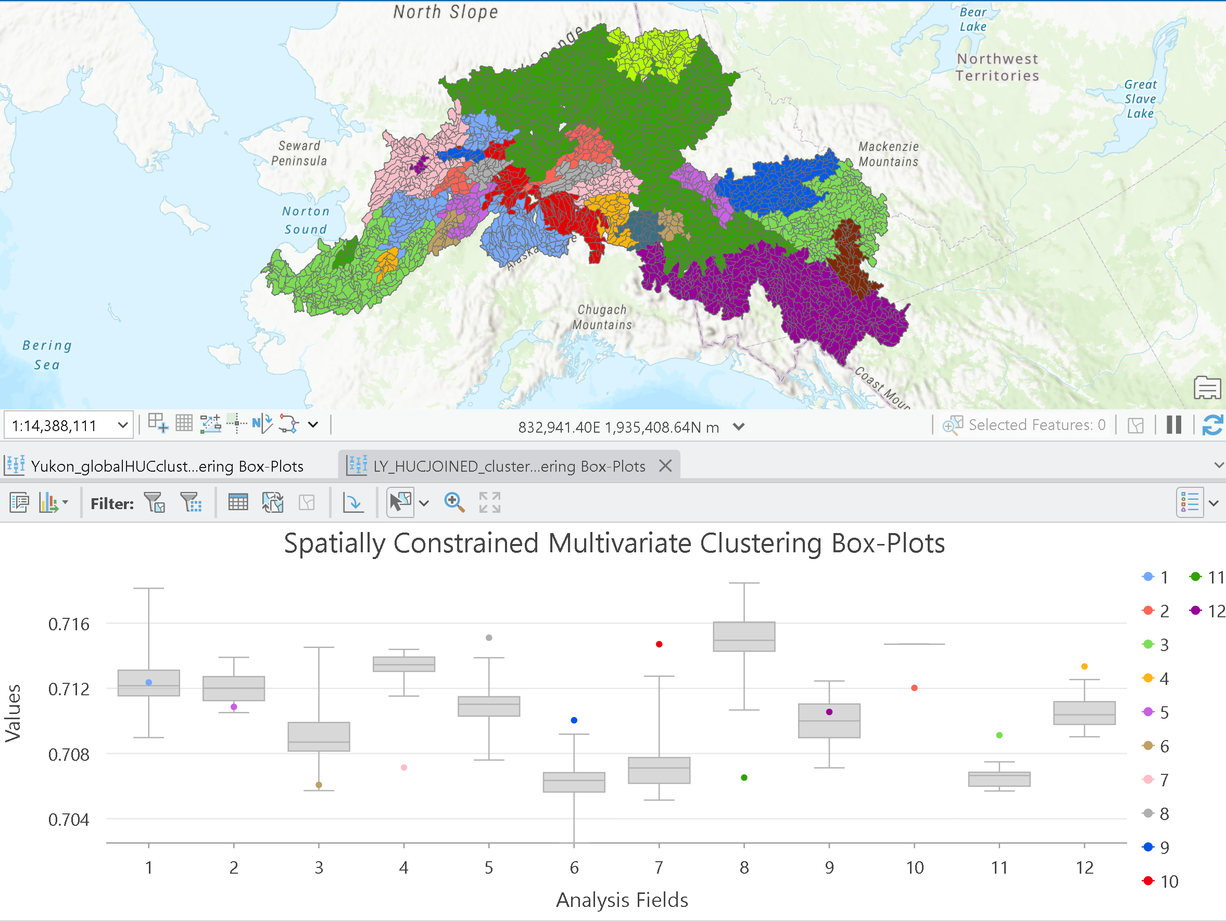
We could.. A) try to bin based on isoscape values
Manageable for the Kuskokwim, Difficult in the Yukon…
But more defensible if we can meaningfully say which regions we can discriminate between.

Slide 29
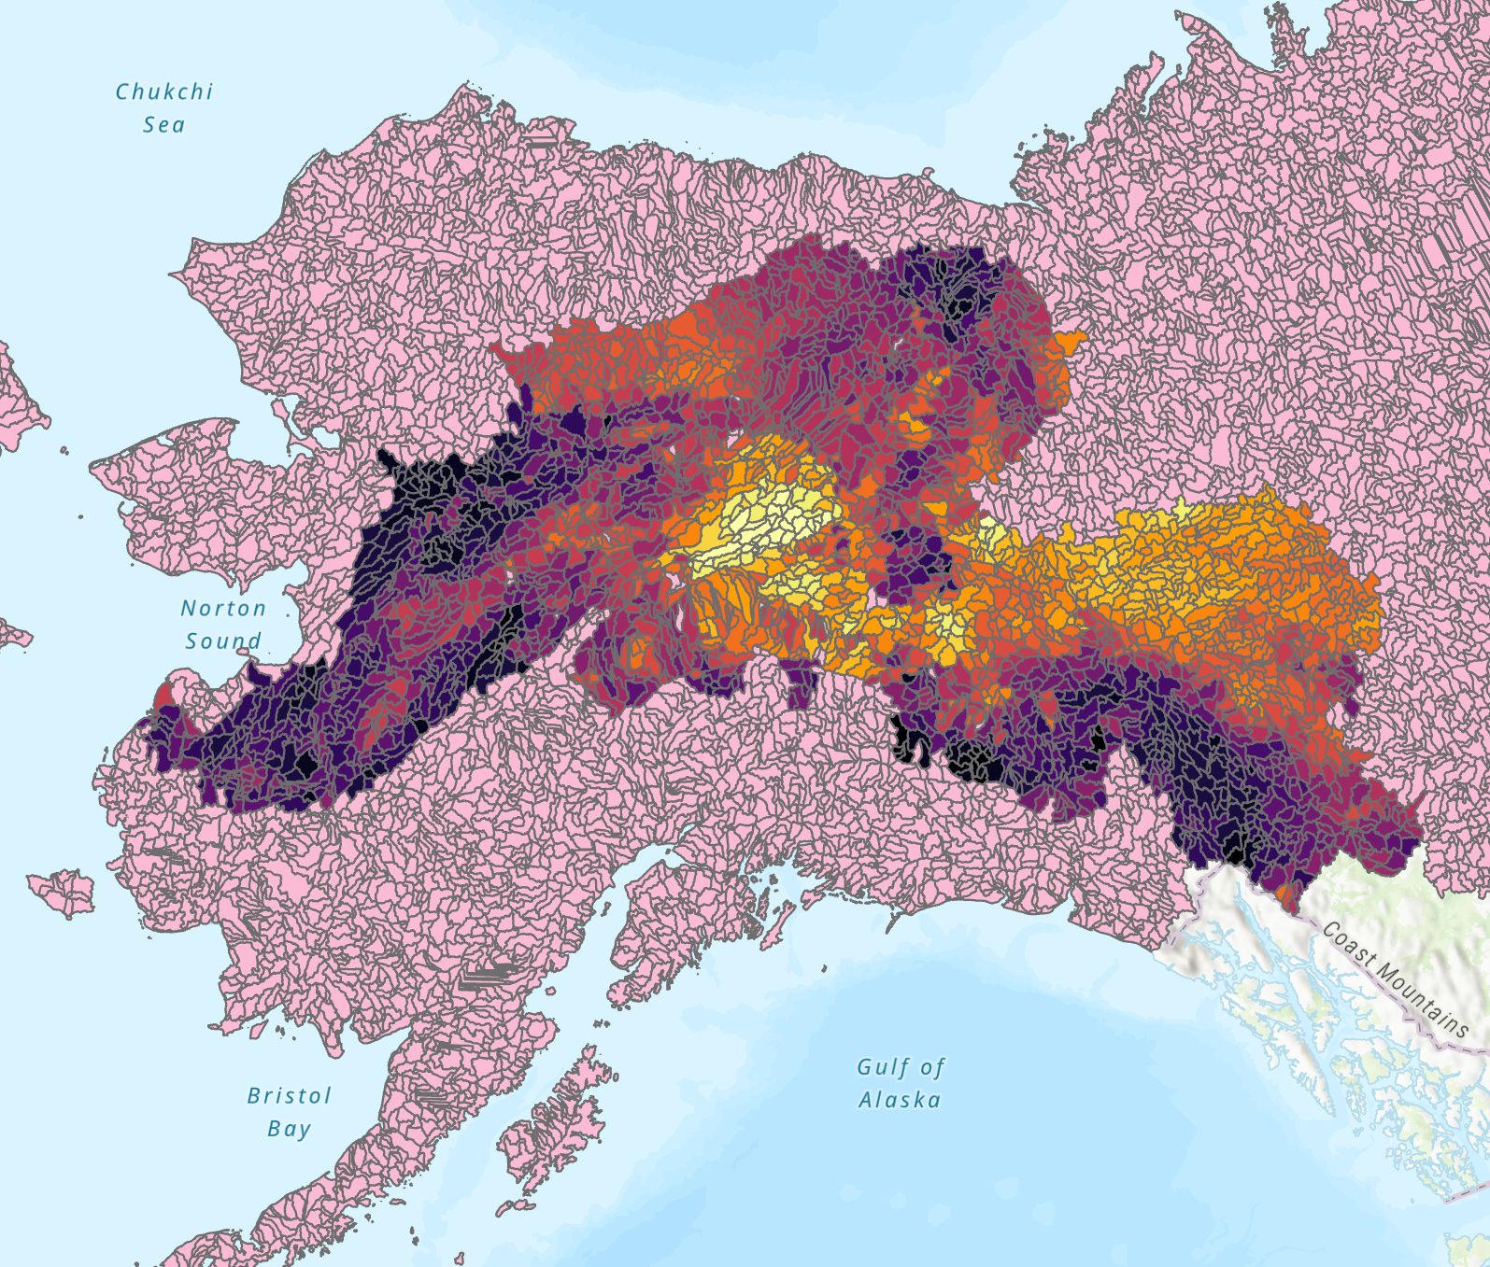
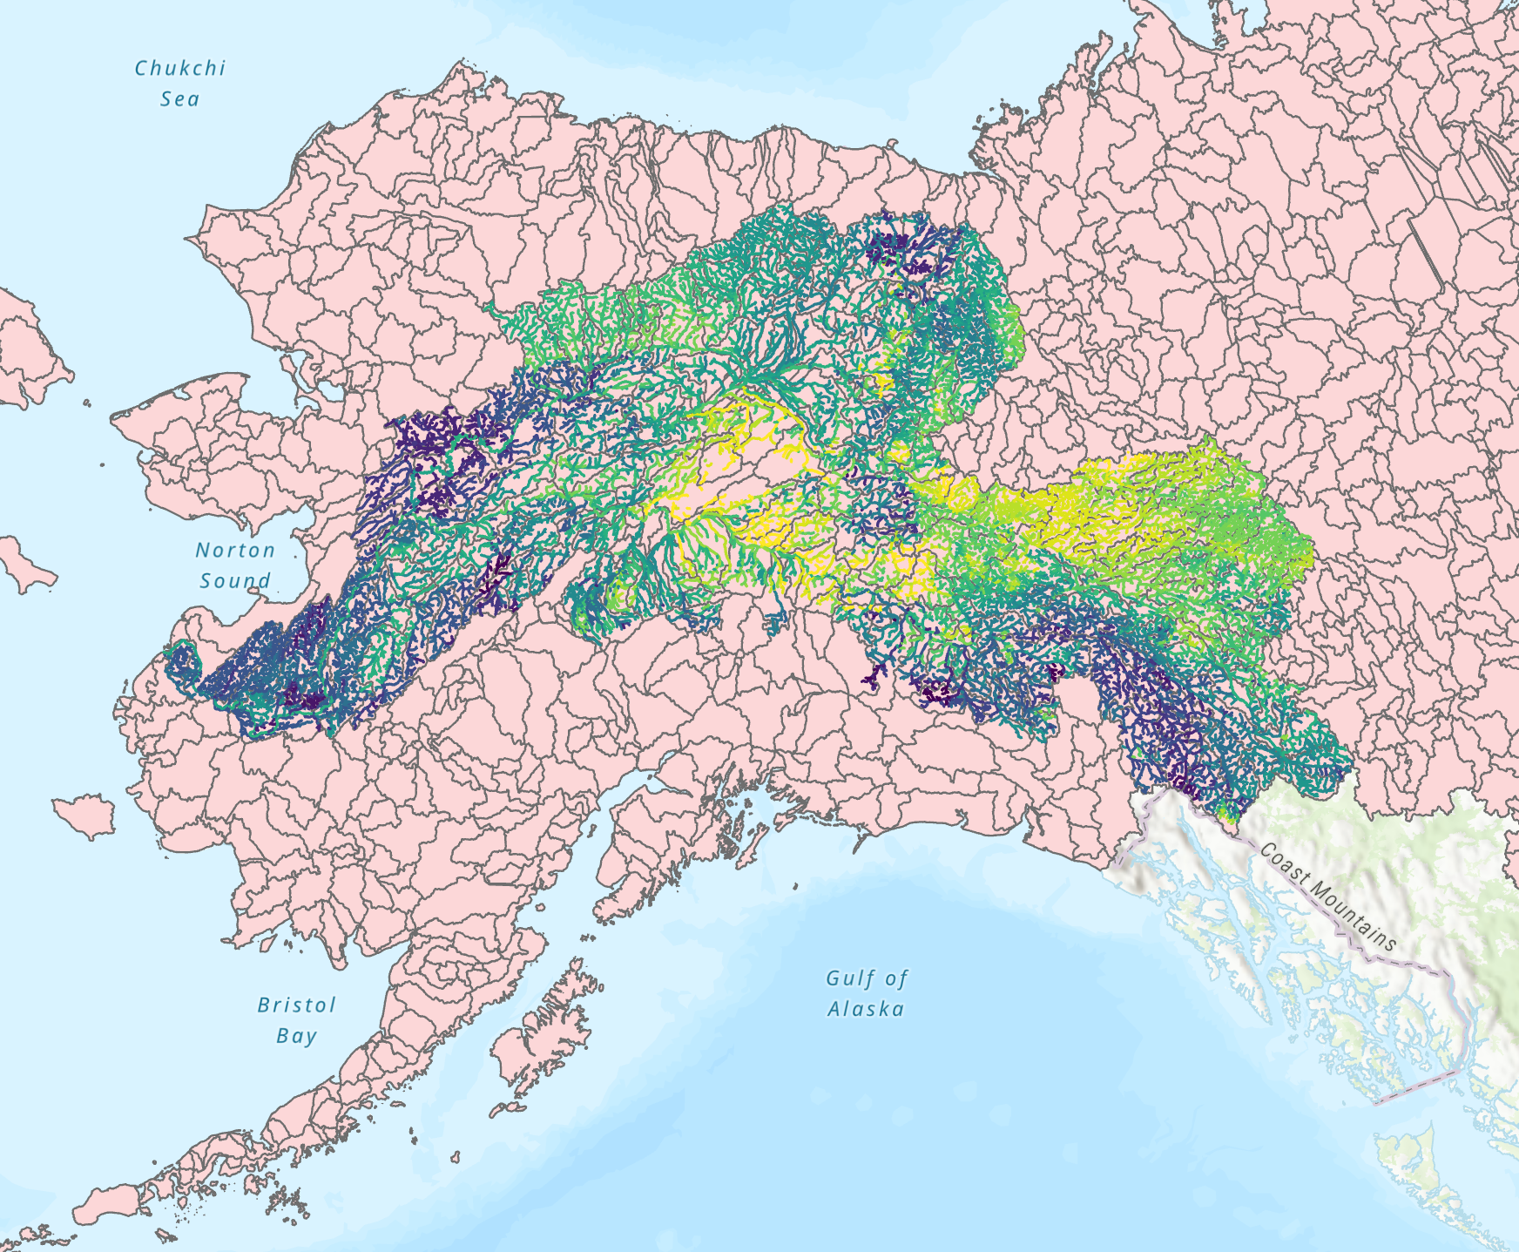
We could.. B) try to bin by sub-watershed
Standardized sub watershed polgyons available at multiple spatial scales for both watersheds
The criticism would be that some polygons may be the same isotope value

Slide 30
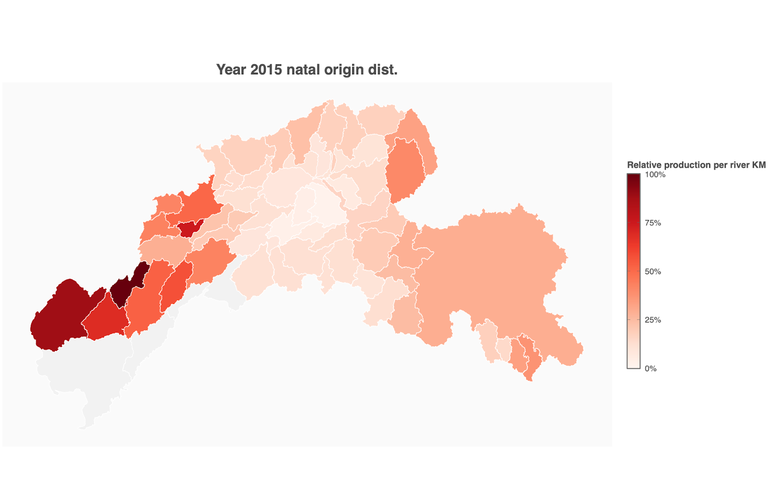
H1 : Patterns of production (natal origin) and growth will be significantly different among years, reflecting suitability of habitat “patches”
Qualitative maps showing changing production, CV by polygon, same thing but with growth (otolith microns). Some quantitative tools exist to test the significance
H2; Variation is independent of relative productivity, i.e. both “weak” and “strong” stocks are subject to this shifting habitat mosaic
Coefficient of variation per bin vs mean # of returners (scaled “production” * returns in that year)
H3; negative correlation among components results in a stabilization effect at increasingly larger spatial scales
Calculate covariance among groups (?)
Calculate CV at several spatial scales (basin, sub-basin, smaller sub basin) , compare

Slide 31
Thoughts?

