Slide 1
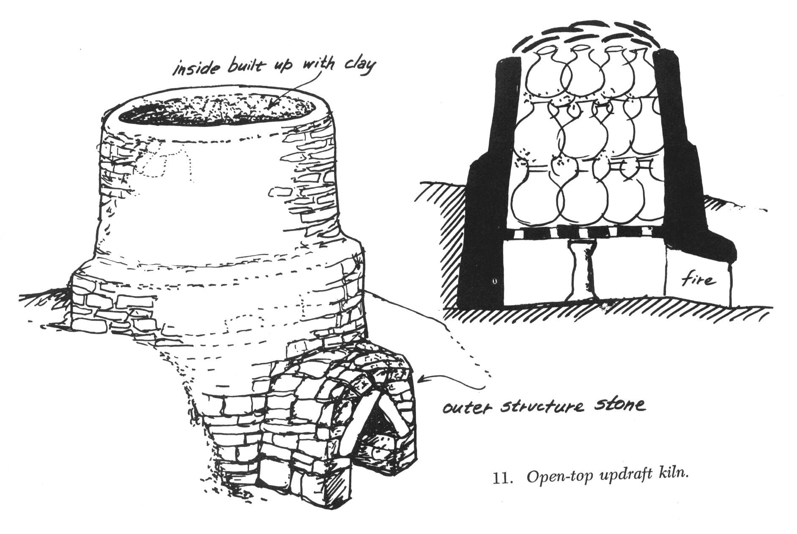
RuTAG IIT Delhi
Group 36
Tawa Making Process
Prashanth Badavath 2019BB10015
Ashu 2019BB10012
Jatavath Pavan Naik 2019BB10027
Himanshu Bairwa 2020CH70167
Tanishq Panwar 2020AM10673

Slide 2
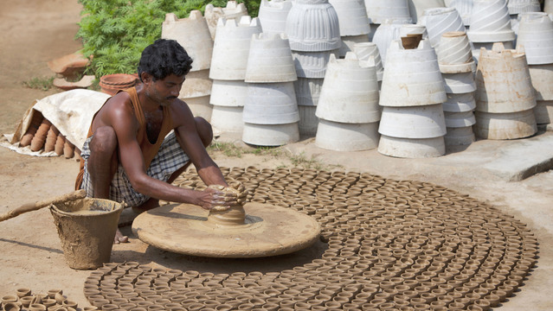
Introduction
The existing firing process is less efficient as its thermal efficiency is just around 8%, and around 20% of Tawas get damaged during the firing process.
The firing process is also time-consuming as it takes around three days to complete the firing of a lot of 2000 to 3000 Tawas.
Earthen Tawa is usually lower value than their effective and efficient uses.
These Earthen Tawa usually heats at a very high temperature in an open area which causes enormous energy loss and pollutes the environment.
While making these earthen wares, their shapes may be deformed and considered defective pieces. This problem also lags behind them in comparison to machine-making wares.
In the last 2 two years, these small-scale workers have suffered a lot as their wares were not able to generate even enough revenue; these workers tried to manage their home expenses as most things were out of reach.

Slide 3
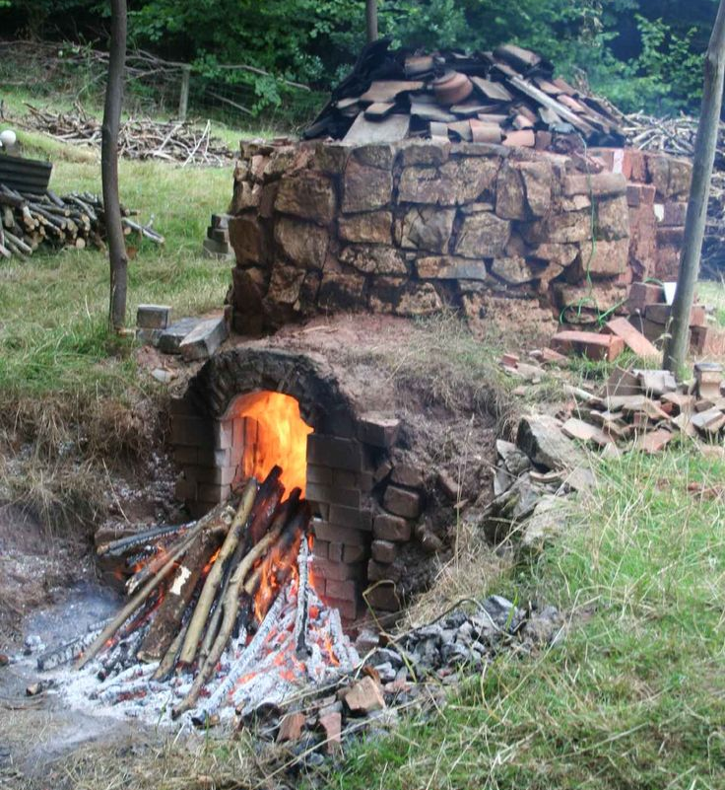
Kilns
A kiln is a thermally insulated chamber, a type of oven, that produces temperatures sufficient to complete some process, such as hardening, drying, or chemical changes.
The high efficiency pottery kilns used in the organised sector are too expensive to be affordable by the small-scale sector.
There is a need for improving the traditional kilns so as to reduce their energy consumption per unit of load substantially without any significant increase in cost.

Slide 4
Firing consists of various stages, namely, smoking, slow firing, rapid firing, and soaking:
Smoking: the heating is prolonged, and pottery temperatures are below 150 ^{C}. The fuel can burn without an enormous flame at meagre rates. This is the phase during which the remaining moisture in the pottery is allowed to evaporate, and the low heating rates ensure no cracks due to violent eruptions of water vapor from the pottery.
Slow firing: volatile matter other than moisture is removed at two temperatures below 450­500 ºC, at moderate rates of heating with typical temperature rise rates of 1.5 to 2 ºC per minute.
Rapid firing: rapid firing is done at a high rate to raise the temperature of the wares rapidly to 800­950 ºC. Typical temperature rise rates are 3­4 ºC per minute.
Soaking: In soaking, firing is done at a rate sufficient to maintain the temperature of the wares at the required value over a period of time. The total firing duration for terracotta wares ranges from about 5 to 10 hours.
Rural pottery kilns are invariably batch kilns. Tunnel kilns are not suitable at trim scale levels due to the higher cost of construction, fuel, and the need for continuous operation to be economical. Thus, updraught kilns appear to be of much greater appeal among the small potters due to their moderate cost and much better performance than low-cost bonfire kilns.

Slide 5
Solutions
The thermal mass of the structure needs to be decreased. This is possible by reducing the thickness of the walls of the kiln and the density of the material used to build the kiln.
The kiln needs isolation from the floor, and firing should be done on grates rather than on the floor.
The weight of packing tiles and wares was about 50% of the importance of the payload in both kilns. This can be reduced by altering the size distribution of the wares to be fired in each batch. Nonetheless, in the present scenario, this only contributes to a slight increase in fuel consumption since the energy absorbed by the payload is also tiny. If the latter increases in an improved kiln, as desired, the energy absorbed by the packing will also increase proportionately unless their amount is reduced.
Ensuring a less open flame and better control on primary and secondary air inlet areas, better control on excess air and flame temperatures could be achieved, securing better combustion and heat release from the fuel. In both the kilns, the flames were almost entirely open to the atmosphere, and the air inlet areas in the firebox were vast.

Slide 6
Energy Terms
The energy terms can be grouped under four major heads:
Energy released by combustion of the fuel;
Energy absorbed by the pottery
Energy absorbed by the furnace, including the floor below the furnace, the walls of the furnace, the grate
Energy lost directly to the surroundings through flue gases and ash, direct radiation from flame and convection from the outer surface of kiln walls.

Slide 7
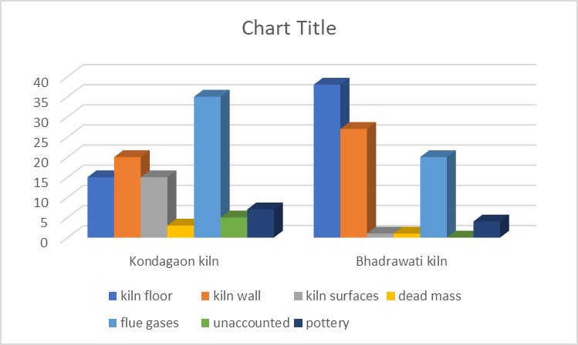
Analysis of Energy Distribution in two Kilns
The distribution of energy in the two kilns shown describe that during the firing process, the pottery absorbs the least amount of heat.(i.e accounted for),and most of the energy released is from floor and the wall combined
.

Slide 8
Ideas For Kiln Renovation
As most of the heat losses are from walls and ground so cheap insulation needs to be done between the first layer of bricks facing the fire and the remaining portion of the wall or floor. Ash is a common insulator used in traditional kilns
The wall should be constructed using a rat ­trap bonded structure
We use cow dung bricks instead of normal bricks because it is much cheaper than normal bi
What is a ‘ Modified rat trap’? In this design the inner layers of the wall are constructed using the rat­trap bond. The air gap after the innermost row of bricks insulates the rest of the brick structure from the hot inner layer, thereby preventing a large part of the wall from absorbing energy.
This construction reduces the mass of the wall in direct thermal contact with the hot gases. While air gap prevents heat transfer due to conduction, discontinuous gaps keep the convective heat transfer in these gaps low
Volume of air gap/cavity = (230 mm)*(115 mm)*(115 mm) =30,41,750 mm³

Slide 9
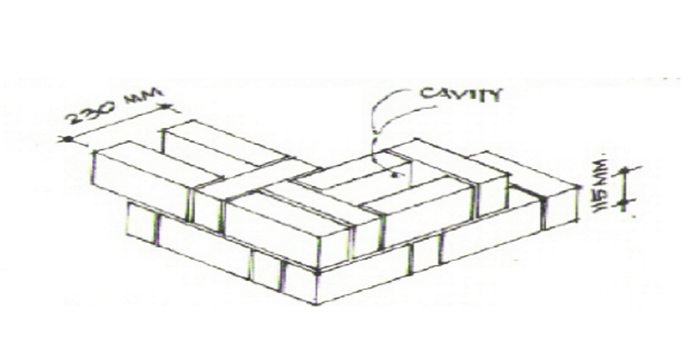
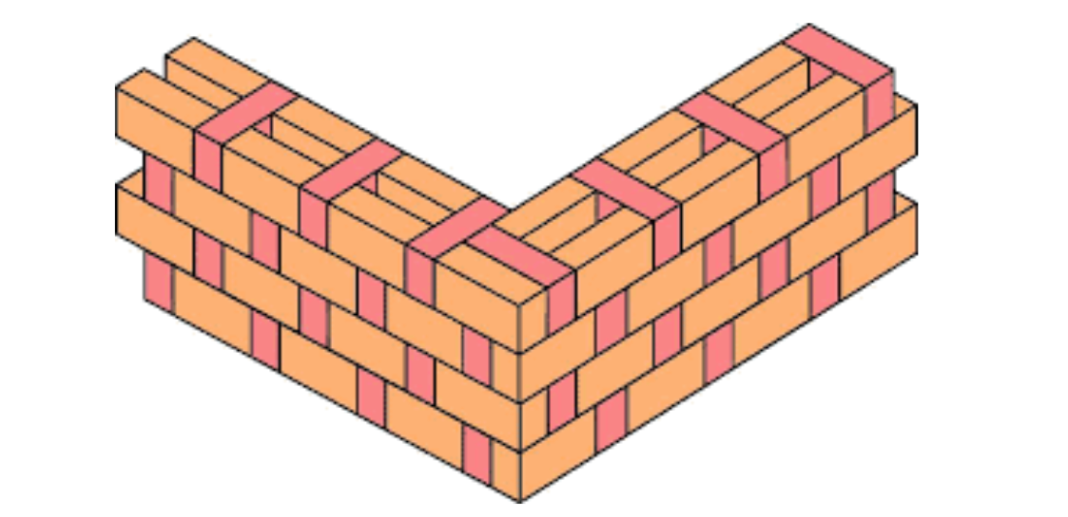








CAD MODEL
Shown above a rat trap structure in which we use cow dung bricks because it is cheap and easily available in traditional areas
Similar to this, creating channels of brick structure on the floor reduces losses from the floor. First a continuous layer of bricks is laid on the floor. On top of this, channels are constructed with alternating rows of bricks and air­gapAbove this, another continuous layer of bricks is provided to make the floor of the kiln. This construction reduces the contact between the floor of the kiln where fuel is fired and the ground, hence reducing the losses substantially

Slide 10
References
Ravi, M.R., Dhar, P.L., Kohli, S., 2007. Energy audit and improvement of an updraught pottery kiln. Department of mechanical engineering, Indian Institute of Technology Delhi, New Delhi, India.
Ravi, M.R., Prasad Y. Improved Earthen Tawa Firing Process. Department of Mechanical Engineering, Indian Institute of Technology Delhi, India

