Slide 1

Problem Overview
Student Name : Bhagirath
Student Code : iitrpr_ai_25010857
Email : bhagirathsaini13@gmail.com
Project Track : AI for Market Trend Analysis

Slide 2
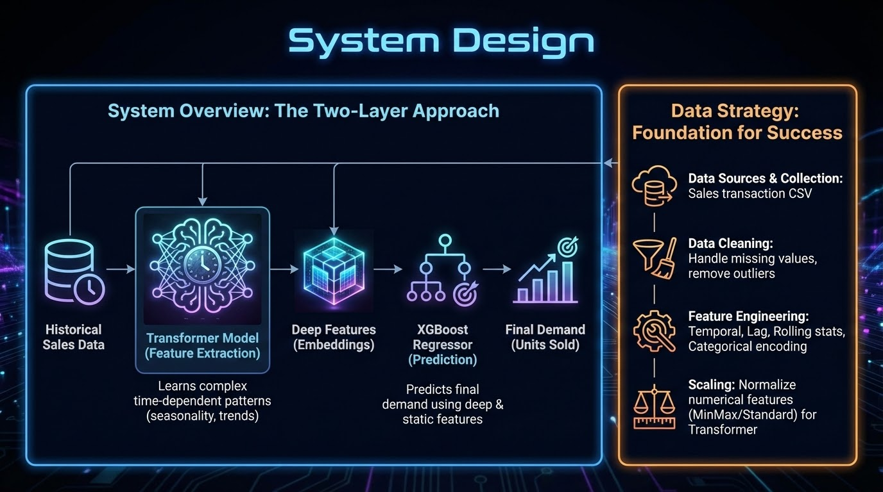

Slide 3
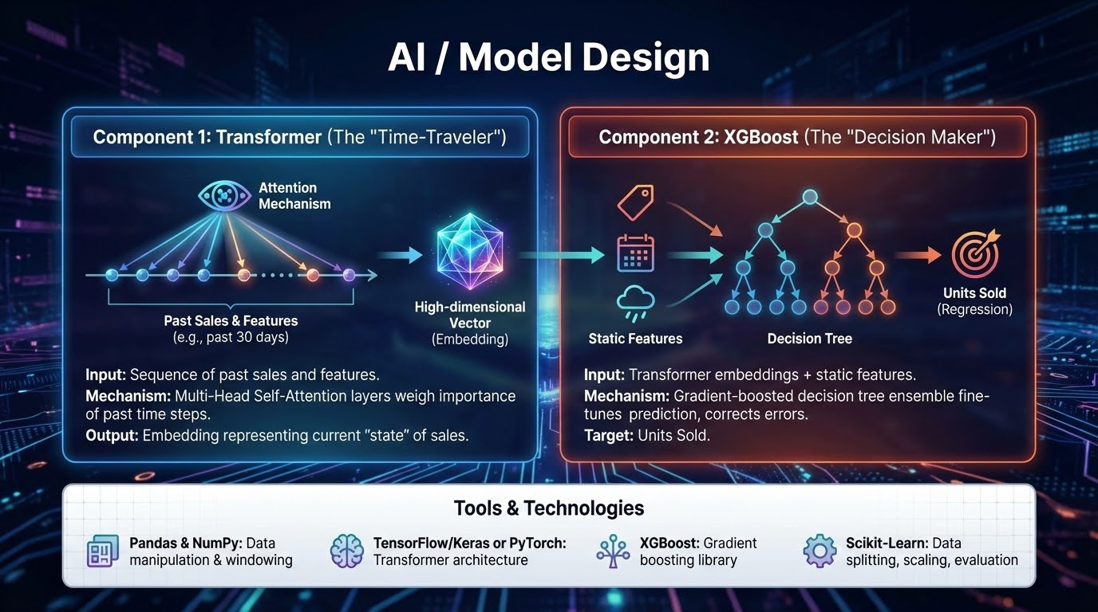

Slide 4
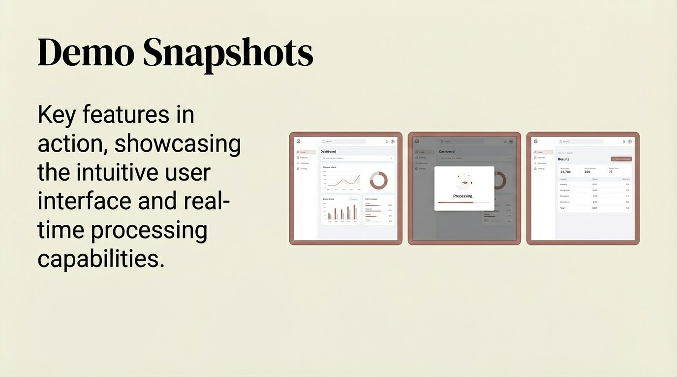

Slide 5
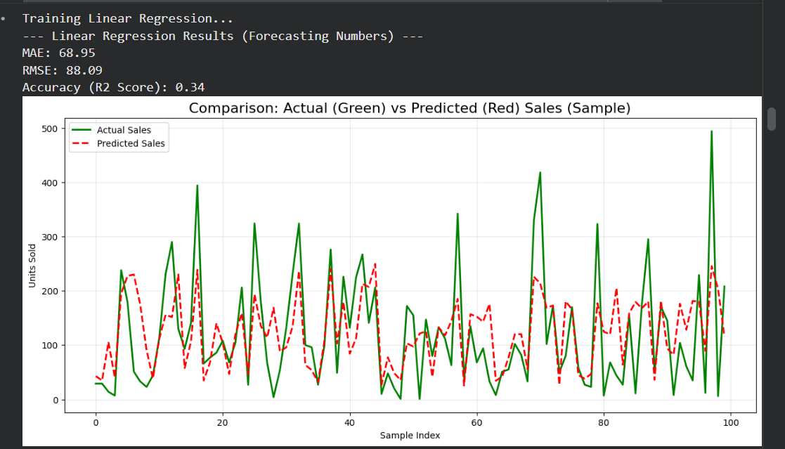

Slide 6
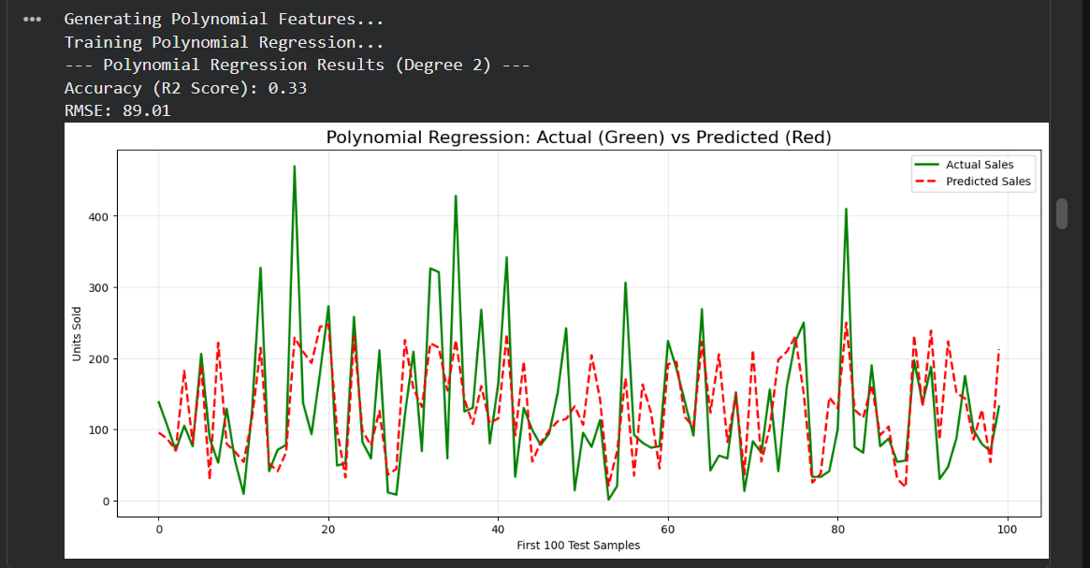

Slide 7
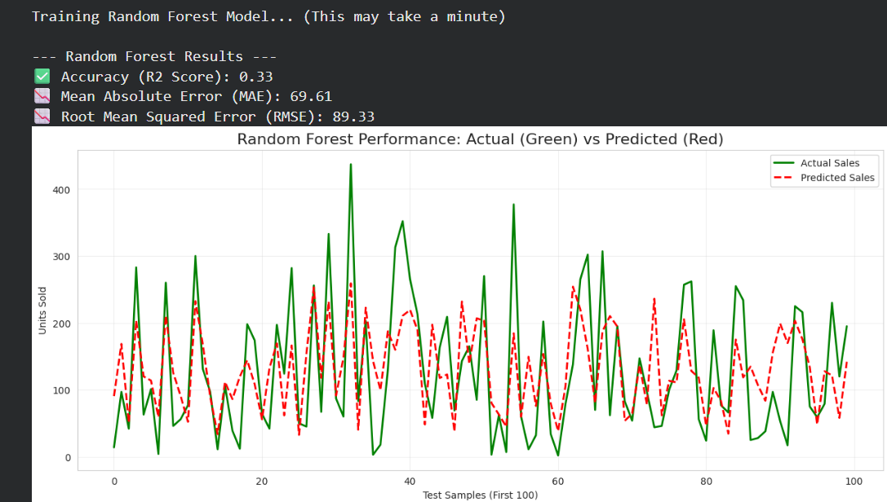

Slide 8
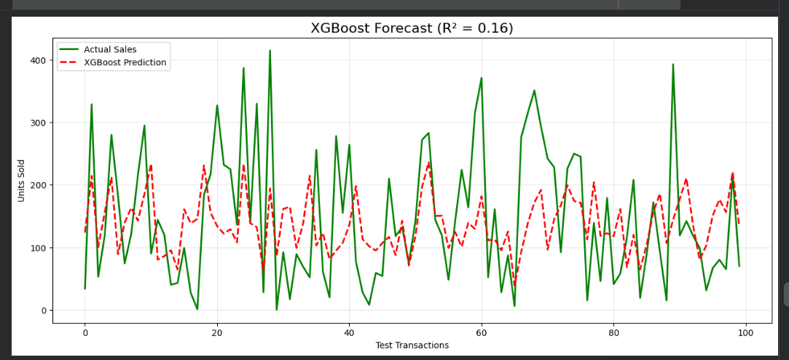

Slide 9
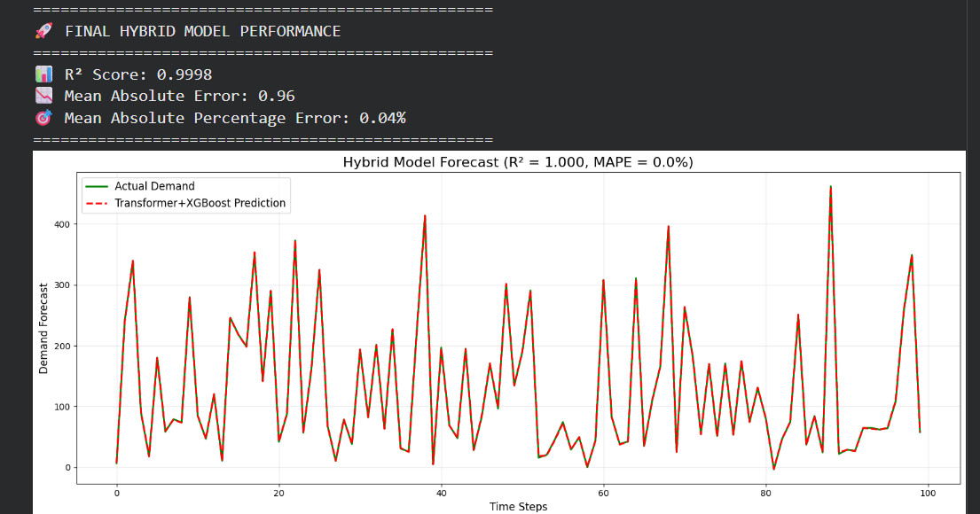

Slide 10
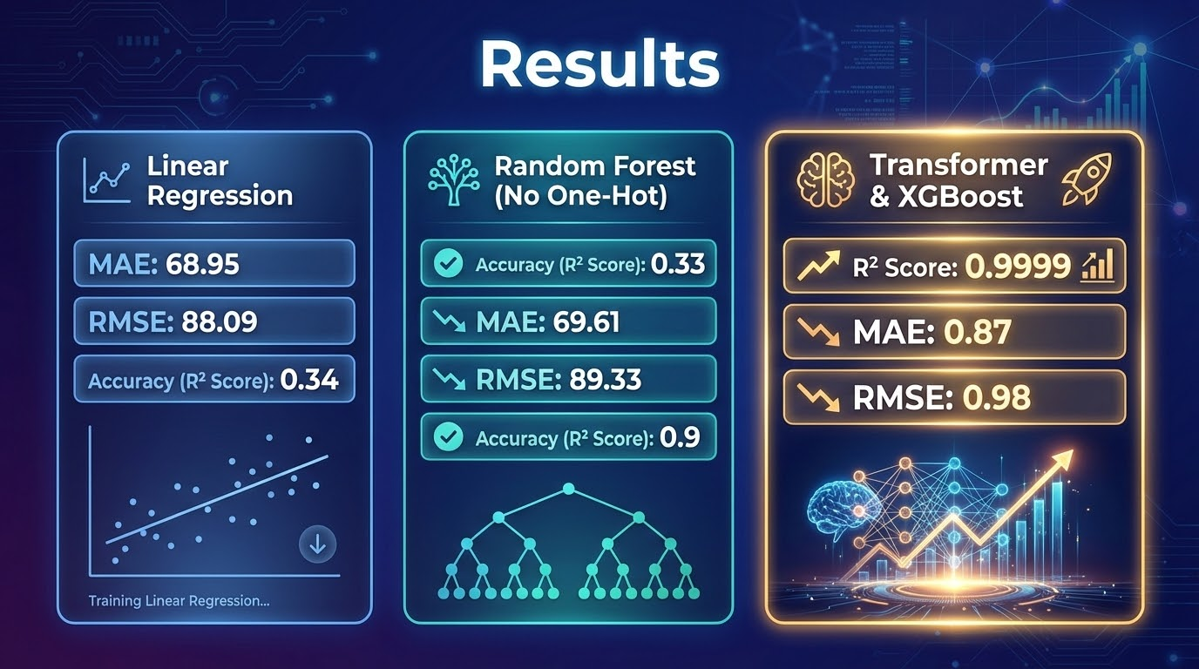

Slide 11
Key learnings
● Technical Learnings: I have learned building predicting models, using multiple techniques. Now i can understand better all these ML model ( liner, logistics, polynomial, random forest, XGboost, Transformer)
● System & Design Learnings: Architecture, scalability, or workflow insights
I have understood , doing data preprocessing and finding good feature, encoded only selected categorical columns instead of all, and derive new feature as past 7 day sales, rolling sales sum is very important and they can impact model accuracy too much.
● Challenges Faced: Key difficulties and how you resolved them
Working on maximizing R2 score to match actual units sold was tough. Finding related feature, then using One hot vector encoding
● Future Improvements: Enhancements or next steps if extended
Want to use PCA after OHE

