Slide 1

VARDHAMAN COLLEGE OF ENGINEERING (AUTONOMOUS) Affiliated to JNTUH, Approved by AICTE, Accredited by NAAC with A++ Grade, ISO 9001:2015 Certified Kacharam, Shamshabad, Hyderabad – 501218, Telangana, India DEPARTMENT OF COMPUTER SCIENCE AND ENGINEERING (AI&ML)
MINI PROJECT PRESENTATION - II
III - Year B.Tech - I Sem
CSE – AI & ML
SESSION 2024-2025
OTAKU NEXUS
Team No:13
B S Siddhartha 23881A66D3
D. Shradha 23881A66J0
V. Pranavi 23881A66K0
M. Varun Sai 24885A6619
SUPERVISOR NAME:
Mr. Anudeep Meda
Assistant professor
Department of CSE – AI & ML

Slide 2
AGENDA
Project Overview
Requirements
Concepts / Technologies
Flowchart
Conclusion

Slide 3
Project Overview
Objectives:
We aim to provide users the personalized recommendations on anime series, manga, based on genre, themes, and author preferences where users can explore anime/manga by specific authors, artists, and genres.Users can get the latest release and detailed information about their favourite anime or manga.
Scope:
User friendly interface
Manga integration
Design and usability
Review and recommendation system

Slide 4
Requirements
User Registration and Authentication: Users should be able to create accounts, log in, and logout. Include password recovery and email verification processes.(LOGIN PAGE)
Anime and Manga Database: A searchable database of anime and manga, including details such as title, genre, synopsis, new release, ratings, and cover images.
Personalized Recommendations: Provide users with recommendations based on their preferences, viewing history, and ratings.
Search and Filtering: Advanced search functionality with filters for genre, release year, rating, and popularity.

Slide 5
Concepts / Technologies
User Profiles and Preferences: Allow users to create profiles where they can set their favorite genres, shows, and characters. Use this data to provide personalized recommendations.
Recommendation System: Implement algorithms (like collaborative filtering or content-based filtering) to suggest anime and manga based on user preferences and viewing history.
HTML/CSS: For structuring and styling your web pages.
JavaScript: For adding interactivity, such as fetching data dynamically and handling user input.
SQL : to store trailer videos of particular anime , this DBMS is used.

Slide 6
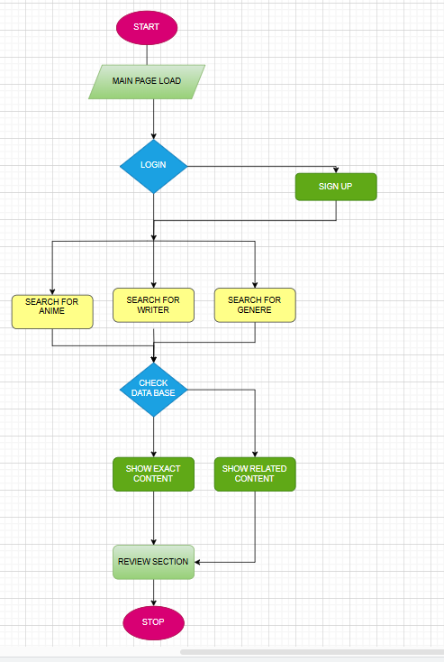
FLOWCHART :

Slide 7
Conclusion
Otaku Nexus is here to tackle the challenge of finding anime and manga that truly resonate with each user's unique preferences. We offer personalized recommendations and rich, detailed information about characters and their backgrounds, helping fans connect more deeply with their favorite series. Built with essential web technologies like HTML, CSS, and JavaScript, and developed in VS Code, our platform ensures a smooth and engaging user experience. This means users can easily discover content that suits their tastes while diving deeper into the world of anime and manga. As Otaku Nexus grows, we're excited to explore new frameworks and technologies to further enhance our functionality and impact in the anime community.

