Slide 1
Project Title
Sequential Recommendations with Graph Neural Networks

Slide 2
Aim
This project aims to explore how graph neural networks can be used to build efficient and accurate sequential recommendation systems. The goal is to develop an effective way to capture user behavior patterns and make accurate recommendations based on them.

Slide 3
Objectives
Analysing the existing literature, databases, and technical solutions pertaining to sequence suggestion
Design and execute a sequential recommendation system utilising graph neural networks.
Assess the efficacy of the suggested algorithm and enhance its prediction capability
Validate the algorithm's practical usefulness and gather feedback from end users

Slide 4
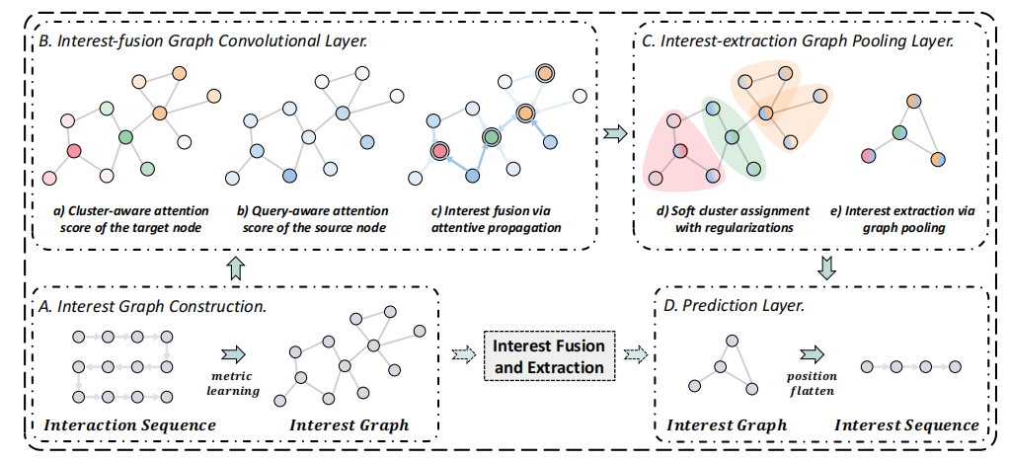
Methodology
Interest Graph Construction
Figure 1: Illustration of the SURGE model.
By re-constructing loose item se-quences as tight item-item interest graphs based on metric ing, we explicitly integrate and distinguish different types ofpreferences in long-term user behaviors.

Slide 5
Methodology
Interest-fusion Graph Convolutional Layer
The graph convolution propagation on the constructed interest graph dynamicallyfuses the user's interests, strengthening important bchaviors, andweakening noise behaviors.

Slide 6
Methodology
Interest-extraction Graph Pooling Layer
Considering users’ different preferences at diferent moments, a dynamie graph pooling operation is conducted to adaptively reserve dynamicallyactivated core preferences.

Slide 7

Methodology
Prediction Layer
Table 1: Statistics ofthe Datasets
After the pooled graphs are flattened into reduced sequences, we model the evolution of the enhanced interest signals and predict the next item that the user has highprobability to interact with.

Slide 8
Key Papers
[1] J. Chang et al., ‘Sequential Recommendation with Graph Neural Networks’, Jul. 26, 2023, arXiv: arXiv:2106.14226. Accessed: Nov. 14, 2024. [Online]. Available: http://arxiv.org/abs/2106.14226
[2] Y. Zhang, B. Yang, H. Liu, and D. Li, ‘A time-aware self-attention based neural network model for sequential recommendation’, Applied Soft Computing, vol. 133, p. 109894, Jan. 2023, doi: 10.1016/j.asoc.2022.109894.
[3] Y. Hao et al., ‘Multi-dimensional Graph Neural Network for Sequential Recommendation’, Pattern Recognition, vol. 139, p. 109504, Jul. 2023, doi: 10.1016/j.patcog.2023.109504.
[4] F. Yin, T. Xing, M. Ji, Z. Yao, R. Fu, and Y. Wu, ‘Multipath-guided heterogeneous graph neural networks for sequential recommendation’, Computer Speech & Language, vol. 87, p. 101642, Aug. 2024, doi: 10.1016/j.csl.2024.101642.
[5] Z. Huang, Z. Sun, J. Liu, and Y. Ye, ‘Group-aware graph neural networks for sequential recommendation’, Information Sciences, vol. 670, p. 120623, Jun. 2024, doi: 10.1016/j.ins.2024.120623.

