Slide 1

AI Clips Generator
By Steven Akamelu
Supervisor: Luke Raeside

Slide 2
Automating Clips for Social Media Content
Creators nowadays spend too long reviewing footage to put in different social media accounts
I noticed a gap in the market that will help out people and be more time efficient. Such as streamers, content creators and the high push in content creation
AI can detect emotions see what seems more likely to it and make a decision on what emotion it analysis.
My project’s frontend is built using React, while the backend is built using Python/FastAPI while using the packages of tensorflow and deepface

Slide 3
Project Objectives
To build a project that will create highlight clips using AI
Detect key moments, emotions and timestamps
Given a clean UI system for uploads and previews
Allow users the ability to share to different platforms
Integrate a backend processing system to a frontend interface

Slide 4
System Overview
Input Video -> Backend Processing -> AI Analysis -> Suggested Clips -> Frontend Display -> Export

Slide 5
Frontend Display
Built using React and styling for UI that would be modern
This would be used for upload, previews and seeing timelines, pasting urls and emotions
Styling is supported by my CSS files from App.css

Slide 6
Backend
My backend will handle intake of videos, frame extraction through the use of deepface, emotion detection through the use of tensorflow
Outputs Json for each that has been made

Slide 7
Current Limitation
The backend and frontend connection isn’t complete
The frontend visually doesn’t seem to be receiving data but it’s seen in the backend post connection system
Most likely due to routing and request formatting issues

Slide 8
Use Case Diagram
This diagram showcases the interaction between the user and the system
The Creator will be the main user and can create clips, upload videos, or even paste urls, preview said clips, edit clips, run face analysis and download final clips
The AI Model will perform core tasks such as analysing emotions, detecting speech, identifying high emotional peaks and generating the best clips based on this information
The Social Media Platform represents the role of exporting videos unto the multiple different platforms
The system uses include and extends relationships to showcase it exporting clips or detecting speech

Slide 9
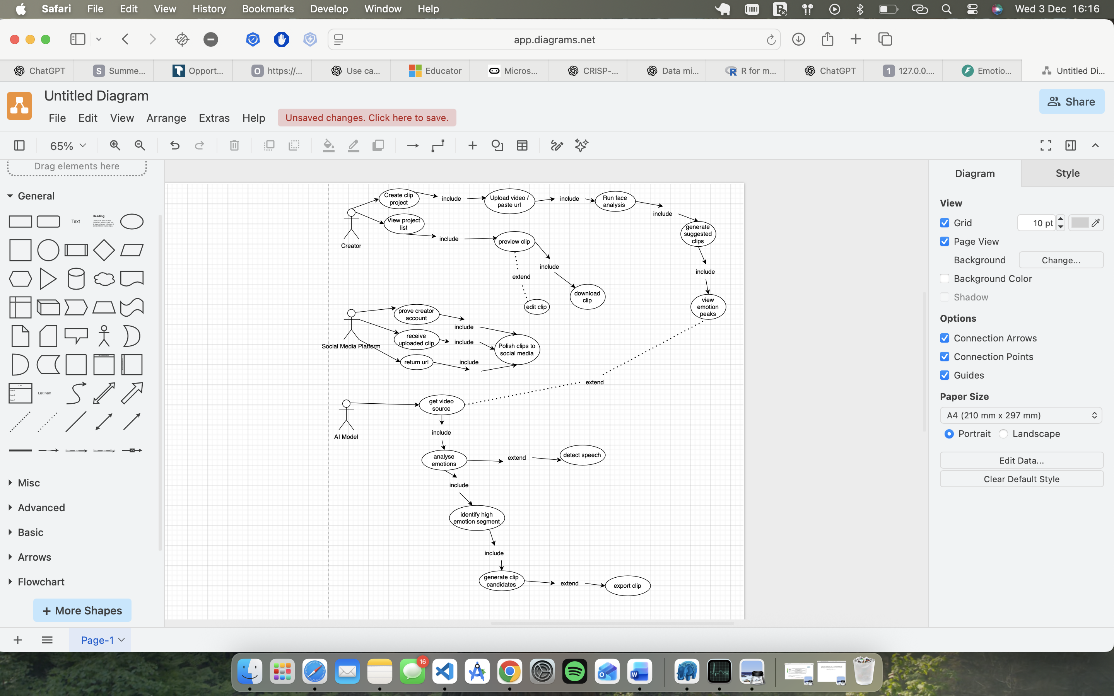
Use Case Diagram

Slide 10
ERD Diagram
This Erd diagram highlights the full structure used by the system
A creator can have many clips 1 to M relationship
Every clip is linked to different emotion analysis result. Due to this many emotion peaks can be stored because of this
Clips suggested are made from AI analysis and are extensions of the entity.

Slide 11
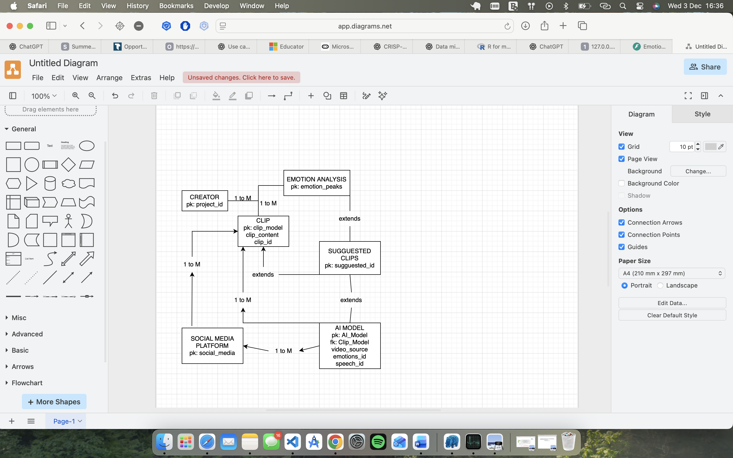
ERD Diagram

Slide 12
Connecting Use Case + ERD + System Flow
Use Case = How users interact with the system
ERD Diagram = How data is stored and structured
When both are combined it’s an end-to-end workflow from the upload to the analysis to the suggested clips to the final result
Together they define how the project is built, tested and evaluated.

