Slide 1
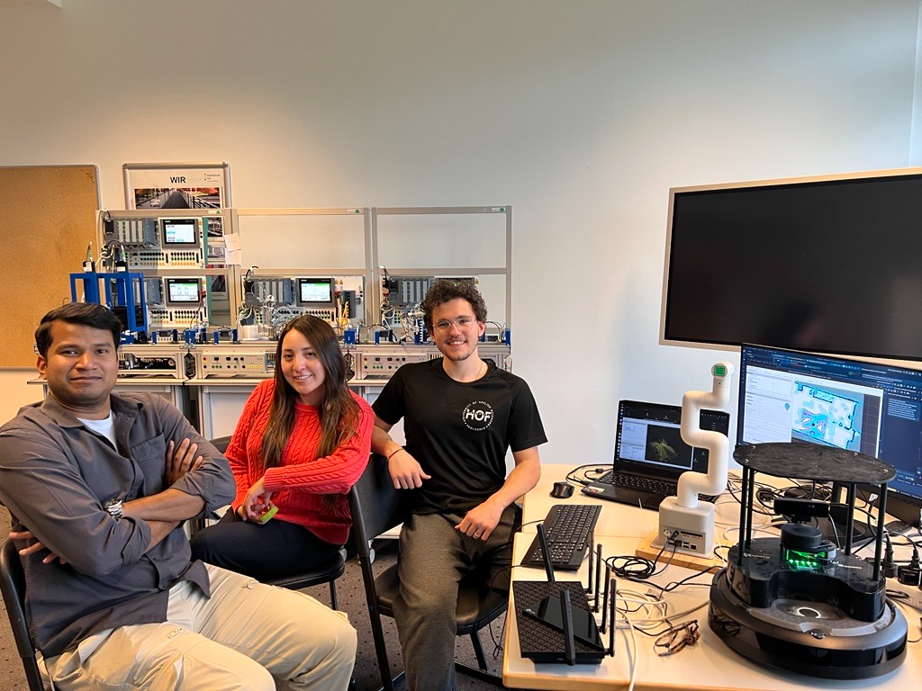
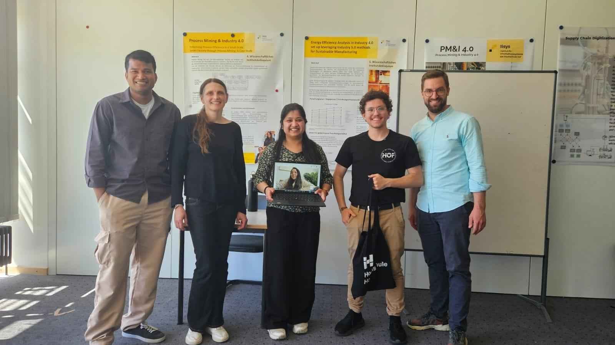
Cooperative Robots
for Smart Factories
An open-source logistics integration blueprint
Abstract
TurtleBot 4 and MyCobot 280 cooperate with a Siemens
smart factory. Modular software connects navigation,
vision and manipulation using onboard sensors,
without external tracking or proprietary middleware.
System & methods
TurtleBot 4: ROS 2 Jazzy, Nav2 and AMCL
for mapping, localisation and delivery.
MyCobot 280: Jetson Nano, MoveIt 2
and camera-based product recognition.
Factory gateway: OPC UA links the
robotics stack to Siemens S7-1500 PLCs.
A shared dashboard coordinates operation.
Three logistics missions
Product delivery
Identify the product, collect it and deliver
it to the destination for its colour.
Defective-component retrieval
Transport rejected components to an
inspection area.
Material restocking
Bring supplies to the factory inventory
station.
B002 Future Lab: robots, team and factory testbed.
Delivery cycle: detect → pick up → hand off → deliver → return to dock
Research collaboration at Hof University.
Contribution & next steps
Replaceable modules connect heterogeneous robotics and industrial systems.
Coordinated handoffs exchange product class, arrival and release status.
Next: benchmark complete cycles in clear, static and dynamic obstacle scenarios.
Supervision: Prof. Dr.-Ing. Christoph Koch
Future Lab: Shantall Marucia Cisneros Saldana
Matheus Hipólito Carvalho
EESC–USP / Hof University of Applied Sciences
matheus.carvalho@hof-university.de
Notes:
Sources: user-supplied HOF_USP_Bots_Paper.pdf (architecture, mission descriptions, author and affiliations); user-supplied project implementation context (dashboard and coordinated handoff); image.png and Mídia.jpeg (team photographs); Postervorlage_2026_iisys (1).ppt (layout, colours, logos and event identity). Quantitative experimental results are not presented: the supplied paper leaves its benchmark table unfilled.

