Slide 1
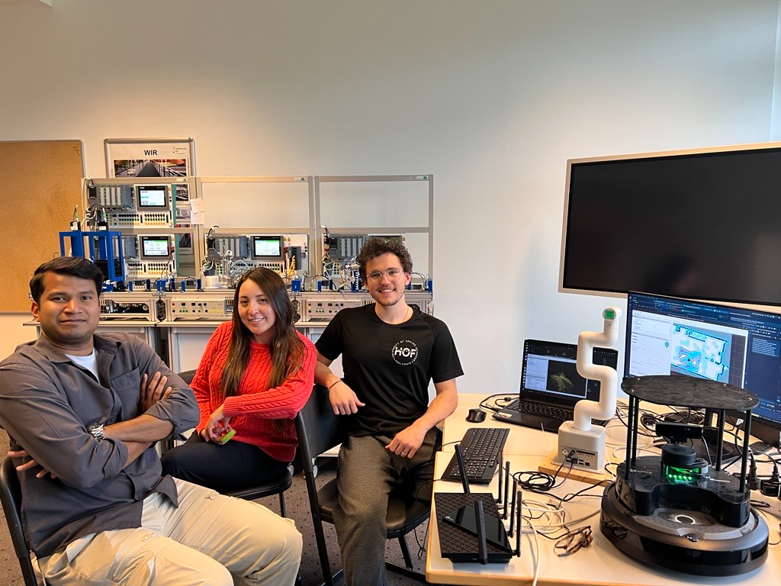
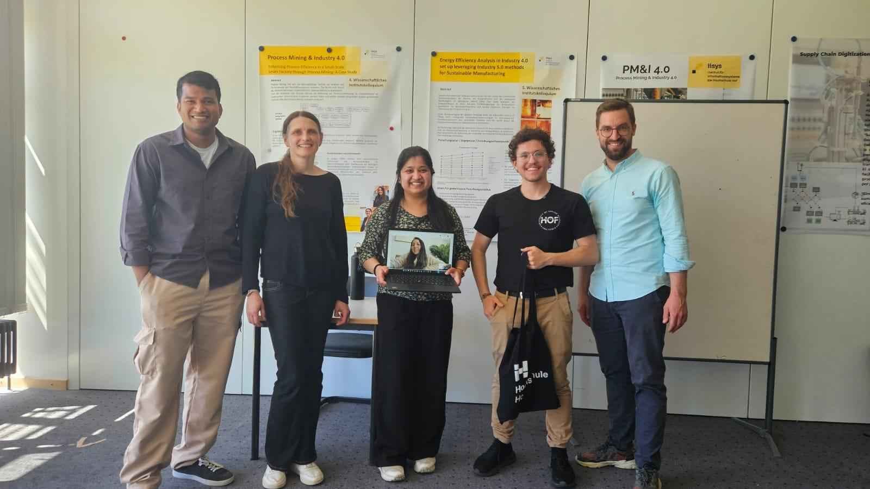
Cooperative Robots
for Smart Factories
An open-source logistics integration blueprint
Abstract
A TurtleBot 4 and a MyCobot 280 jointly run three
logistics missions in a didactic Siemens smart factory,
linked to a real-time 3D twin of the same cell. Only
open-source software and onboard sensors are used.
The integration challenge
A modular solution
Mobile robots, manipulators and factory PLCs run
on separate software stacks. ROS 2 Jazzy, ROS 2
Galactic and the Siemens S7-1500 network have to
be coordinated explicitly to work as one system.
Three replaceable modules — mobile base, arm
and OPC UA factory gateway — meet at fixed
interfaces, so any one can be swapped out or
run on its own.
Cooperative delivery pipeline
SLAM mapping · AMCL localisation · Nav2 navigation
MoveIt 2 motion planning + suction gripper
Perception
Coordination
Pickup
Transfer
Delivery
Camera + YOLO
class
Mission manager
task
TurtleBot 4
arrival
MyCobot 280
release
TurtleBot 4
Detect product
Validate class
Send class
Select mission
Check readiness
Set destination
Undock
Drive to pickup
Confirm arrival
Wait for arrival
Place product
Confirm release
Wait for release
Deliver by colour
Return to dock
Two handshakes keep the robots in step: the arm waits for arrival, the base waits for release.
Digital twin & factory in the loop
A real-time 3D twin rehearses missions on the same ROS 2 stack, and a web dashboard starts
and monitors them. The factory joins as a peer: it releases the can to the arm.
Three logistics missions
Product delivery
Defective-part retrieval
Material restocking
Fetch the detected product and
deliver it to the station that
matches its colour.
Pick up rejected components
at the factory and carry them
to the inspection area.
Collect raw material, restock
the factory inventory station
and return to the dock.
Evaluation & outlook
Missions run on real hardware against a live
Siemens S7-1500 network. ROS bag logs give
cycle time and completion rate under clear,
static and moving obstacles.
B002 laboratory and project team.
Supervision: Prof. Dr.-Ing. Christoph Koch
Future Lab: Shantall Marucia Cisneros Saldana
Matheus Hipólito Carvalho
EESC–USP / Hof University of Applied Sciences
matheus.carvalho@hof-university.de
Notes:
Sources: user-supplied HOF_USP_Bots_Paper.pdf (architecture, mission definitions, author and affiliations); user-supplied implementation context and turtlebot4_jazzy/scripts/delivery_routine.py (fresh product class, pickup arrival and item-release gates); image.png and Mídia.jpeg (team photographs); Postervorlage_2026_iisys (1).ppt (template and logos). The user-supplied image(2).png informs the pipeline layout only, not its technical content. Performance benchmarking remains future work.

