Slide 1
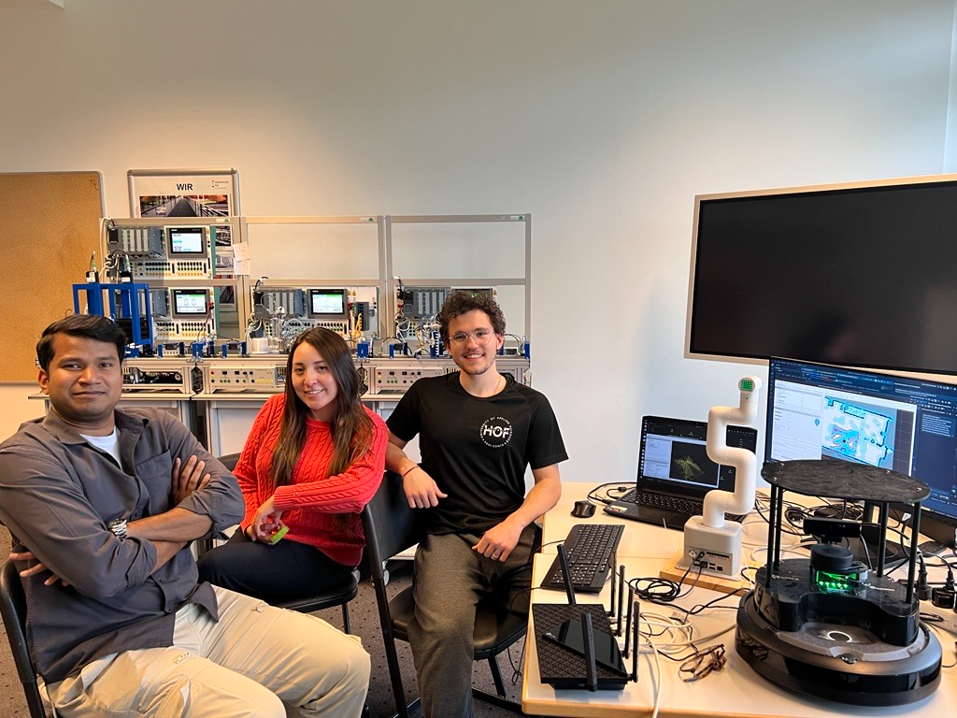
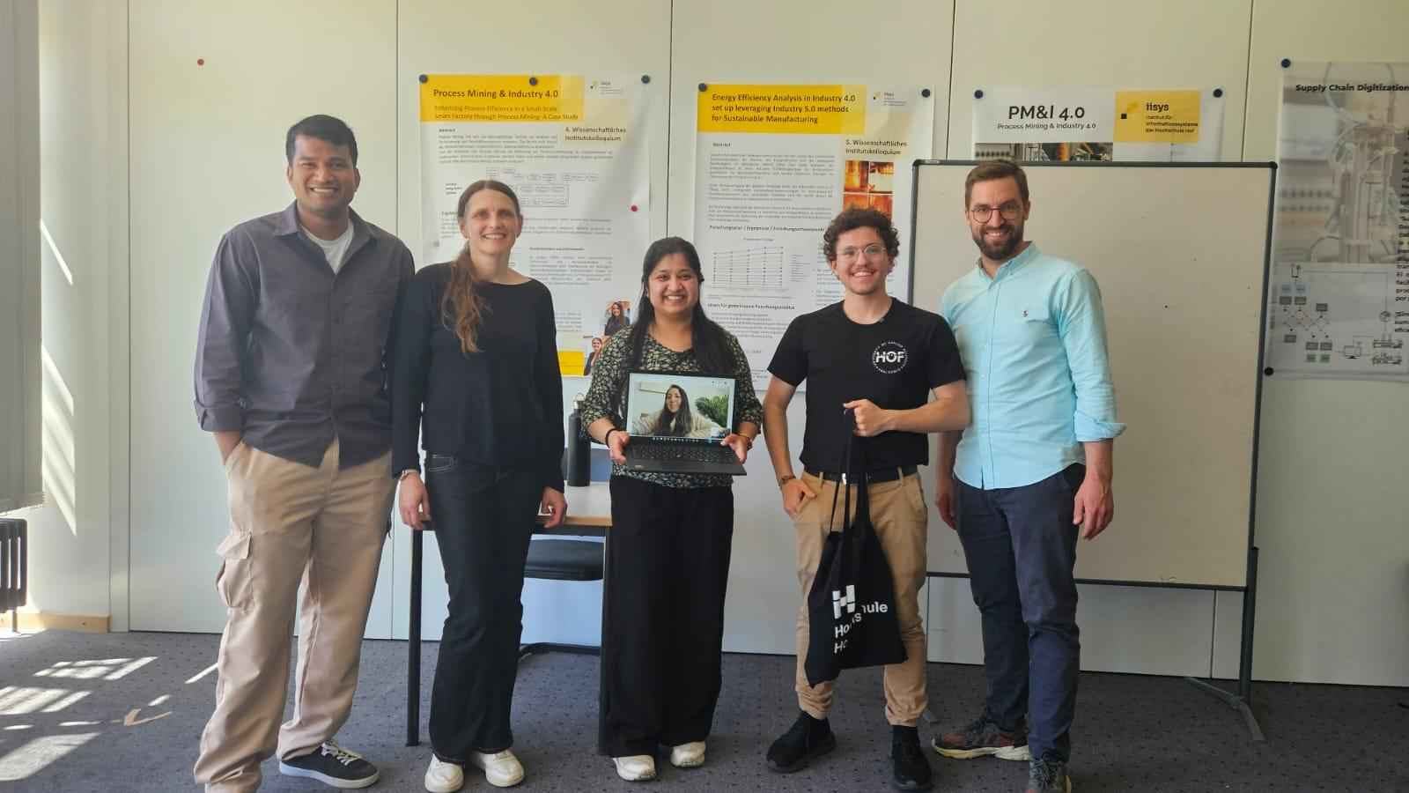
Cooperative Robots
for Smart Factories
An open-source logistics integration blueprint
Abstract
A TurtleBot 4 and a MyCobot 280 share logistics tasks
in a didactic Siemens smart factory. The system links
robot navigation, vision and manipulation through
open-source software, using only onboard sensors.
The integration challenge
A modular solution
Robot platforms and factory PLCs use different
software stacks. Reliable operation requires explicit
coordination across ROS 2 Jazzy, ROS 2 Galactic
and the Siemens industrial network.
Separate interfaces connect the mobile base,
manipulator and OPC UA factory gateway.
The dashboard supervises shared missions,
while each robot can also run independently.
Cooperative delivery pipeline
SLAM mapping · AMCL localisation · Nav2 navigation
MoveIt 2 motion planning + suction gripper
Perception
Coordination
Pickup
Transfer
Delivery
Arm camera + YOLO
class
Mission manager
task
TurtleBot 4
arrival
MyCobot 280
release
TurtleBot 4
Detect product
Validate class
Send class
Select mission
Check readiness
Set destination
Undock
Navigate to pickup
Confirm arrival
Wait for arrival
Place product
Confirm release
Wait for release
Deliver by colour
Return to dock
The arm waits for the mobile base to reach pickup. The base waits for product release before delivery.
Three logistics missions
Product delivery
Defective-part retrieval
Material restocking
Collect the identified product,
deliver it to the destination for
its colour and return to dock.
Collect rejected components
from the factory and transport
them to the inspection area.
Collect supplies and bring them
to the factory inventory station
before returning to dock.
Evaluation & outlook
The next benchmark covers clear paths,
static obstacles and moving obstacles.
ROS bag recordings capture robot motion
and mission events for cycle-time and
completion-rate analysis.
B002 laboratory and project team.
Supervision: Prof. Dr.-Ing. Christoph Koch
Future Lab: Shantall Marucia Cisneros Saldana
Matheus Hipólito Carvalho
EESC–USP / Hof University of Applied Sciences
matheus.carvalho@hof-university.de
Notes:
Sources: user-supplied HOF_USP_Bots_Paper.pdf (architecture, mission definitions, author and affiliations); user-supplied implementation context and turtlebot4_jazzy/scripts/delivery_routine.py (fresh product class, pickup arrival and item-release gates); image.png and Mídia.jpeg (team photographs); Postervorlage_2026_iisys (1).ppt (template and logos). The user-supplied image(2).png informs the pipeline layout only, not its technical content. Performance benchmarking remains future work.

