Slide 1

New location for Indian restaurant in Toronto

Slide 2
Process
Data frame construction
Analyse
Results
Conclusion

Slide 3
Data frame Construction
Downloaded the data from Wikipedia website on boroughs in Toronto
Cleaned it by removing duplicates and empty data cells.
Combined with latitude and longitude for each borough

Slide 4
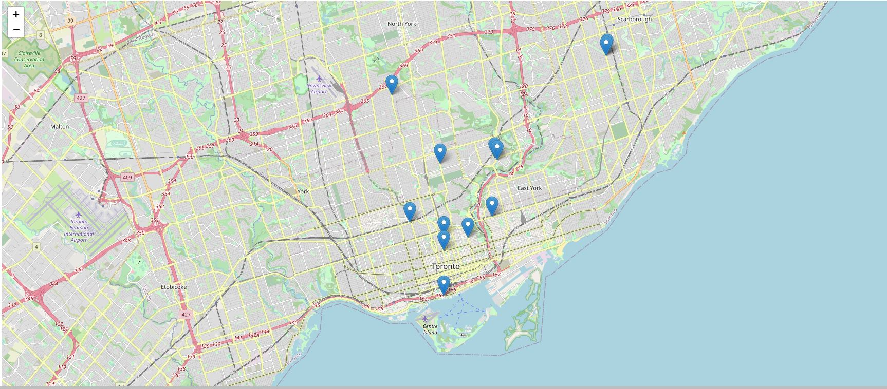
Analyse
The markers represent the presence of Indian restaurants in the area

Slide 5
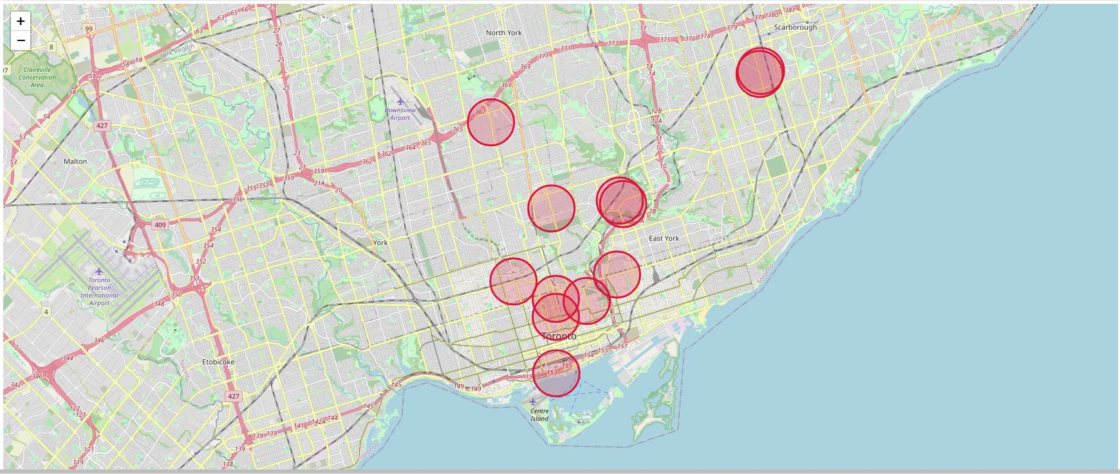
Results
The circles show the radius of each restaurants, we can now see which area has no Indian restaurants

Slide 6
Conclusion
The best location for a new Indian restaurant is York.
There is no competitors in the area.

