Slide 1
Predicting heat transfer PDE with Machine Learning
b04505008 施伯諺
B04505010 蘇柏燁

Slide 2
outline
Hear transfer
介紹Heat transfer equation
目標
實作方法
預測
誤差比較
問題與討論

Slide 3
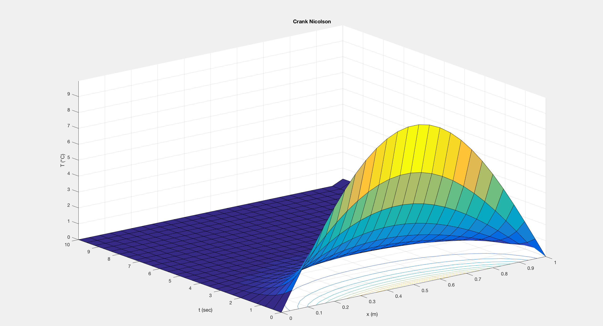

1D Heat Equation
Hear transfer
$u_{t}=αu_{xx}$
find u(x,t)

Slide 4
目標
Hear transfer
u(t+1)
u(t+1)
FDM
Neural Network
u(t)
u(t)

Slide 5

Data Preparing
Hear transfer
使用符合方程式的數學公式
Ex. $u\left(x,t\right)=e^{−απ^{2}t}sin(πx)$
Initial condition : u(x,0) = sin($πx$)
Boundary condition : u(0,t)=u(1,t)=0

Slide 6
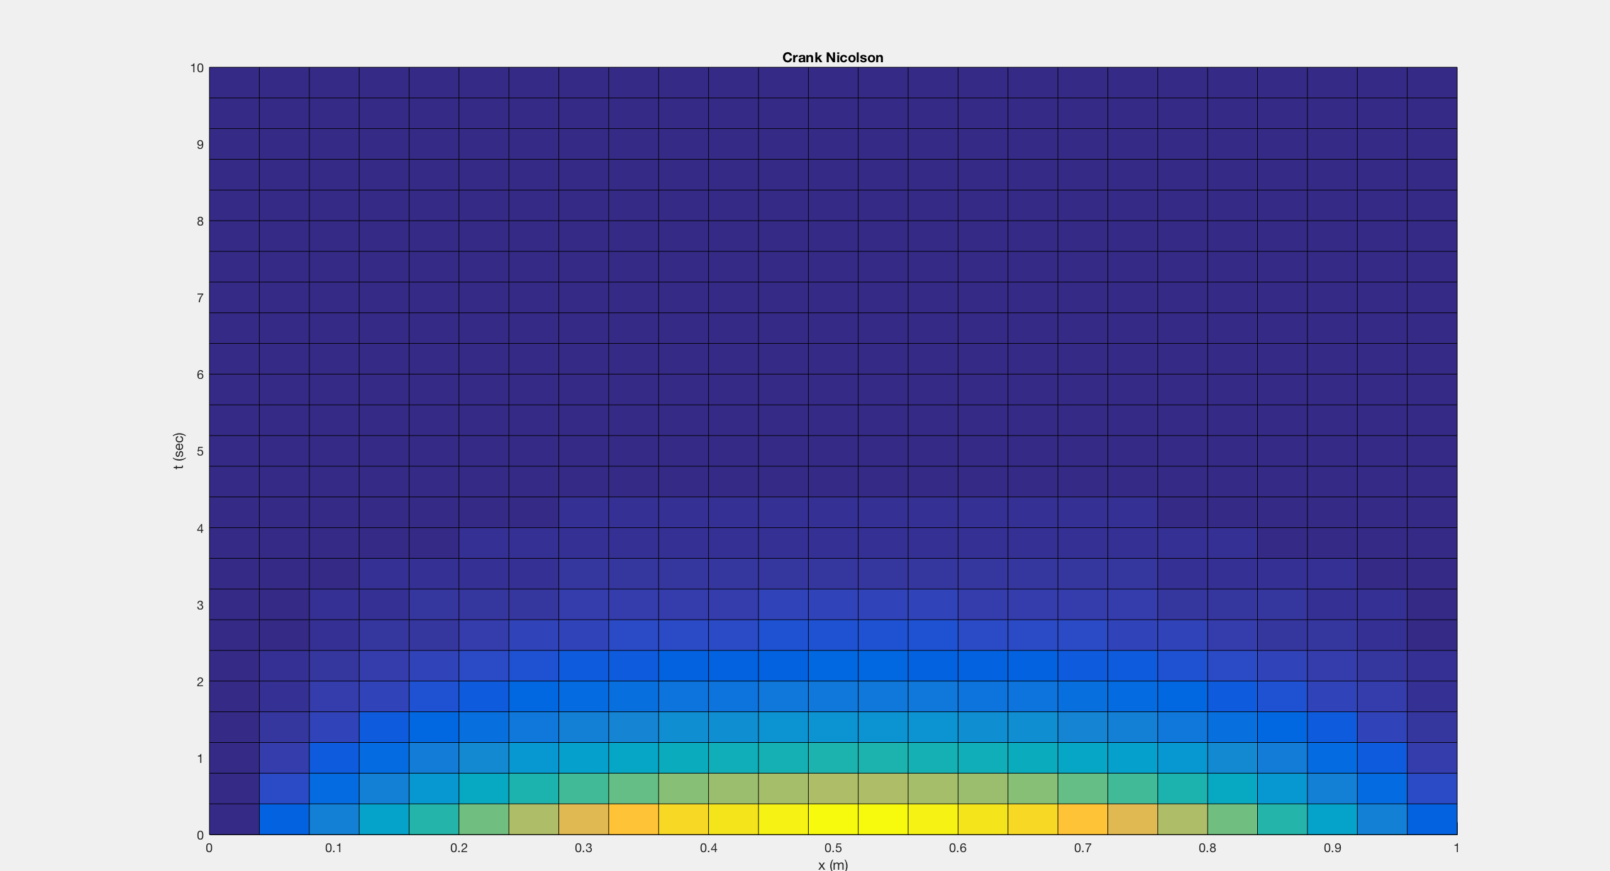
Training Data
Hear transfer

Slide 7
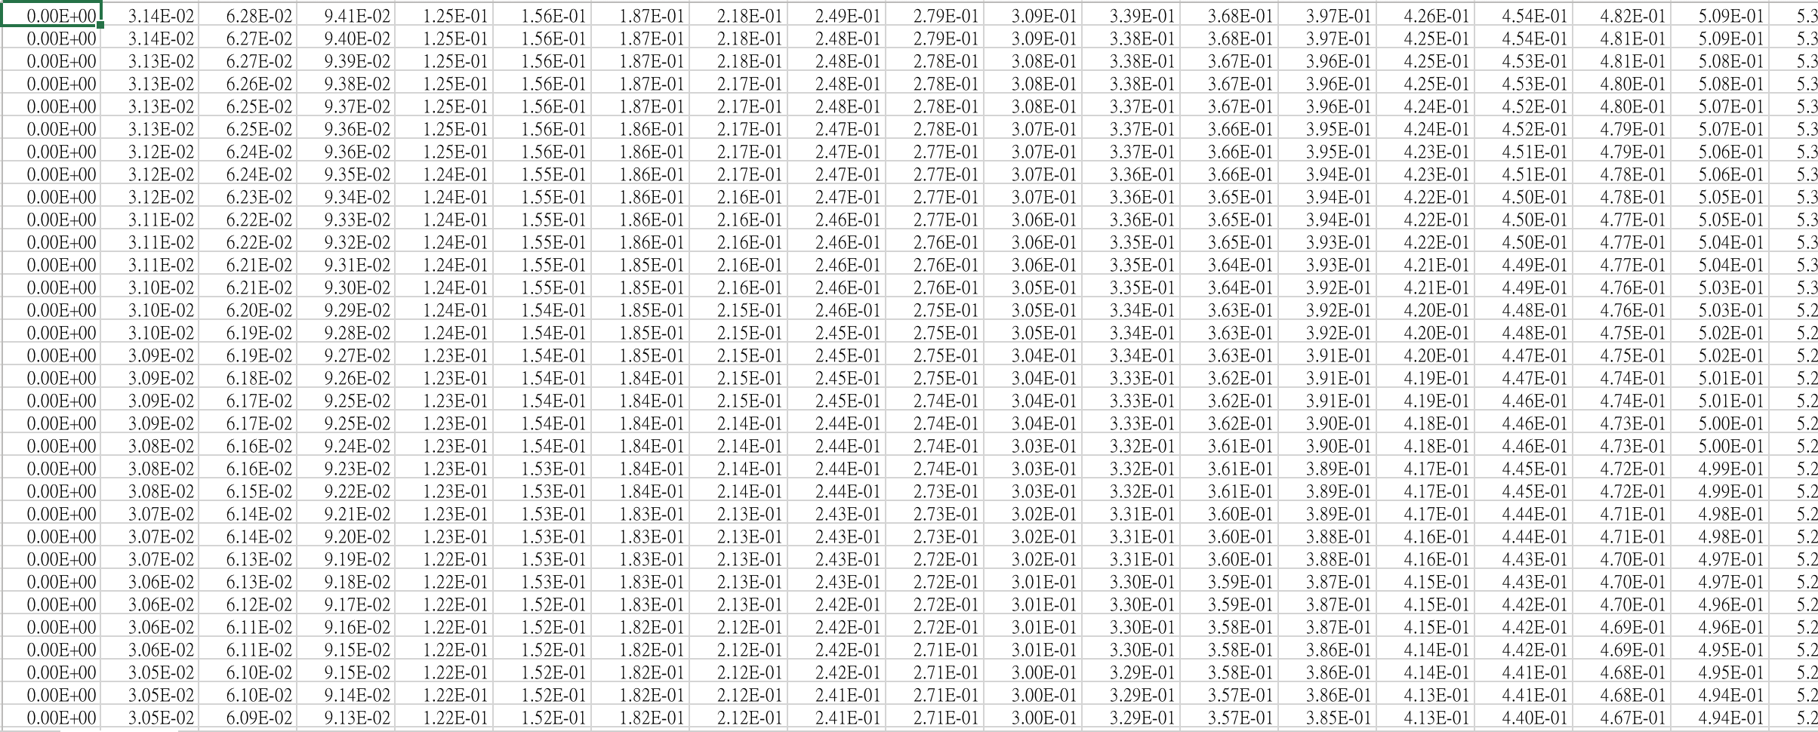
Training Data
Hear transfer

Slide 8

不同熱傳導係數？
Hear transfer
無因次項 $ρ=\frac{αΔt}{{Δx}^{2}}$
調整預測的時間$Δt$

Slide 9
決策樹
Hear transfer
Gradient Boosting
Regression Tree
Adaptive Boosting
Regression Tree
Random Forest
Regression
XGBoosting
Regression Tree

Slide 10
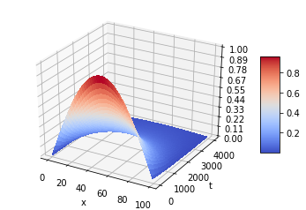
Exact Solution

Slide 11




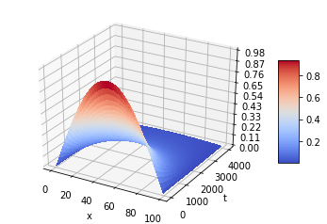
Gradient Boosting Regression
Adaptive Boosting Regression
Error:0.00306
Error:0.01976
Random Forest Regression
XGBoosting Regression
Error:0.00009
Error:0.00304

Slide 12
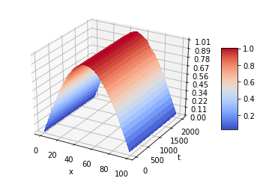
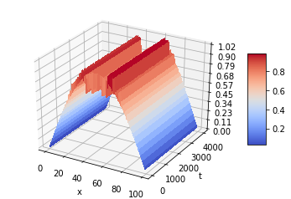
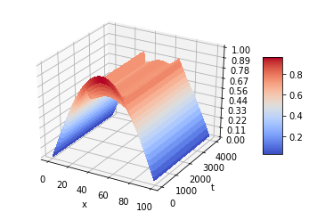
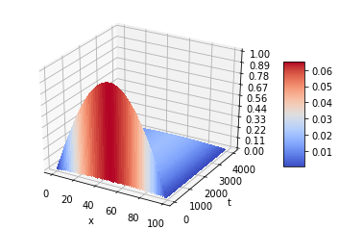
Gradient Boosting Regression
Adaptive Boosting Regression
Random Forest Regression
XGBoosting Regression

Slide 13
DNN架構
Hear transfer
[
]
input
Dense(2000,relu)
X 3
Dense(500,relu)
Dropout(0.3)
Dropout(0.3)
BatchNormalization
BatchNormalization
Dense(100,linear)
output

Slide 14

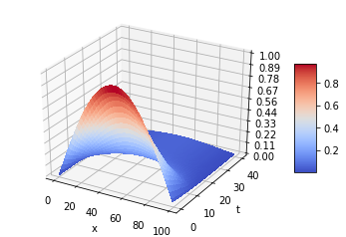

Exact Solution

Slide 15
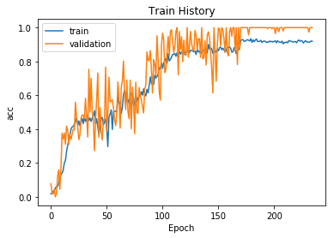

Slide 16
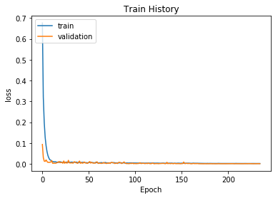

Slide 17
問題與討論
Hear transfer
決策樹很容易遇到瓶頸就無法下降
神經網路會太快收斂
預測的效率問題

