Slide 1
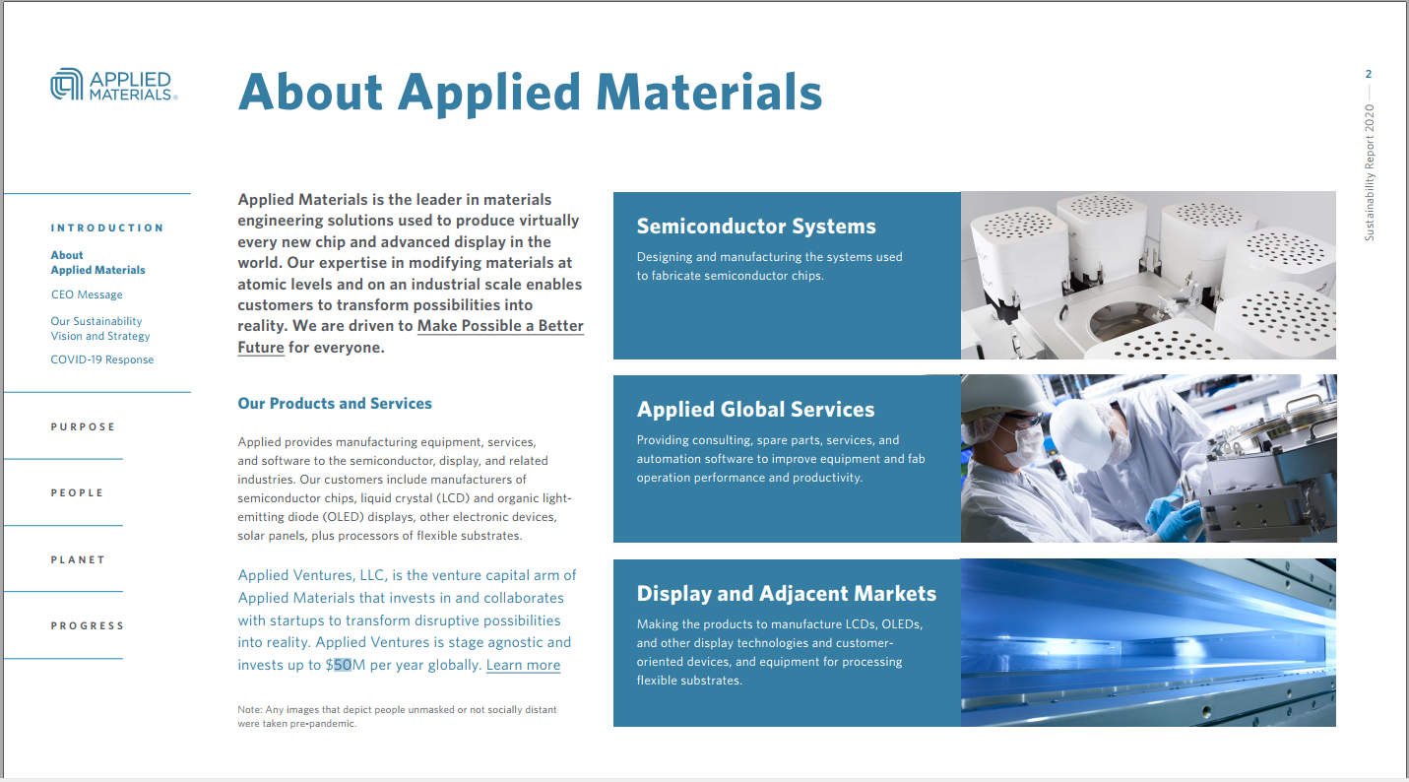
讀取PDF text(含圖片中的文字)
Sustainability Report 2020 2 Applied Materials is the leader in materials engineering solutions used to produce virtually every new chip and advanced display in the world. Our expertise in modifying materials at atomic levels and on an industrial scale enables customers to transform possibilities into reality. We are driven to Make Possible a Better Future for everyone. About Applied Materials Our Products and Services Applied provides manufacturing equipment, services, and software to the semiconductor, display, and related industries. Our customers include manufacturers of semiconductor chips, liquid crystal and organic light- emitting diode displays, other electronic devices, solar panels, plus processors of flexible substrates. Applied Ventures, LLC, is the venture capital arm of Applied Materials that invests in and collaborates with startups to transform disruptive possibilities into reality. Applied Ventures is stage agnostic and invests up to / 50M per year globally. Learn more Semiconductor Systems Designing and manufacturing the systems used to fabricate semiconductor chips. Applied Global Services Providing consulting, spare parts, services, and automation software to improve equipment and fab operation performance and productivity. Display and Adjacent Markets Making the products to manufacture LCDs, OLEDs, and other display technologies and customer- oriented devices, and equipment for processing flexible substrates. Note: Any images that depict people unmasked or not socially distant were taken pre-pandemic. I N T R O D U C T I O N P U R P O S E P E O P L E P L A N E T P R O G R E S S CEO Message Our Sustainability Vision and Strategy COVID-19 Response About Applied Materials

