Slide 1
EEGs Speak for Themselves
108-1 G3 B06901069 黃品文
B06901086 吳建翰
B06901141 何俊緯

Slide 2
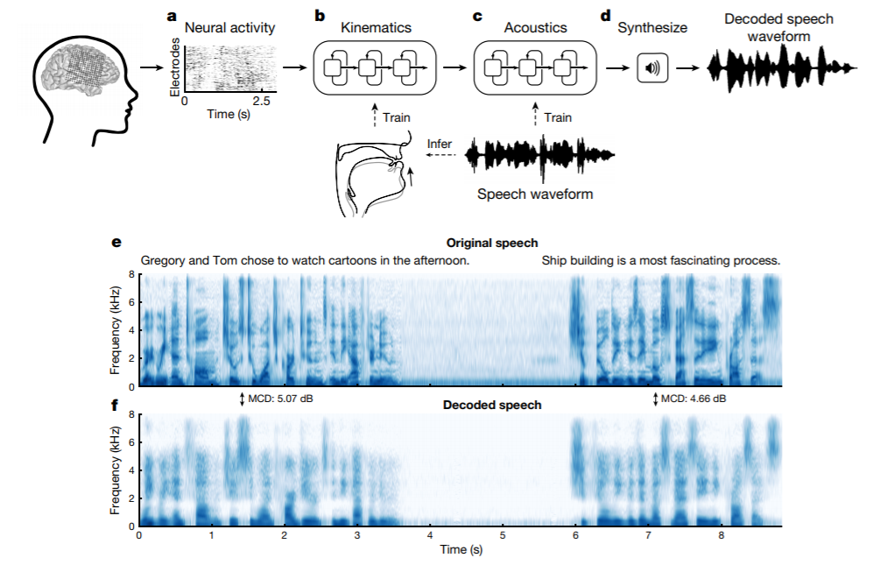
Speech synthesis from neural decoding of spoken sentences
https://www.nature.com/articles/s41586-019-1119-1.pdf
MCD: mean mel-cepstral distortion

Slide 3
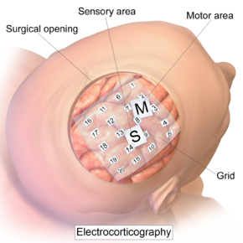
Some possible problems with the survey
Record ECoG instead of EEG
We want to develop a non-invasive approach to decode brain signal.
May be helpful for those who are aphonic.

Slide 4

A simplified version of the survey
Instead of decoding the whole sentence into voice waveform, we focus on extracting the message of EEG and classify it into some specified type.

Slide 5
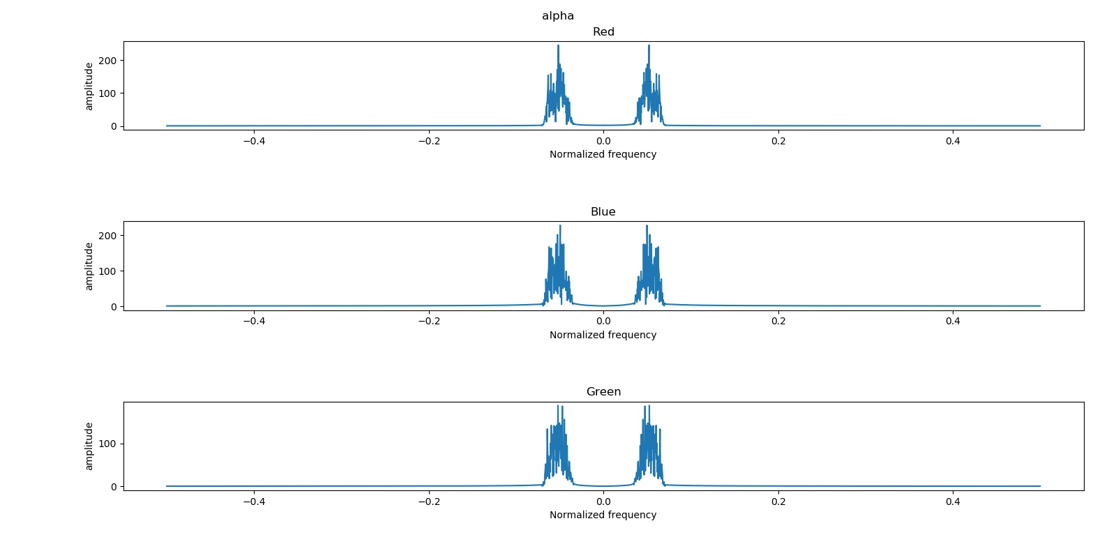
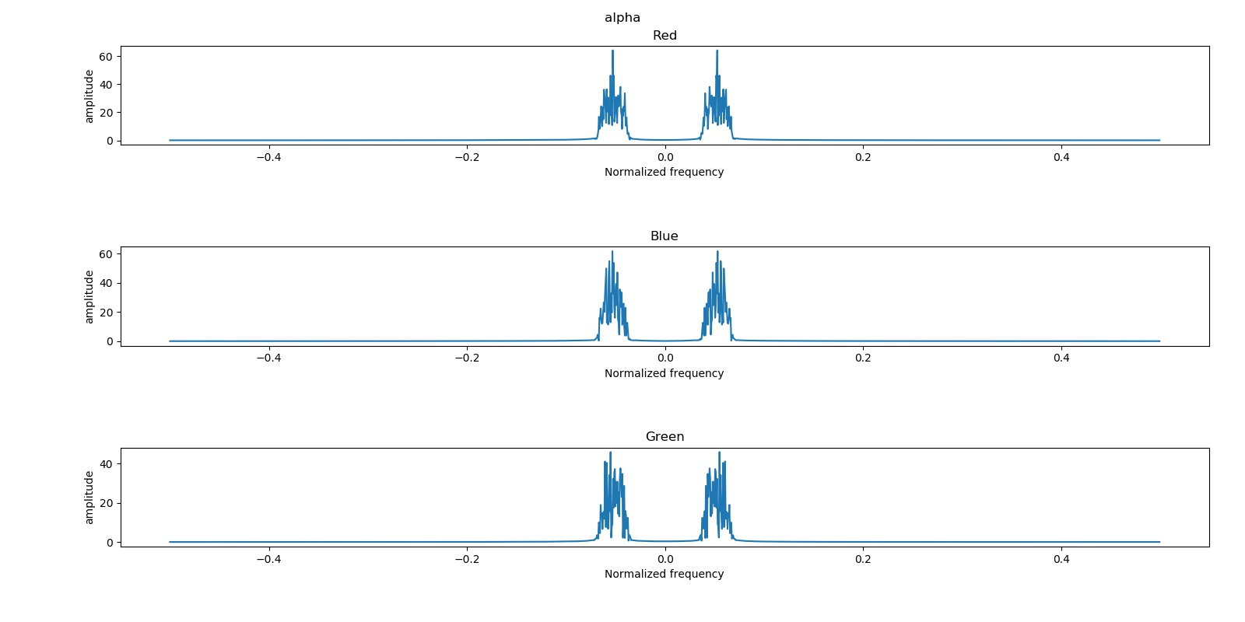
Is it possible to decode brain signal only from EEGs?
Jian Han, Wu
Chun Wei, Ho

Slide 6
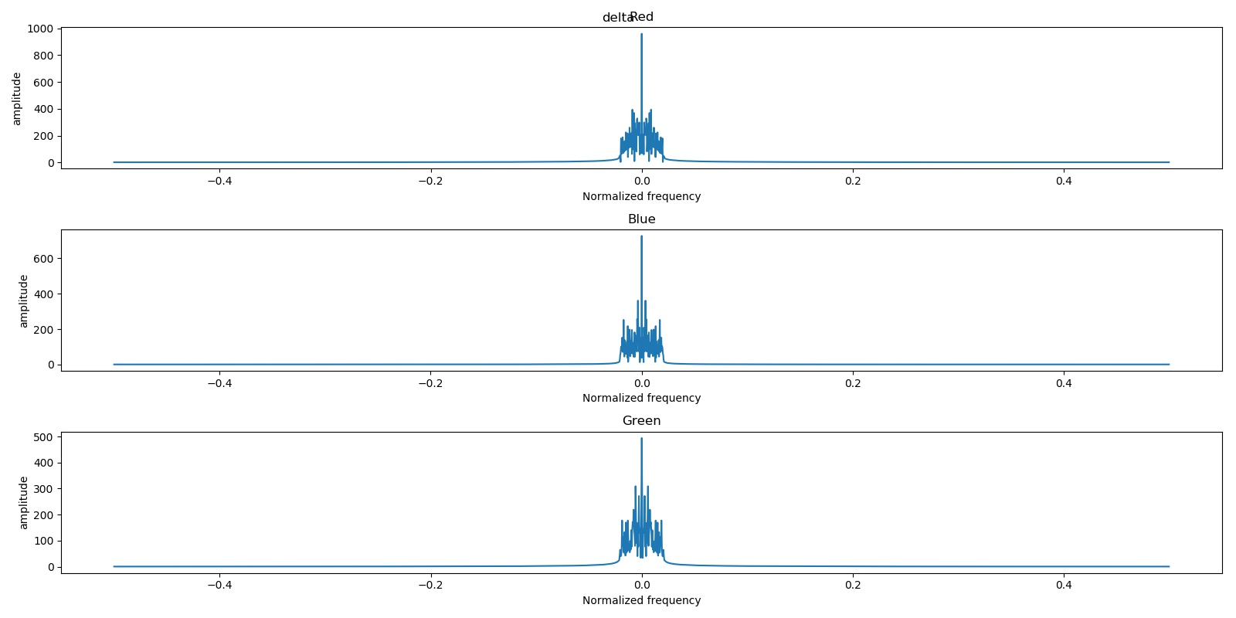
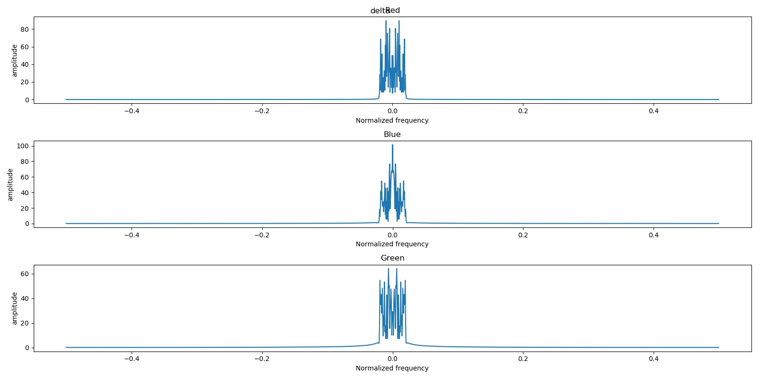
Is it possible to decode brain signal only from EEGs?
Jian Han, Wu
Chun Wei, Ho

Slide 7
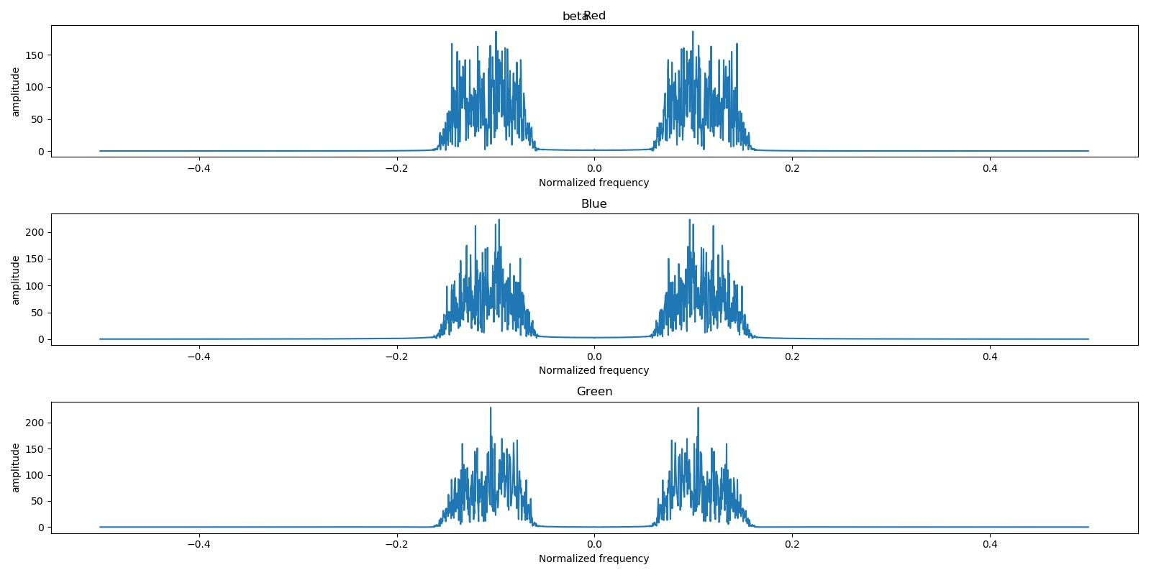
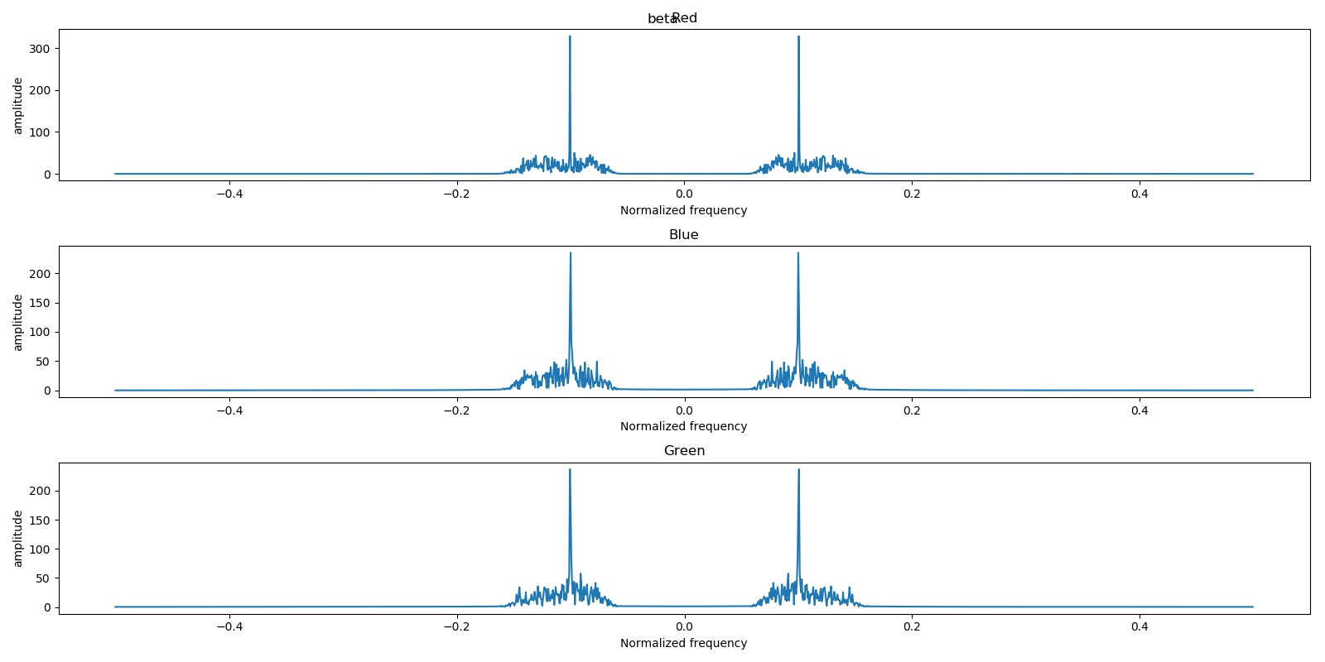
Is it possible to decode brain signal only from EEGs? (orz)
Jian Han, Wu
Chun Wei, Ho

Slide 8
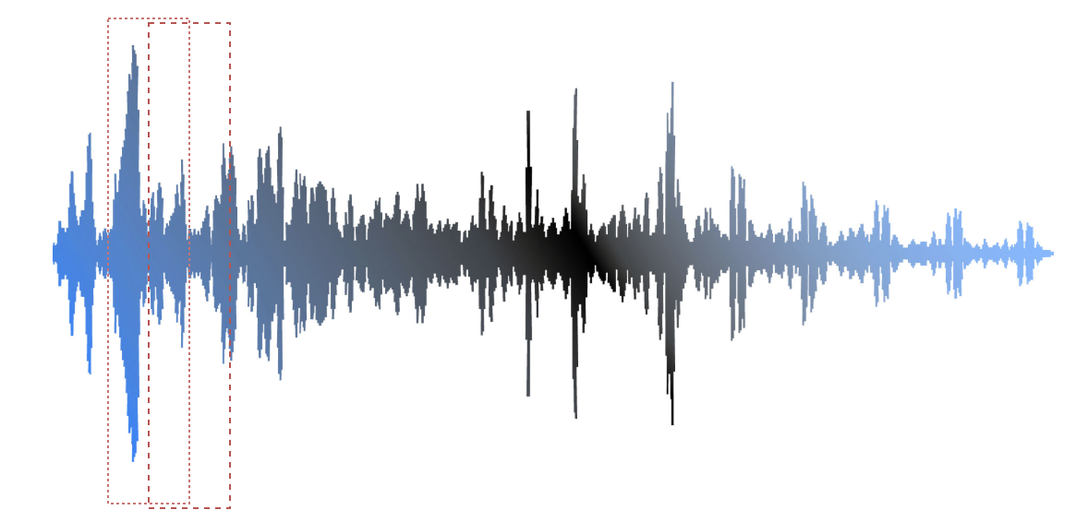

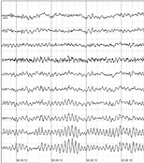
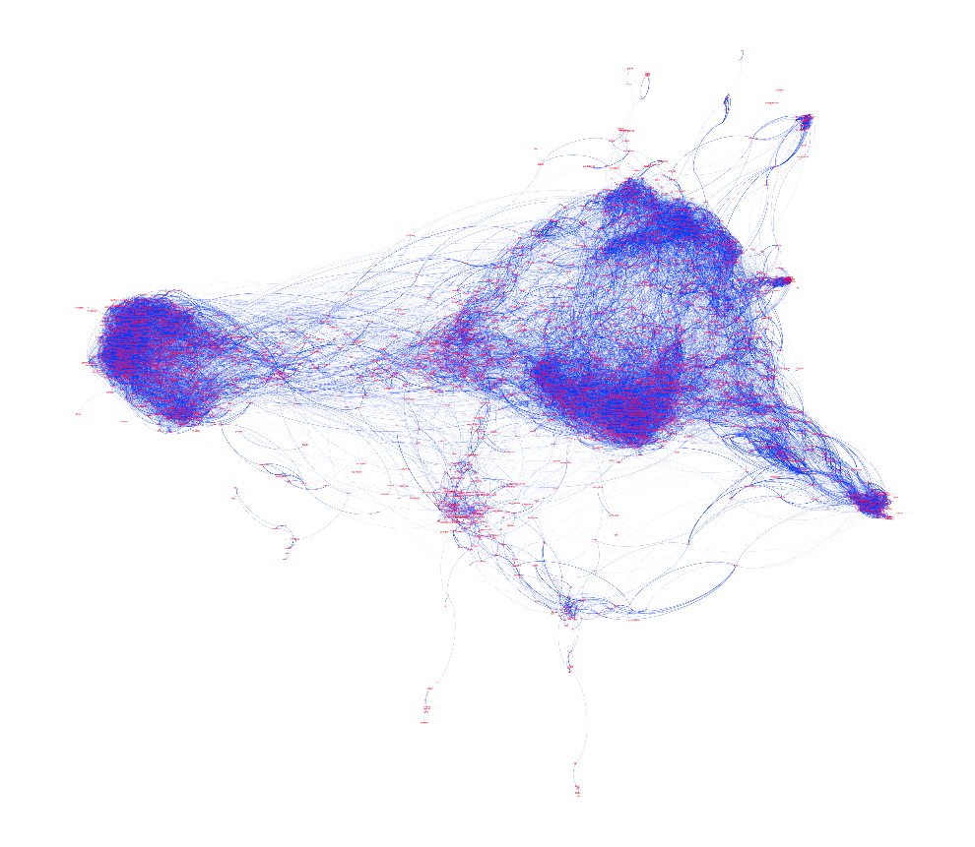
Block Diagram of the project
Source Separation
Personwise Normalization
Time domain feature extraction
classification
EEG-signal

Slide 9

Unsolved problem
Real-time display.
Need to keep silence when the user thinks nothing.
Required list
BIOPAC sticker
GPU
GPU
GPU
海超人說，再買更多顯卡

Slide 10



Slide 11

Thank You!

