Slide 1
Language Is Not All You Need: Aligning Perception with Language Models
Shaohan Huang∗, Li Dong∗, Wenhui Wang∗, Yaru Hao∗, Saksham Singhal∗, Shuming Ma∗, Tengchao Lv, Lei Cui, Owais Khan Mohammed, Qiang Liu, Kriti Aggarwal, Zewen Chi, Johan Bjorck, Vishrav Chaudhary, Subhojit Som, Xia Song, Furu Wei†
Microsoft

Slide 2
Introduction
LLMs have successfully served as a general-purpose interface across various natural language tasks. The LLM-based interface can be adapted to a task as long as we are able to transform the input and output into texts.
It is still struggling to natively use LLMs for multimodal data, such as image, and audio.
Multimodal perception is a necessity to achieve artificial general intelligence, in terms of knowledge acquisition and grounding to the real world. Unlocking multimodal input greatly widens the applications of language models to more high-value areas, such as multimodal machine learning, document intelligence, and robotics.

Slide 3
key takeaways
1. From LLMs to MLLMs:
1. multimodal perception enables LLMs to acquire commonsense knowledge beyond text descriptions.
2. aligning perception with LLMs opens the door to new tasks.
3. the capability of perception unifies various APIs, as graphical user interfaces are the most natural and unified way to interact with.
KOSMOS-1 models are trained on web-scale multimodal corpora, which ensures that the model robustly learns from diverse sources. We not only use a large-scale text corpus but also mine high-quality image-caption pairs and arbitrarily interleaved image and text documents from the web.

Slide 4
key takeaways
2. Language models as general-purpose interfaces:
1. because of the open-ended output space, we are able to unify various task predictions as texts.
2. natural-language instructions and action sequences can be well handled by language models.
3. LLMs also serve as basic reasoners, which is complementary to perception modules on complex tasks.
So it is natural to align world, action, and multimodal perception with the general-purpose interface.

Slide 5
key takeaways
3. New capabilities of MLLMs:
1.conduct zero- and few-shot multimodal learning by using natural language instructions and demonstration examples.
2.observe promising signals of nonverbal reasoning by evaluating the Raven IQ test, which measures the fluid reasoning ability of humans.
3. MLLMs naturally support multi-turn interactions for general modalities, such as multimodal dialogue.

Slide 6
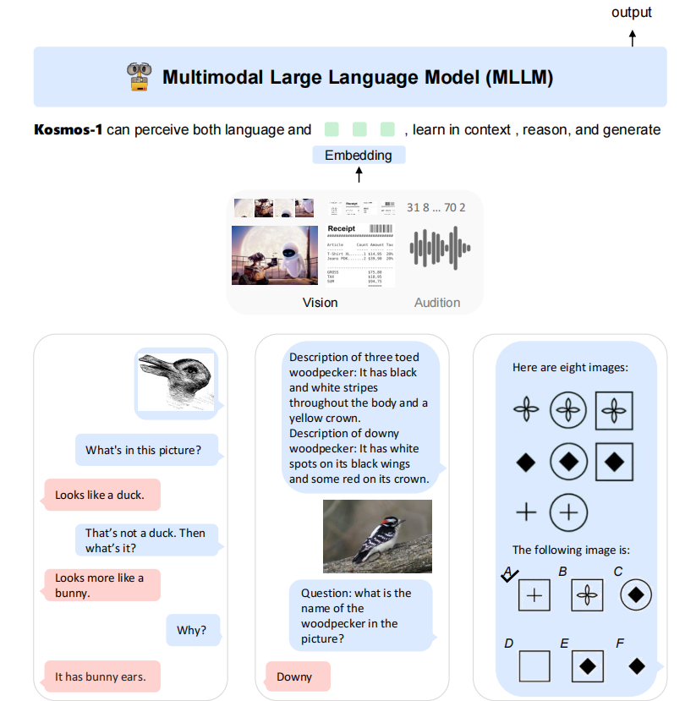

Slide 7
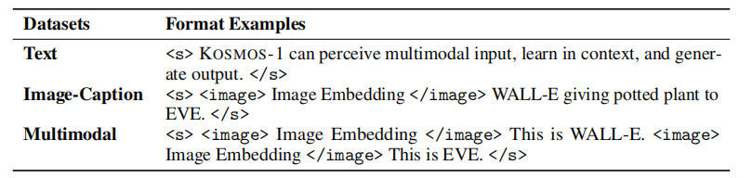
KOSMOS-1
Input Representation
use <s> and </s> to denote start and end-of sequence.
special tokens <image> and </image> indicate the beginning and end of encoded image embeddings.
An embedding module is used to encode both text tokens and other input modalities into vectors:
use a lookup table to map tokens into embeddings.
represent modalities of continuous signals inputs as discrete code and then regard them as “foreign languages”

Slide 8
KOSMOS-1
Multimodal Large Language Models (MLLMs)
MAGNETO:
a Transformer variant, as the backbone architecture.
(It introduces an extra LayerNorm to each sublayer (i.e., multi-head self-attention, and feed-forward network))
XPOS:
employ XPOS relative position encoding for better long-context modeling.
The method can better generalize to different lengths.

Slide 9
KOSMOS-1
Training Objective
training is conducted on web-scale multimodal corpora, including monomodal data, cross-modal paired data, and interleaved multimodal data
The models are trained with the next-token prediction task. The training objective is to maximize the log-likelihood of tokens in examples. Notice that only discrete tokens, such as text tokens, are accounted for in the training loss.

Slide 10
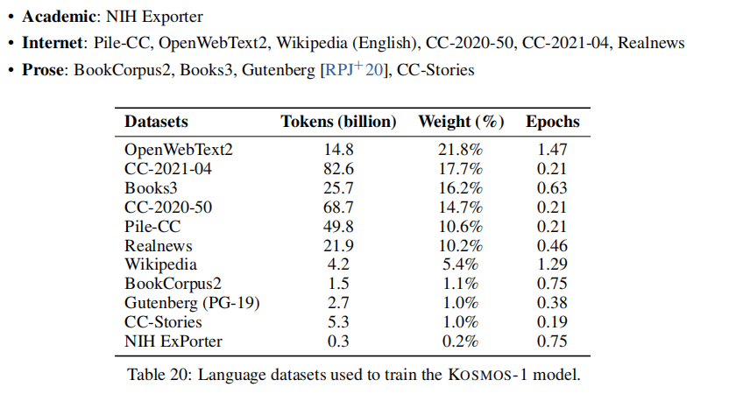
Model Training
Datasets
Text Corpora:
1. The Pile : 800 GB English text corpus combining 22 diverse sources.
2. Common Crawl

Slide 11
Model Training
Datasets
Image-Caption Pairs:
1. LAION-2B
2. LAION-400M
3. COYO-700M
4. Conceptual Captions.
Interleaved Data:
collect a large corpus of 2 billion web pages from the snapshots of common crawls. After applying filters, end up with about 71 million documents for training.

Slide 12
Model Training
Language-Only Instruction Tuning
Continue-train the model with the instruction data in the format of (instructions, inputs, and outputs). The instruction data is language-only, which is mixed with training corpora. The tuning process is conducted as language modeling. Notice that instructions and inputs are not accounted for in the loss.
Datasets:
1. Unnatural Instructions: generate instructions for various natural language processing tasks
2. FLANv2: cover diverse types of language understanding tasks, such as reading comprehension, commonsense reasoning, and closed-book question answering.

Slide 13
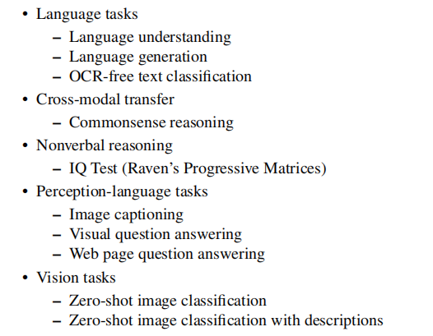
Evaluation

Slide 14
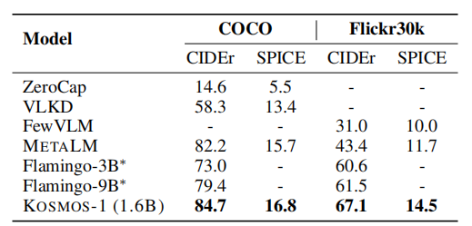
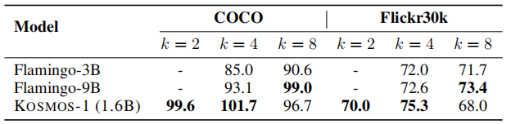
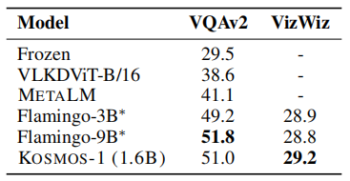
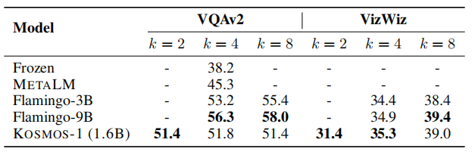
Evaluation
1. Perception-Language Tasks
Image captioning
datasets：MS COCO Caption， Flickr30k
prompt：“An image of”
Visual question answering
datasets：VQAv2， VizWiz
prompt：“Question: {question} Answer: {answer}”

Slide 15
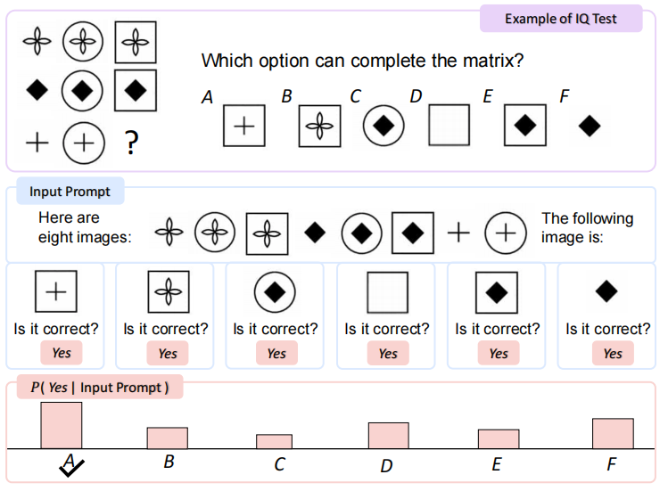
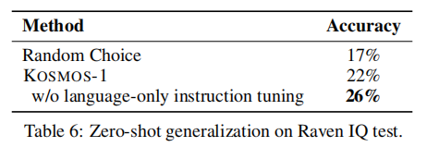
Evaluation
2. IQ Test: Nonverbal Reasoning
Raven’s Progressive Matrices：the models have to recognize abstract concepts and identify the underlying patterns of given images
prompt：“Here are three/four/eight images:”, “The following image is:”, “Is it correct?”

Slide 16
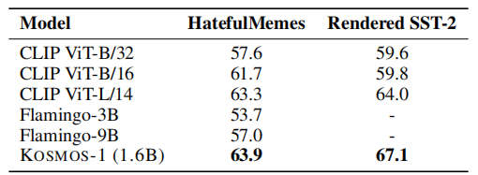
Evaluation
3. OCR-Free Language Understanding
The task evaluates a model’s ability to read and comprehend the meaning of words and sentences directly from the images
datasets：Rendered SST-2，HatefulMemes
prompt: “Question: what is the sentiment of the opinion? Answer: {answer}” “Question: does this picture contain real hate speech? Answer: {answer}”

Slide 17
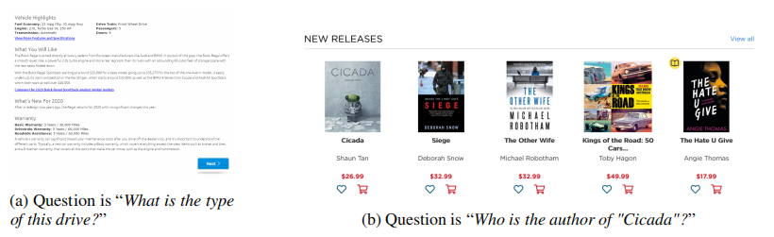
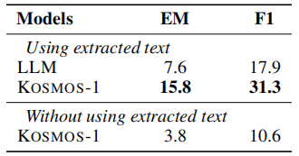
Evaluation
4. Web Page Question Answering
The task evaluate model’s ability to understand the semantics and the structure of web pages(table, html...)
datasets: Web-based Structural Reading Comprehension (WebSRC)
prompt: “Given the context below from web page, extract the answer from the given text like this: Qusestion: Who is the publisher of this book? Answer: Penguin Books Ltd. Context: {WebText} Q: {question} A: {answer}”

Slide 18
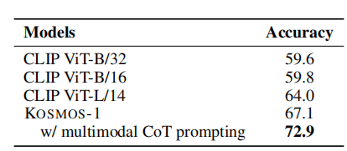
Evaluation
5. Multimodal Chain-of-Thought Prompting
rationale first, then answer.
datasets: Rendered SST-2
prompt: “Introduce this picture in detail:” , “{rationale} Question: what is the sentiment of the opinion? Answer: {answer}”

Slide 19
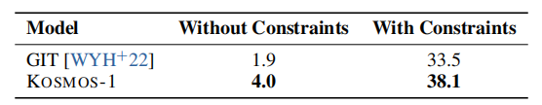
Evaluation
6. Zero-Shot Image Classification
datasets: ImageNet
prompt:“The photo of the”
whether use the 1k object category names to constrain the decoding

Slide 20
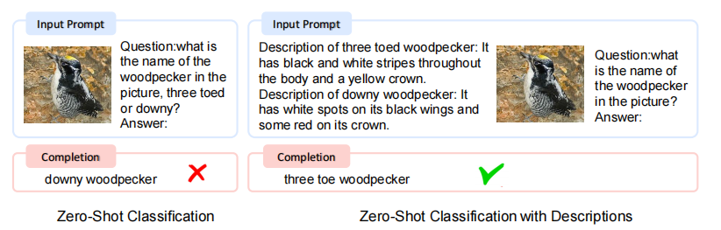
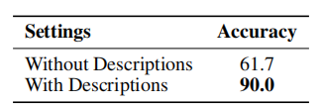
Evaluation
7. Zero-Shot Image Classification with Descriptions
datasets: bird classification dataset
prompt: “Question:what is the name of {general category} in the picture? Answer:”

Slide 21
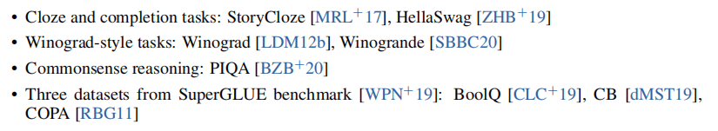
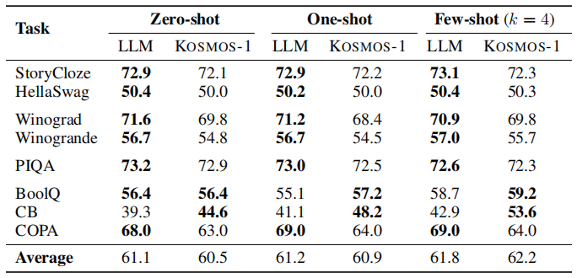
Evaluation
8. Language Tasks

Slide 22
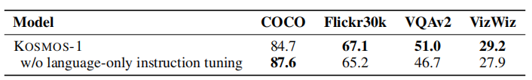
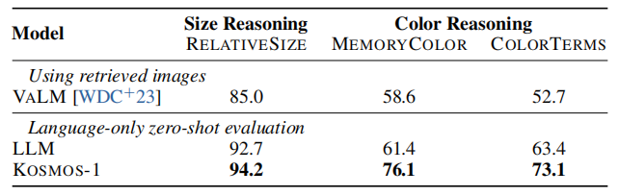

Evaluation
9. Cross-modal Transfer
Cross-modal transferability allows a model to learn from one modality and transfer the knowledge to the other modalities.
1. Transfer from Language to Multimodal: Language-Only Instruction Tuning
2. Transfer from Multimodal to Language: Visual Commonsense Reasoning
datasets: RELATIVESIZE, MEMORYCOLOR, COLORTERMS

Slide 23
Visual ChatGPT: Talking, Drawing and Editing with Visual Foundation Models
Chenfei Wu，Shengming Yin， Weizhen Qi， Xiaodong Wang， Zecheng Tang， Nan Duan*
Microsoft Research Asia

Slide 24
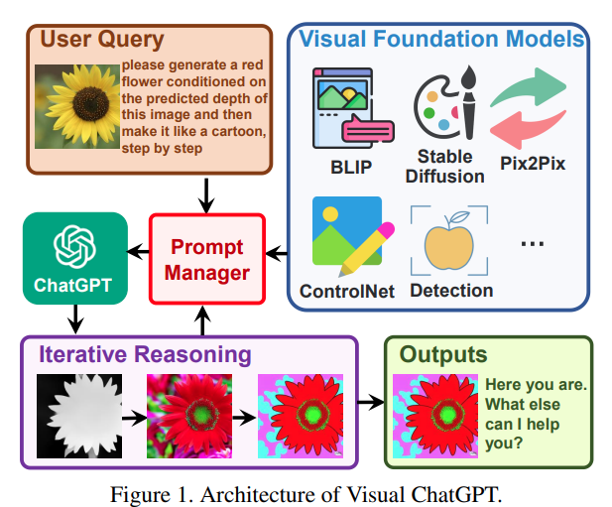
Introduction

Slide 25
Introduction
Motivation:
Chatgpt does not support multimodality.
Could we build a ChatGPT-like system that also supports image understanding and generation?
Would it be necessary to train a totally new multi-modality model every time when it comes to new modalities or functions?
To build a ChatGPT-like system that also supports image understanding and generation without training a new multi-modal conversational model from scratch.

Slide 26

Visual ChatGPT
1. System Principle P: provides basic rules for Visual ChatGPT;
2. Visual Foundation Model F: F = {f₁, f₂, ..., f_{N} };
3. History of Dialogue H_{<i}: concatenation of i-th round of conversation history;
4. User query Q_{i}: include both linguistic and visual queries;
5. History of Reasoning R_{i}^{(<j)}: all the previous reasoning histories from j invoked VFMs;
6. Intermediate Answer A^{(j)}: multiple intermediate answers;
7. Prompt Manager M: convert all the visual signals into language.

Slide 27
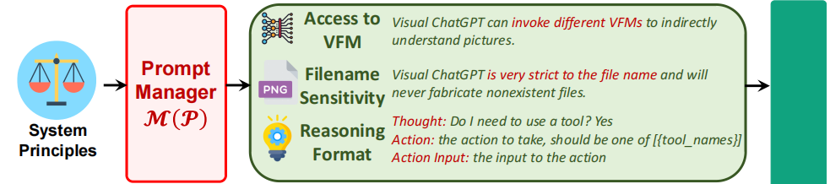
Visual ChatGPT
Prompt Managing of System Principles M(P)
some system principles need to be customized, which are then transferred into prompts that ChatGPT can understand. These prompts serve several purposes, including:
1. Role of Visual ChatGPT: assist with a range of text and visual-related tasks.
2. VFMs Accessibility: have access to a list of VFMs to solve various VL tasks.
3. Filename Sensitivity: it is crucial to use precise filenames to avoid ambiguity.
4. Chain-of-Thought: to cope with one seemingly simple command may require multiple VFMs.
5. Reasoning Format Strictness: must follow strict reasoning formats.
6. Reliability: require Visual ChatGPT to be loyal to the output of the vision foundation models and not fabricate image content or filenames.

Slide 28
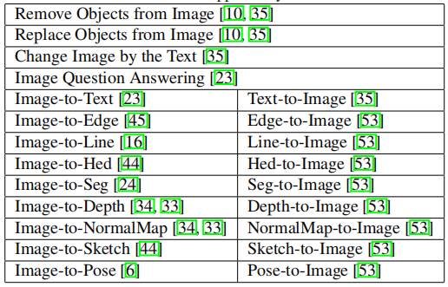
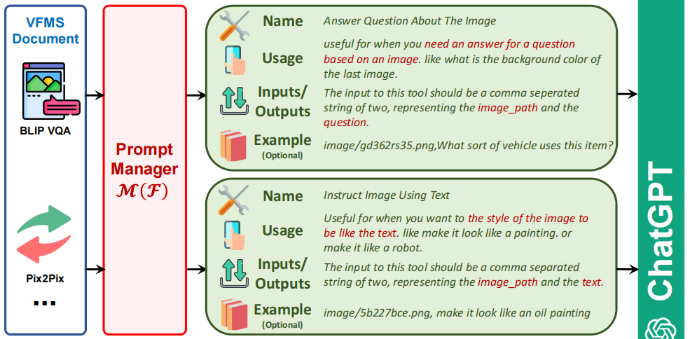
Visual ChatGPT
Prompt Managing of Foundation Models M(F)
different VFMs may share some similarities, the Prompt Manager specifically defines the following aspects to help Visual ChatGPT accurately understand and handle the VL tasks:
1. Name: The name prompt provides an abstract of the overall function for each VFM.
2. Usage: The usage prompt describes the specific scenario where the VFM should be used.
3. Inputs/Outputs: Outlines the format of inputs and outputs.
4. Example(Optional): The example prompt is optional.

Slide 29
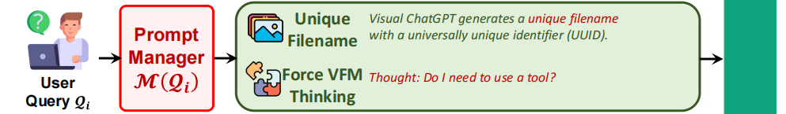
Visual ChatGPT
Prompt Managing of User Querie M(Q_{i})
Prompt Manager handles user queries in the following two aspects:
1. Generate Unique Filename: can handle two types of image-related queries:
(1) those that involve newly uploaded images;
(2) those that involvereference to existing images.
the newly uploaded image will not be fed into ChatGPT, a fake dialogue history is generated with a question stating the image’s filename and an answer indicating that the image has been received
2. Force VFM Thinking:“Since Visual ChatGPT is a text language model, Visual ChatGPT must use tools to observe images rather than imagination. The thoughts and observations are only visible for Visual ChatGPT, Visual ChatGPT should remember to repeat important information in the final response for Human. Thought: Do I need to use a tool?”
(1) it prompts Visual ChatGPT to use foundation models instead of relying solely on its imagination;
(2)it encourages Visual ChatGPT to provide specific outputs generated by the foundation models.

Slide 30
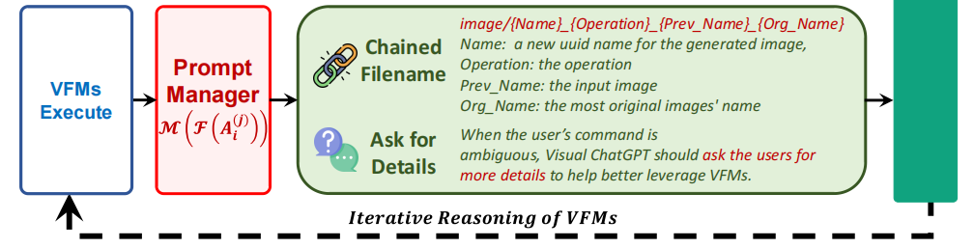
Visual ChatGPT
Prompt Managing of Foundation Model Outputs M(F(A_{i}^{(j)}))
Visual ChatGPT will implicitly summarize and feed them to the ChatGPT for subsequent interaction. The inner steps can be summarized below:
1. Generate Chained Filename: the image is named as “{Name}_{Operation}_{Prev Name}_{Org Name}” e.g. “image/ui3c edge-of o0ec nji9dcgf.png”
2. Call for More VFMs:make the ChatGPT keep asking itself whether it needs VFMs
to solve the current problem by extending one suffix “Thought: ” at the end of each generation.
3. Ask for More Details:When the user’s command is ambiguous, Visual ChatGPT should ask the users for more details to help better leverage VFMs.

Slide 31
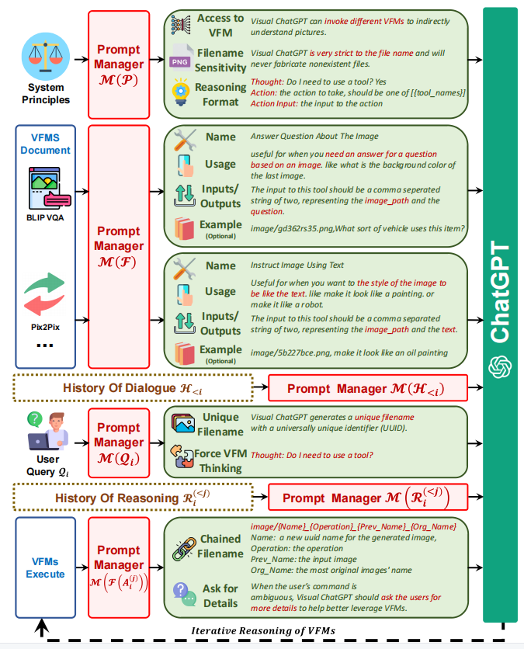
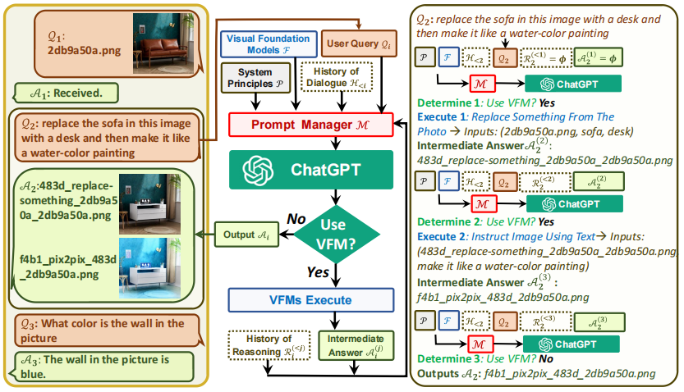
Visual ChatGPT

Slide 32
Experiments
Setup
OpenAI “text-davinci-003” version
collect foundation models from HuggingFace Transformers, Maskformer and ControlNet
The fully deployment of all the 22 VFMs requires 4 Nvidia V100 GPUs

Slide 33
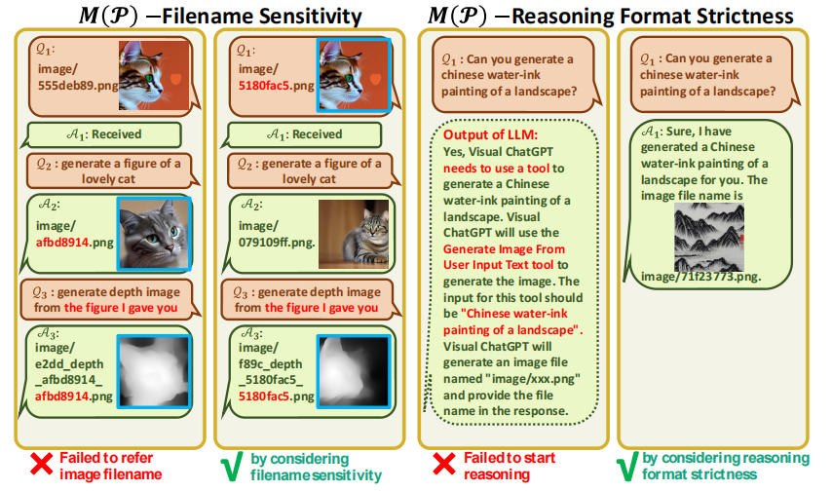
Experiments
Case Study of Prompt Manager
Case Study of prompt managing of system principles.

Slide 34
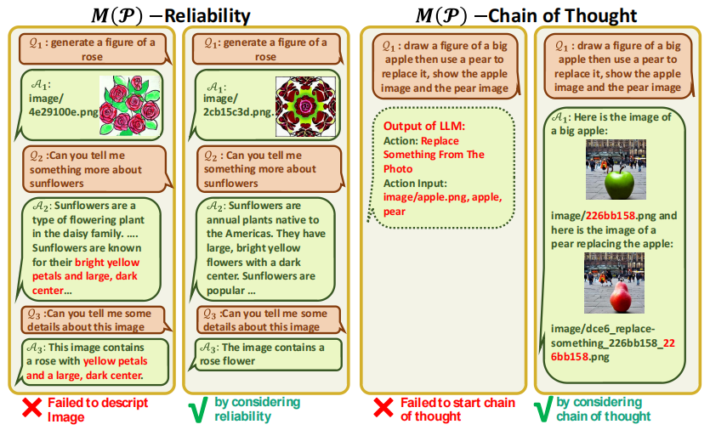
Experiments
Case Study of Prompt Manager
Case Study of prompt managing of system principles.

Slide 35
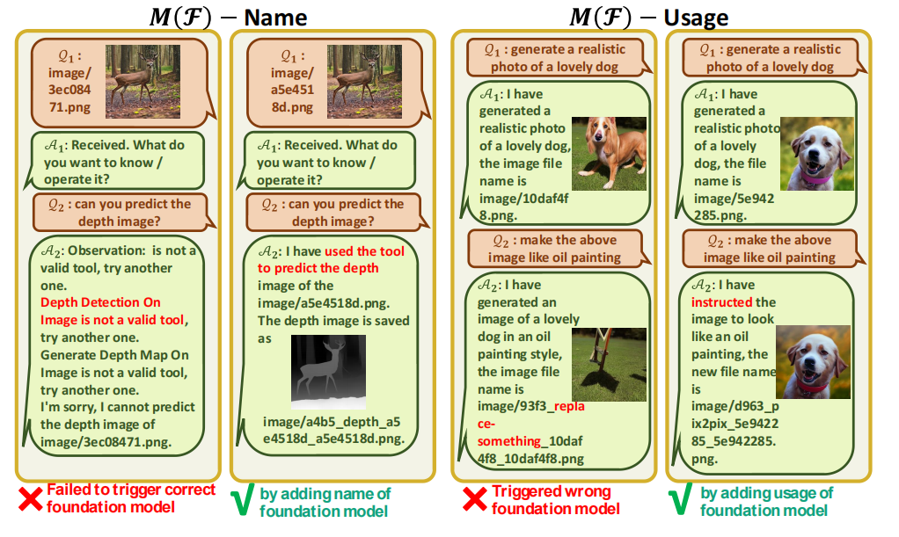
Experiments
Case Study of prompt managing of foundation models
1. The name of the VFM is the most
important and needs to be clearly defined.
2. The VFM usage should clearly
describe the specific scenario where a model should be used
to avoid the wrong responses.

Slide 36
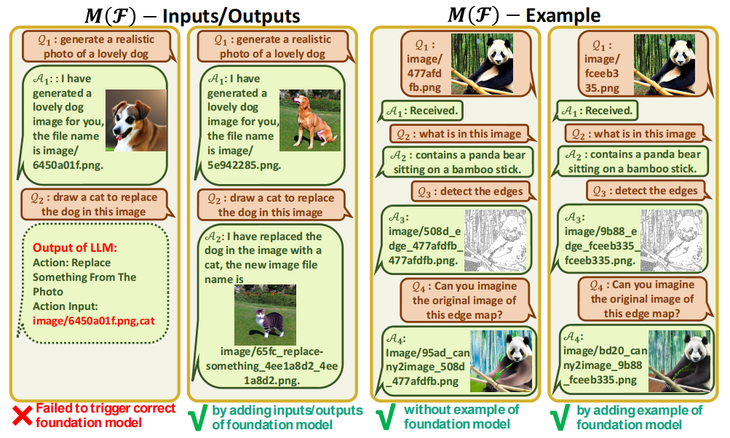
Experiments
Case Study of prompt managing of foundation models
3. The input and output format should be prompted accurately to
avoid parameter errors.
2. The example prompt can help the model deal with complex usages but is optional.

Slide 37
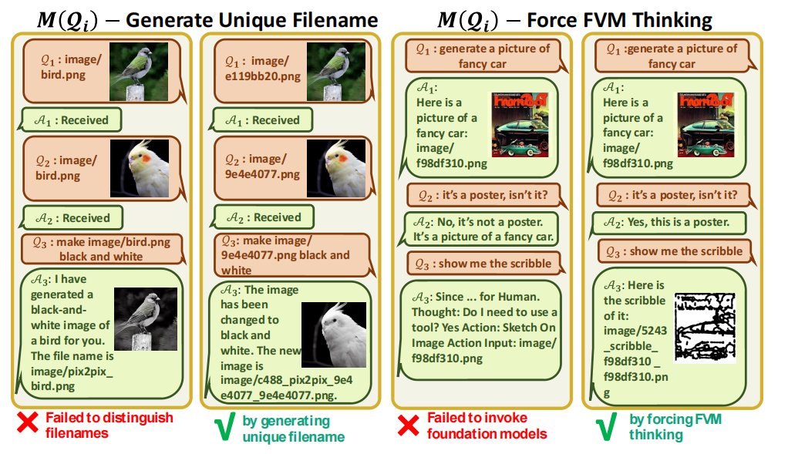
Experiments
Case Study of prompt managing of user query
1. without image file unique naming, newly uploaded image file might be renamed to avoid overwritten and result in wrong reference.
2. without force thinking, A3 may wrongly generate the end of thoughts token and directly consider all of its ChatGPT outputs as the final response.

Slide 38
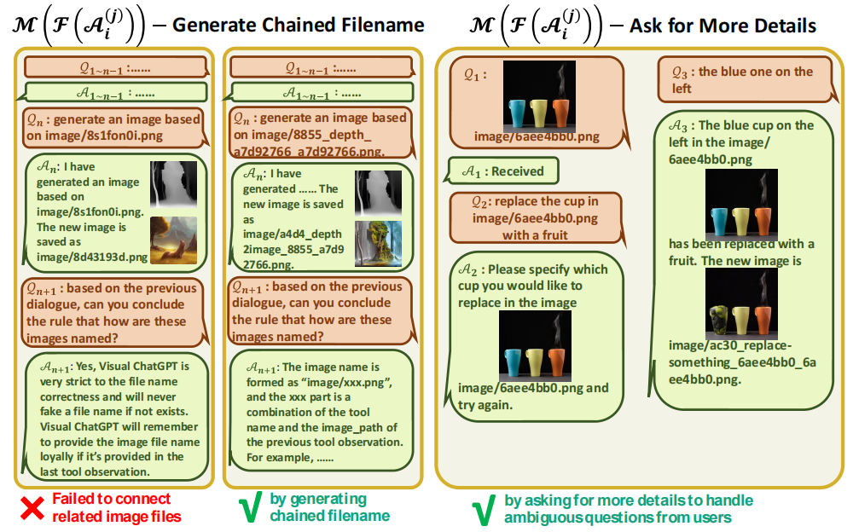
Experiments
Case Study of prompt managing of model outputs
1. chained naming rule does help Visual Chat_x0002_GPT to understand.
2. gives an ex_x0002_ample of asking for more details when the item inference is ambiguous.

Slide 39
Limitations
1. Dependence on ChatGPT and VFMs:
relies heavily on ChatGPT to assign tasks and on VFMs to execute them
2. Heavy Prompt Engineering:
requires a significant amount of prompt engineering to convert VFMs into language and make these model descriptions distinguishable
3. Limited Real-time Capabilities:
Visual ChatGPT may invoke multiple VFMs, resulting in limited real-time capabilities.
4. Token Length Limitation:
The maximum token length in ChatGPT may limit the number of foundation models that can be used.
5. Security and Privacy:
The ability to easily plug and unplug foundation models may raise security and privacy concerns.

