Slide 1
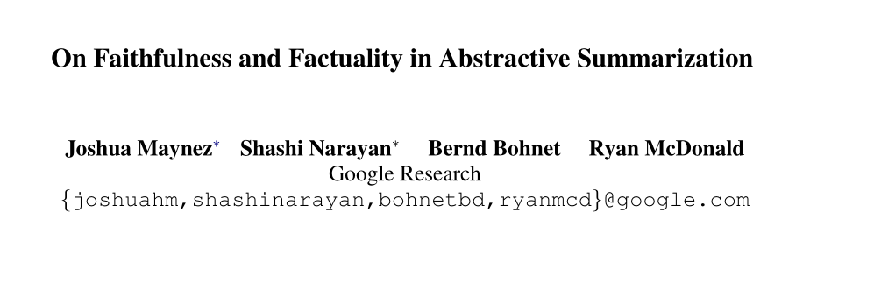

Slide 2
Motivation
Current state of the art conditional text generation models accomplish a high level of fluency and coherence, There has been a growing interest in understanding how maximum likelihood training and approximate beam-search decoding in these models lead to less human-like text in open-ended text generation such as language modeling and story generation In this paper we investigate how these models are prone to generate hallucinated text in conditional text generation,specifically, extreme abstractive document summarization.
We seek to answer the following questions:
How frequently do abstractive summarizers hallucinate content?;
Do models hallucinate by manipulating the information present in the input document (intrinsic hallucinations) or by adding information not directly inferable from the input document (extrinsic hallucinations)?;
How much hallucinated content is factual, even when unfaithful?;
Are there automatic means of measuring these hallucinations?

Slide 3
hallucination（幻觉）：一般指自然语言生成模型生成了输入文本之外的信息 。这些信息可以是无关的噪声或者发散性的语句。在文本创作的时候，hallucination并不是一件坏事，但是在文本摘要这类任务上，一般hallucination很少存在。本文作者把hallucination分为内在（intrinsic）和外在（extrinsic）两类进行讨论。“内在”指文本摘要把原文中的信息用一种新的方式呈现，而这种新的呈现方式不被原文所支持。“外在”指文本摘要引入了原文中没有的新信息。
faithfulness（忠实性）：忠实性一般指生成的摘要中的信息是否能输入文本所支持，可以理解成和hallucination负相关。
factuality（真实性）：真实性一般指生成的摘要中信息的真实性。一段不忠实于原文的摘要，可以同时有很高的真实性，这种信息被作者叫作“factual hallucination”。作者的立场是文本摘要中的factual hallucination如果结合了背景知识以生成更好的总结，则是可以被接受的。

Slide 4
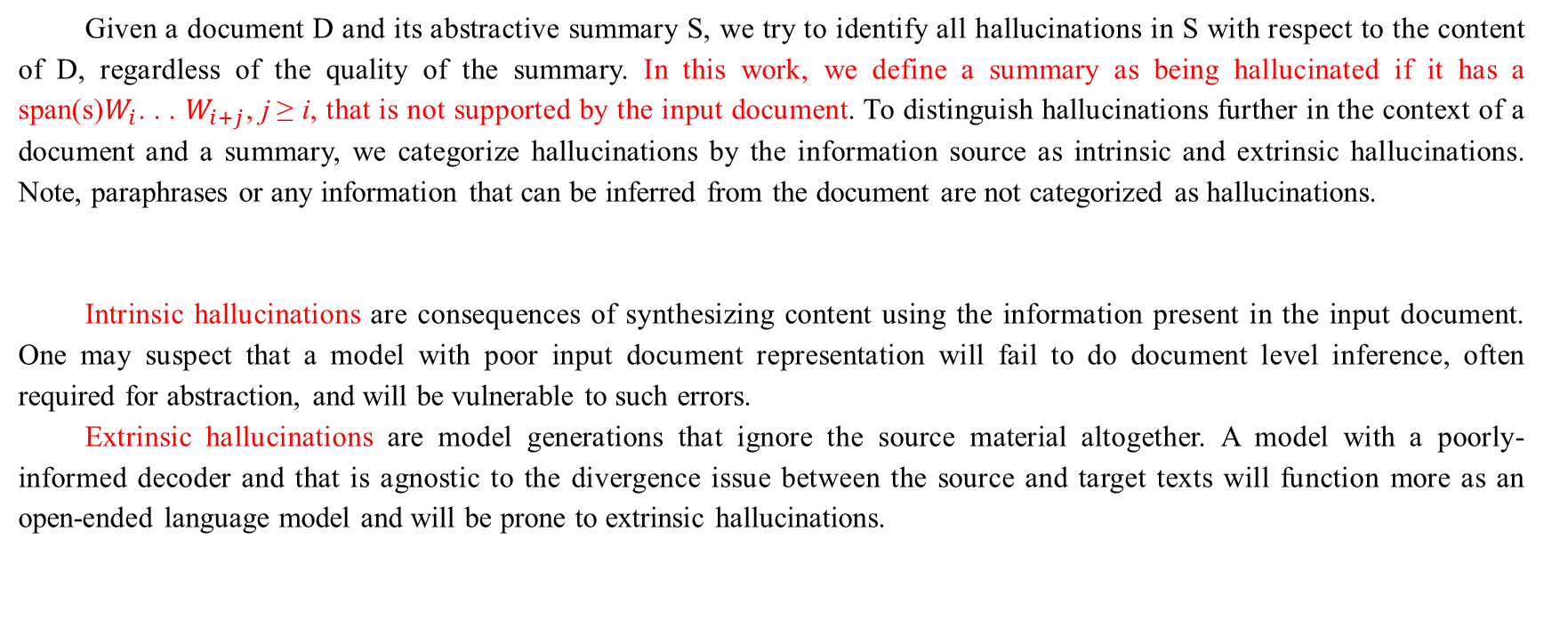
Hallucinations in Summarization
Given a document D and its abstractive summary S, we try to identify all hallucinations in S with respect to the content of D, regardless of the quality of the summary. In this work, we define a summary as being hallucinated if it has a span(s)$W_{i}$. . . $W_{i+j}$, j ≥ i, that is not supported by the input document. To distinguish hallucinations further in the context of a document and a summary, we categorize hallucinations by the information source as intrinsic and extrinsic hallucinations. Note, paraphrases or any information that can be inferred from the document are not categorized as hallucinations.
Intrinsic hallucinations are consequences of synthesizing content using the information present in the input document. One may suspect that a model with poor input document representation will fail to do document level inference, often required for abstraction, and will be vulnerable to such errors.
Extrinsic hallucinations are model generations that ignore the source material altogether. A model with a poorly-informed decoder and that is agnostic to the divergence issue between the source and target texts will function more as an open-ended language model and will be prone to extrinsic hallucinations.

Slide 5
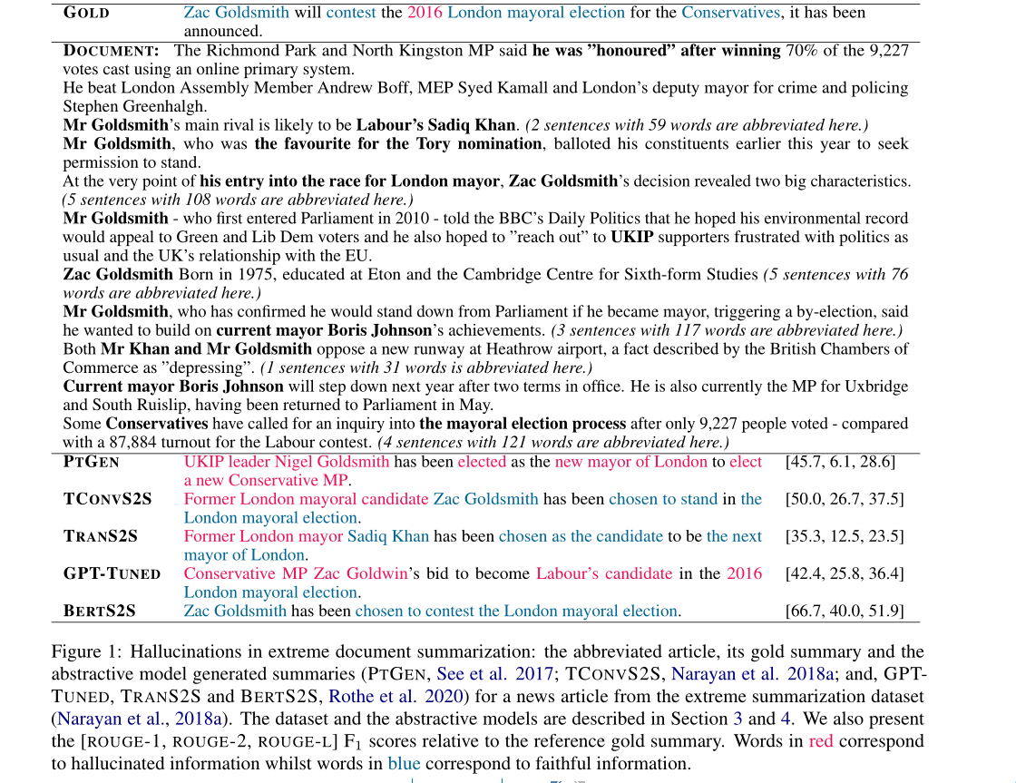

Slide 6
Factual Hallucinations in Summarization
A summary S of a document D contains a factual hallucination if it contains information not found in D that is factually correct. Factual hallucinations may be composed of intrinsic hallucinations or extrinsic hallucinations.
By definition, abstractive summaries are written to preserve the salient information in the input document, but they are expressed in the words of the summary author as opposed to the input document author. As such, it is natural to construct summaries that integrate with the author’s background knowledge. Such knowledge integration can also be desirable in real world applications. For instance, an engaging sports report will reflect an understanding of the game to provide color and context.
More advanced pretrained text generators are even better at capturing world knowledge as they are informed by a vast amount of background text.
In this paper we stand in favour of the assertion that abstractive systems may integrate with the background knowledge to generate rich and meaningful summaries. More concretely, “hallucinations in summarization are acceptable if they lead to better summaries that are factual with respect to the document and the associated background knowledge.”

Slide 7
Extreme Document Summarization
We choose to focus our study on extreme summarization for the following reasons:
First, this task aims to create a single-sentence summary of a news article; these shorter summaries are relatively easier to annotate and analyze than longer summaries such as story highlights from the CNN/Dailymail dataset or abstracts from the NYTimes or the WikiSum dataset.
Secondly, the gold summary in the extreme summarization dataset is an introductory sentence prefacing each article. By virtue of this property, the extreme summarization task is not amenable to extractive strategies and requires an abstractive modeling approach. Hence, it provides us a better benchmark to assess abstractive models’ abilities to produce abstractions which are faithful and factual.
Finally, since we conclude that hallucination is a problem on this dataset, then we can safely conclude it is a problem for summarization datasets with longer summaries, as modeling longer-distance dependencies and discourse structures make the task harder.

Slide 8
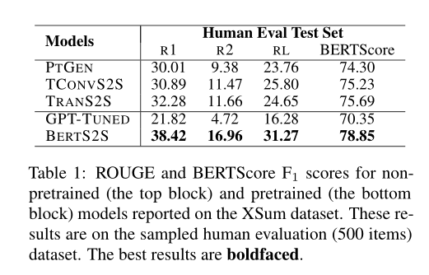
Experiments and Results

Slide 9
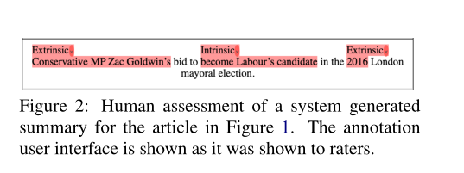
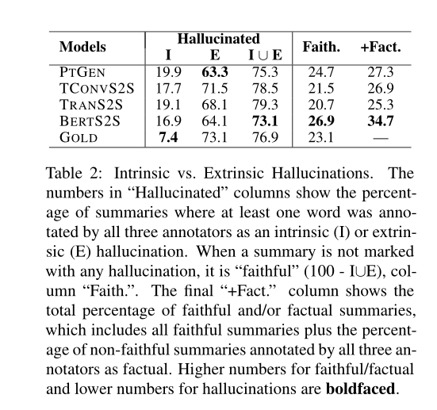
Assessment of Hallucinations
For summaries containing hallucinations, annotators were tasked with
(i) identifying those text spans that were unfaithful to the article
(ii) for each text span, annotating whether the hallucination was intrinsic or extrinsic. We elicited judgments from three different annotators for each of 2500 (500x5) document-summary pairs.
Figure 2 shows an example assessment of a summary of an article from Figure 1. Results from the full assessment are shown in Table 2, which shows the percentage of documents per system that were annotated as faithful or hallucinated (faithful= 100 - hallucinated).

Slide 10
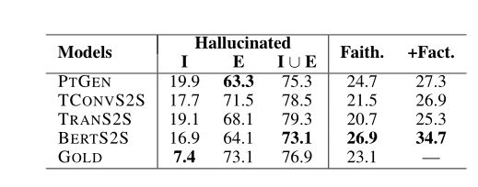
Extrinsic Hallucination due to Divergence between Source and Target Our results confirmed that the BBC gold summaries often have extrinsic hallucinations due to the dataset artifact that gold summaries are introductory sentences prefacing each article. It was not surprising that most models also had significant extrinsic hallucinations.
Intrinsic Hallucination is Also Common in Abstractive Summaries. Gold summaries can also display intrinsic hallucinations. For example, a news article could describe an event related to “Barack Obama” and “the office of the President of the United States” without inferring that “Obama is the President of the United States.” A journalist with the knowledge of the event in the article could write a summary stating “President Obama.”
However, the percentage of system summaries with intrinsic hallucination was much higher than in gold summaries (7.4% vs others). This phenomenon particularly revealed the models’ tendency to misrepresent information in the document due to the lack of document-level understanding and inference. The copy mechanism in PTGEN is good at copying from the source (showing the least percentage of extrinsic hallucination of 63.3%), but he mechanism lacks the inference capability and is prone to generate a summary that is not supported by the document (19.9% intrinsic hallucination). TRANS2S showed similar performance to PTGEN and ranked second worst. The BERTS2S showed the least number of intrinsic hallucination (16.9%) among all four abstractive systems.

Slide 11
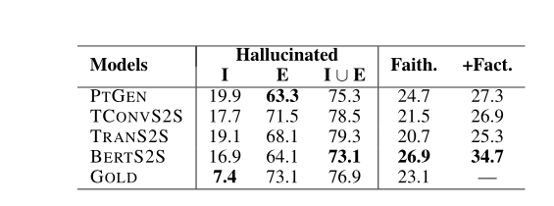
Pretraining Improves Faithfulness
Hallucinations do not result from the artifacts in the training data only, but also due to model shortcomings. The PTGEN model with the copy mechanism had the lowest extrinsic hallucination (63.3%), but BERTS2S reported the highest number of faithful summaries. It appears that BERTS2S is overall most conservative among all four abstractive systems while getting closer to reference summaries in terms of ROUGE. The pre-training prepares BertS2S to be more aware of the domain of the document and less prone to language model vulnerabilities. Consequently, BertS2S is more confident in predicting tokens from the document than TranS2S, hence, improving faithfulness.

Slide 12
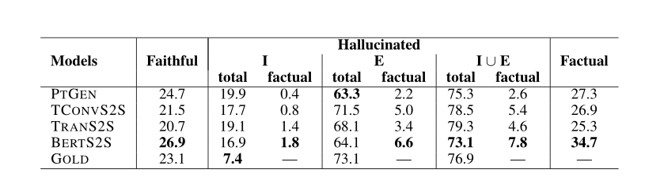
Pretraining Helps Generating Factual Summaries
In total, 34.7% of the BERTS2S abstracts were faithful (26.9%) and/or factual(+7.8%). This is 7.4% absolute better than the next-best model (PTGEN). The number of unfaithful yet factual summaries for BERTS2S, 7.8%, was also the highest. In fact, for extrinsic hallucinations, even though PTGEN hallucinates less than BERTS2S (63.3% vs. 64.1%), 6.6% of BERTS2S hallucinations were factual, compared to 2.2% of PTGEN. Thus, if we consider factual hallucinations to be valid, this means that even for extrinsic cases, BERTS2S hallucinates the least.
The superior performance of BERTS2S is most likely due to its exposure to vast amount of text through pretraining, allowing it to integrate background knowledge with generation. Even so, over 90% of BERTS2S hallucinations are erroneous.

Slide 13
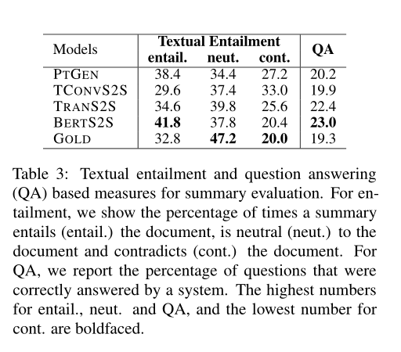
Automatic Measures for Hallucinations
Textual Entailment. Interestingly, the GOLD summaries are more neutral to their documents, whereas the BERTS2S summaries are more entailed by their documents. This is probably due to the nature of the data and that journalists tend to add color and have a high number of extrinsic (but valid) hallucinations.
Question Answering. We adapted the QA framework to assess hallucination in model generated summaries;a faithful model will generate a summary that only has information that is supported by its document.Under this assumption, any question answerable by the summary should also be answerable by the source. Similar to textual entailment results, the BERTS2S abstracts were the most faithful to their source documents in terms of question answering.The GOLD abstracts were the least accurate due to a high number of extrinsic hallucination in them.

Slide 14
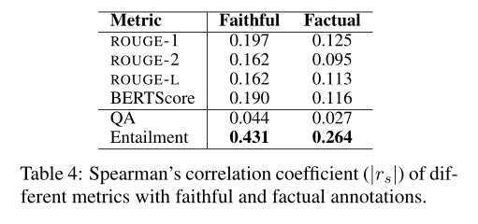
Spearman’s Correlation
We found that the textual entailment scores are best correlated with both faithful (moderate, 0.40 ≤ |rs| ≤ 0.59) and factual (weak,0.20 ≤ |rs| ≤ 0.39) human scores. Comparatively,ROUGE-based metrics and BERTScore have very weak correlation, Surprisingly,the question answering scores showed a very weak correlation (0.0 ≤ |rs| ≤ 0.19) with faithful and factual human scores.

Slide 15
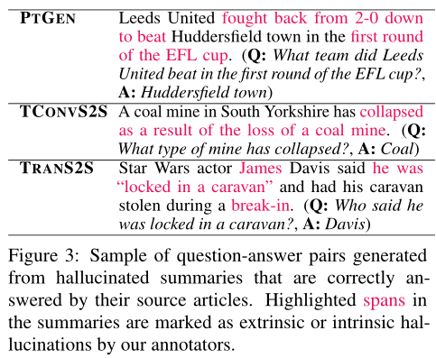
We hypothesize that this is due to a compounding of errors where
(i) the question generator is used to generate questions from the systems’ generated abstracts, instead of human-written text on which they were trained,
(ii)the question generator is susceptible to generate questions with hallucinated content when fed in with hallucinated summaries, and
(iii) our assumption that a summary is faithful if the answers from the source and the summary match, is rather poor for extreme summarization. We demonstrate these issues in Figure 3. Irrespective of questions with hallucinated content, our reading comprehension model can fortuitously answer them correctly from their source articles. Better ways of generating questions and measuring factual consistency may alleviate some of these issues.

Slide 16
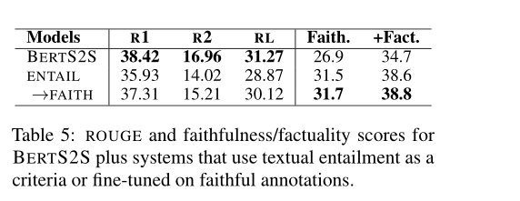
Model Selection with Entailment
Our study suggests that entailment could be used as an automatic measure for faithfulness. However,we should point out that this measure is reference-less. Thus, it can easily be gamed, i.e., the first sentence of any source document is always entailed by the whole document. Because of this, entailment-based measures for evaluation need to be coupled with reference-based measures like ROUGE.

Slide 17
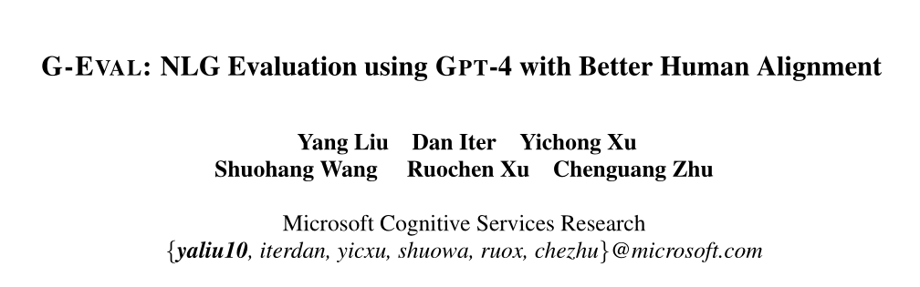

Slide 18
Motivation
Evaluating the quality of natural language generation systems is a challenging problem even when large language models can generate high-quality and diverse texts that are often indistinguishable from human-written texts. Traditional automatic metrics, such as BLEU , ROUGE, are widely used for NLG evaluation, but they have been shown to have relatively low correlation with human judgments, especially for open-ended generation tasks. Moreover, these metrics require associated reference output, which is costly to collect for new tasks.
Recent studies propose directly using LLMs as reference-free NLG evaluators;. The idea is to use the LLMs to score the candidate output based on its generation probability without any reference target, under the assumption that the LLMs have learned to assign higher probabilities to high-quality and fluent texts.However, the validity and reliability of using LLMs as NLG evaluators have not been systematically investigated. In addition, meta-evaluations show that these LLM-based evaluators still have lower human correspondence than medium-size neural evaluators Thus, there is a need fora more effective and reliable framework for using LLMs for NLG evaluation.

Slide 19
In this paper, we propose G-EVAL, a framework of using LLMs with chain-of-thoughts (CoT) to evaluate the quality of generated texts in a form-filling paradigm.
By only feeding the Task Introduction and the Evaluation Criteria as a prompt, we ask LLMs to generate a CoT of detailed Evaluation Steps. Then we use the prompt along with the generated CoT to evaluate the NLG outputs. The evaluator output is formatted as a form. Moreover, the probabilities of the output rating tokens can be used to refine the final metric.
We conduct extensive experiments on three meta-evaluation benchmarks of two NLG tasks:text summarization and dialogue generation. The results show that G-EVAL can outperform existing NLG evaluators by a large margin in terms of correlation with human evaluations. Finally, we conduct analysis on the behavior of LLM-based evaluators,and highlight the potential issue of LLM-based evaluator having a bias towards the LLM-generated texts.

Slide 20
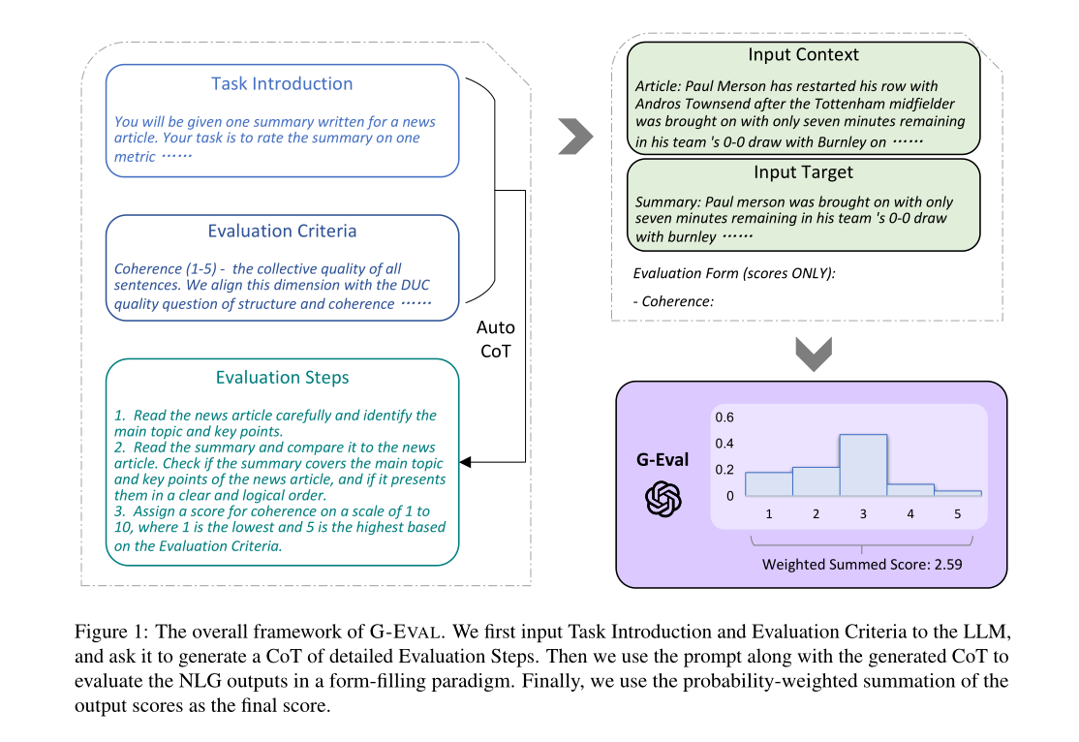

Slide 21
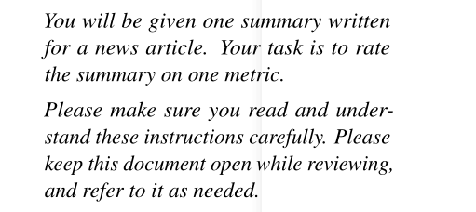
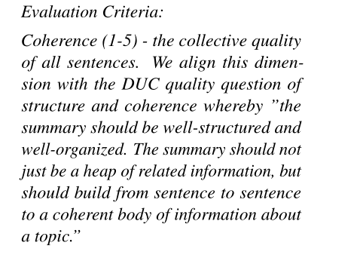
Prompt for NLG Evaluation
The prompt is a natural language instruction that defines the evaluation task and the desired evaluation criteria. For example, for text summarization, the prompt can be:
The prompt should also contain customized evaluation criteria for different NLG tasks and, such as coherence, conciseness, or grammar. For example,for evaluating coherence in text summarization, we add the following content to the prompt:

Slide 22
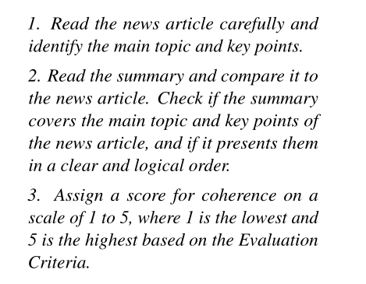
Auto Chain-of-Thoughts for NLG Evaluation
For evaluation tasks, some criteria need a more detailed evaluation instruction beyond the simple definition,and it is time-consuming to manually design such evaluation steps for each task. We find that LLM can generate such evaluation steps by itself. The CoT can provide more context and guidance for the LLM to evaluate the generated text, and can also help to explain the evaluation process and results.For example, for evaluating coherence in text summarization, we add a line of “Evaluation Steps:” to the prompt and let LLM to generate the following CoT automatically:

Slide 23
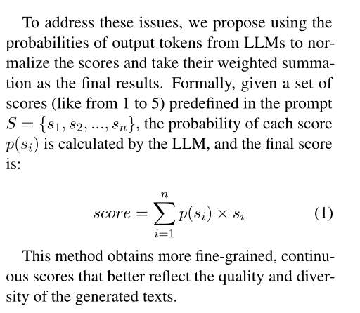
Scoring Function
The scoring function calls the LLM with the designed prompt, auto CoT, the input context and the target text that needs to be evaluated.
For example, for evaluating coherence in text summarization, we concatenate the prompt, the CoT, the news article, and the summary, and then call the LLM to output a score from 1 to 5 or each evaluation aspect, based on the defined criteria.
However, we notice this direct scoring function has two issues:
For some evaluation tasks, one digit usually dominates the distribution of the scores, such as 3 for a 1 - 5 scale. This may lead to the low variance of the scores and the low correlation with human judgments.
LLMs usually only output integer scores, even when the prompt explicitly requests decimal values. This leads to many ties in evaluation scores which do not capture the subtle difference between generated texts.

Slide 24
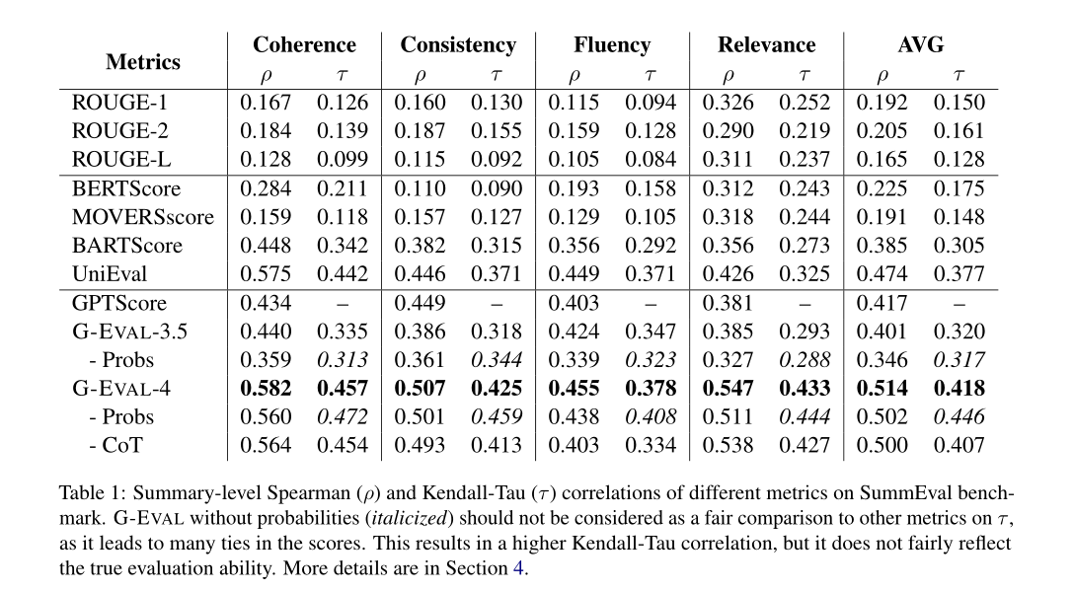
Results for Summarization
相关性（relevance）：摘要包含的信息是否为文中重要信息。
一致性（consistency）：摘要是否有事实性错误。本文关注的忠实度（faithfulness）也和一致性较为相关。
流畅性（fluency）：摘要中的单个句子是否通顺。
连贯性（coherence）：摘要整体是否行文流畅连贯。

Slide 25
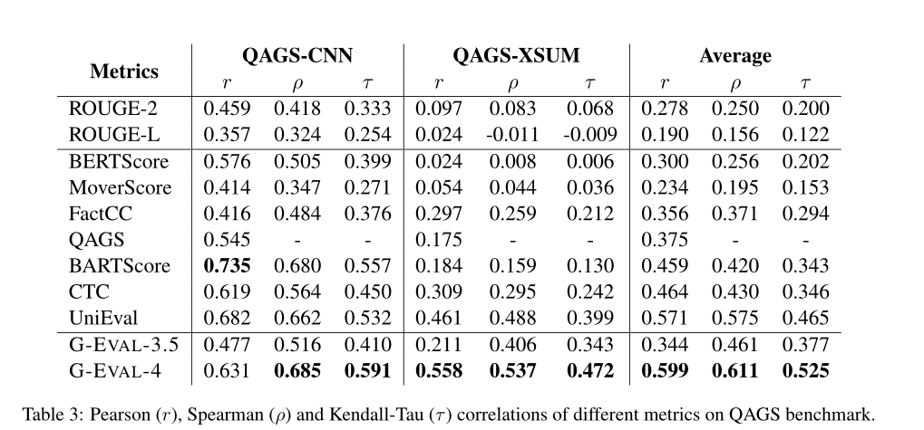
Results on Hallucinations
QAGS is a benchmark for evaluating hallucinations in the summarization
task. It aims to measure the consistency dimension of summaries on two different summarization datasets. QAGS基于一个直觉，即：如果对摘要和其源文本提出分别相同的问题，若摘要和文本的反应的事实一致，则能够获得相似的回答。

Slide 26
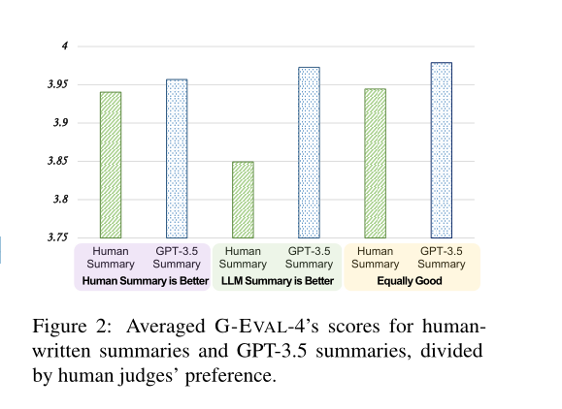
Will G-EVAL prefer LLM-based outputs?
1)human-written summaries that are rated higher than GPT-3.5 summaries by human judges,
2)human-written summaries that are rated lower than GPT-3.5 summaries by human judges, and
3)human-written summaries and GPT-3.5 summaries are rated equally good by human judges.
We use G-EVAL-4 to evaluate the summaries in each category, and compare the averaged scores
1.NLG outputs from high-quality systems are in natural difficult to evaluate. The authors of the original paper found that inter-annotator
agreement on judging human-written and LLM-generated summaries is very low, with Krippendorff’s alpha at 0.07.
2. G-EVAL may have a bias towards the LLM generated summaries because the model could share the same concept of evaluation criteria
during generation and evaluation.

