Slide 1
Prefix-Tuning: Optimizing Continuous Prompts for Generation
前缀调整：优化生成的连续提示

Slide 2
Introduction
Existing problems:
- Fine-tune: a way to use large pre-trained language models to preform downstream tasks.
- However, It modifies all the language model parameters .So it needs to store a full copy for each tasks , a very large overhead.
Solution
- Prefix-tuning: a lightweight alternative for NLG tasks.
- It keeps language model parameters frozen , but optimizes a small continuous task-specific vector , which called prefix .
- It draws inspiration from prompting , and allow subsequent tokens to attend to this prefix.
- Virtual token

Slide 3
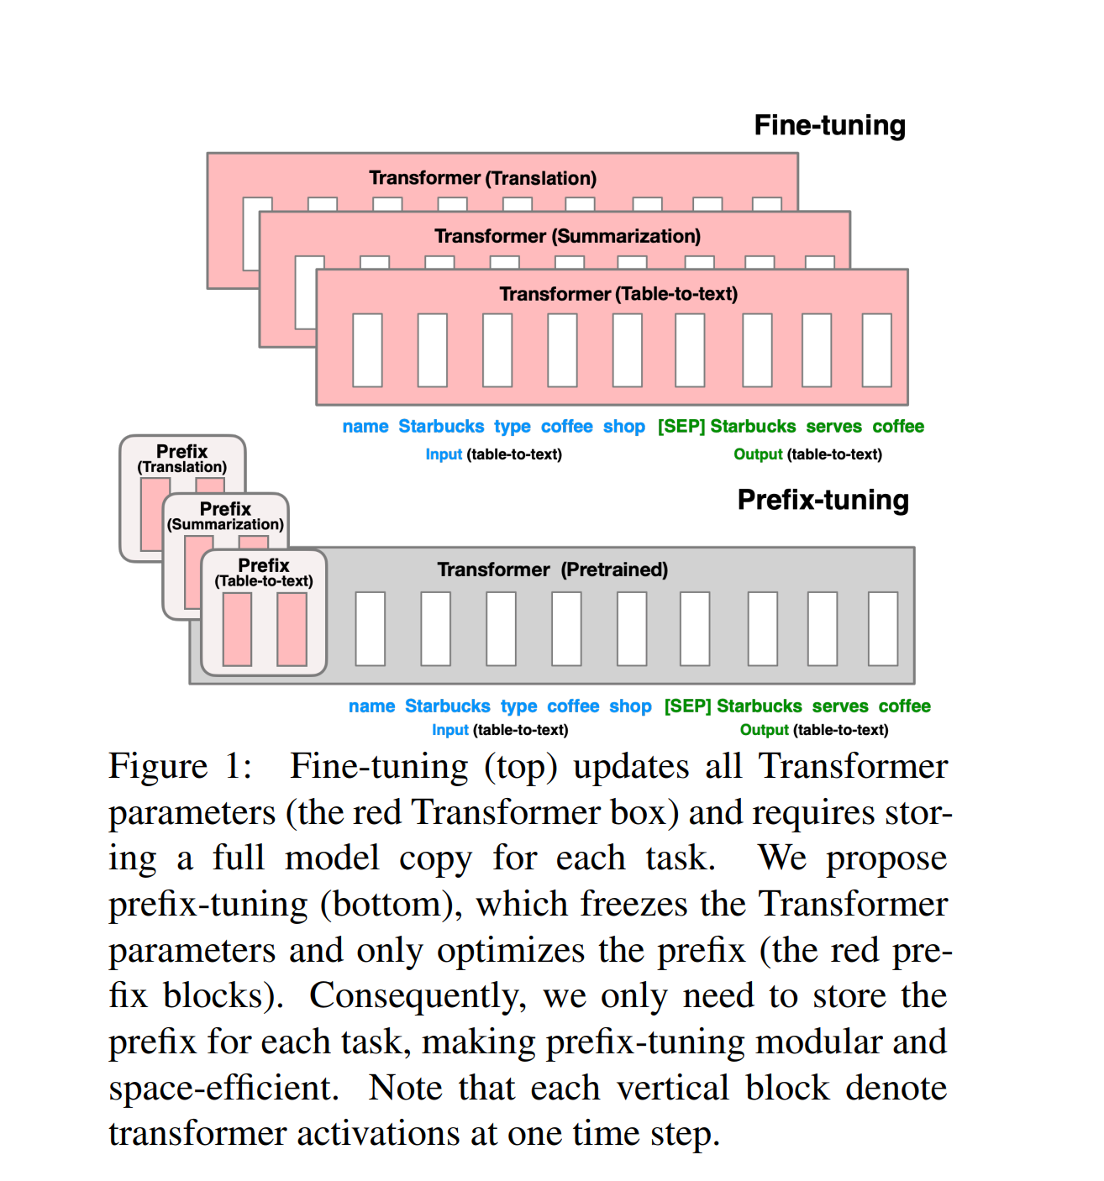
Input
Linearized table:
name:Starbucks | type:coffee shop
Output
Textual description:
Starbucks serves coffee.
Details
Prefix-tuning prepends a sequence of continuous task-specific vectors to the input.
Transformer attend to the prefix as if it were a sequence of “virtual tokens”.
Prefix consists entirely of free parameters which do not correspond to real tokens

Slide 4
Details
Train an upstream prefix which steers a downstream LM,which remains unmodified.
A single LM can support many tasks at once.
Advantage
In the context of personalization where the tasks correspond to different users we could have a separate prefix for each user trained only on that user’s data, thereby avoiding data cross-contamination.
the prefix-based architecture enables us to even process examples from multiple users/tasks in a single batch.

Slide 5
Related Work
Fine-tuning for natural language generation
Current state-of-the-art systems for natural language generation are based on fine-tuning pre-trained language models
fine-tunes a sequence-to-sequence model for table-to-text generation.
fine-tune masked language models (e.g., BERT) and encode-decoder models (e.g., BART) for extractive and abstractive summarization.
Lightweight fine-tuning
Lightweight fine-tuning freezes most of the pre-trained parameters and modifies the pre-trained model with small trainable modules.
The key challenge is to identify high-performing architectures of the modules and the subset of pretrained parameters to tune.

Slide 6
Prompting
Prepend instructions and a few examples to the task input and generate the output from the LM.
GPT-3 uses manually designed prompts to adapt its generation for different tasks, and this framework is termed in-context learning.
There are also researchers who use keywords to control the sentiment or theme of the generated sentence.
Continuous vectors have been used to steer language models; Subramani showed that a pre-trained LSTM language model can reconstruct arbitrary sentences by optimizing a continuous vector for each sentence, making the vector input-specific.
In contrast, prefix-tuning optimizes a task-specific prefix that applies to all instances of that task. As a result, unlike the previous work whose application is limited to sentence reconstruction, prefix tuning can be applied to NLG tasks.

Slide 7
Controllable generation
Aims to steer a pre-trained language model to match a sentence level attribute.
The control can happen at decoding time , by weighted decoding or iteratively updating the past activations.
However, there is no straightforward way to apply these controllable generation techniques to enforce fine-grained control over generated contents, as demanded by tasks like table-to-text and summarization.

Slide 8

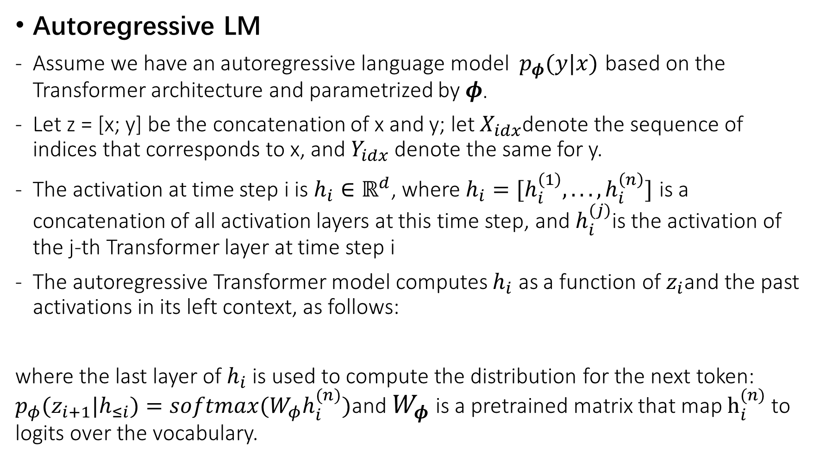
Problem Statement
Autoregressive LM
Assume we have an autoregressive language model $p_{φ}(y|x)$ based on the Transformer architecture and parametrized by$φ$.
Let z = [x; y] be the concatenation of x and y; let $X_{idx}$denote the sequence of indices that corresponds to x, and $Y_{idx}$ denote the same for y.
The activation at time step i is $h_{i}∈ℝ^{d}$, where $h_{i}=[h_{i}^{\left(1\right)},...,h_{i}^{\left(n\right)}]$ is a concatenation of all activation layers at this time step, and $h_{i}^{(j)}$is the activation of the j-th Transformer layer at time step i
The autoregressive Transformer model computes $h_{i}$ as a function of $z_{i}$and the past activations in its left context, as follows:
where the last layer of $h_{i}$ is used to compute the distribution for the next token: $p_{φ}(z_{i+1}|h_{≤i})=softmax(W_{φ}h_{i}^{(n)})$and $W_{φ}$ is a pretrained matrix that map $h_{i}^{(n)}$to logits over the vocabulary.

Slide 9
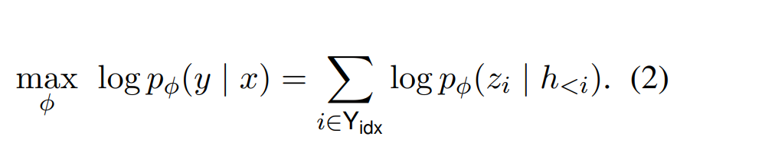
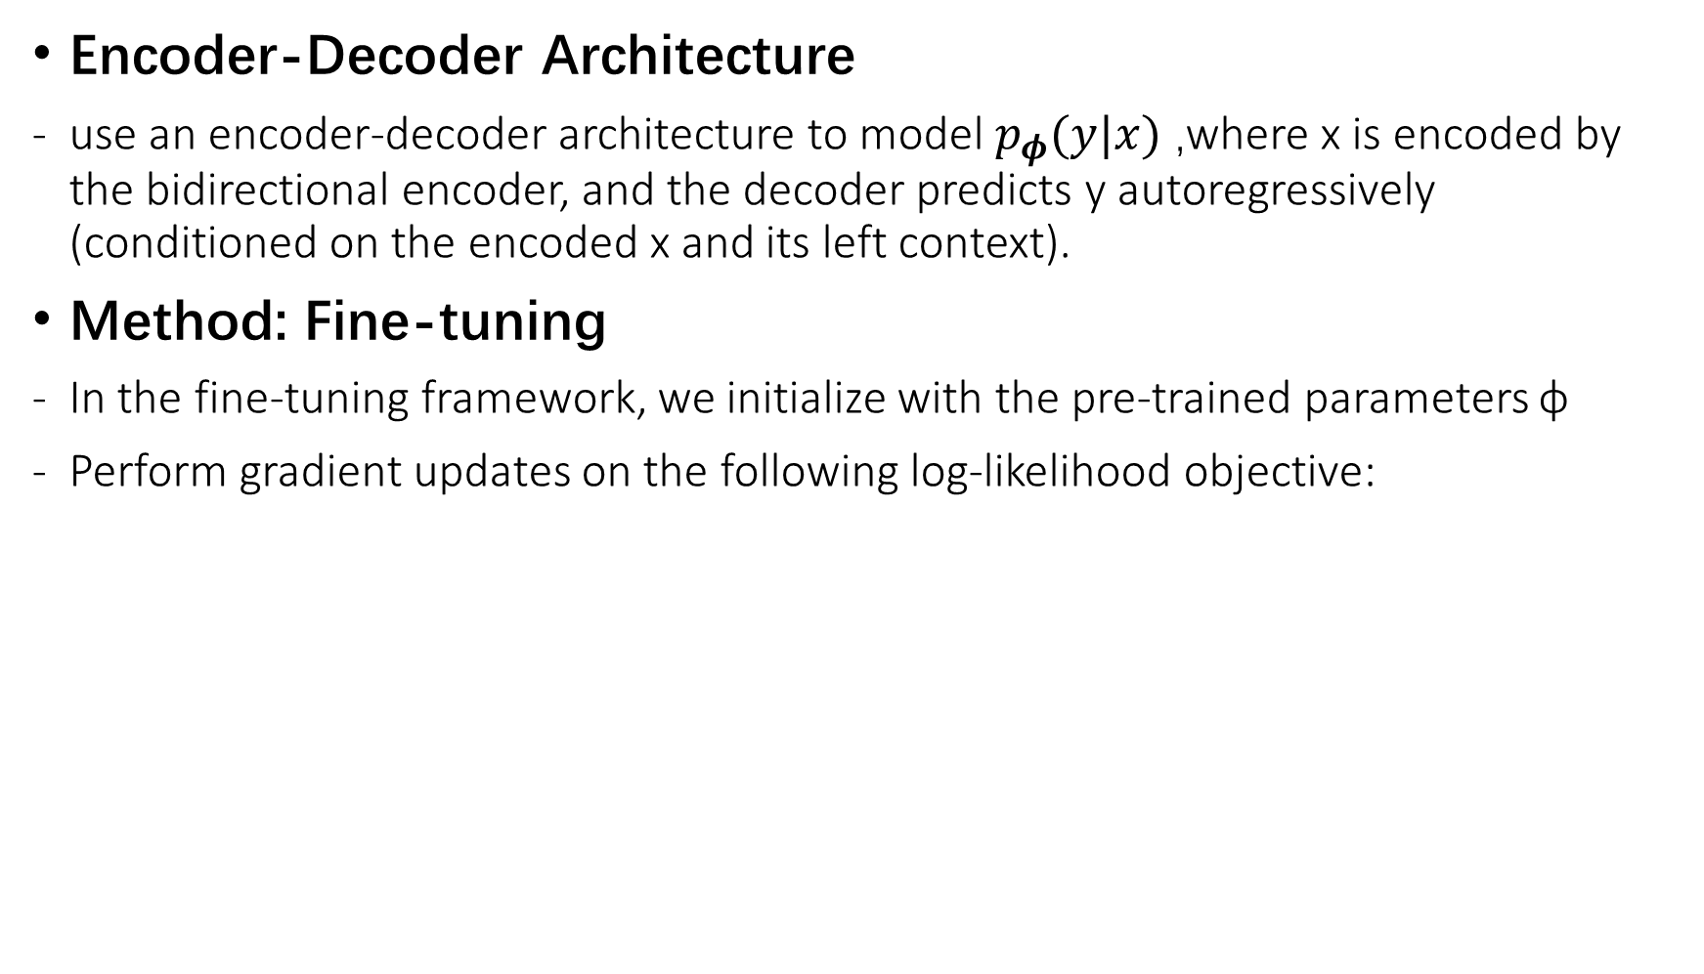
Encoder-Decoder Architecture
use an encoder-decoder architecture to model $p_{φ}(y|x)$ ,where x is encoded by the bidirectional encoder, and the decoder predicts y autoregressively (conditioned on the encoded x and its left context).
Method: Fine-tuning
In the fine-tuning framework, we initialize with the pre-trained parameters φ
Perform gradient updates on the following log-likelihood objective:

Slide 10
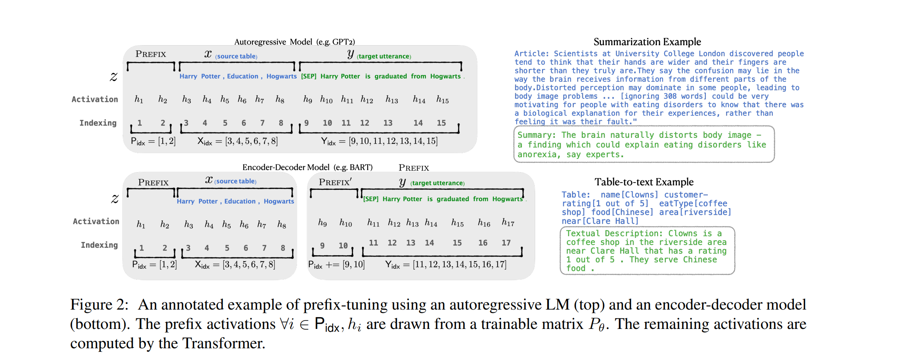

Slide 11
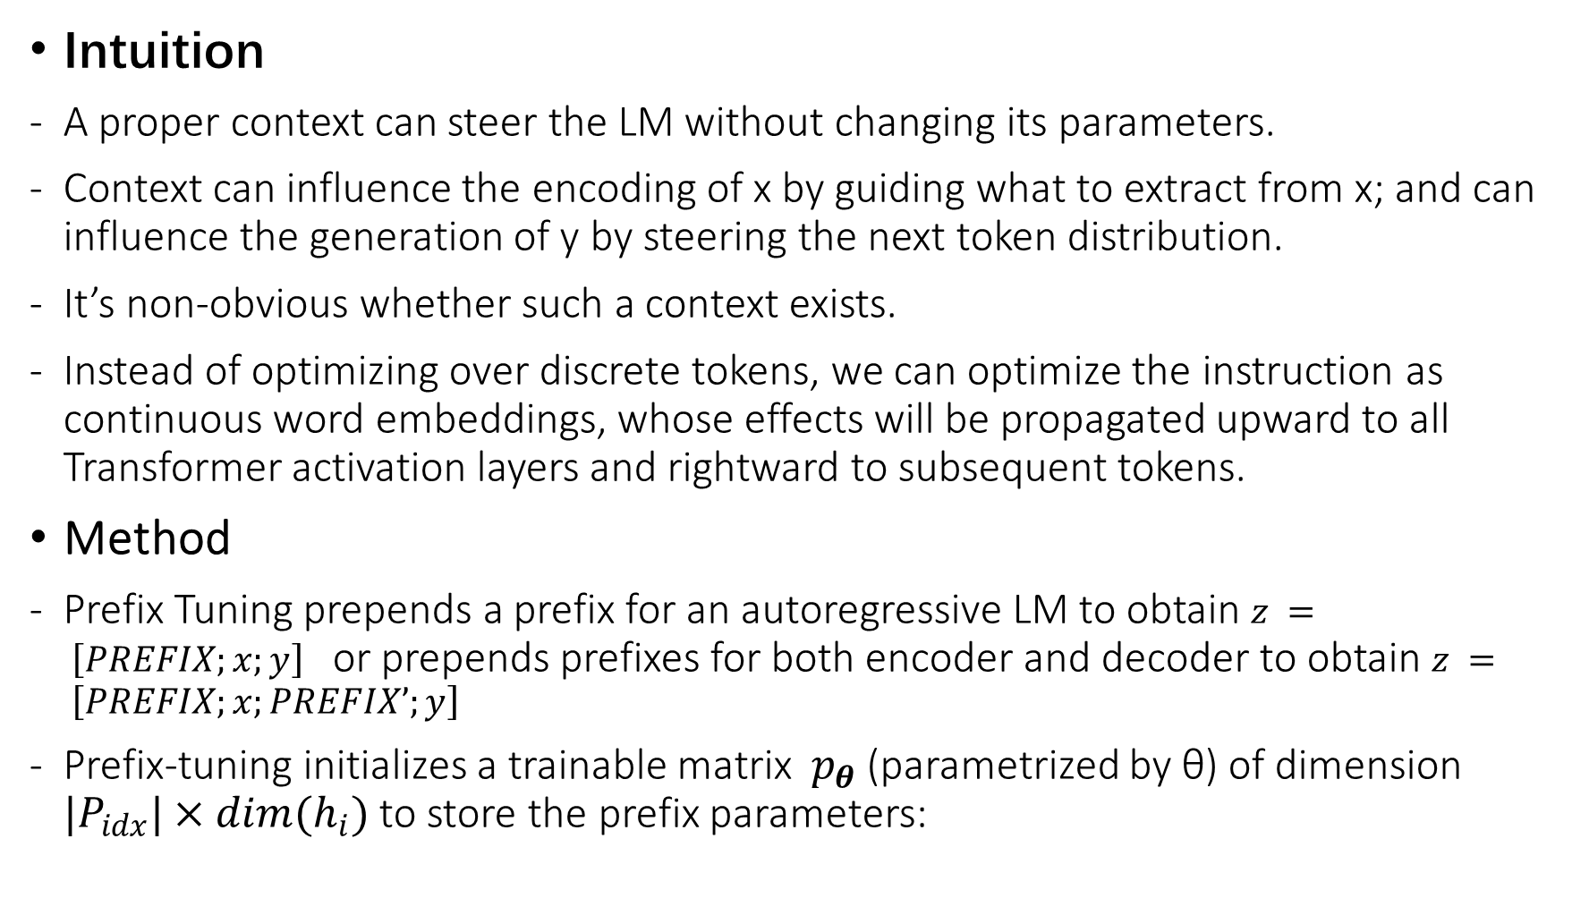
Prefix-Tuning
Intuition
A proper context can steer the LM without changing its parameters.
Context can influence the encoding of x by guiding what to extract from x; and can influence the generation of y by steering the next token distribution.
It’s non-obvious whether such a context exists.
Instead of optimizing over discrete tokens, we can optimize the instruction as continuous word embeddings, whose effects will be propagated upward to all Transformer activation layers and rightward to subsequent tokens.
Method
Prefix Tuning prepends a prefix for an autoregressive LM to obtain $z = \left[PREFIX;x;y\right]$ or prepends prefixes for both encoder and decoder to obtain $z = \left[PREFIX;x;PREFIX’;y\right]$
Prefix-tuning initializes a trainable matrix $p_{θ}$ (parametrized by θ) of dimension $|P_{idx}|×dim(h_{i})$ to store the prefix parameters:

Slide 12
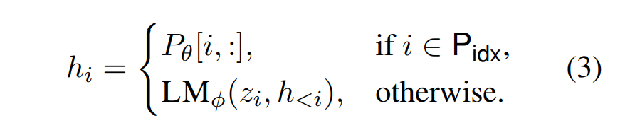
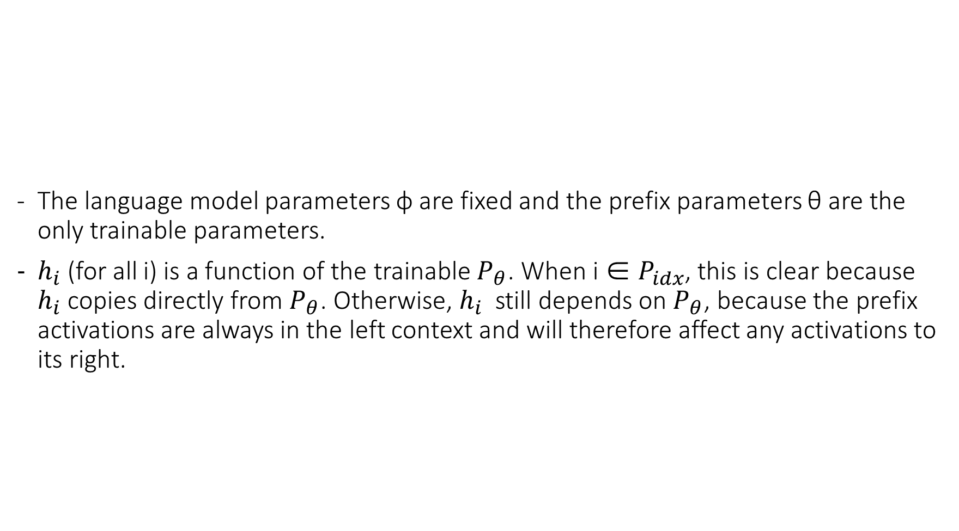
The language model parameters φ are fixed and the prefix parameters θ are the only trainable parameters.
$h_{i}$(for all i) is a function of the trainable $P_{θ}$. When i ∈ $P_{idx}$, this is clear because $h_{i}$ copies directly from $P_{θ}$. Otherwise, $h_{i}$ still depends on $P_{θ}$, because the prefix activations are always in the left context and will therefore affect any activations to its right.

Slide 13
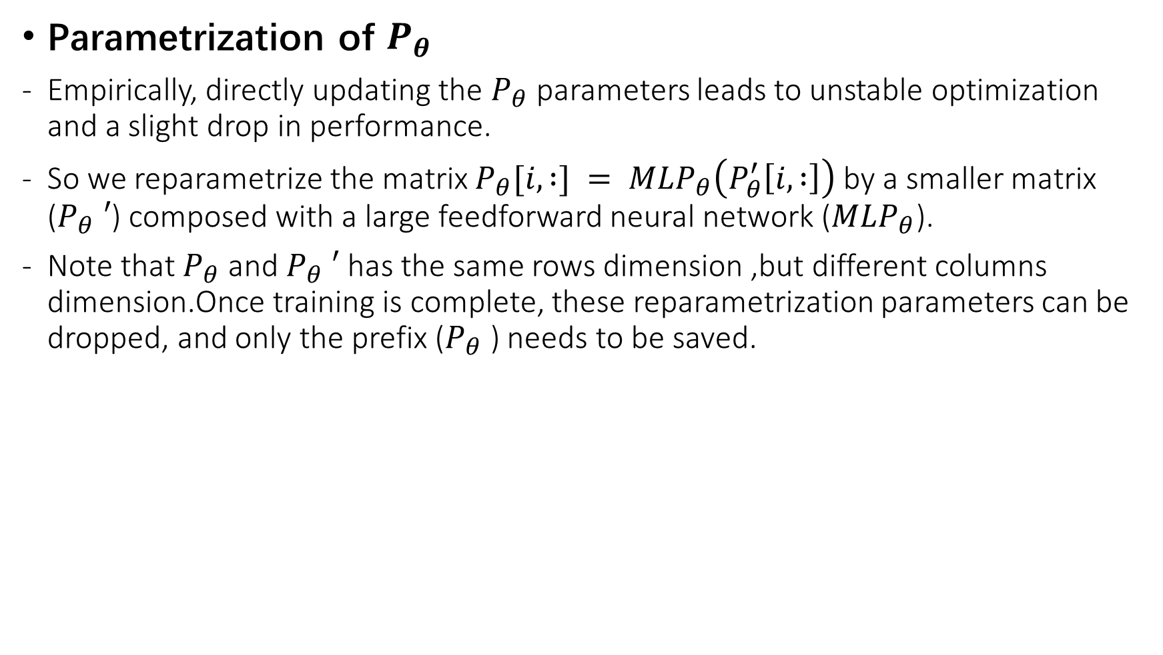
Parametrization of $P_{θ}$
Empirically, directly updating the $P_{θ}$parameters leads to unstable optimization and a slight drop in performance.
So we reparametrize the matrix $P_{θ}[i, :] = MLP_{θ}\left(P_{θ}^{′}\left[i, :\right]\right)$by a smaller matrix ($P_{θ} ′$) composed with a large feedforward neural network ($MLP_{θ}$).
Note that $P_{θ}$ and $P_{θ} ′$has the same rows dimension ,but different columns dimension.Once training is complete, these reparametrization parameters can be dropped, and only the prefix ($P_{θ}$) needs to be saved.

Slide 14
总结

