Slide 1

Paper Sharing—Mixture of Experts
· Go Wilder Instead of Deeper
·Towards Being Parameter-Efficient: A Stratified Sparsely Activated Transformer with Dynamic Capacity
·Mixture-of-Experts with Expert Choice Routing
·Brainformers: Trading Simplicity for Efficiency
2023年11月29日 182010629 蓝杨松

Slide 2
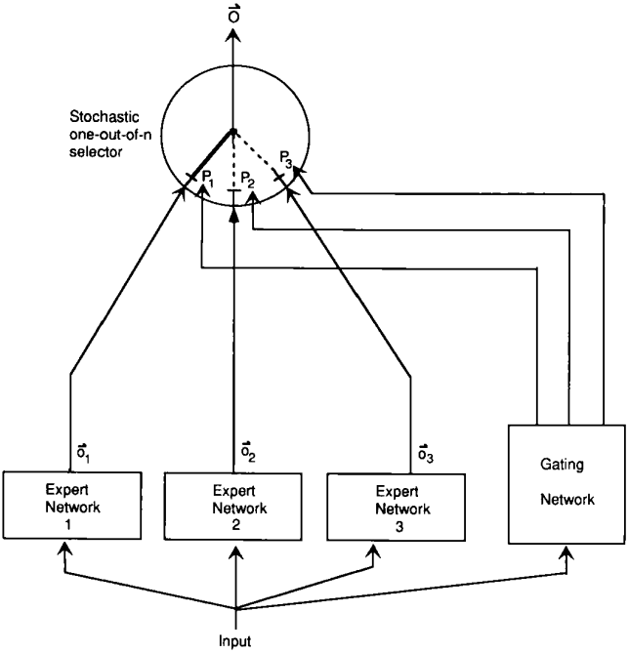
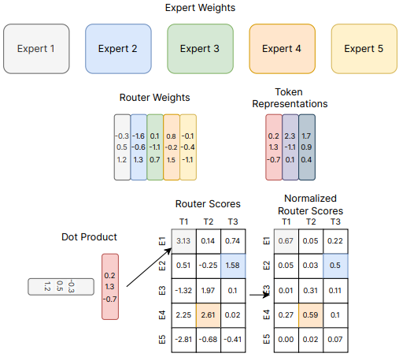


Brief Introduction

Slide 3
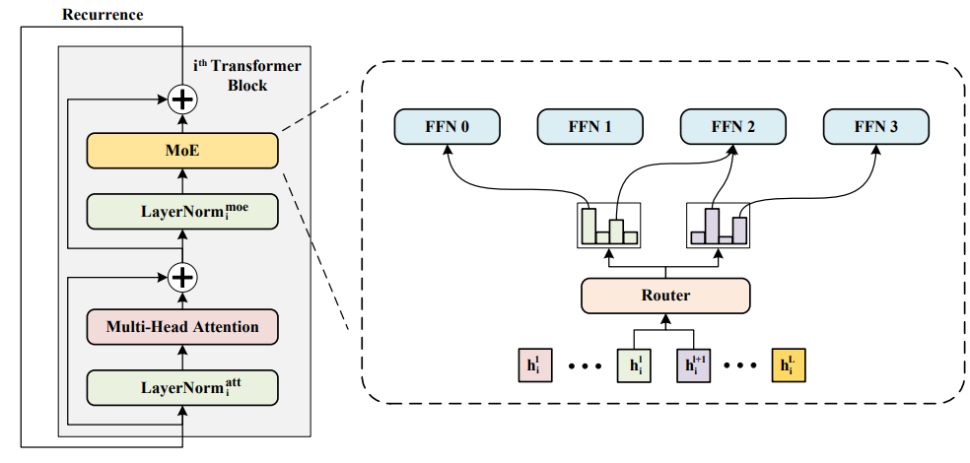
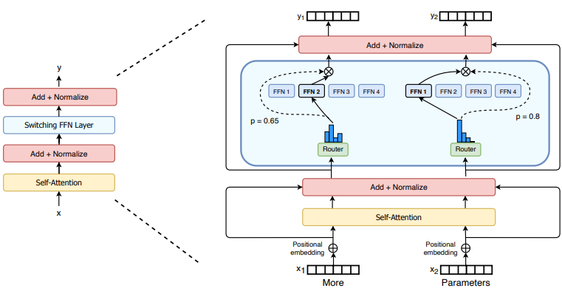
Go Wider Instead of Deeper
• To improve the parameter efficiency, we propose sharing the MoE layer across transformer blocks. The shared experts can receive diversified token representations in different transformer blocks, which enables each expert to be fully trained.
• We propose to keep individual normalization layer across transformer blocks. The individual normalization layers can transform input hidden vectors to semantic information by adding few trainable parameters. Then, diversified input can be fed into the same attention layer or stronger MoE layer to model different semantics.

Slide 4
Mixture-of-Experts with Expert Choice Routing

Slide 5
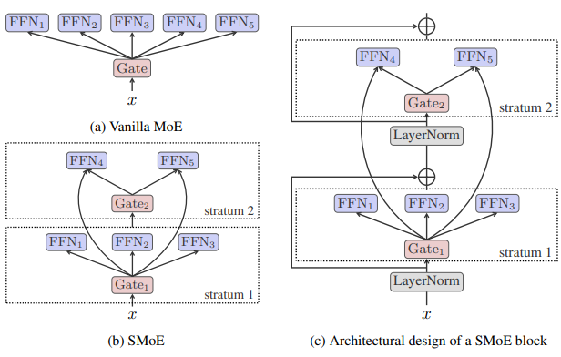
Towards Being Parameter-Efficient：…
• We introduce the concept of dynamic capacity for MoE models and propose a mixture-of-experts model with a stratified structure, namely SMoE, which can automatically assign dynamic capacity to different incoming tokens to make experts become more parameter-efficient.
·We focus on the task of multilingual machine translation (MMT) and show that SMoE substantially outperforms numerous strong baselines with fewer than or the same number of parameters. For instance, we demonstrate that SMoE only needs half the number ofarameters to achieve a performance onpar with a naive MoE (Lepikhin et al., 2021). Furthermore, we carry out an indepth analysis to probe the factors that impact dynamic capacity assignment, including the language of tokens and the position of the SMoE block within the model’s architecture

Slide 6
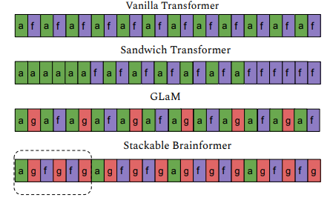
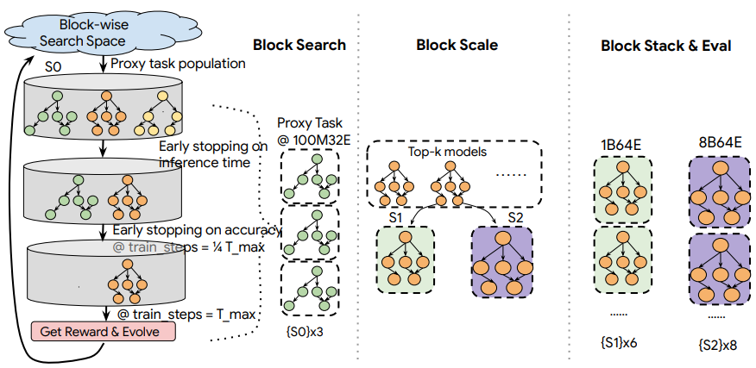
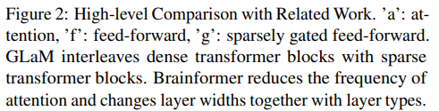
Brainformers: Trading Simplicity for Efficiency
Neural Architecture Search

Slide 7
Thank you for Listening ！
· Go Wilder Instead of Deeper
·Towards Being Parameter-Efficient: A Stratified Sparsely Activated Transformer with Dynamic Capacity
·Mixture-of-Experts with Expert Choice Routing
·Brainformers: Trading Simplicity for Efficiency
2023年11月29日 182010629 蓝杨松

