Slide 1

Knowledge Editing
Xinyan Shi 2023.10.11

Slide 2
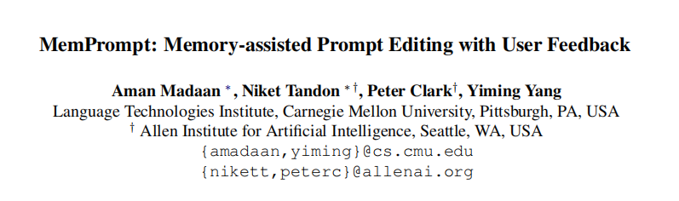

Slide 3
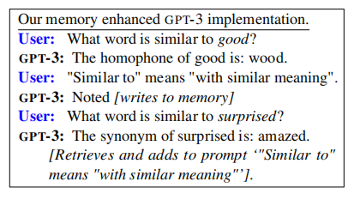
Contributions
·Backgrounds:For example, GPT-3 would mistakenly interpret "What word is similar to good?" to mean a homophone, while the user intended a synonym. (misunderstand user’s intent)
·MemPrompt, pairs GPT-3 with a growing memory of cases where the model misunderstood user’s intent and was provided with corrective feedback.

Slide 4
Approach
·Memory enhanced GPT-3 architecture
·Memory M : M is a growing table of key (xi)- value (fbi) pairs.
·Lookup M(x) : The memory allows lookup operations, denoted as M(x), that matches the
query=x against all the keys of M.
·Combiner C(x,M(x)) : A gating function allowing irrelevant, retrieved feedback to be ignored.

Slide 5
Approach
The underlying assumption here is that for a fixed model, similar inputs will incur similar errors.
Steps
(1)few-shot prompting with GPT-3:input x->output y,a sentence u expressing its understanding of the task
(2)User can then critique u by providing natural language feedback fb.
(3)MemPrompt uses fb from similar, prior queries to enrich the (few-shot) prompt p.

Slide 6
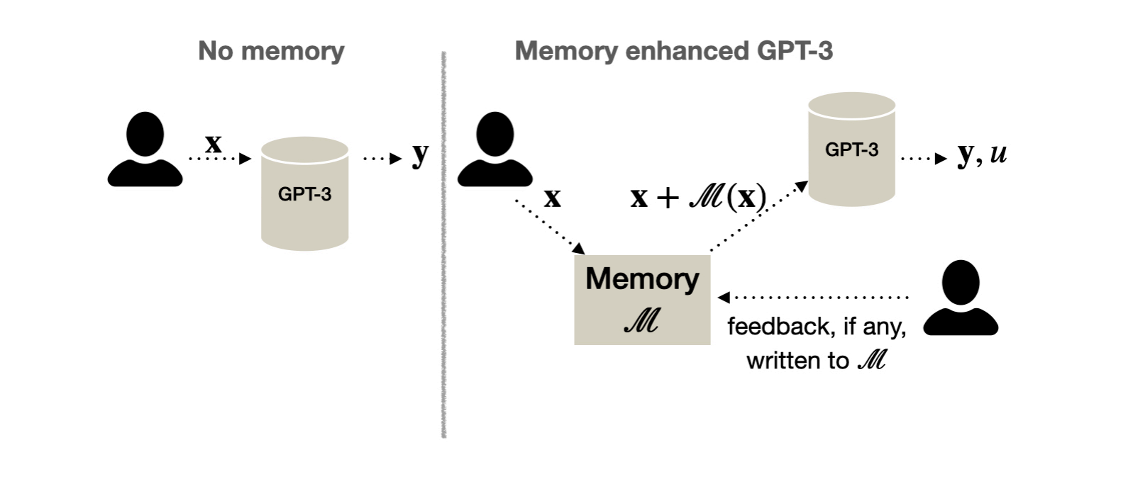
Approach
·Memory enhanced GPT-3 architecture
·

Slide 7

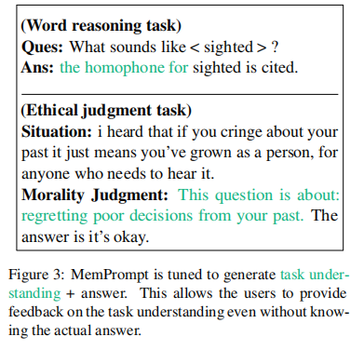
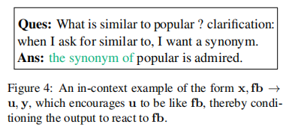
Approach
·Verbalizing Task Understanding
Our experiments demonstrate that GPT-3
models are able to generate this additional
information in all tasks presented.
·Allowing GPT-3 to react to feedback
adding a few examples of the form
x,fb → u, y in the prompt and setting
fb = u

Slide 8
Approach
·Tasks
Lexical Relations
·Lexical Relations:synonym (syn), antonym (ant),homophone (hom)...
·Word Scrambling：reversal of words (rev,yppup → puppy), cycle letters in word (cyc, atc →cat))...
Ethical Reasoning:
·Categorical feedback (ERT-CAT)
·Natural language feedback (ERT-NL)

Slide 9
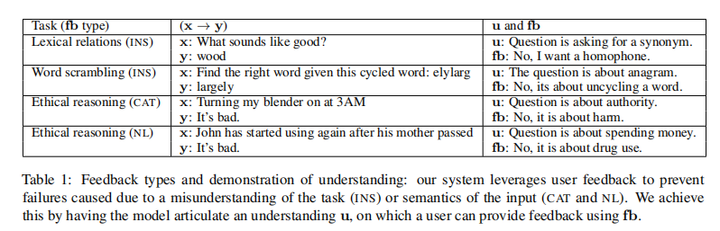
Approach
·Feedback on model’s understanding
two modes of failure:task instruction understanding and task nuanced understanding

Slide 10
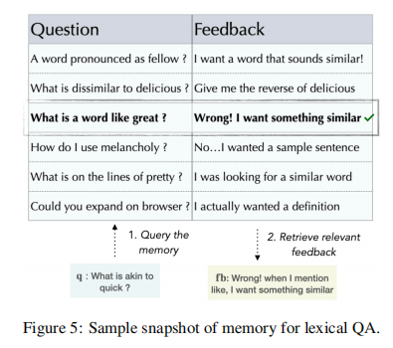
Approach
·MemPrompt Implementation

Slide 11
Approach
·MemPrompt Implementation
·Implementation of retriever M(x): transforming x,followed by a similarity lookup of the transformed x in M
design a novel SEQ2SEQ based transformation called GUD-IR.
compute similarity based on a fine-tuned Sentence transformers
·Implementation of combiner C:concatenates x with relevant fb retrieved by M(x)
use a threshold on the similarity score(need further work)

Slide 12
Experiments
·Baselines
NO-MEM
GROW-PROMPT
·Metrics
·Acc(y): % of cases where answer matched the ground truth.
·Acc(u): % of cases where the model’s understanding of user’s intent is correct. Acc(u) is also referred to as instruction accuracy.
·Clarification probability

Slide 13
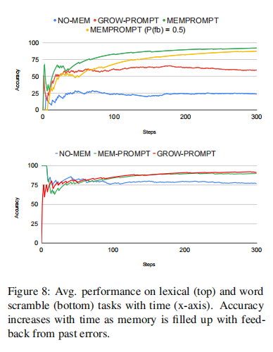
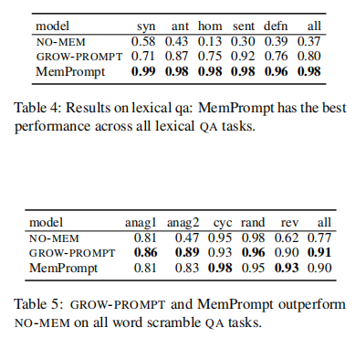
Experiments
Improving model’s
understanding of a
task might lead to
an improved
performance.

Slide 14
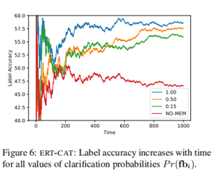
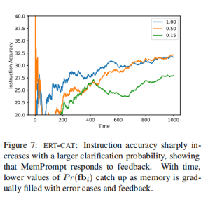
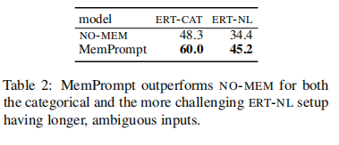
Experiments
MemPrompt effectively incorporates feedback,improving accuracy over time.

Slide 15
Experiments
·Using dynamic prefix in prompts
·MemPrompt with label feedback
·Using MemPrompt for language and dialects based personalization
Limitations：
·Scaling memory, users
·Ethical concerns

Slide 16
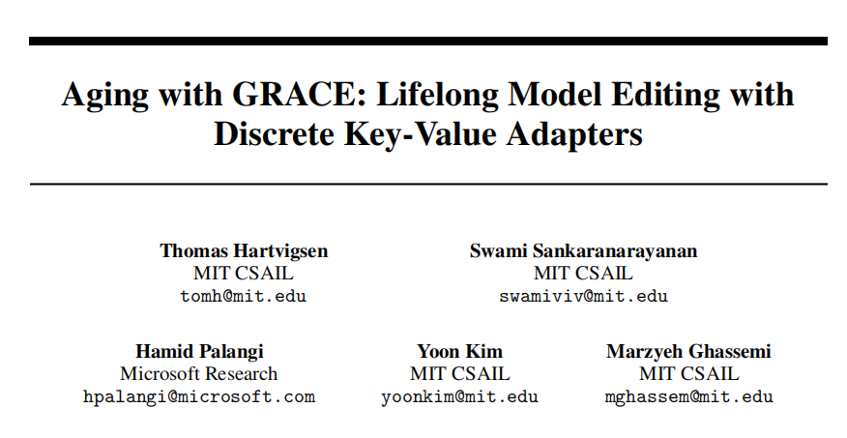

Slide 17
Introductions
·Current model editors, which adjust specific behaviors of pre-trained models, degrade model performance over multiple edits.
·We propose GRACE, a Lifelong Model Editing method, ensuring minimal impact on unrelated inputs.GRACE writes new mappings into a pre-trained model’s latent space, creatinga discrete, local codebook of edits without altering model weights.
·establish key metrics and comparisons for lifelong model editing
·T5, BERT, and GPT models

Slide 18
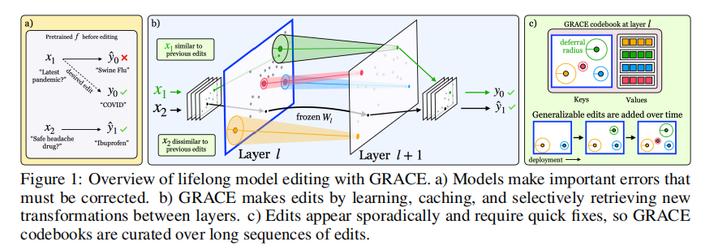
Introductions

Slide 19
Approach
·A GRACE adapter at model f’s layer l contains two components:
(1) a discrete codebook C
(2) a deferral mechanism to decide whether to use C for a given input
GRACE codebook:
·Keys (K): Set of keys, where each key is a cached activation predicted by layer l−1.
·Values (V): Set of values that are randomly initialized and are updated using finetuning loss on edit examples. Each key maps to a single, corresponding value.
·Deferral radii (ε): Each key has a deferral radius ϵ, which serves as a threshold for similarity matching.

Slide 20
Approach
Deferral mechanism:
layer l ：
Through explicit similarity search, we use the fact that large models encode semantic similarity with respect to their tasks in their latent spaces. This allows GRACE edits to inherently generalize to similar inputs in the future.

Slide 21
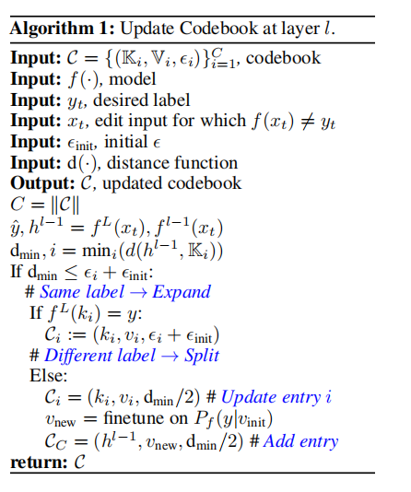
Approach
Codebook maintenance

Slide 22
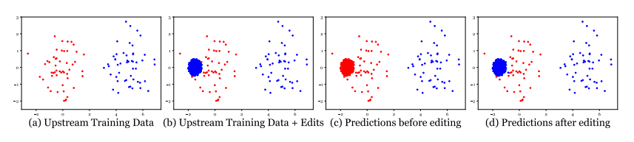
Approach
Example

Slide 23
Experiments
Metrics
Edit Success (ES)
Test Retention Rate (TRR)
Edit Retention Rate (ERR)
the number of edits (#E)

Slide 24
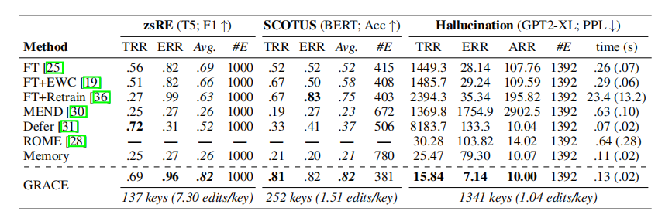
Experiments

Slide 25
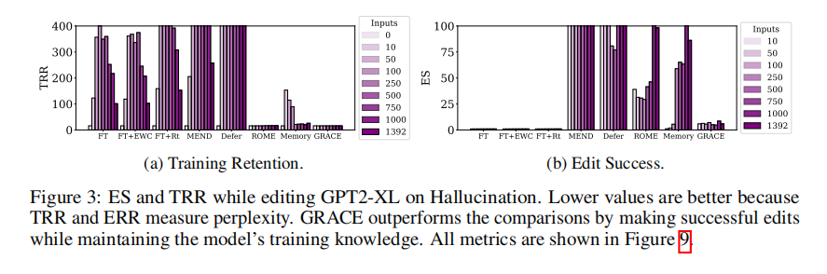
Experiments

Slide 26
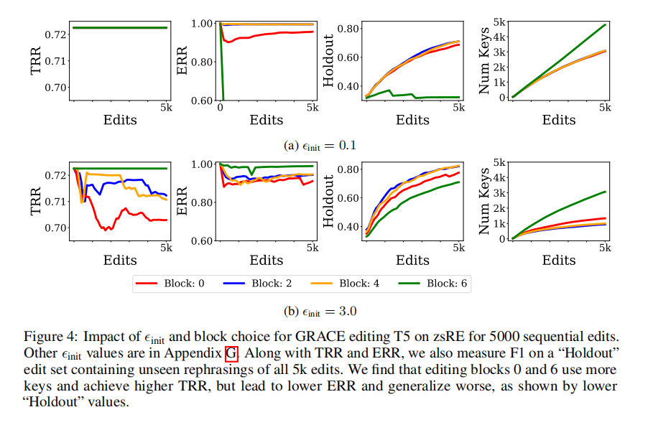
Experiments

Slide 27
Limitations
slow down inference
behaviors are edited in isolation

Slide 28
Conclusion
·寻找入手点的方式可以参考
·第一篇的架构细节和实验有些粗糙
·方法的共性与区别

Slide 29
Thanks！
Xinyan Shi 2023.10.11

