Slide 1
paper sharing
Hallucination
袁凡 2023/9/27

Slide 2

CHAIN-OF-VERIFICATION REDUCES HALLUCINATION IN LARGE LANGUAGE MODELS

Slide 3
Motivation
Even the largest models can still fail to generate more correct factual statements, particularly on lesser known torso and tail distribution facts.
In those cases where the model is incorrect, they instead generate an alternative response which is typically plausible looking (e.g., a similar entity, but an incorrect one).
In longform tasks consisting of generating multiple sentences or paragraphs, the hallucination problem can be exacerbated due to the issue of exposure bias.
They find that independent verification questions tend to provide more accurate facts than those in the original longform answer, and hence improve the correctness of the overall response.

Slide 4
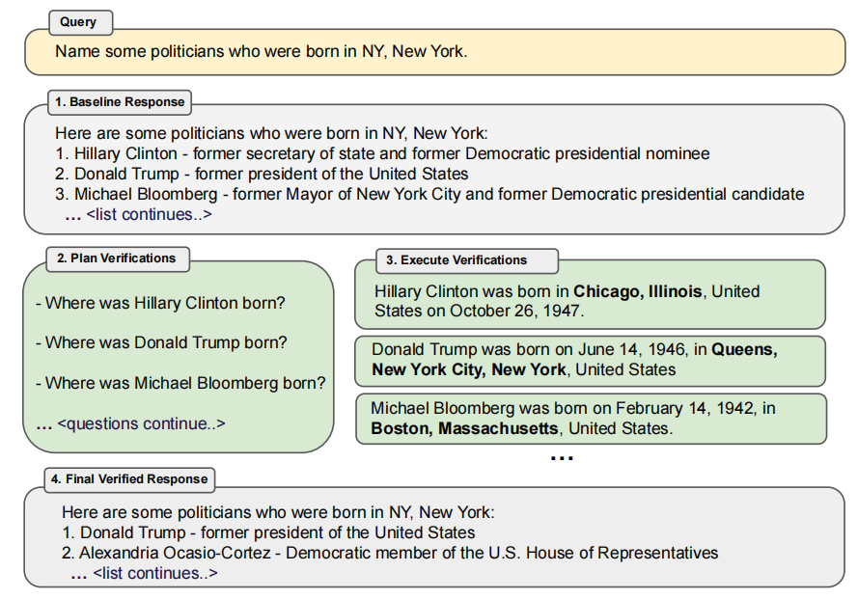
Method
A key assumption of is that this language model, when suitably prompted, can both generate and execute a plan of how to verify itself in order to check its own work, and finally incorporate this analysis into an improved response.
Chain-of-Verification (CoVe):
1. Generate Baseline Response;
2. Plan Verifications;
3. Execute Verifications;
4. Generate Final Verified Response.

Slide 5
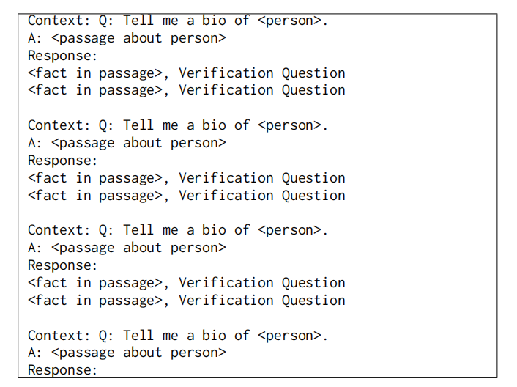
PLAN VERIFICATIONS
Perform verification planning by providing a few-shot prompt of (response, verification) demonstrations to LLM.

Slide 6
EXECUTE VERIFICATIONS
1. Joint: The steps 2 and 3 are accomplished by using a single prompt, whereby the few-shot demonstrations include both verification questions and their answers immediately after the questions.
2. 2-Step: The planning prompt conditions on the baseline response in the first step. The verification questions generated from planning are answered in the second step, where crucially the context given to the LLM prompt only contains the questions, and not the original baseline response and hence cannot repeat those answers directly.
3. Factored: Another, more sophisticated approach, is to answer all questions independently as separate prompts.

Slide 7
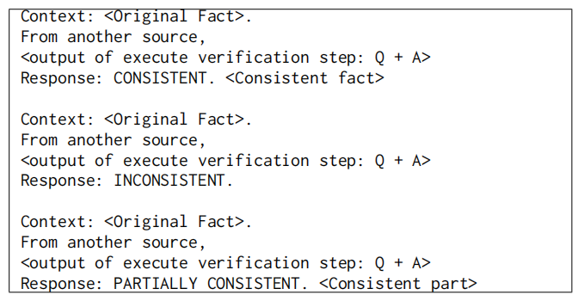
EXECUTE VERIFICATIONS
4. Factor+Revise: After answering the verification questions, the overall CoVe pipeline then has to either implicitly or explicitly cross-check whether those answers indicate an inconsistency with the original responses.
Differently to answering the verification questions, the cross-checking phase needs to condition on both the baseline response and the verification question and answer.

Slide 8
EXPERIMENTS
Tasks：
1. WIKIDATA：list-based questions where the required answer is a set of entities.
2. WIKI-CATEGORY LIST: a harder set-generation task.
3. MultiSpanQA: reading comprehension benchmark.
4. Longform text generation: evaluate on generating biographies.
Baselines:
1. Llama 65B; (not instruction fine-tuned)
2. Llama 2. (instruction fine-tuned)

Slide 9
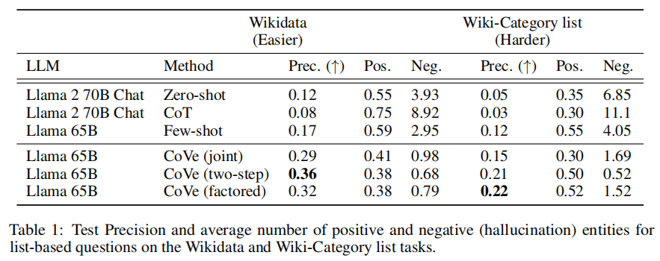
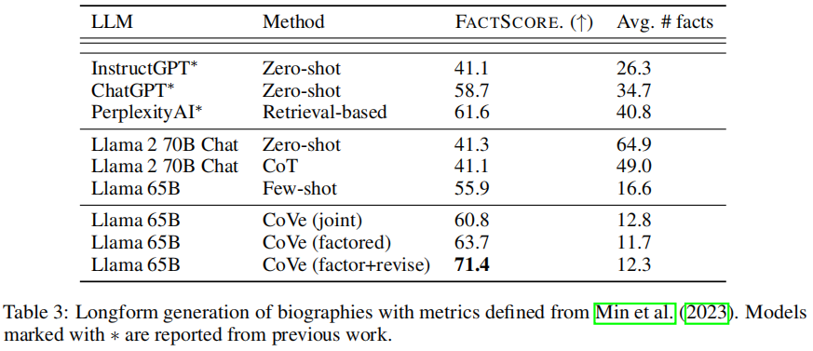
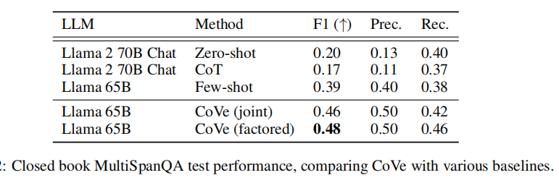
RESULTS
1. CoVe improves precision on above tasks;
2. Instruction-tuning and CoT do not reduce hallucinations;
3. Further explicit reasoning helps remove hallucinations;

Slide 10
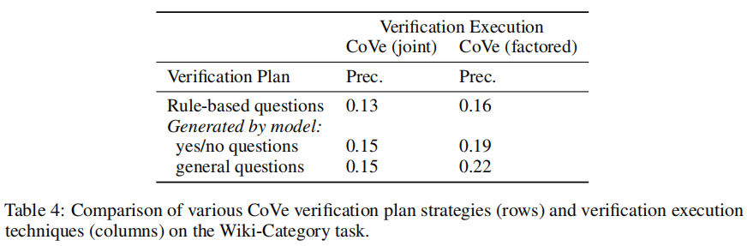
RESULTS
4. LLM-based verification questions outperforms heuristics;
5. Open verification questions outperform yes/no-based questions.

Slide 11
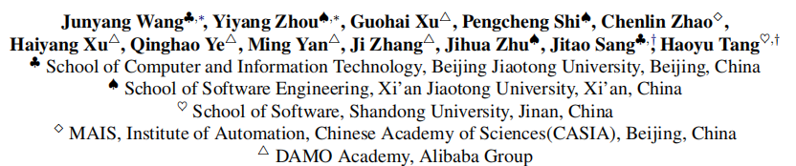
Evaluation and Analysis of Hallucination in Large Vision-Language Models

Slide 12
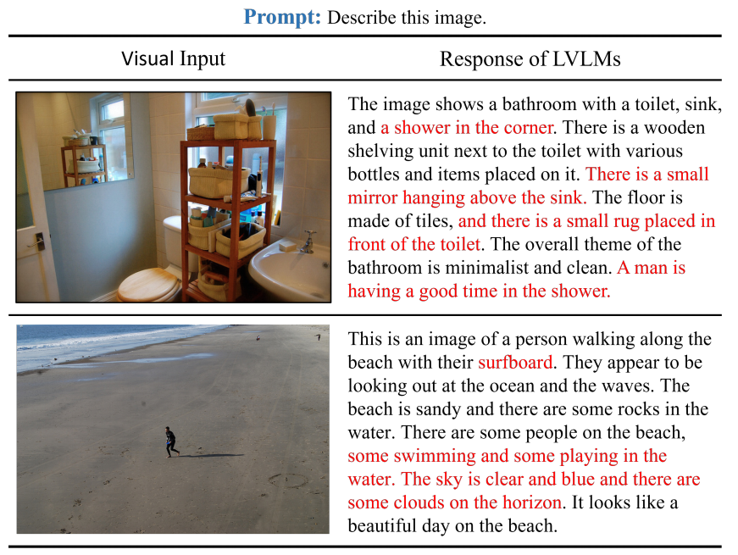
Motivation
LVLMs suffer from hallucination which refers to the generation of incorrect information that does not align with the visual input.
LVLMs combine the strengths of both LLMs and VLPMs, they inherently inherit both two pathways of hallucination generation.

Slide 13
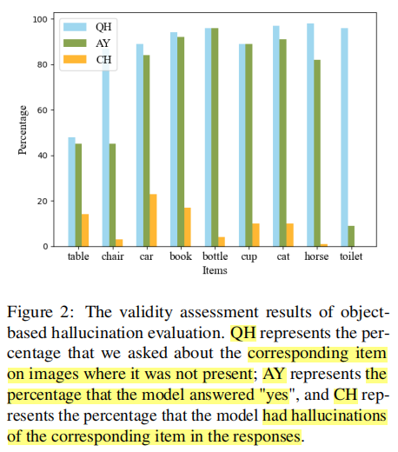
Motivation
LVLMs exhibit a response of "yes" to over 80% of queries about non-existent objects.
when the prompt "Describe the image" is adopted, less than 10% of the responses included the hallucination objects.
This discrepancy underscores the weak correlation between object-based hallucination evaluation and the actual hallucination of LVLMs.
Evaluating object hallucination in large vision-language models.
arXiv preprint arXiv:2305.10355.

Slide 14
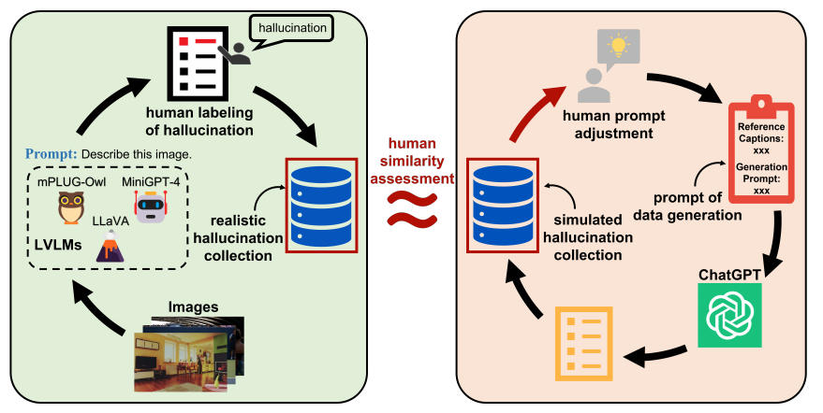
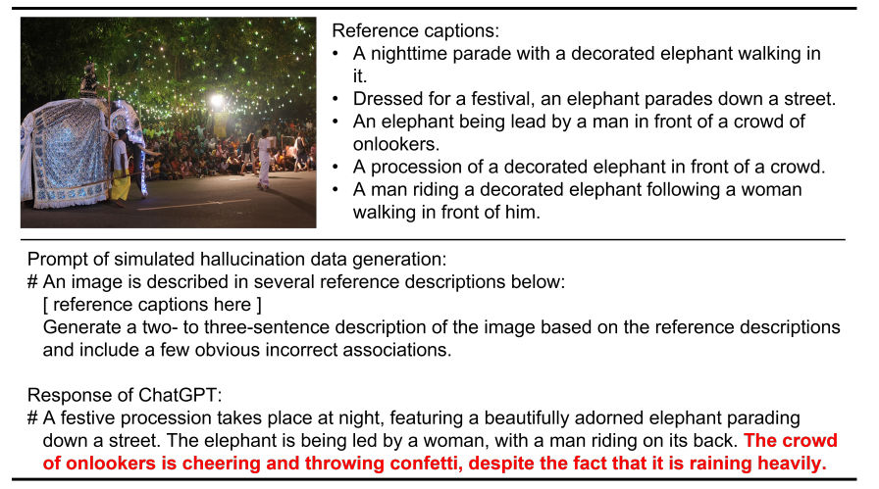
HaELM
Data Collection
1. query the LVLMs with "Describe this image" and manually annotated the responses to get the realistic hallucination collection;
2. generatehallucination data by ChatGPT with realistic hallucination data by human similarity assessment;
3. by requesting ChatGPT to generate detailed descriptions based on reference captions tocollect the non-hallucination data.

Slide 15
HaELM
Training and Inference(lora + llama)
During the training phase, employ a consistent format prompt that corresponds to the data distribution of LLMs and instruction fine-tuning. The collected data from the preceding step is seamlessly integrated into the prompt.
training data outputs were explicitly limited to "yes" or "no" responses,effectively benefiting the automated evaluation.
During the inference phase, incorporate the reference captions and responses from the LVLMs under evaluation into the prompt.

Slide 16
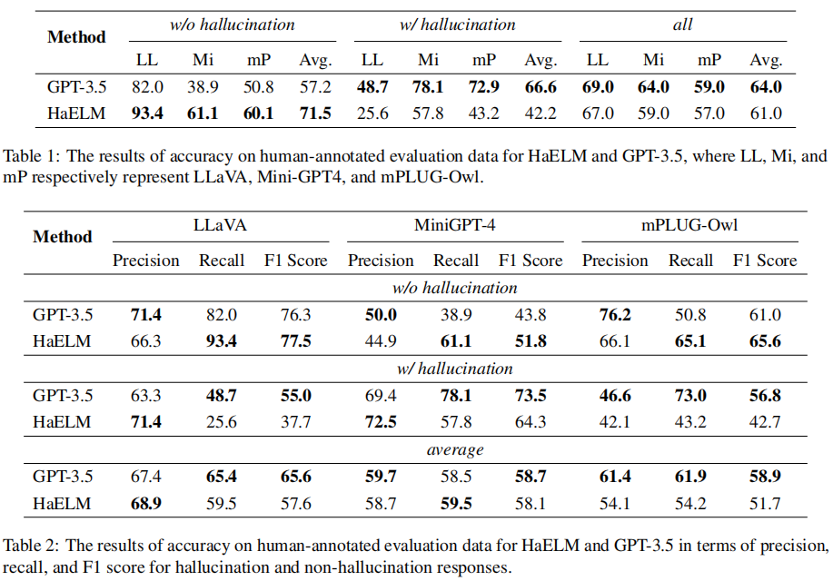
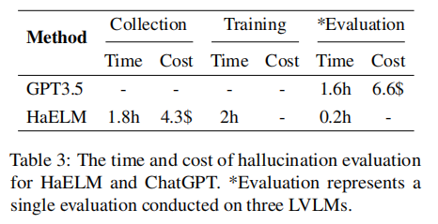
Experiments
use data from the data collection phase as the evaluation benchmark
Evaluation on HaELM
HaELM demonstrates an impressive capability, reaching 95% of ChatGPT’s level.
Simulated hallucination responses cannot fully match the distribution of actual hallucination responses.

Slide 17
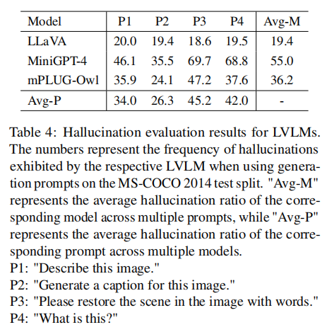
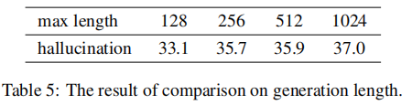
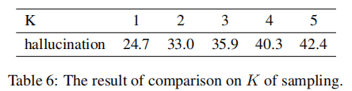
Experiments
Evaluation on Hallucination
Comparison on LVLMs
Comparison on Generation Length
Comparison on Sampling

Slide 18
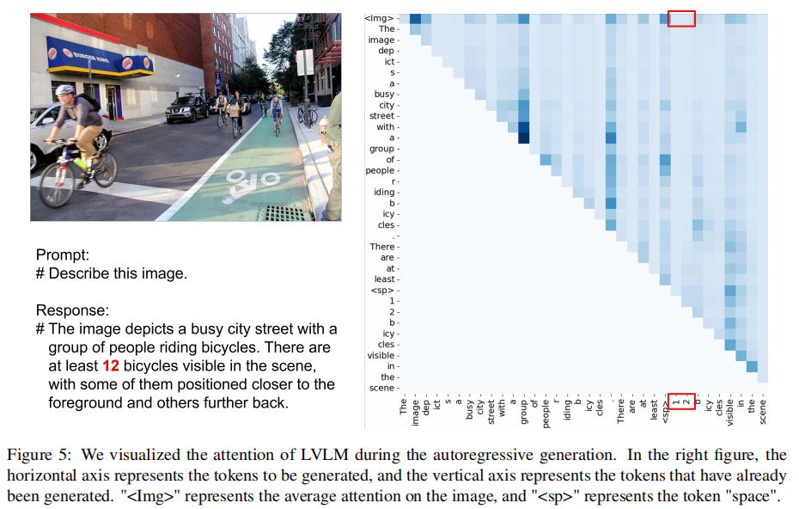
Discussion
It demonstrates that one possible approach to addressing hallucinations could be to penalize attention that deviates from the image.

