Slide 1
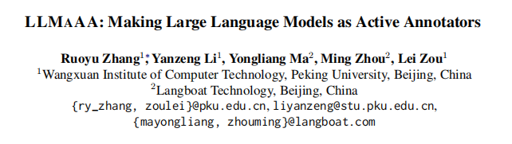

Slide 2
Introduction
Large language models (LLMs) have exhibited remarkable few-shot performance in a wide range of tasks, with only a few demonstrations and well designed prompts. However, with rapid advancements comes vast potential risks in adopting LLMs for widespread downstream production applications. One of the main concerns is about data privacy and security.
On the other hand, training task-specific models (TAMs) for NLP tasks necessitates extensive amounts of labeled data. Due to the superior generative capacity of LLMs, some researchers attempt to synthesize training data with text generation.However, the generated text usually struggles with low-quality issues and may exhibit domain shifts with test data.
To enhance the reliability (i.e. accuracy) of TAMs’ performance as well as to ensure the data efficiency in annotation cost, we propose LLMAAA, an innovative framework that integrates active learning into the LLM annotation process,i.e., making LLMs as Active Annotators. By exploring different active acquisition strategies, LLMAAA enables the LLM to annotate more informative instances that benefit model performance more.To train TAMs reliably, we optimize both the annotation and training processes within LLMAAA framework.

Slide 3
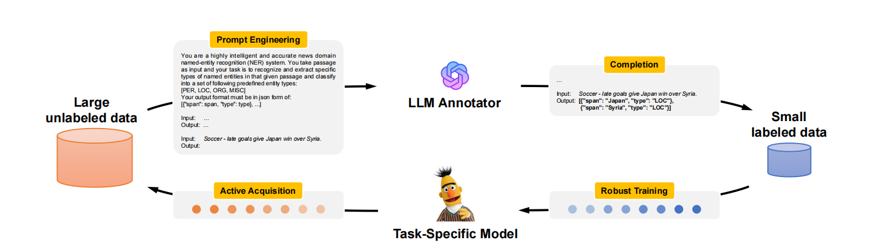
Method
LLM as Active Annotator
Active Data Acquisition
Robust Learning with Noisy Labels

Slide 4
LLM as Active Annotator
In-context learning (i.e. PROMPTING) enables LLM to conduct few-shot inference without fine-tuning.
k-NN Example Retrieval.To select good in context examples, Liu et al. (2022) propose a k-NN retrieval strategy, which first embeds the demonstration pool Ddemo and query sample to vector representations, and then retrieves the nearest k neighbors of the query to form its exemplars. The rationale behind this is that semantically similar examples may help LLM answer the query better.
Label Verbalizer.In classification tasks, the surface forms of labels may induce difficulties and ambiguities. Taking relation classification for instance, the label “per:parents” can indicate either “subject is the parent of object” or “object is the parent of subject”, depending on its definition. To address this problem, we utilize a label verbalizer to transform the surface forms to natural language descriptions with pre-defined templates, serving as fine-level guidance.

Slide 5
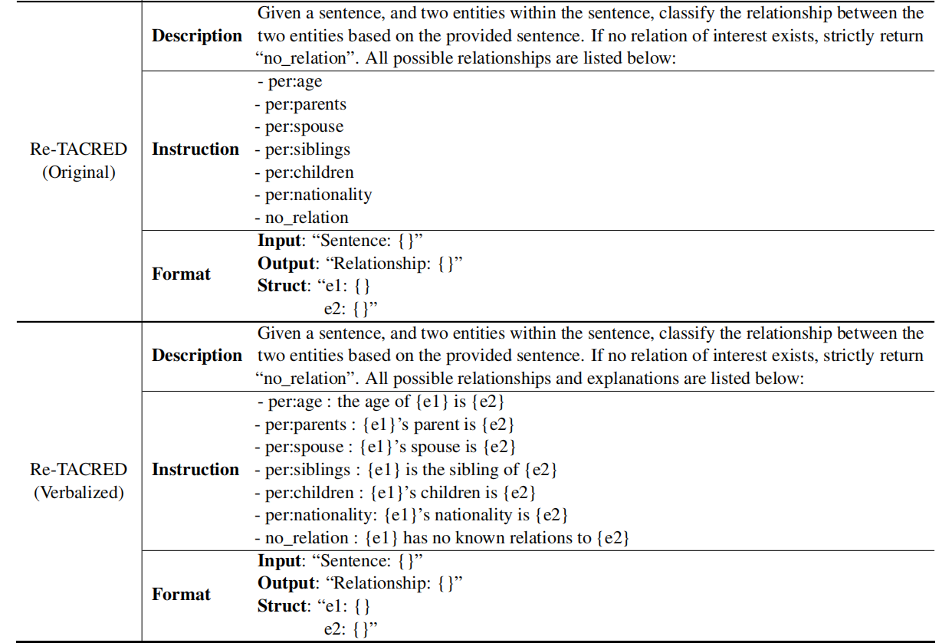

Slide 6


Active Data Acquisition
Random
Maximum Entropy
Least Confidence
K-Means

Slide 7
Robust Learning with Noisy Labels
The authors adopt a meta-learning objective to learn the weights by minimizing the validation loss. Online approximation is used to eliminate the nested loop in optimization. During training, the model first predicts on the training examples, then calculates the loss between the predictions and the true labels. The weights are adjusted based on the loss, giving lower weights to examples with higher losses (which may be due to noisy labels). This helps prevent the model from overfitting to noisy annotations.

Slide 8
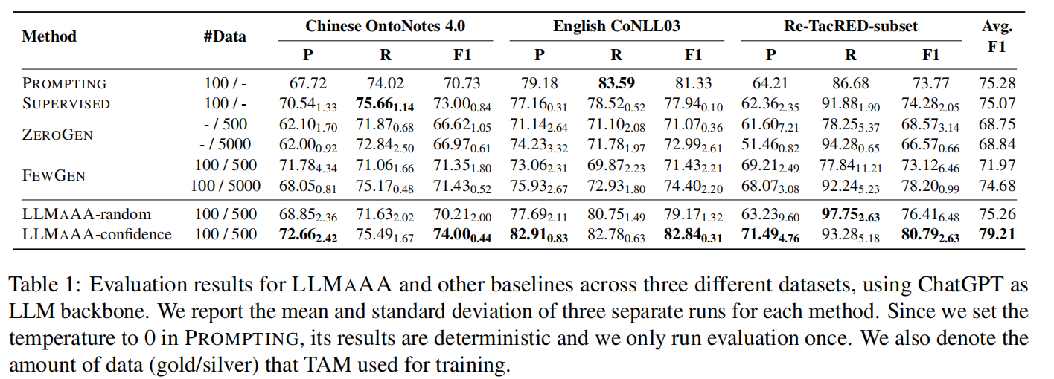
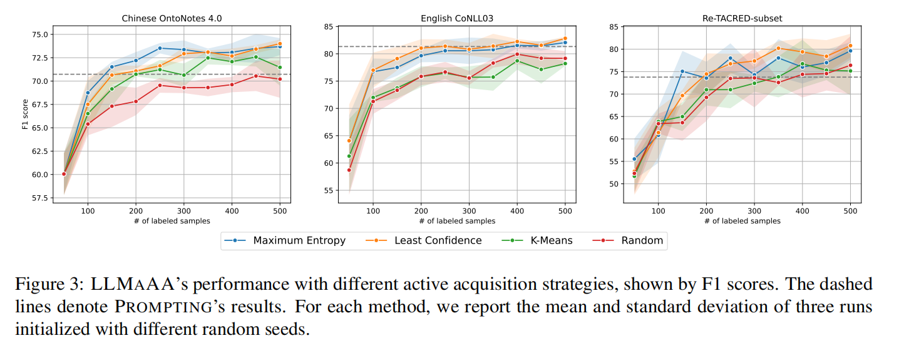
Experiment

Slide 9
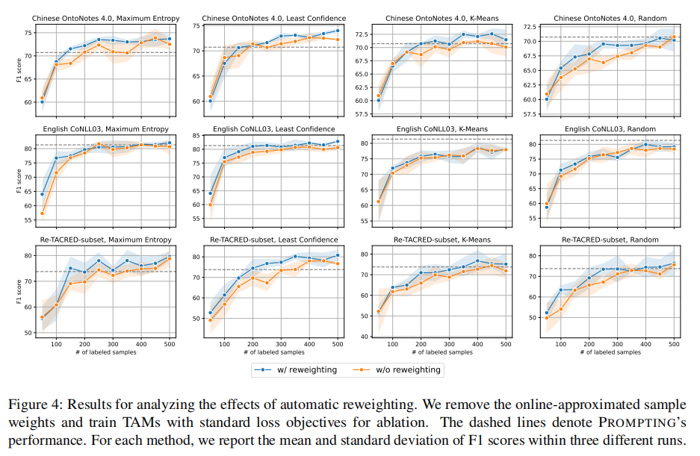
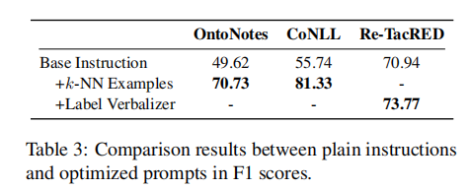
ablation experiments

Slide 10
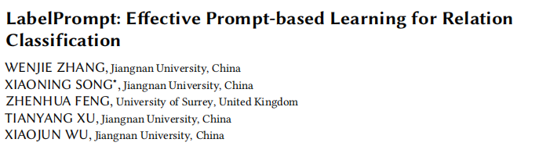

Slide 11
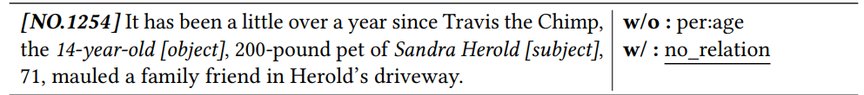
Introduction
First, relation classification presents a unique challenge compared to many NLP tasks in that the target labels contain rich semantic information, as opposed to being single words representable within the pretrained model’s vocabulary. Consequently, existing answer mapping techniques struggle to effectively project the model’s masked outputs to the complex, multi-word relation labels when reformulating relation classification as a masked language modelling task.
Second, the masked language modelling (MLM) pre-training objective depends on predictions derived from neighbouring words and global sentence features. However, relation classification requires not only identifying a relation from a sentence, but also determining whether the relation holds between two given entities. Existing approaches predominantly predict relations at the sentence level, without explicitly modelling the correspondence between the entity-relation triplet.
Subsequently, an additional challenge arising in relation classification is augmenting the model’s capacity to discern givenentities when inferring relations.

Slide 12
Related work
Pre-training and Fine-tuning
Prompt-based Learning
Prompt-based learning is a different approach that aims to reduce the gap between pre-training and fine-tuning. Rather than fine-tuning, prompt-based learning reformulates a downstream task to the original PLM training task.
Relation Classification

Slide 13
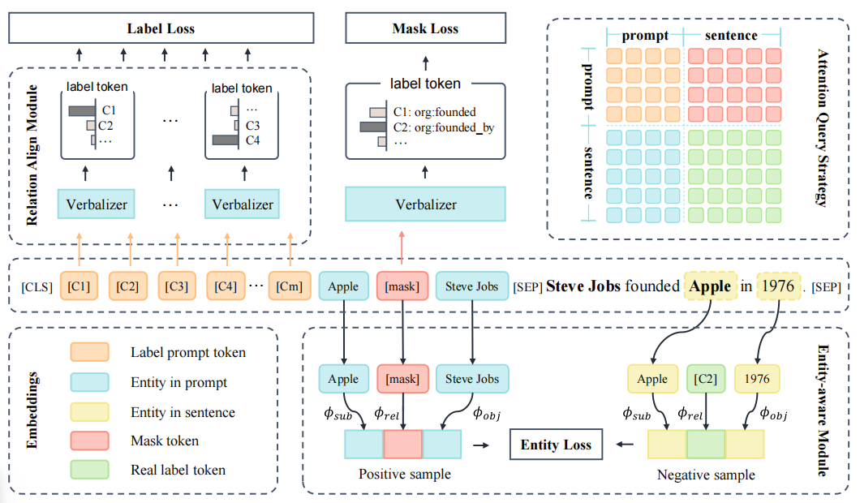
Method
Label Prompt
Relation-Align Module
Entity-Aware Module
Attention Query Strategy

Slide 14
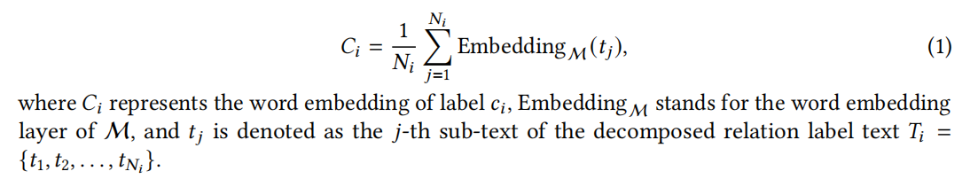
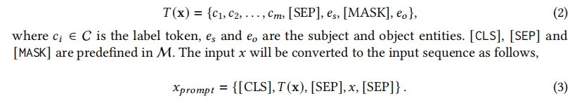
Label Prompt
Label Prompt Tokens
Label Prompt Template

Slide 15
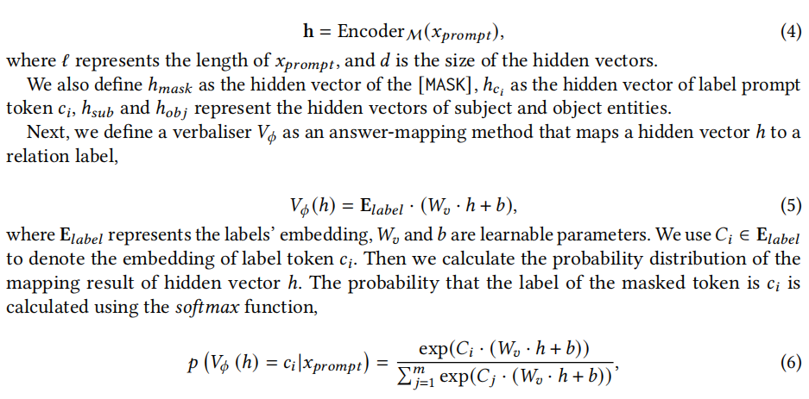
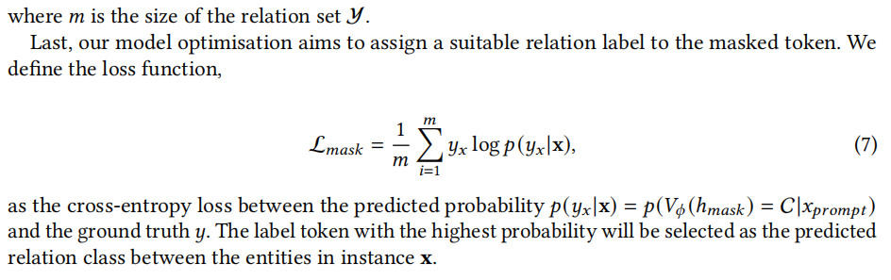
Label Prompt
Label Prompt Learning

Slide 16
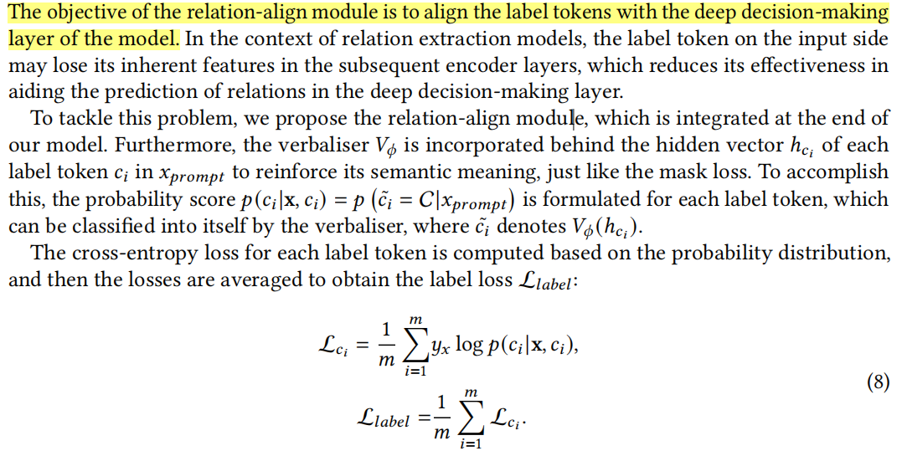
Relation-Align Module

Slide 17
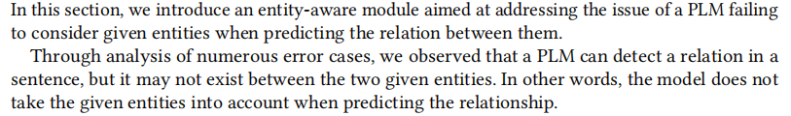
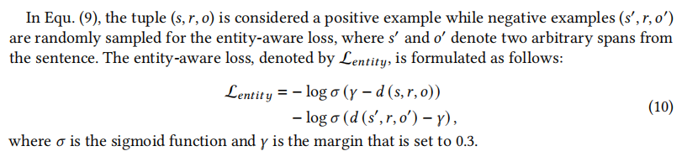

Entity-Aware Module

Slide 18
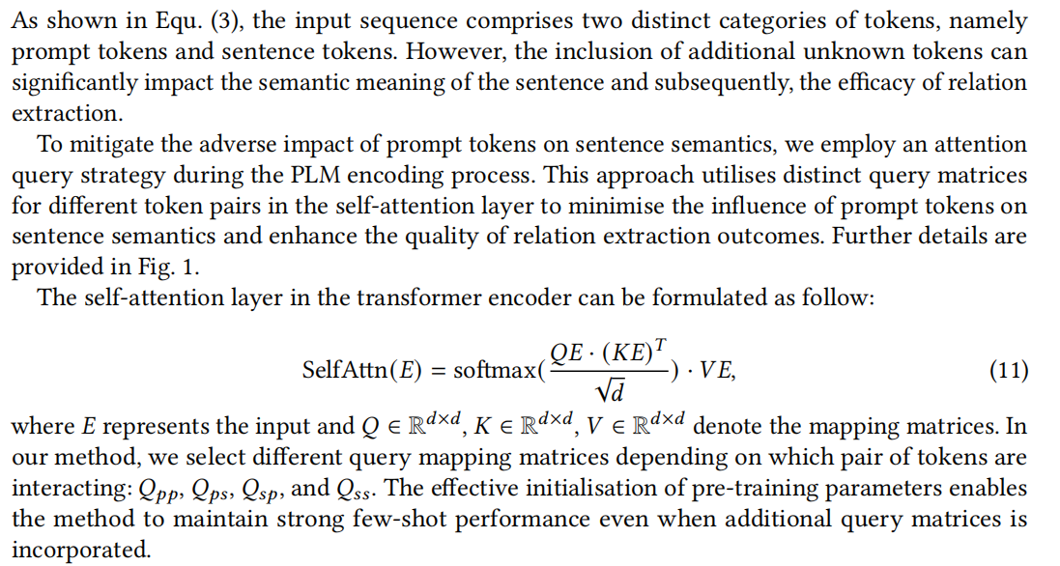
Attention Query Strategy

Slide 19
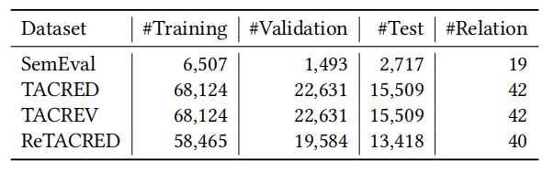
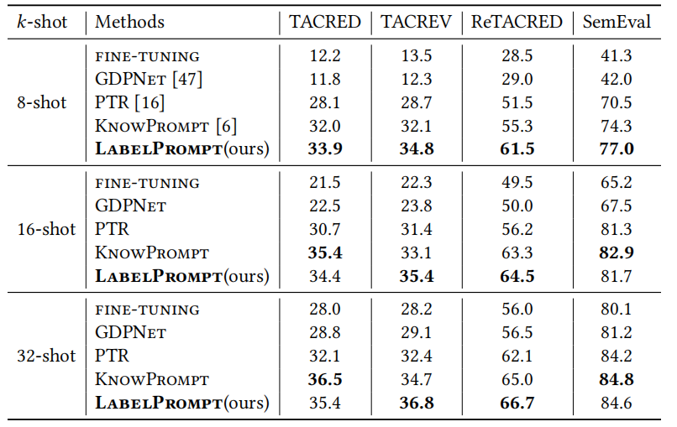
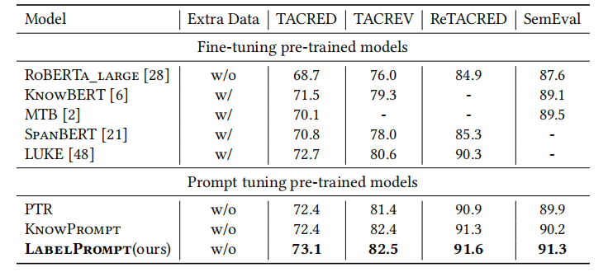
Experiment

Slide 20
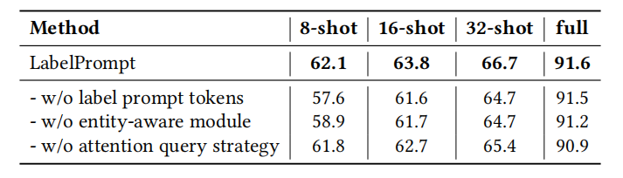
ablation experiments in ReTACRED

