Slide 1
MAZE: Data-Free Model Stealing Attack Using Zeroth-Order Gradient Estimation
Sanjay Kariyappa, Atul Prakash, Moinuddin K. Qureshi

Slide 2
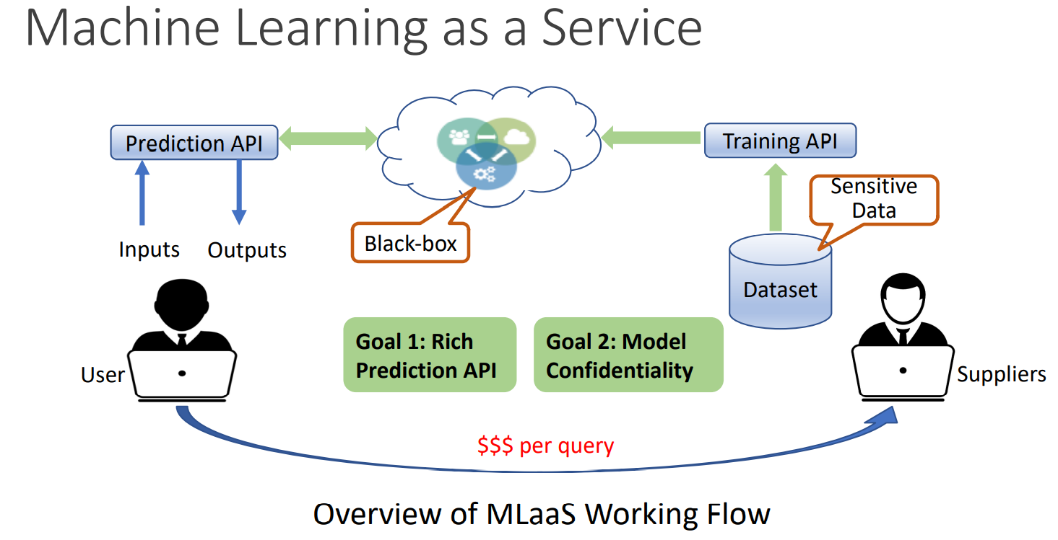

Slide 3
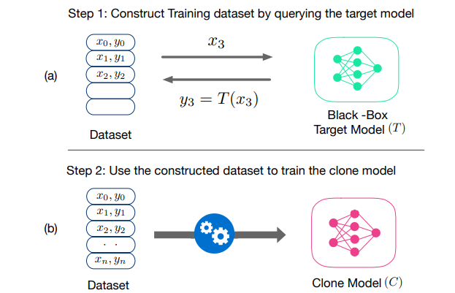
Model stealing attacks
Model Stealing attacks allow an adversary with blackbox access to a ML model to replicate its functionality by training a clone model using the predictions of the target model for different inputs

Slide 4
Model stealing attacks
parameter stealing
hyper-parameter stealing
functionality stealing attacks
（1）partial-data（e.g.JBDA）
（2）surrogate-data（e.g. KnockoffNets）
（3）data-free（e.g. Noise）

Slide 5
MAZE Overview
Motivation：Best available existing MS attacks fail to produce a high-accuracy clone without access to the target dataset or a representative dataset necessary to query the target model.
Achievement：MAZE, a data-free model stealing attack using zeroth-order gradient estimation that produces high-accuracy clones. MAZE-PD, an extension of MAZE in the partial-data setting, which generates synthetic data closer to the target distribution.

Slide 6
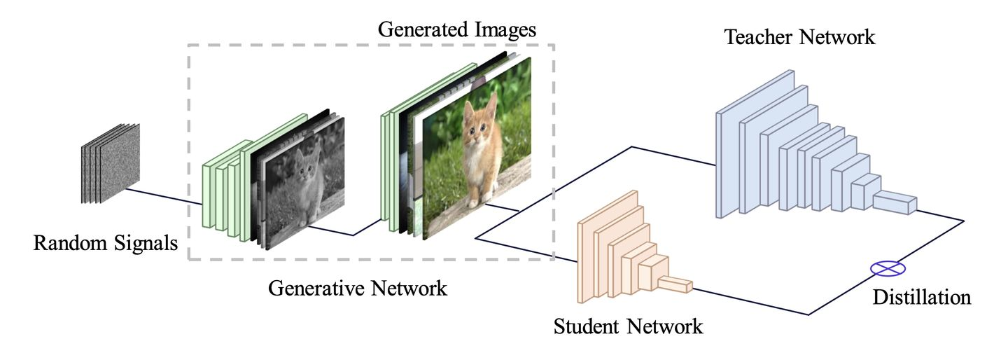




Data-free Knowledge Distillation

Slide 7
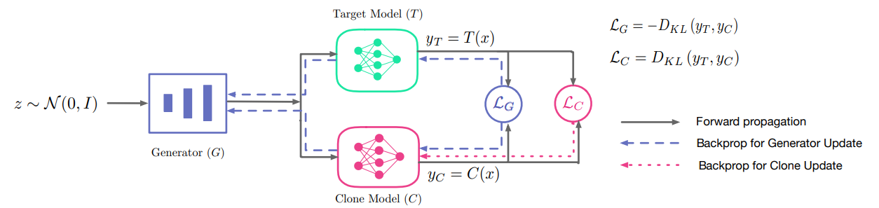



MAZE: Data-Free Model Stealing

Slide 8



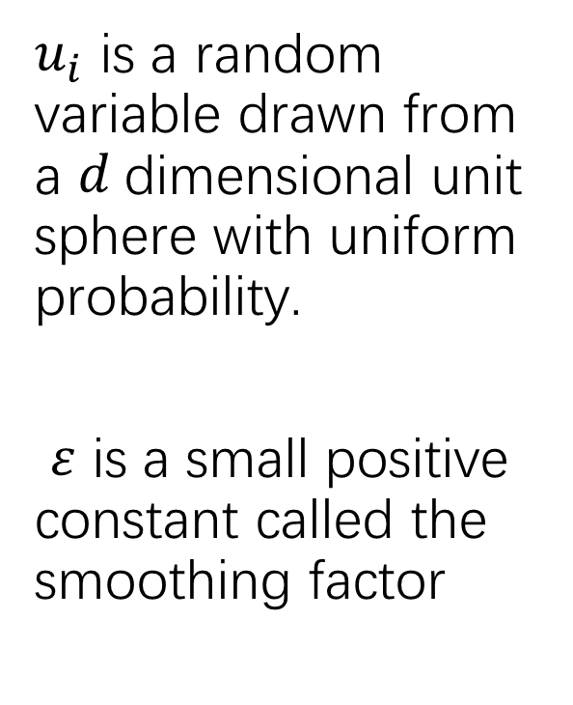
Zeroth-Order Gradient Estimate
$u_{i}$ is a random variable drawn from a $d$dimensional unit sphere with uniform probability.
$ε$ is a small positive constant called the smoothing factor

Slide 9
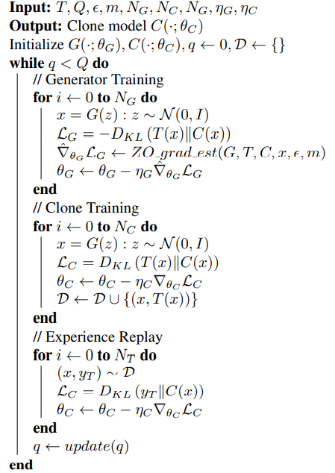
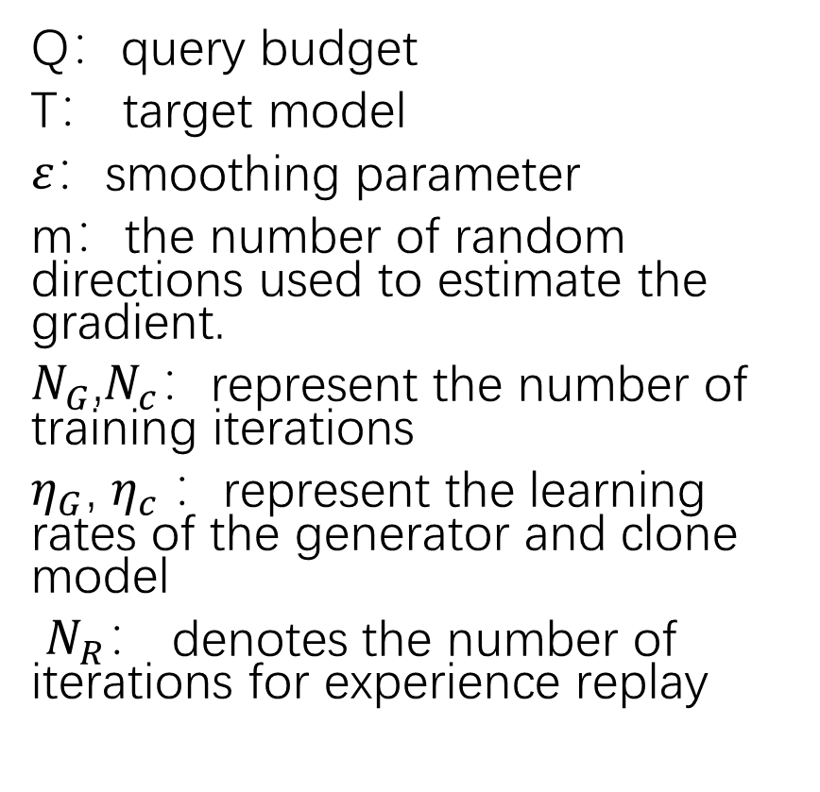
MAZE Algorithm
Q：query budget
T： target model
$ε：$smoothing parameter
m：the number of random directions used to estimate the gradient.
$N_{G}$,$N_{c}$：represent the number of training iterations
$η_{G}$, $η_{c} ：$represent the learning rates of the generator and clone model
$N_{R}$： denotes the number of iterations for experience replay

Slide 10
Experimental Setup
DataSet：FashionMNIST、 SVHN、 GTSRB 、 CIFAR-10
Existing Attacks： KnockoffNets 、JBDA、Noise
Target Model：LeNet、ResNet-20
Substitute/Shadow Model：22-layer WideResNet
Generator：generative model with 3 convolutional layers
Baseline：Noise
Evaluation Index： Normalized Clone Accuracy

Slide 11
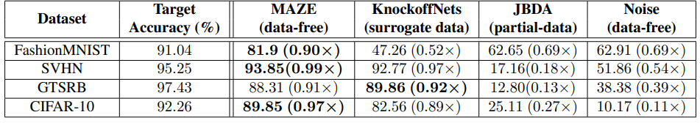
Experimental Results

Slide 12
MAZE-PD: MAZE with Partial-Data
In the presence of a limited amount of data, we can additionally train the generator to produce inputs that are closer to the target distribution by using the Waserstein Generative Adversarial Networks (WGANs) training objective.
In addition to the generator (G) and clone (C) models, we define a critic model D, which estimates the Wasserstein distance between the target data distribution P(T) and the synthetic data distribution of the generator P(G):

Slide 13

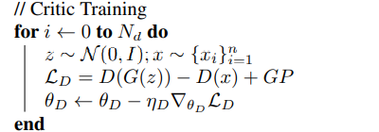
MAZE-PD Algorithm
The generator model aims to produce examples closer to the target distribution by minimizing the Wasserstein distance estimated by the critic model. To incorporate the WGAN objective in the training of the generator, we modify the original loss function of G

Slide 14
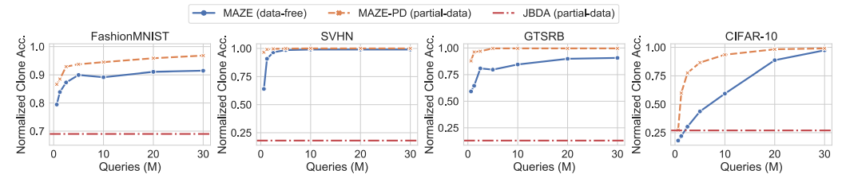
Experimental Results

Slide 15
Conclusion
This paper proposes MAZE, a high-accuracy MS attack that requires no input data. MAZE uses a generator trained with zeroth-order optimization to craft synthetic inputs, which are then used to copy the functionality of the target model to the clone model.

