Slide 1


TAU 2021 Timing Contest
iTimer Team
Graduate Institute of Electronics Engineering
Department of Electrical Engineering
National Taiwan University

Slide 2


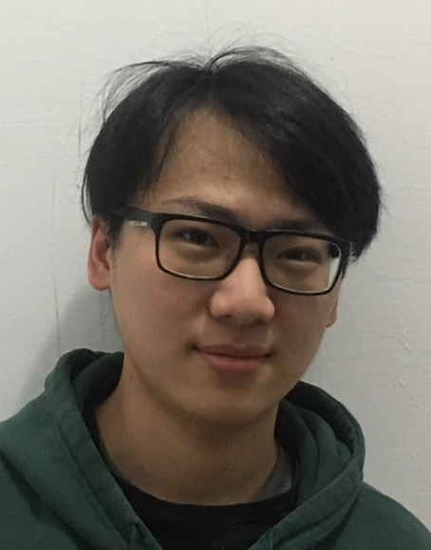

Team Members
Zi-Sheng Lin
Yu-Kang Lin
Shih-Kai Lee
Pei-Huan Tsai

Slide 3

Advisors
Pei-Yu Lee
Iris Hui-Ru Jiang

Slide 4
Our Framework
Stage Delay Calculator
RC Network Reduction
TICER based RC Reduction Algorithm
Gate Delay/Slew Calculation
Y-parameter Extraction
Driver Waveform Solving
Net Delay/Slew Calculation
Driver Waveform Reduction
Receiver Waveform Solving

Slide 5
RC Network Reduction
Stage Delay Calculator
RC Network Reduction
TICER based RC Reduction Algorithm
Gate Delay/Slew Calculation
Y-parameter Extraction
Driver Waveform Solving
Net Delay/Slew Calculation
Driver Waveform Reduction
Receiver Waveform Solving

Slide 6
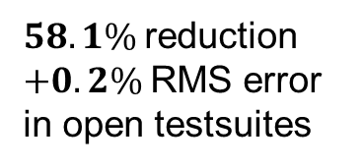
RC Reduction Algorithm
Size of network is critical to both efficiency and stability
Modify the TICER* algorithm for better accuracy when using CCS models
Achieve 2.87x speed up in total runtime
$58.1\%$reduction
$+0.2\%$RMS error
in open testsuites
(a) Original tree circuit
(b) Reduced circuit
*B. N. Sheehan, "TICER: Realizable reduction of extracted RC circuits," 1999 IEEE/ACM International Conference on Computer-Aided Design.

Slide 7
Gate Delay/Slew Calculation
Stage Delay Calculator
RC Network Reduction
TICER based RC Reduction Algorithm
Gate Delay/Slew Calculation
Y-parameter Extraction
Driver Waveform Solving
Net Delay/Slew Calculation
Driver Waveform Reduction
Receiver Waveform Solving

Slide 8











Solving Driver Waveform
Solve complete driver waveform instead of a single cell slew
Attain accurate net delay/slew in Long Tail situation
Apply Multiple Voltage Threshold Model* (MVTM) algorithm
Avoid interpolation in the time-axis
Efficiently extract Y-parameters from RC trees
$$V_{out}(t)$$
$$C_{1}⟹C_{2}$$
$$V_{out}(t)$$
$$V_{dd}$$
$$Y_{2}(s)$$
$$…$$
$$C_{1}⟹C_{2}$$
$$0.5V_{dd}$$
$$Y_{1}(s)$$
$$…$$
$$C_{1}⟹C_{2}$$
interconnect tree
CCS driver
CCS receivers
*P. Feldmann et. al., "Driver waveform computation for timing analysis with multiple voltage threshold driver models," 45th Design Automation Conference, 2008.

Slide 9
Net Delay/Slew Calculation
Stage Delay Calculator
RC Network Reduction
TICER based RC Reduction Algorithm
Gate Delay/Slew Calculation
Y-parameter Extraction
Driver Waveform Solving
Net Delay/Slew Calculation
Driver Waveform Reduction
Receiver Waveform Solving

Slide 10




Solving Receiver Waveform
Apply circuit simulation to solve receiver waveforms
No extra Model-Order-Reduction applied since we have reduced the RC network
Driver waveform reduction
33% runtime reduction to the circuit simulation in average
$$V(t)$$
9 segments
$⟹$ 5 segments
reduced waveform
driver waveform
$$Delay$$
receiver waveform
$$Slew$$

Slide 11
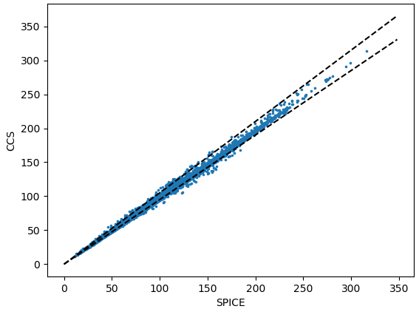
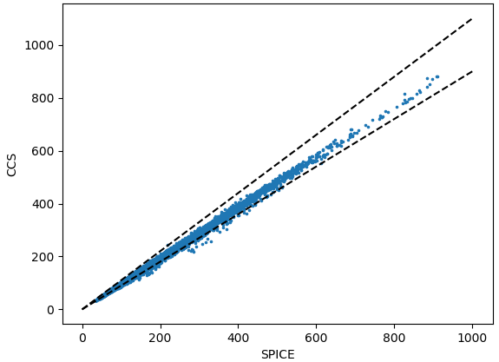
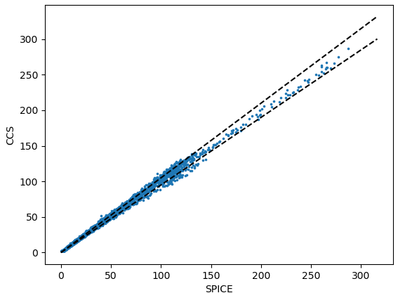
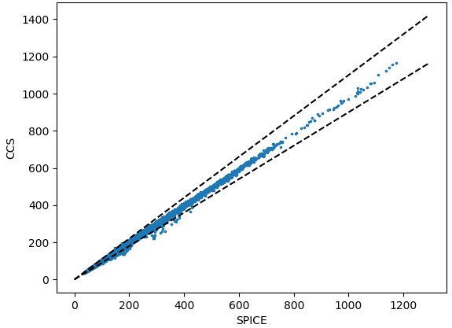
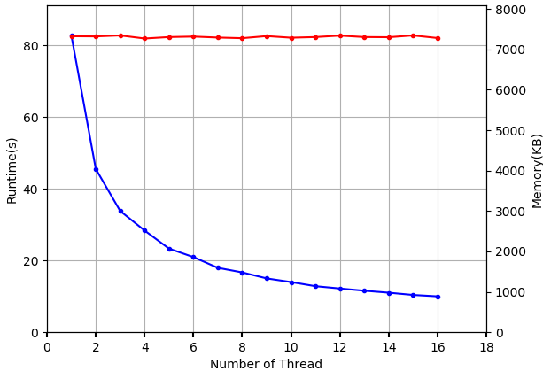




Experimental Results
Correlation against SPICE simulation
Achieve 0.998+ correlation in cell/net delay/slew.
Multi-threading performance
8.3x speed up when using 16 threads
$$C.C.=0.9987$$
$$C.C.=0.9986$$
$$C.C.=0.9983$$
$$C.C.=0.9990$$
(a) Cell Delay
(b) Cell Slew
(c) Net Delay
(d) Net Slew

Slide 12


Teamwork
Stage Delay Calculator
RC Network Reduction
TICER based RC Reduction Algorithm
Gate Delay/Slew Calculation
Pei-Huan Tsai
Yu-Kang Lin
Y-parameter Extraction
Driver Waveform Solving
INTEGRATION & TESTING
Net Delay/Slew Calculation
Driver Waveform Reduction
Zi-Sheng Lin
Receiver Waveform Solving
Shih-Kai Lee

Slide 13
Thank You!

