Slide 1




ShadowGuard AI
PROBLEM STATEMENT
Discover.
Read.
Score.
Respond.
02
Governing shadow AI across the university
Finds the AI tools staff actually use, reads each vendor's privacy policy with quoted proof, and asks IT to act before student data leaks.
Answers two of the example use cases
HR & IT operations automation
Finds tools, files tickets
Intelligent document processing
Reads and quotes policies
APU Cloud Innovation Hackathon 2026 shadowguard-ai-bice.vercel.app
Notes:
Timing: 0:00 to 0:30.
ShadowGuard AI is our answer to Problem statement 02, intelligent automation and digital transformation. It automates a job university IT does badly by hand today: finding which AI tools staff really use, reading what each vendor does with the data, and deciding what to do about it.
It lands on two of the example use cases. IT operations automation: discovery, risk tickets and Teams nudges happen without anyone watching logs. Intelligent document processing: every vendor privacy policy is read automatically, and every answer quotes the sentence it came from.
Live demo: https://shadowguard-ai-bice.vercel.app

Slide 2
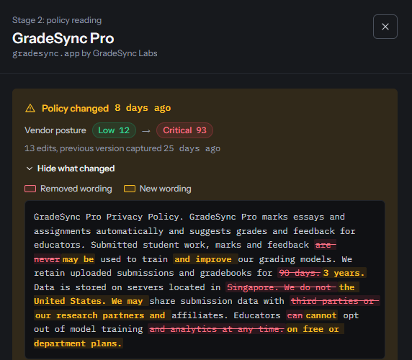



A free AI grader rewrote its privacy
policy, and nobody noticed
THE PROBLEM
A lecturer uploads class essays
Exams office staff use GradeSync Pro, a free AI grader, to beat a marking deadline.
The vendor quietly rewrites its policy
Student work may now train its models, sit in the US for 3 years and go to research partners. No opt-out.
Exposure jumps from Low 12 to Critical 93
Coursework leaves Malaysia: PDPA s. 9 (security) and s. 129 (cross-border transfer) are at stake.
Demo scenario with a fictional vendor. The policy diff on the right is the dashboard's own output.
Notes:
Timing: 0:30 to 1:00.
Here is the trap. A lecturer in the exams office uses a free AI grader to get through a marking deadline. Twenty days ago its policy said student work was never used for training, data stayed in Singapore for 90 days, nothing was shared, and staff could opt out.
Then the vendor rewrote it. Now submitted student work, marks and feedback may be used to train its models, everything is kept for 3 years in the United States, it is shared with research partners, and educators cannot opt out on free plans. Nobody on campus reads that page twice.
ShadowGuard caught the rewrite, showed every changed word, and the vendor's posture moved from Low 12 to Critical 93. For a Malaysian university that touches PDPA section 9 (security) and section 129 (transfer outside Malaysia).
Be clear with judges: GradeSync Pro is a fictional demo vendor; the diff and the scores are what the real pipeline produced from those two policy texts.

Slide 3



Staff bring their own AI faster
than IT can vet it
THE PROBLEM
78%
Why today's approach fails
Manual review doesn't scale
Every vendor policy needs re-reading each week to catch silent rewrites.
of AI users bring their
own AI tools to work
Blanket bans backfire
Blocking all AI pushes staff onto personal hotspots that IT can't see.
75%
of knowledge workers already use AI at work
Not every upload is equal
A public syllabus is fine. Exam scripts in a tool that trains on them are not.
Source: Microsoft and LinkedIn, 2024 Work Trend Index. Survey of 31,000 people in 31 countries.
Notes:
Timing: 1:00 to 1:30.
This is not one careless lecturer. Microsoft and LinkedIn's 2024 Work Trend Index surveyed 31,000 people in 31 countries: 75% of knowledge workers already use AI at work, and 78% of those AI users bring their own tools. Universities are no different, and those tools see exam scripts, student records and unpublished research.
Today's options fail. Reading every vendor's policy by hand, and re-reading it every week for silent changes, doesn't scale. Banning all AI pushes people onto personal hotspots where IT sees nothing. And risk depends on the data: a public syllabus in a summariser is fine, exam scripts in a tool that trains on them are a breach.
Source: Microsoft and LinkedIn, "2024 Work Trend Index Annual Report: AI at work is here. Now comes the hard part", May 2024.

Slide 4





One pipeline that discovers,
reads, scores and responds
OUR SOLUTION
01
02
03
Collect
Analyse
Act
Python log shipper and laptop proxy
FastAPI on Vercel, Neon Postgres
Next.js 15 rail & graphite UI
Squid, FortiGate & laptop proxy
Auto-discovers unknown AI hosts
Staff directory for departments
Safe fetcher + rules & Gemini
5 scored factors + 4 advisories
Quote-checked, 0–100 exposure
Live map, PDPA checks & brief
Human-approved block lifecycle
SHA-256 hash-chained audit log
No TLS decryption, no prompts, no files. Usernames are hashed with a secret salt before anything leaves campus.
Notes:
Timing: 1:30 to 2:30.
ShadowGuard is one pipeline in three parts.
Collect: a Python log shipper reads the campus Squid proxy or FortiGate logs, watches known AI tools, and looks up each person's department in the staff directory; laptops off campus use the local proxy collector. At ingest, the API also auto-discovers unknown *.ai and AI-keyword hostnames into an unverified posture.
Analyse: a FastAPI backend on Vercel fetches each vendor's privacy policy through an SSRF-hardened fetcher, reads it with deterministic rules and, when a key is set, Gemini 2.5 Flash. It keeps an answer only if it quotes a whole sentence verbatim—extracting five scored factors and four supplemental compliance advisories—then scores every department and tool pair from 0 to 100 in Neon Postgres with a SHA-256 hash-chained audit log.
Act: a Next.js 15 dashboard shows the live map and traffic, PDPA checks and printable executive brief, plus the human-approved block lifecycle.
Privacy by design: we only see metadata, never content. No TLS decryption, no prompts or files, and usernames are hashed with a secret salt at the source.

Slide 5
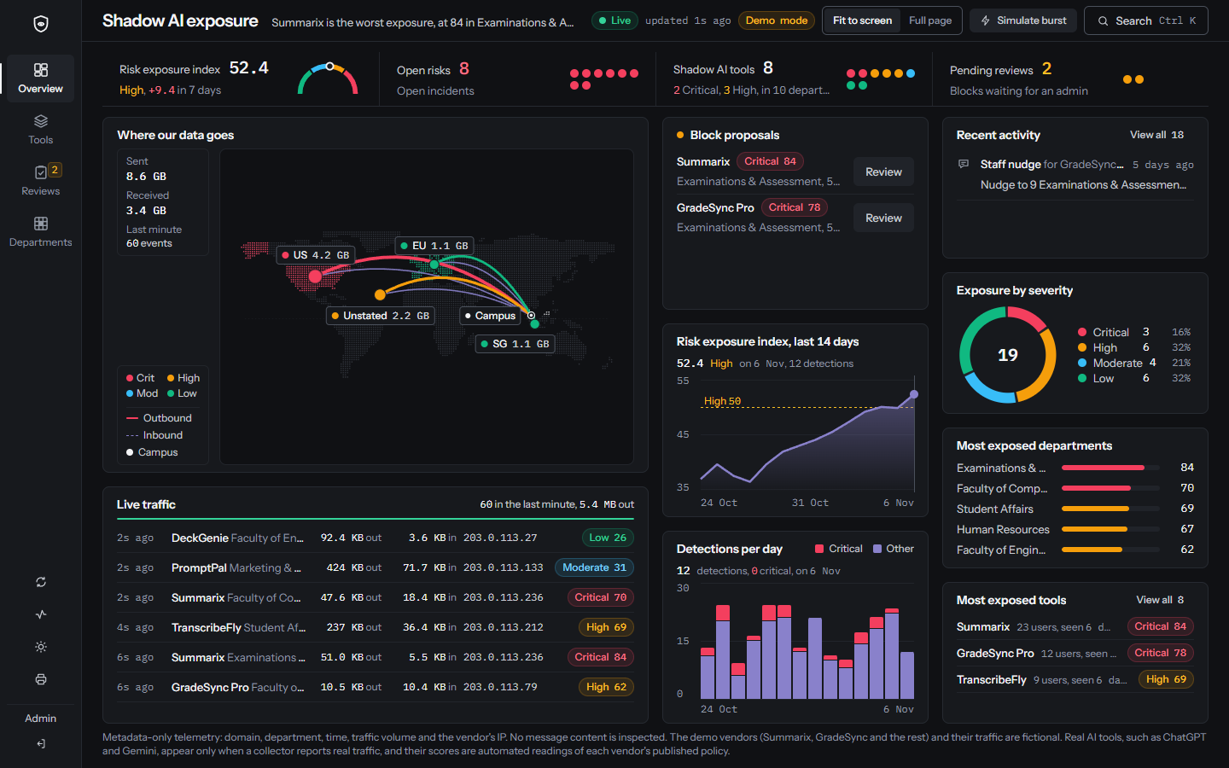
Two minutes, end to end,
on the live site
LIVE DEMO
What we'll show
1
The Overview on one screen
2
Lock a region pin for deep dive
3
Open vendor: quotes, advisories & PDPA
4
Simulate a burst of new traffic
5
Approve block, export & verify audit
shadowguard-ai-bice.vercel.app
Notes:
Timing: 2:30 to 4:30. Switch to the browser at https://shadowguard-ai-bice.vercel.app.
Two-minute demo script (time, action, what to say):
0:00 to 0:05. Open the live URL with the address bar visible. "This is the live site on Vercel."
0:05 to 0:15. Overview in Fit to screen. "Every block fits one screen: the traffic map, live traffic, block proposals, the 14-day trend, severity, departments and the most exposed tools."
0:15 to 0:30. Hover, then click a region on the map. "Each region shows the real bytes out and in, and which tools sent them."
0:30 to 0:55. Click a tool name to open the vendor drawer. "Every scored answer and each of the four supplemental advisories quotes the vendor's policy verbatim. Here are the PDPA checks and the word diff from when GradeSync rewrote its policy." Optionally press Fetch the latest policy.
0:55 to 1:10. Open Tools in the left rail, sort by severity. "The full list, sortable, with the departments affected."
1:10 to 1:30. Back to Overview, then click Simulate burst in the top bar. "New telemetry arrives; each event travels an arc on the map and lands in Live traffic within seconds."
1:30 to 1:50. Open Reviews in the left rail. Show a block proposal dialog (close Cancel), show the execution stages (Rule applied / Verify block), FortiGate or Squid export, and click Verify audit chain. "Nothing is blocked until an admin approves it; applied rules are verified, exported straight to the firewall, and every entry is SHA-256 hash-chained."
1:50 to 2:00. Show the rail Print button (Executive Governance Brief) or return to Overview. "Discover, read, score, respond and audit, in one place."

Slide 6
Find the tools, then read
their policies with proof
HOW IT WORKS
Proxy or DNS log
Match AI domains
Fetch policy safely
Rules + Gemini
Quote and trap check
01
Discover
02
Read
Reads Squid or FortiGate logs, or a laptop proxy's connection lines
Collectors watch catalogued AI domains; ingest API discovers unknown AI services
Hashes usernames with a secret salt at the source; no URLs, prompts or staff IPs
Answers five scored questions plus four supplemental compliance advisories
Every answer must quote a whole sentence from the policy, or it is dropped
Rules and Gemini read separately; disagreement or hidden instructions mark the vendor Unverified
Notes:
Timing: 4:30 to 5:00.
Discover. The log shipper reads standard Squid access logs or FortiGate web filter and traffic logs; laptops use the local proxy, which reads only the hostname from each CONNECT line, with no decryption. Collectors watch catalogued AI domains by default, and any unknown *.ai or AI-keyword hostname sent directly to the telemetry API is auto-discovered into an unverified High-floored posture while general web traffic stays ignored. Each username is mapped to a department and hashed with a secret salt before it leaves the machine.
Read. For each vendor we fetch the privacy policy through a fetcher that pins DNS, allows HTTPS on port 443 only, and strips hidden text. The reader answers five scored questions (training, sharing, opt-out, retention, data location) and extracts four quote-verified supplemental advisories (human review of prompts, breach notification, encryption, and unilateral term changes). Every answer must quote one whole sentence verbatim or it is dropped. Rules and Gemini 2.5 Flash read independently; disagreement or hidden instructions mark the vendor Unverified (scored at least High).

Slide 7



Score the exposure, then
let a person decide
HOW IT WORKS
03
Score
04
Respond
Exposure = posture × sensitivity × usage
High or Critical
An IT risk ticket and a Teams nudge, at most once a day per department and tool
Posture 0–100 from the five policy answers
Sensitivity 0.30–1.0 for the data a department holds
Usage 0.6–1.0, rising with distinct users
Critical
A block proposal waits for an admin; a rejection keeps it quiet for 7 days
Never automatic
Admins approve blocks, mark applied & checked, and export firewall configs
Low <30
Moderate 30+
High 50+
Critical 70+
Notes:
Timing: 5:00 to 5:30.
Score. Vendor posture is 0 to 100 from the five answers: training on inputs up to 35 points, retention up to 20, third-party sharing up to 20, no opt-out up to 15, data location up to 10. Four supplemental advisories surface extra compliance context without altering the numeric score. An unverified policy is never scored below 50. Exposure for one department and one tool is posture times the department's data sensitivity (0.30 to 1.0; student records and HR are 1.0) times usage spread (0.6 to 1.0 on a log scale, saturating at 50 distinct users). Approved tools score zero. Bands: Low under 30, Moderate from 30, High from 50, Critical from 70.
Respond. High or Critical opens an incident with a pre-filled IT risk ticket, and sends a Teams nudge to staff at most once every 24 hours per department and tool, after the database commit. Critical also queues a block proposal, unless one is already pending or an admin rejected one in the last 7 days. No code path blocks automatically: an admin approves in a review dialog that opens with focus on Cancel (with optional REQUIRE_DUAL_APPROVAL four-eyes check), exports the FortiGate or Squid blocklist, and marks the rule applied (executed) and verified blocked (verified).

Slide 8



Built as a security
product first
SECURITY AND COMPLIANCE
Small supply chain
OWASP Top 10
Every control lives in code, and most have a test that proves it.
The frontend runs on Next.js, React and server-only. Charts, diff and menus are built in-house.
SHA-256 hash-chained audit log, signed sessions, nonce CSP, SSRF guard & rate limits.
PDPA (Act 709)
Accessible
SECURITY.md maps each OWASP Top 10 category to the file that implements it and the test that checks it.
Every vendor is checked against sections 8, 9, 10 and 129.
Keyboard paths, focus traps and screen-reader announcements throughout.
Notes:
Timing: 5:30 to 6:30.
ShadowGuard handles sensitive metadata, so it is built as a security product. SECURITY.md maps every OWASP Top 10 category to the code that implements it and the test that proves it.
Small supply chain: the frontend's runtime dependencies are only Next.js, React and server-only; the command menu, word diff, charts and table sorting are written in-house. CI runs npm audit and pip-audit.
OWASP: HMAC-signed session cookies, a per-request nonce Content Security Policy, an SSRF guard that pins DNS for policy fetches, rate limits per client and on sign-in failures, hashed API keys, optional four-eyes block approval (REQUIRE_DUAL_APPROVAL), and a SHA-256 hash-chained audit_log protected by database UPDATE/DELETE/TRUNCATE triggers and verified via GET /api/audit/verify.
PDPA (Act 709): each vendor is checked against section 8 (disclosure to third parties), section 9 (security, including training on university data), section 10 (retention) and section 129 (transfer outside Malaysia).
Accessibility & Governance Brief: full keyboard paths, ARIA tabs, focus traps in dialogs, screen-reader announcements, and a print-ready Executive Governance Brief.

Slide 9
Fast enough to watch
the network live
PERFORMANCE
4 s
8 s
0.2–0.5 s
Live feed
Full summary
Dashboard reads
The map and traffic table update while the tab is open.
Every 8 s while traffic arrives, every minute when quiet.
The app and its database both run in Singapore.
240 / min
90 days
0
Reads per client
Raw telemetry kept
Slow calls in transactions
Plus 20 writes; failed sign-ins are capped too.
Older rows are pruned; the summaries stay.
Teams nudges go out only after the database commits.
Notes:
Timing: 6:30 to 7:30.
The live feed (map and Live traffic) refreshes every 4 seconds while the tab is visible. The full summary (scores, charts and metrics) follows it every 8 seconds while new traffic is arriving, and once a minute when the network is quiet. Functions run in Vercel's Singapore region next to the Neon database; after moving from iad1 to sin1, dashboard and live reads dropped from 3 to 4 seconds to about 0.2 to 0.5 seconds (measured 5 November 2026).
Each signed-in client is capped at 240 reads and 20 writes a minute, and failed sign-ins are rate limited. Raw telemetry is kept 90 days, then pruned; aggregate snapshots stay. Browser requests have hard deadlines (10 s polls, 15 s requests, 30 s policy reads) and every database transaction has a 15-second statement timeout. Teams webhooks are sent after the commit, so a slow webhook never holds a connection or a row lock.

Slide 10






Deployed on Vercel,
tested on every push
DEPLOYMENT AND OPERATIONS
Browser signed session cookie
Checked on every push
GitHub Actions
Next.js 15 frontend Vercel
86
Frontend tests, design contract included
FastAPI backend Vercel, private service binding
202
Backend tests, 23 of them on a real Postgres
Neon Postgres Singapore, TLS required
npm audit and pip-audit on every build
One Vercel project, two services, functions in Singapore (sin1).
Notes:
Timing: 7:30 to 8:30.
One Vercel project runs two services from vercel.json: the Next.js frontend and the FastAPI backend, which the frontend reaches over Vercel's private service binding. The database is Neon Postgres in Singapore with TLS required, idempotent migrations 001–005 (including SHA-256 hash-chained immutable audit triggers in 004 and remediation lifecycle columns in 005), and a least-privilege application role.
GitHub Actions runs on every push: the frontend gate runs 84 tests including the design contract and v2 lifecycle/audit UI checks, plus npm audit; the backend gate runs 191 tests, 22 of them against a real PostgreSQL service, plus pip-audit. (Local runs on 13 November 2026: 84 of 84 frontend tests pass; 169 backend tests pass and the 22 database integration tests skip when TEST_DATABASE_URL is unset.)
Operations: API keys are stored as SHA-256 digests and can be rotated with two keys live at once; raw telemetry is pruned after 90 days.

Slide 11
From one campus to
every university
ROADMAP
Now
Next
Later
Live on Vercel
The next build
Year two
Collectors & AI auto-discovery
Quote-checked policies + 4 advisories
Tracked block lifecycle + firewall export
SHA-256 hash-chained audit & print brief
Read-only MCP server for Gemini Enterprise
Push approved blocks directly to firewall APIs
SSO with Entra ID / Google (mandatory four-eyes)
Per-university score weights
Coaching in the browser before a sensitive upload
SIEM and ticketing sync
Workspaces for many campuses
Notes:
Timing: 8:30 to 9:30.
Now, live on Vercel: the campus log shipper, laptop proxy, and backend unknown-AI auto-discovery; quote-checked policy reading with four supplemental advisories and PDPA checks for every vendor; human-approved blocks with tracked execution/verification stages and FortiGate/Squid exports; plus the SHA-256 hash-chained audit ledger with /api/audit/verify and printable executive governance brief.
Next: a read-only MCP server so Gemini Enterprise can query ShadowGuard; pushing approved blocks straight to firewall APIs instead of exporting them; single sign-on with Entra ID or Google Workspace so REQUIRE_DUAL_APPROVAL enforces true per-person four-eyes control; and per-university score weights.
Later: coaching in the browser before someone uploads a sensitive file, sync with SIEM and ticketing tools, and separate workspaces for many campuses.

Slide 12



Try ShadowGuard live
THANK YOU
Questions welcome.
shadowguard-ai-bice.vercel.app
Live demo
github.com/B0mb0cl4t5/shadowguard-ai
Source, tests and documentation
Scan for the demo
APU Cloud Innovation Hackathon 2026, Problem statement 02
Notes:
Timing: 9:30 to 10:00.
Thank you. The live demo is at https://shadowguard-ai-bice.vercel.app and the code, tests and documentation are at https://github.com/B0mb0cl4t5/shadowguard-ai. The QR code opens the live demo.
Happy to take questions.

