Slide 1
進度報告
Department of Electrical Engineering, National Yunlin University of Science and Technology
E-mail: B10812006@yuntech.edu.tw
Professor : 洪崇文 博士
Student : 李崎維
Date : 12/31/2024
Notes:
1

Slide 2

目前進度
PID參數調整 測試

Slide 3
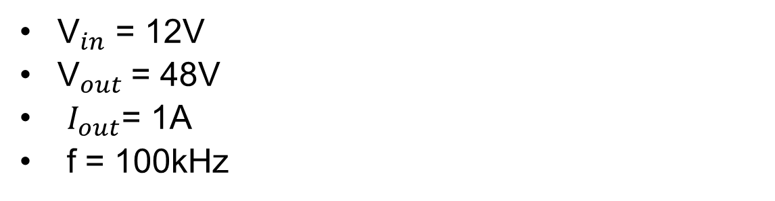
Boost Converter規格
${\text{V}}_{in}$ = 12V
${\text{V}}_{out}$= 48V
$I_{out}$= 1A
f = 100kHz

Slide 4
遭遇問題
輸出電壓分成兩段(已解決)
開關過熱(已解決)
Notes:
while(1)
{
real = (float)(adc_value)*3300/4096/1000;
if(real>0.45)
{
if(flag==1)
{
real = (float)(adc_value)*3300/4096/1000;
error=setting-real;//誤差
total_error=total_error+error;//積分項
derivative=error-pre_error;//微分項
pre_error=error;
output =Kp*error+Ki*total_error+Kd*derivative;
duty_cycle_counts = (uint32_t)output;
if (duty_cycle_counts > 1000.0) duty_cycle_counts = 1000.0;
if (duty_cycle_counts < 100.0) duty_cycle_counts = 100.0;
err = R_GPT_DutyCycleSet(&PWM_duty_ctrl, duty_cycle_counts,GPT_IO_PIN_GTIOCA);
}
}

Slide 5
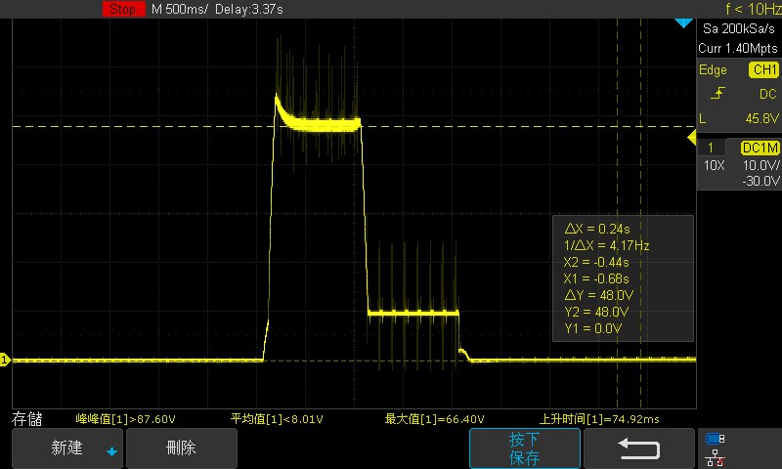
輸出電壓分兩段

Slide 6
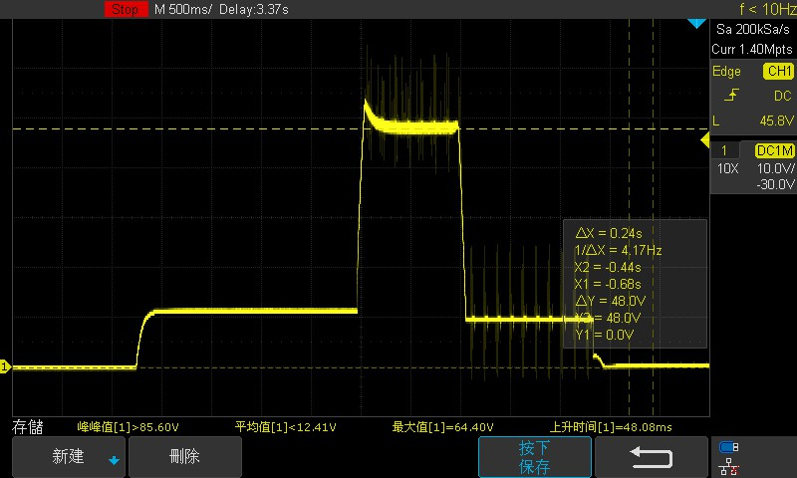

Slide 7
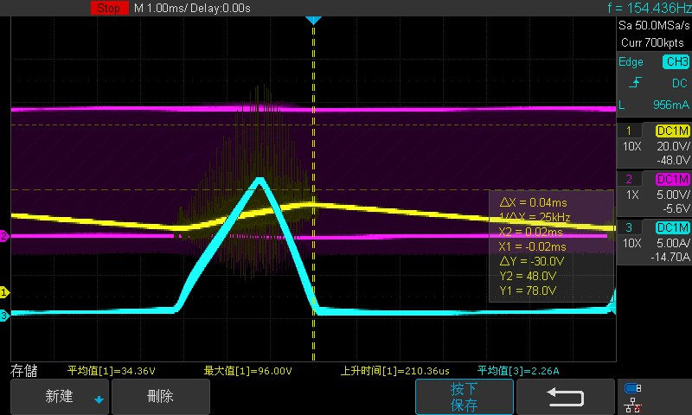
電感電流飽和

Slide 8
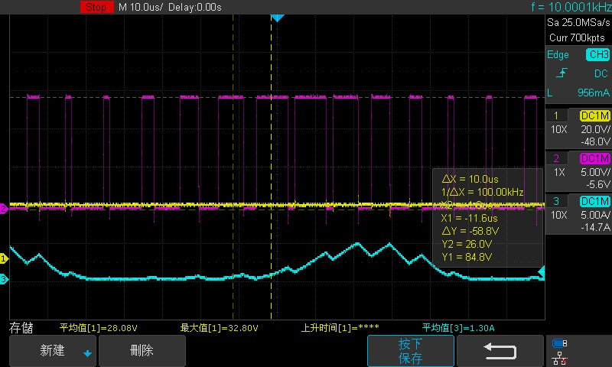

Slide 9
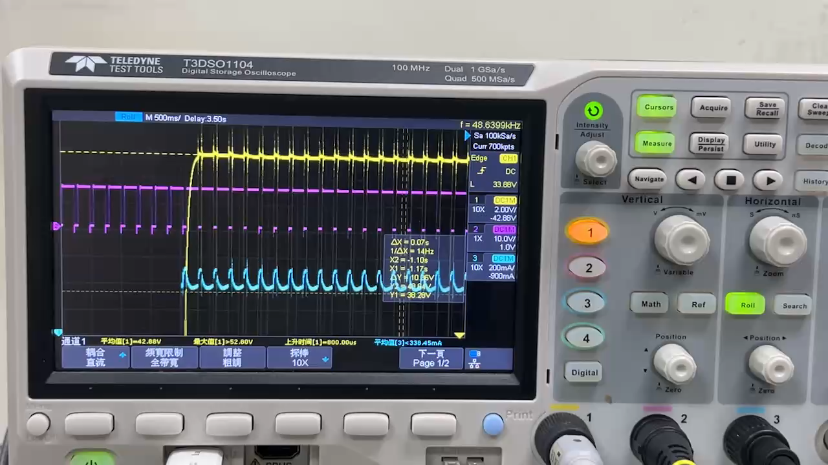
無PID 調整負載

Slide 10
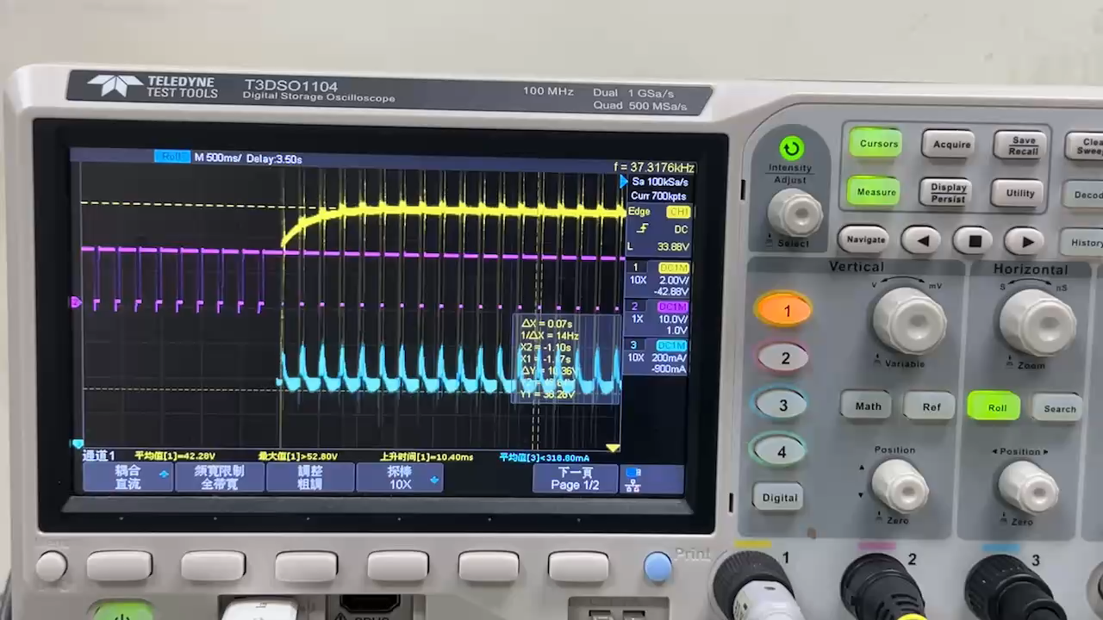
加入PID 調整負載

Slide 11
遭遇問題
更改輸入電壓無法回到48V(已解決)
Notes:
while(1)
{
real = (float)(adc_value)*3300/4096/1000;
if(real>0.45)
{
if(flag==1)
{
real = (float)(adc_value)*3300/4096/1000;
error=setting-real;//誤差
total_error=total_error+error;//積分項
derivative=error-pre_error;//微分項
pre_error=error;
output =Kp*error+Ki*total_error+Kd*derivative;
duty_cycle_counts = (uint32_t)output;
if (duty_cycle_counts > 1000.0) duty_cycle_counts = 1000.0;
if (duty_cycle_counts < 100.0) duty_cycle_counts = 100.0;
err = R_GPT_DutyCycleSet(&PWM_duty_ctrl, duty_cycle_counts,GPT_IO_PIN_GTIOCA);
}
}

Slide 12
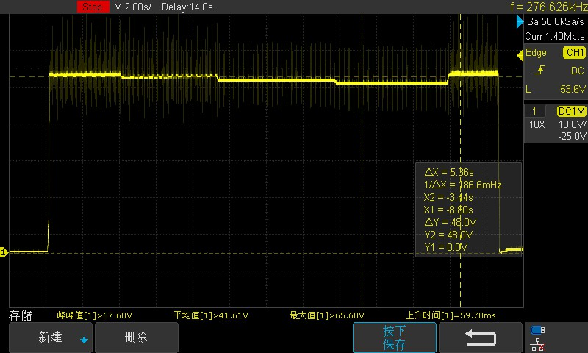
更改輸入電壓無法回到48V

Slide 13
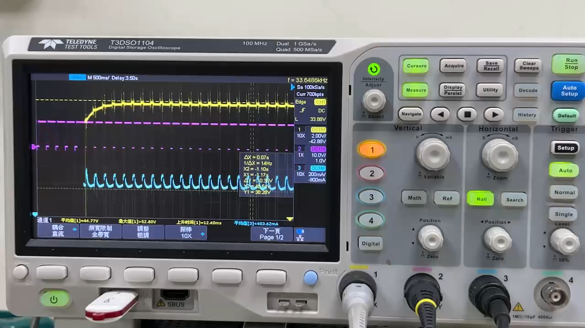
加入PID 12V,15V,20V,24V,12V到48V

Slide 14
預計進度

